Slide 1
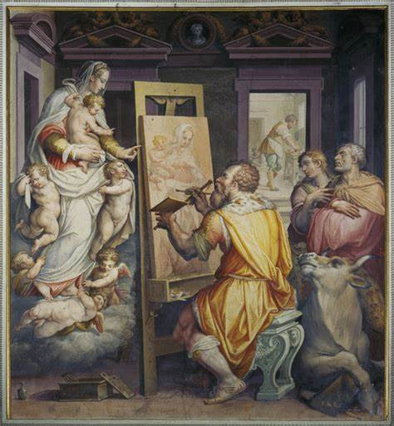
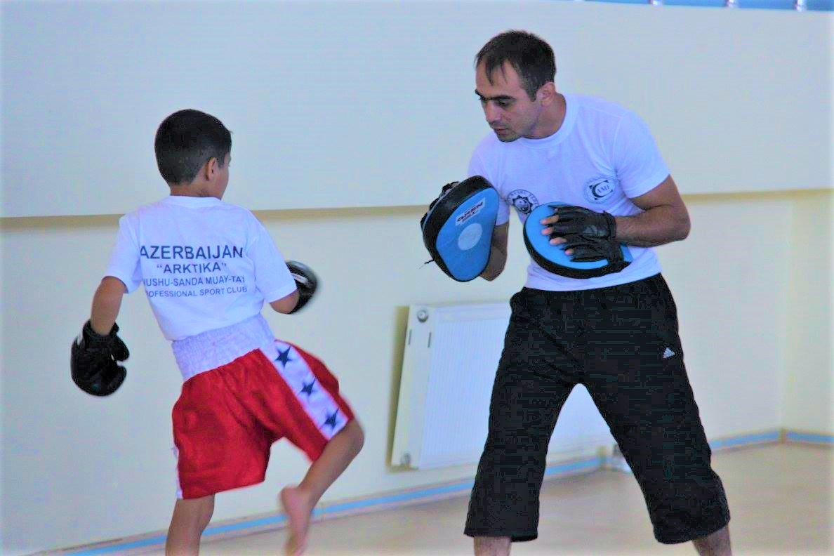
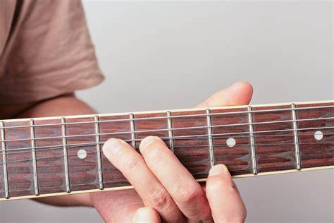
学习外语 Xuéxí wàiyǔ Learning a foreign Language
English-Chinese Handbook for Martial Art Coaches
武术教练中英文手册
草案2019年9月14日
就像学习其他东西一样！
It is the same as learning anything else!

Slide 2
Repeat 重复 Chóngfù
重复，重复，重复。Repeat, repeat, repeat.
“重复”是一个动词。 我们需要重复我们学到的东西。
“Repeat” is a verb. We need to repeat what we learn.
请你再说一遍？ Qǐng nǐ zàishuō yībiàn? Can you repeat that please?
“重复”是一个名词
“Repetition” is a noun.
重复可以帮助我们记住事情。Repetition helps us remember things.

Slide 3
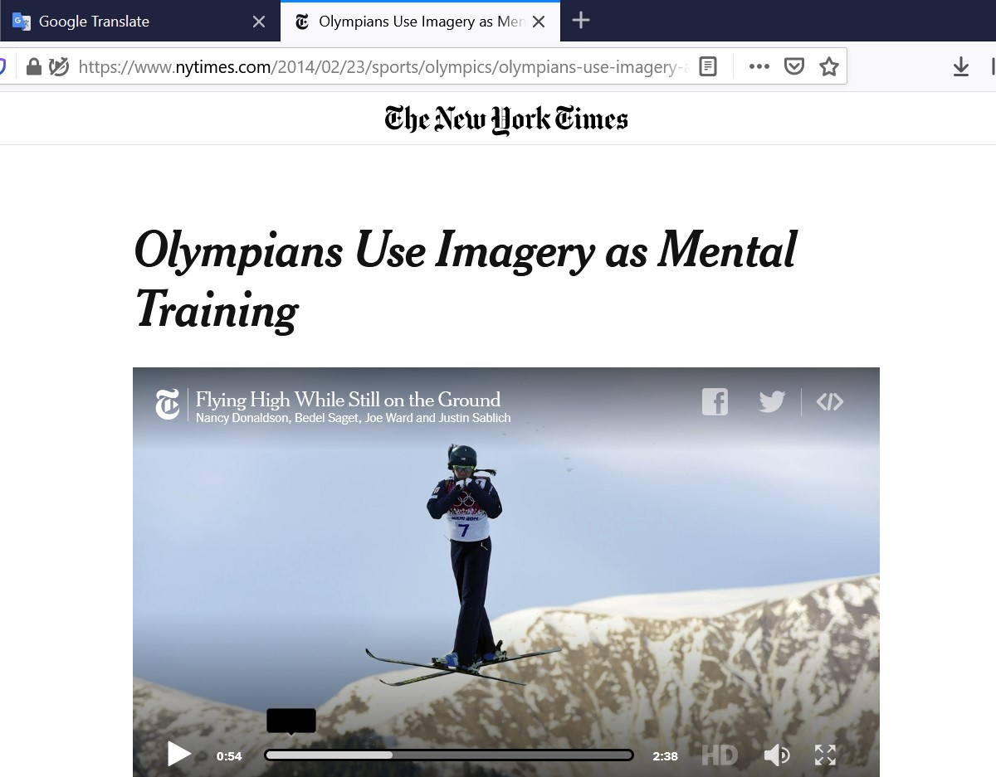
奥运选手将图像用作心理训练–纽约时报
Olympians use imagery as mental training – New York Times newspaper

Slide 4
请在家中一次又一次地查看PPT。 Please review the PPTs at home often
请听PPT上的录音，阅读中文，以便您理解英语，并练习用录音讲话。
Please listen to the recordings on the PPT, read the Chinese so you understand the English, and practice speaking with the recording.
在早晨，下午和临睡前听录音并讲话。 临睡前特别好。 为什么？ 没有什么可以干扰存储任务。Listen and speak with the recordings in the mornings, afternoon, and just before sleep. Just before sleep is an especially good time. Why? There is nothing to interfere with the memory task.

Slide 5
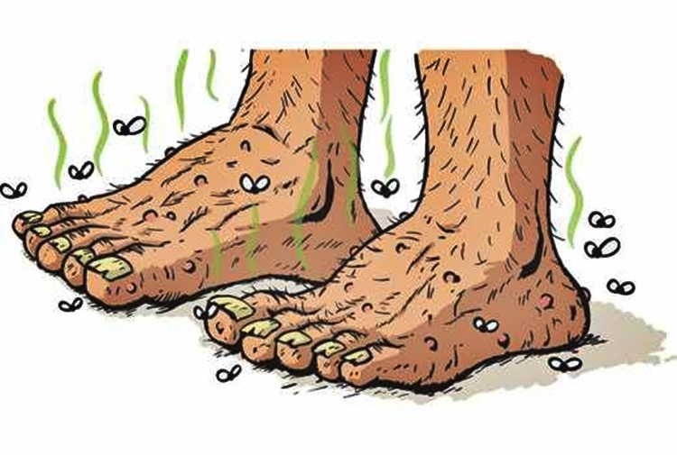
请在我之后重复。 Qǐng zài wǒ zhīhòu chóngfù. Please repeat after me.
重复和脚韵
Repeat and feet rhyme (韵)
我们可以使用押韵的单词来记住其他单词。
We can use rhyming words to remember other words.
重复 脚 遇到
Repeat – feet – meet
重复，重复，重复。
Repeat, repeat, repeat.
他有臭脚
Someone has stinky feet!
有人有臭脚！
在您的脑海中制作照片-图像-确实有助于记忆！
Making pictures in your mind – images – really helps memory a lot!
而且，记住有趣的事情要比无聊的事情容易。
And, it’s easier to remember funny things, than boring things.

Slide 6
The word 这个单词： : Rhyme (韵)
Fine
晴, 美术, 良好, 优美, 罚款, 精密, 精致
I’m fine, thanks!
Rhymes with:押韵：
Time 时间
不要浪费时间 Don’t waste time!
Mind: 心, 心情, 心神, 胸, 关照,
Exercise your cre-a-tive mind.
锻炼你的创造性思维。
Kind: 爱心, 和蔼, 福利, 盛情, 类, 种
She is very kind.
她很善良。
Nurture - 培养 [péi yǎng]

Slide 7
What time is it? 几点了？
Do you have time? 你有时间吗？
Fine = Great! = Won-der-ful! = Fan-tas-tic = Ex-cel-lent = Very very good!
Kind = Nice =
Yes she/he is.
No she/he isn’t.
Do you mind going to the store later?
I don't mind. = It's OK.
Do you mind giving me all your money?
Yes, I do mind! I will not give you all my money!
Do you mind if I smoke? 你介意我抽烟吗？
Yes I do mind! It’s illegal to smoke in offices! 是的，我不介意！在办公室吸烟是违法的！

Slide 8
You try it 你试试看：:
What rhymes with 用什么押韵：:
Fly? 飞 My, buy, high (高的) , lie (撒谎), die 死亡, guy = man
Hear? 听到了吗 , deer, fear (=afraid, scared), near 近的
Do? 做 Can you do it?
Me? 我
Great? 伟大的
Can you make sentence using these words? 你能用这些词造句吗？

Slide 10
How old is your son? He is eight years old.
Does you son ask many questions?
Yes he does?
Now he doesn't.
That's very good. Children who ask a lot of questions are usually smarter children.
Low IQ children don't ask questions.
You should count how many questions your son asks in one day. The answer might be interesting.
There is a lot of research on children's IQ and asking questions. The more questions they ask, the smarter they are.
You should encourage your son to be creative. And ask creative questions!

Slide 11
Life w

Slide 12
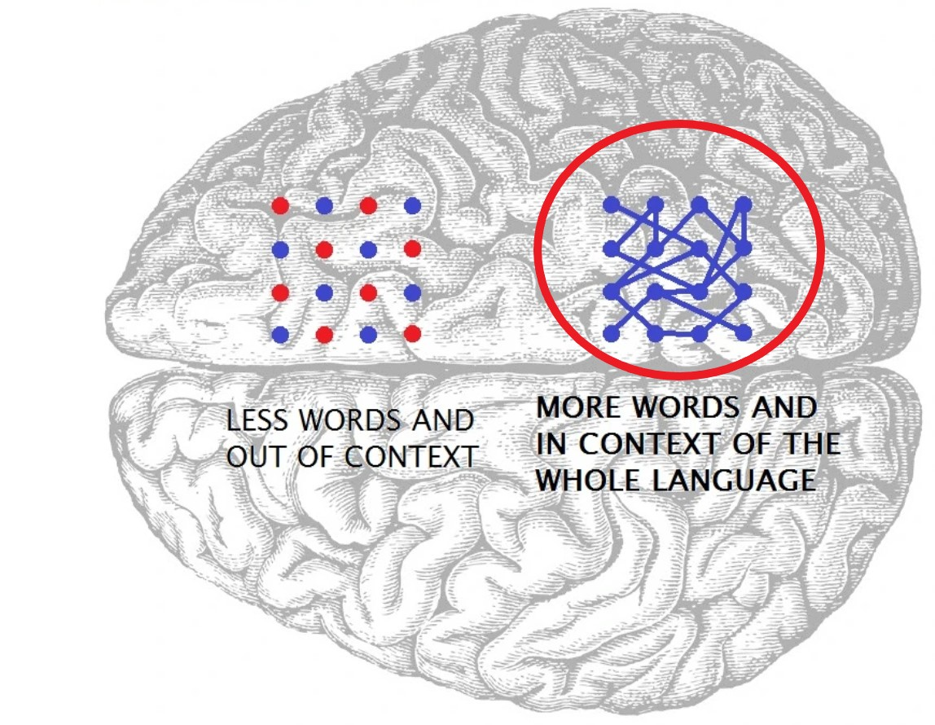
尝试用新词汇来造句 Try making sentences with new vocabulary
为什么？
Why?
造句将词汇记忆整合为更大的片段，更容易记住。Making sentences integrates the vocabulary memories into larger pieces that are more easily remembered.
https://shop.hyplern.com/blogs/news/18838547-spaced-repetition-in-language-learning

Slide 13
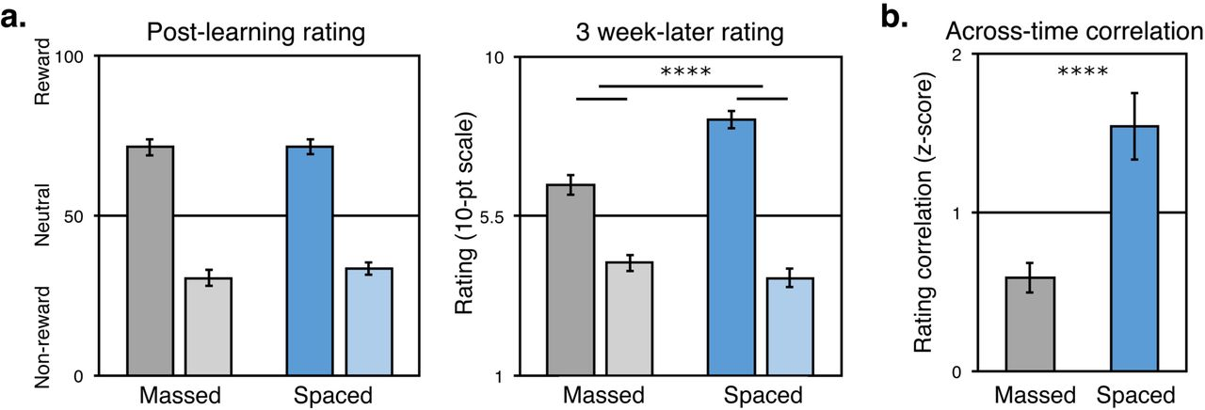
两个或三个较短的学习时间 Two or three short learning sessions…
比一场长时间的学习要好得多。
Are much better than one long learning session.
为什么？Why?
这是因为在长时间的学习中，记忆的整合存在很多“干扰”。It’s because with long learning sessions there is a lot of “interference” (干扰) in the consolidation (合并) of memories (存储).
对此有很多科学研究！
There’s a lot of scientific research on this!

Slide 14
Memory Consolidation 记忆 巩固 // 撤并
感官信息
Sensory information
短期记忆
Short Term Memory (STM)
巩固 // 撤并
长期记忆
排演 Rehearsal
= 实践 // 练习 Practice
= Repeat 重复

Slide 15
重新发现玩的巨大价值 Rediscover the great value of play 玩
尼古拉·特斯拉（发现如何用电），爱因斯坦和比尔·盖茨 Nikola Tesla (discovered how to use electricity), Einstein and Bill Gates,
他们玩弄各种想法，取得了重大发现。…made their great discoveries by playing with ideas.

Slide 16
玩是最高的研究形式
“Play is the highest form of research.”

Slide 17
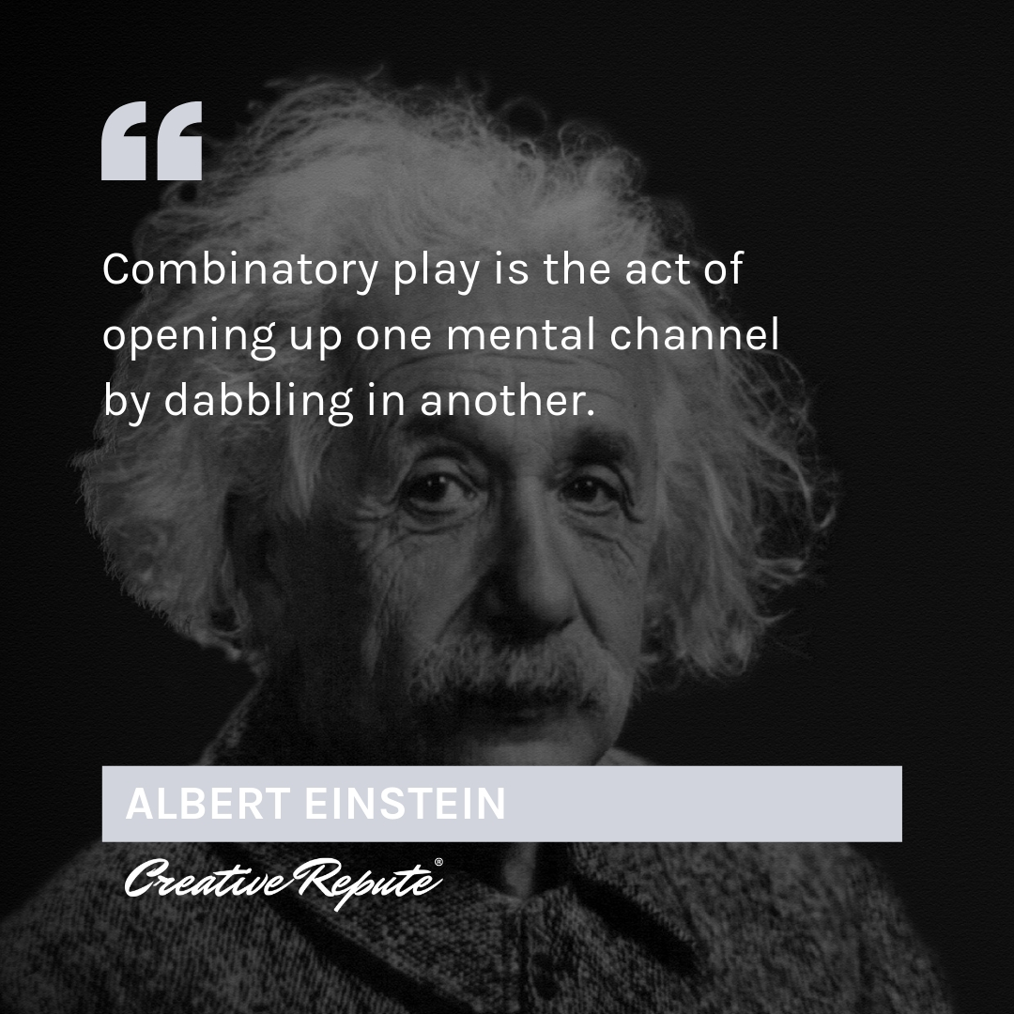
组合的玩是通过与另一种心理渠道“玩”来打开一个心理渠道的行为。 Combinatory play is the act of opening up one mental channel by dabbling with another.

Slide 18
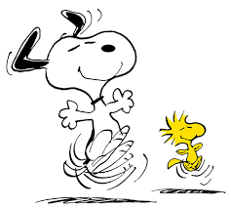
说实话。Shuō shíhuà. Let’s be honest.
如果很有趣，我们会喜欢的。 If it’s fun, we like it.
如果我们喜欢它，我们会做更多。If we like it, we do it more.
如果做得更多，我们会做得更好。If we do it more, we get better at it.
所以，让我们玩得开心！So, let’s have fun!

Slide 19
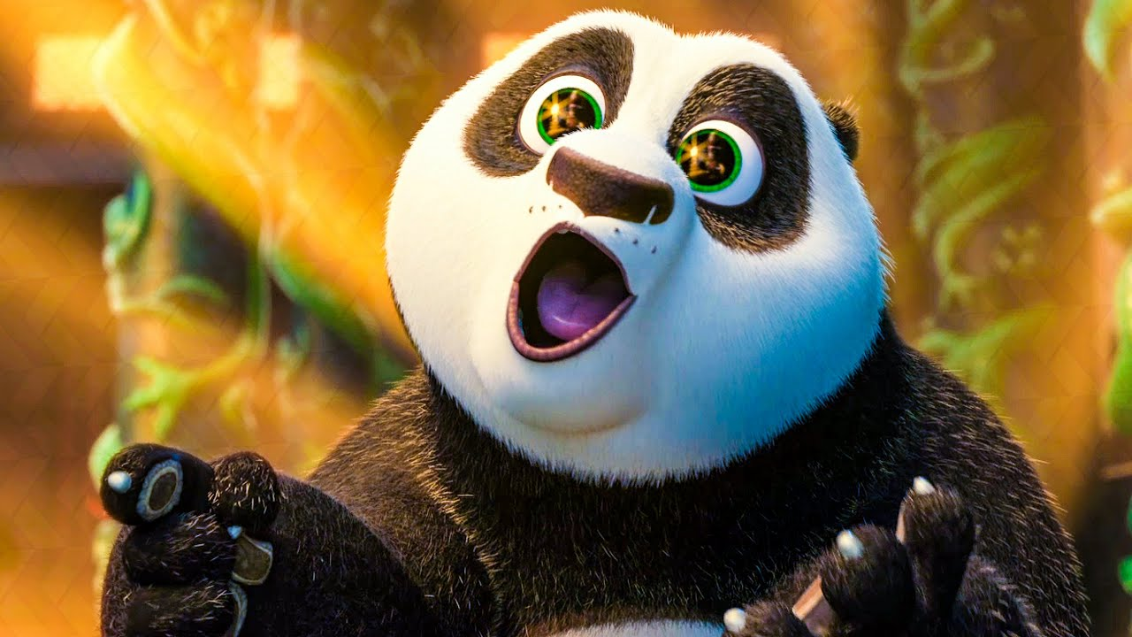
哦! 顺便说说… Oh! By the way…
谁有臭脚？ Who has smelly feet?

Slide 20
TEST 考试

Slide 21
问题1 Question 1
请填写空白 Please fill in the blank
Repeat, repeat, repeat! He has smelly _________.

Slide 22
问题2 Question 2
What are three words that rhyme with “mind?”
_____________
_____________
_____________

Slide 23
问题3 Question 3
请圈出正确答案。 Please circle the correct answer.
你有臭脚吗？ Do you have stinky feet?
A. Yes B. No c. 可能不是 Probably not

Slide 24
恭喜你！ 您已完成考试1 Congratulations! You have finished Exam 1

