Slide 1
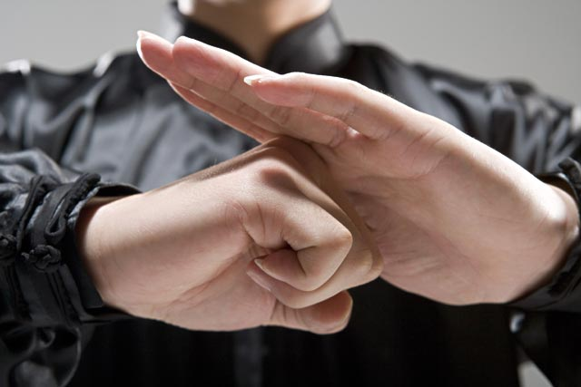
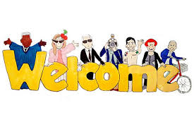
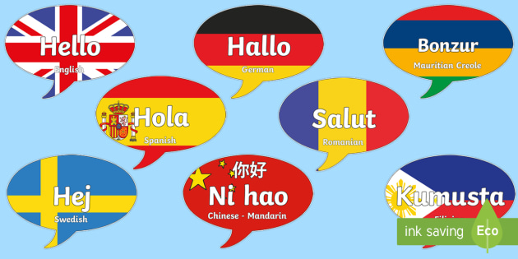
English-Chinese Handbook for Martial Art Coaches
武术教练中英文手册
草案2019年9月14日 PPT 1 B
Greetings
问候语! [wèn hòu yǔ]
And saying “Goodbye”
并说“再见”

Slide 2
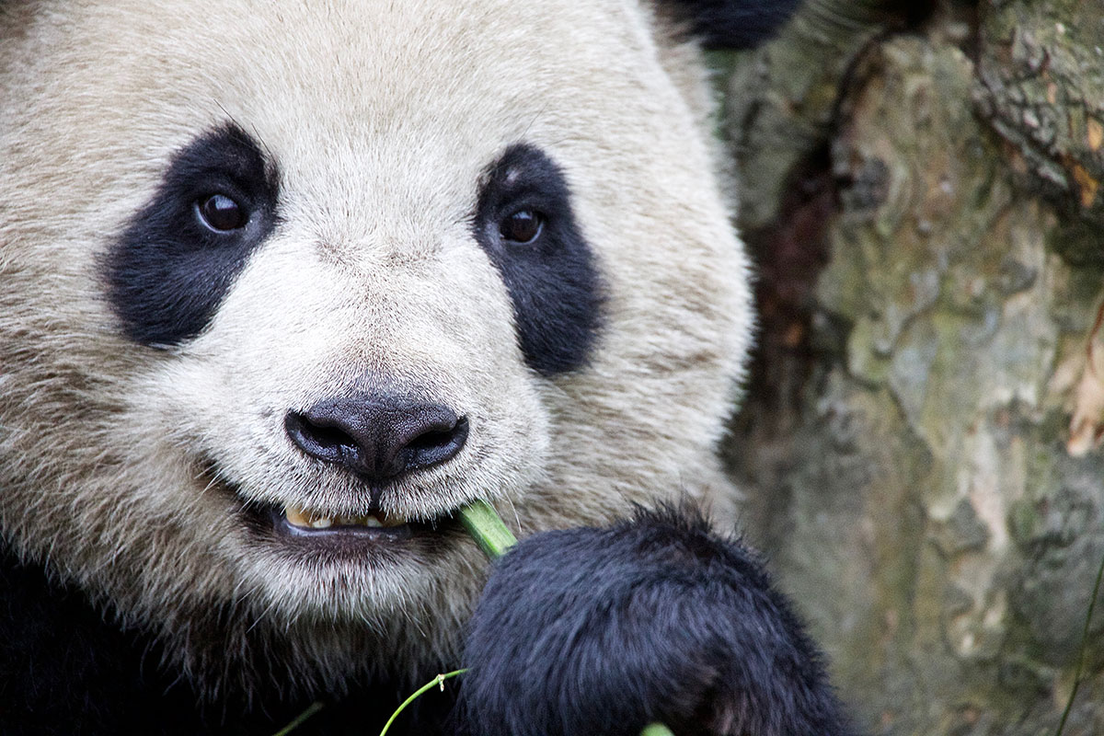
开始之前 Even before beginning
让我们真诚，怀着一颗温暖的心。
Let us be sincere, with a warm heart.
如果我们像机器人一样说话，人们会认为我们是机器人。
If we talk like a robot, people will think we are robots.

Slide 3
How are you?
I’m fine thank you.
And you?
Is OK, but it’s a little boring. Like a robot.
可以，但是有点无聊。 像机器人一样。

Slide 4
How are you?
Very well thank you, and you?
Excellent thank you, and you?
这些问候也是正式的。
These greetings are also formal.
但是，略有不同。
But, slightly different.
他们更有趣。
And much more interesting.
Excellent -优秀的
对“非常好”或“优秀”一词进行打孔（特别强调）。 这增加了您的声音和方式的感觉。
Punch (put extra emphasis) on the words “Very well” “Excellent” and “you?” That gives your voice feeling.

Slide 5
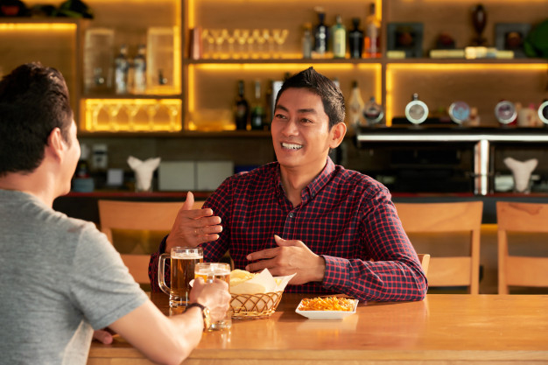
非正式问候1 Informal Greeting 1
Q: How ya doin? (Means: “How are you doing?”) （意思是：“你好吗？”)
A: I’m good! How ‘bout you? (Means: “How about you?”) （意思是：“你呢？“）

Slide 6
A: I’m ___________________. (Answer with an activity (活动), like “…on my way to the store,” or emotion, like “Really happy…”
（回答“活动”，例如“……去商店的路上”，或者情绪激动，例如“……真的很高兴”

Slide 7
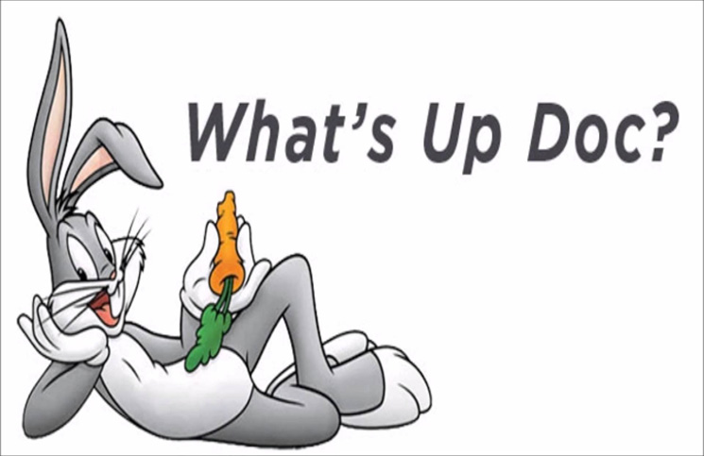
非正式问候2 Informal Greeting 2
Q: Wassup? (Means: “What is new with you these days?” or “What are you doing now?”) （意思是：“你最近有什么新鲜事吗？或者“你现在在干什么？”？”)
A: Not much. Wassup wit you?
不多。和你在一起吗？

Slide 8
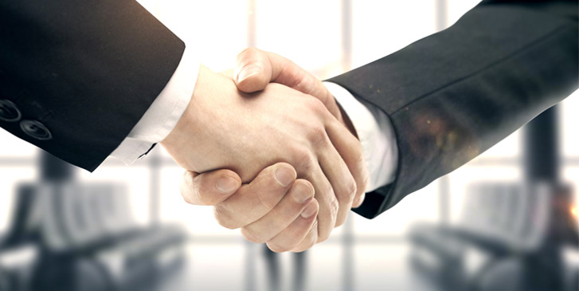
说再见 Saying: Goodbye
正式 Formal
(如果这是您第一次遇到一个人)
If it’s the first time you met a person
It was a pleasure meeting you.
I look forward to meeting you again!
很高兴认识你。 我期待着与您再次见面！

Slide 9
说再见 Saying: Goodbye
正式 Formal
如果你以前见过这个人If you have met the person before.
It was a pleasure seeing you again.
很高兴认识你。

Slide 10
说再见 Saying: Goodbye
非正式的Informal
See ya later! 回头见！Huítóu jiàn!
我告诉朋友，“永远不要说再见。” 只需说：“一会儿见！” 为什么？ 世界是如此之小。 再见有时会有些难过。 “待会儿见”更加积极乐观。
I tell friends, “Never say goodbye.” Just say: “See you later!” Why? The world is so small. Goodbye is sometimes a bit sad. “See you later” is more positive and optimistic.

Slide 11
如何练习会话技巧 How to practice conversation skills
学生之间的互动更基于现实，更有趣。学生们往往能比老师更好地互相解释。Interaction between students is more reality based and fun. Students can often explain things to each other better than teachers.
老式无聊的方式。一切都要经过老师。
Old fashioned boring way. Everything goes through the teacher.
C
D
I’m
good. How ‘bout you?
B
E
How
Are ya?
A

Slide 12
如何练习互动对话 How to practice interactive conversation
A → B How are you?
B → A Very well thank you. And you?
A → B Excellent thank you.
B → C How are you?
C → B I’m tired today. 我今天累了。
B → C Really? Why? 真正地？为什么？
C → B My mother is sick. 我妈妈病了。
B → C I’m sorry to hear that. 听到这个我很难过。
C → D How are you?
D → C Very well, thank you.
D → E How are you?
E → D Excellent, thank you and you?
D → E Very well thank you.
E → Teacher How are you?
Teacher → E Excellent, thank you!
学生可以而且应该互相帮助。他们常常比老师解释得更好！Students can and should help each other. They can often explain things better than teachers!

Slide 13
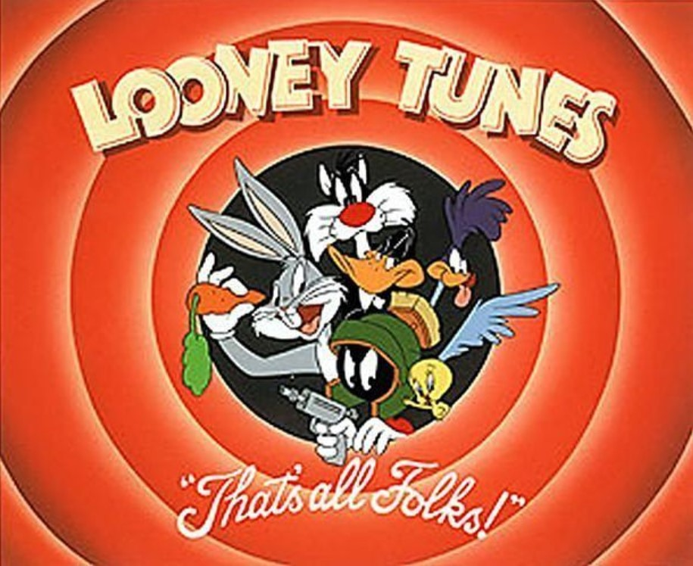
That’s all folks! = 那都是做给当今的人们看的。 That's all for today folks.

