Slide 1
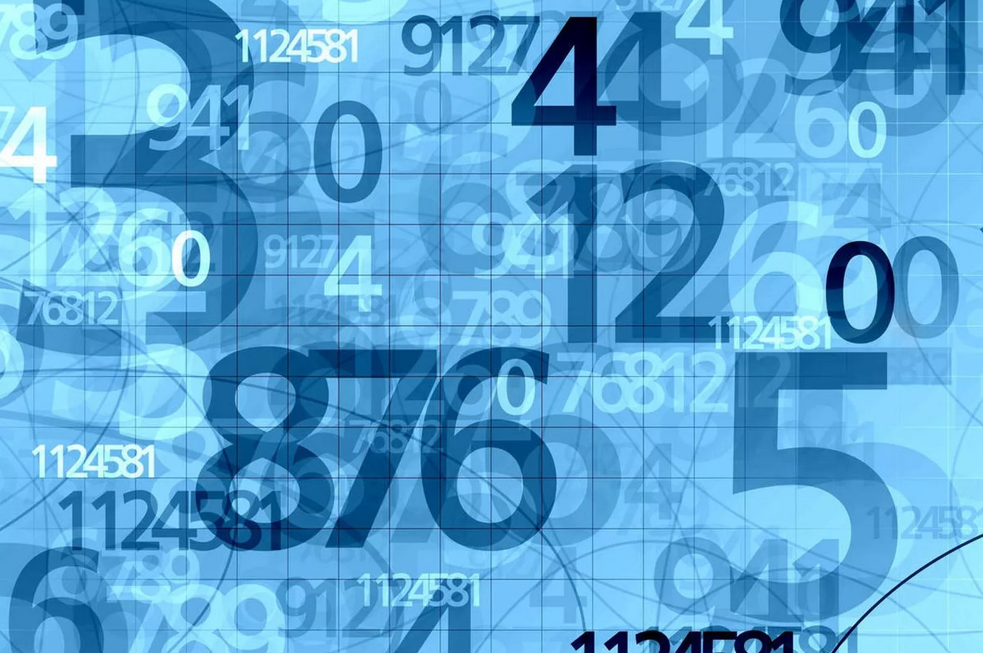
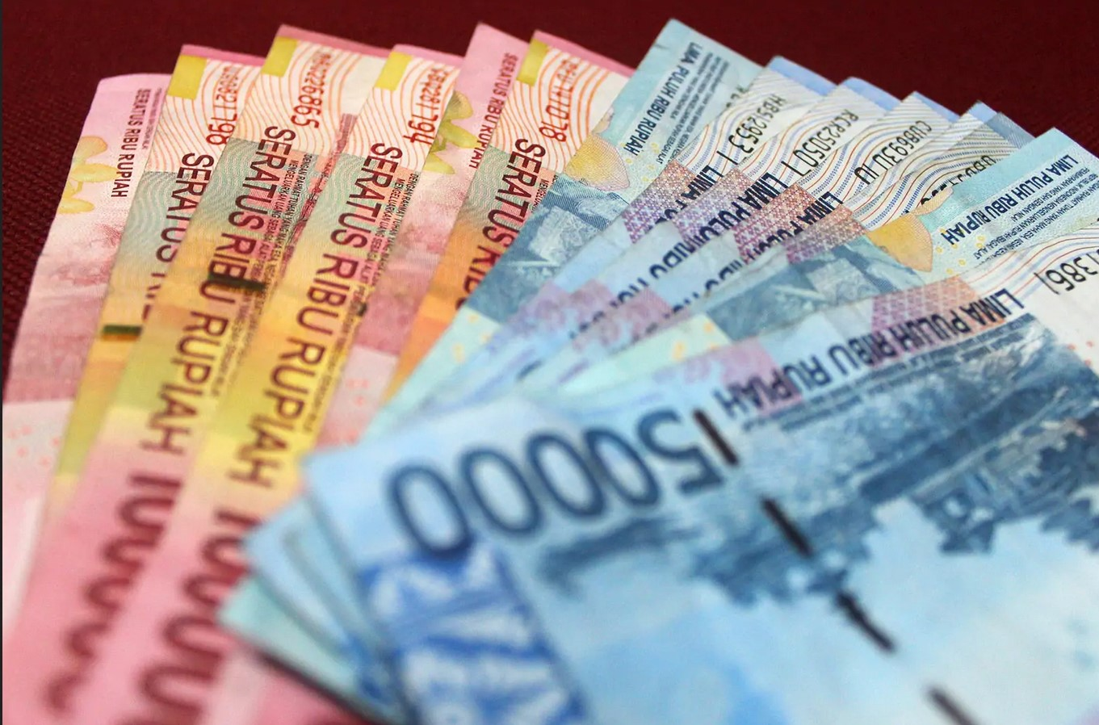
Numbers and paying for things
数字和付款
English-Chinese Handbook for Martial Art Coaches
武术教练中英文手册
草案2019年9月10日 PPT 2
For a lot of big numbers to practice with see: https://usdebtclock.org/

Slide 2
Counting
在我之后重复请Zài wǒ zhīhòu chóngfù
Please repeat after me
1 - One
2 - Two
3 - Three
4 - Four
5 - Five
6 - Six
7 - Seven
8 - Eight
9 - Nine
10 - Ten
how much?多少?
How much does it cost?它要多少钱？

Slide 3
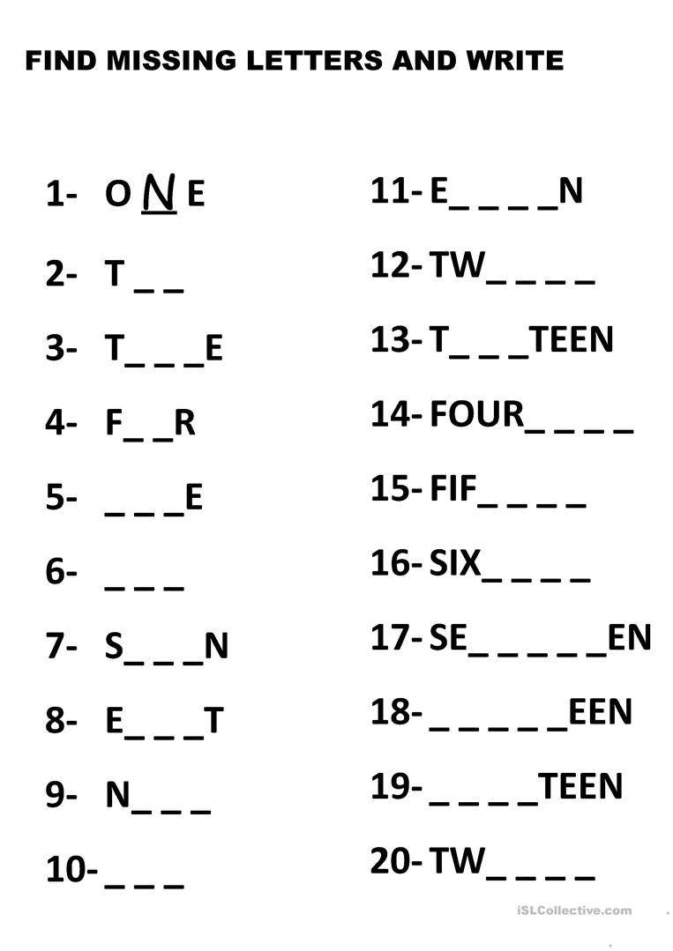
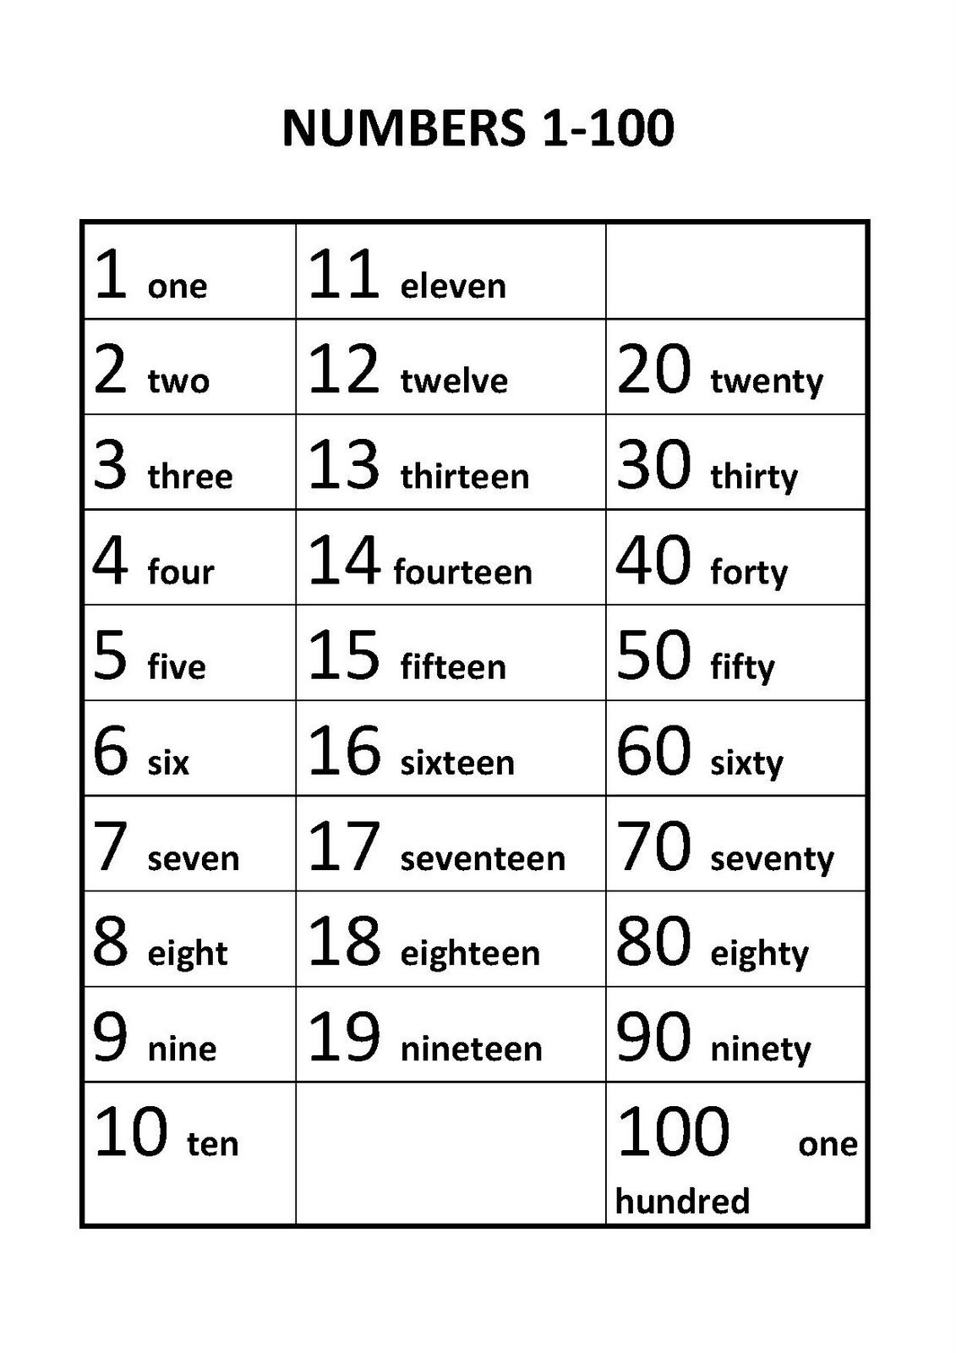
只是回顾一下。有时人们会忘记数字11-20！
Just a little review. Sometimes people forget 11 – 20!

Slide 4
阅读大数字 Reading big numbers
十亿 百万 千 百
billions, millions, thousands, hundreds
999,999,999,999
That number is: nine hundred ninety-nine billion, nine hundred ninety-nine million, nine hundred ninety-nine thousand, nine hundred and ninety-nine!
（翻译软件似乎无法正确翻译以上内容。）
(Translation software does not seem to translate the above correctly.)

Slide 5
999,999 + 1 = One million
999,999 + 2 = One million and one
999,999 + 10 = One million and nine.
999,999 + 100 = One million and ninety nine.
1,000,000 = one million 一百万
1,000,000 + 120 = One million one hundred twenty.
1,000,000 + 1,000 = One million one thousand.
1,000,000 + 1,000,000 = two million
100,000,000 = One hundred million 一亿
100,000,000 + 250 = 100,000,250

Slide 6
您可能想知道... You may wonder…
为什么我们需要学习这么大的数字？
Why do we need to learn such big numbers?
以下是在印度尼西亚雅加达租公寓的月租金。
Below are monthly rates to rent an apartment in Jakarta, Indonesia.

Slide 7
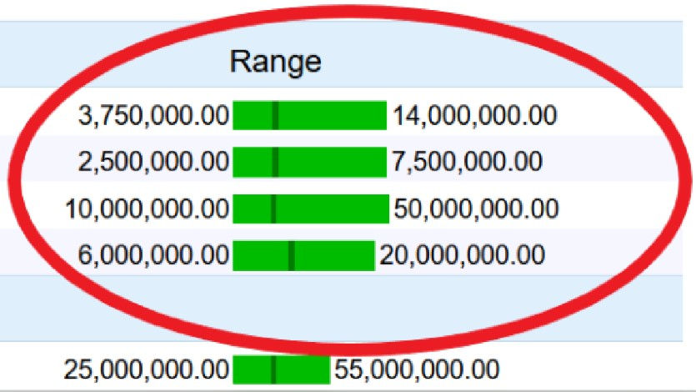
印尼盾的价格
你能用英语阅读这些数字吗？ Can you read those numbers in English?

Slide 8
这些价格贵吗？Are those prices expensive?

Slide 9
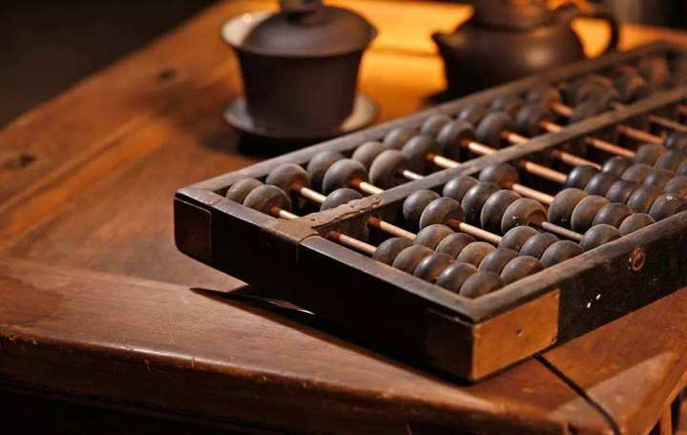
说或写答案 Speak or write the answers
3 +(plus) 1 + 9 = Thirteen
3 X(“times”)4=(equals) 12
2 X 7 = ______
4 X 9 = _______
24/(divided by) 2 = ____
500/2 = ______
14 – (minus) 1 = ____
33 X 3 = _______
106 + 106 = _______
100 X .05 (point zero five) = _____
州销售税。 在某些州为0.05％。 因此，当您购买东西时，请记住价格高于广告价格。In the USA there is a state sales tax on things you buy. In some states it’s .05%. So when you buy things, remember the price is higher than advertised.

Slide 10
说或写答案 Speak or write the answers
75,000 + 75,000 = ______________
100,000 + 100,000 = ______________
25,000,000 + 25,000,000 = _____________
150,000,000 + 150,000,000 = _____________
150,000,000 – 49,000,000 = _______________
如果您能回答上述所有问题，则可以很好地阅读英文数字。 恭喜你！如果没有，只需一点练习即可。 实践使完美。
If you can answer all the above questions, you can read English numbers well. Congratulations! If not, just a little practice will help. Practice makes perfect.

Slide 11
买东西和付钱 Buying and paying for things
购物 Shopping
How much? 多少？
Hello. How much does this cost? 你好。这个要多少钱？
Discount 优惠
That is too expensive. Can you give me a discount?
那太贵了。你能给我打折吗？
Never mind. I’ll look elsewhere. 没关系。 我会去别的地方。

Slide 12
乘出租车前 Before getting in a taxi
大多数国家/地区都有可以下载的出租车APP。 这些应用大多数都只能从google.com或apple.com下载
Most countries have taxi APPs you can download. Most of those APPs can only be downloaded from google.com or apple.com
有时（例如在高峰时段），您将无法获得其中之一，而必须使用常规的商业街出租车。
Sometimes (like during rush hour) you can’t get one of them and must use a regular commercial street taxi.

Slide 13
乘出租车前 Before getting in a taxi
大多数都很好。但是，有些人——甚至那些有电表的人——已经“操纵”了电表。怎么办？
Most are fine. But, some – even those with meters - have “rigged” meters. What to do?
在打车之前，让当地人用当地语言写下你的目的地。
Get a local person to write your destination in the local language before getting your taxi.
上车前，向司机展示目的地并询问“请多少钱？”
Before getting in the taxi, show the destination to the driver and ask “How much please?”

Slide 14
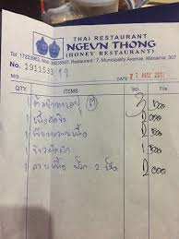
Paying the bill at a restaurant
在餐馆付账
Bill 买单 / 埋单
How much please?
请问多少钱？（或）
May I get the bill please?
请把帐单给我好吗？（或）
How much do I owe you? 我欠你多少钱？
Trip advisor.com

Slide 15
When leaving a restaurant…
离开餐厅时…
餐馆的工作是辛苦的，汗流浃背的工作。工人的工资很少高。对他们好是基本的礼貌。Restaurant work is hard, sweaty work. The workers are rarely paid much. Being nice to them is basic good manners.
我通常会称赞食物和/或厨师。
I usually compliment the food and/or the cook.
总的来说，这给他们留下了很好的外国人印象。
This gives them a nice impression of foreigners in general.
特别是对我的好感。 And a good impression of me in particular.
这种外交姿态是明智的。 This kind of diplomatic gesture is wise.
食物很好吃！ 我对厨师的赞美！
“The food was very delicious! My compliments to the cook!”

Slide 16
对智者说一句话…A word to the wise…
用当地语言学习数字。 许多或大多数公共服务人员可能会说一些英语，但有些或许多不会。Learn numbers in the local language. Many or most public service workers may speak some English, but some or many will not.
在您的新国家下飞机后，请立即获得一本当地的小语种手册，并开始记住数字。As soon as you get off the airplane in your new country, get a small local language phrase book and start to memorize the numbers.
土著人民会尊重您的。The native people will respect you for it.

Slide 17
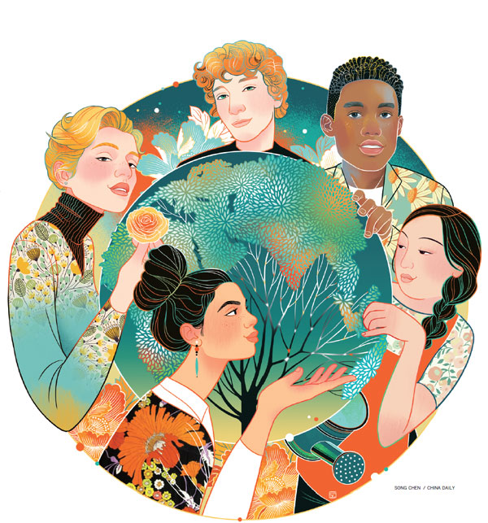
和睦相处
Living in harmony
http://www.chinadaily.com.cn/a/201903/28/WS5c9c0b4aa3104842260b2f8d.html

Slide 18
什么？！？ 您真的想要更多数字练习吗？ 好！What?!? You really want more numbers practice? OK!
What are the following numbers?
14 _______________.
21 _______________.
33 _______________.
105 ____________________.
222 ____________________.
3,333 _______________________________.
33,333 _________________________________________.
333,333 ______________________________________________.
3,333,333 __________________________________________________.
33,333,333 __________________________________________________.
555,555,555 _________________________________________________.
123,456,789 ________________________________________________.

