Slide 1
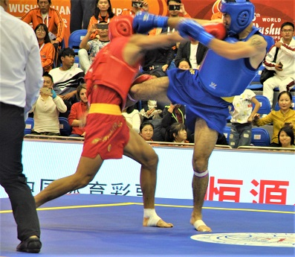
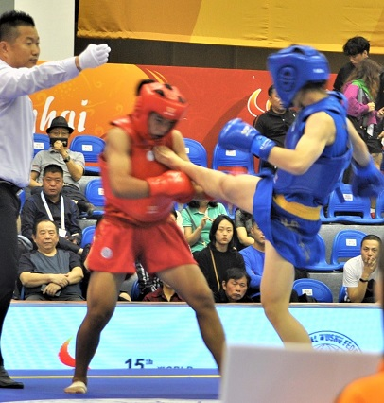
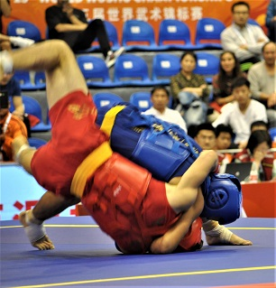
散打词汇 Sanda Vocabulary
English-Chinese Handbook for Martial Art Coaches
武术教练中英文手册
草案2019年9月14日 PPT 7 A
散打 A

Slide 2
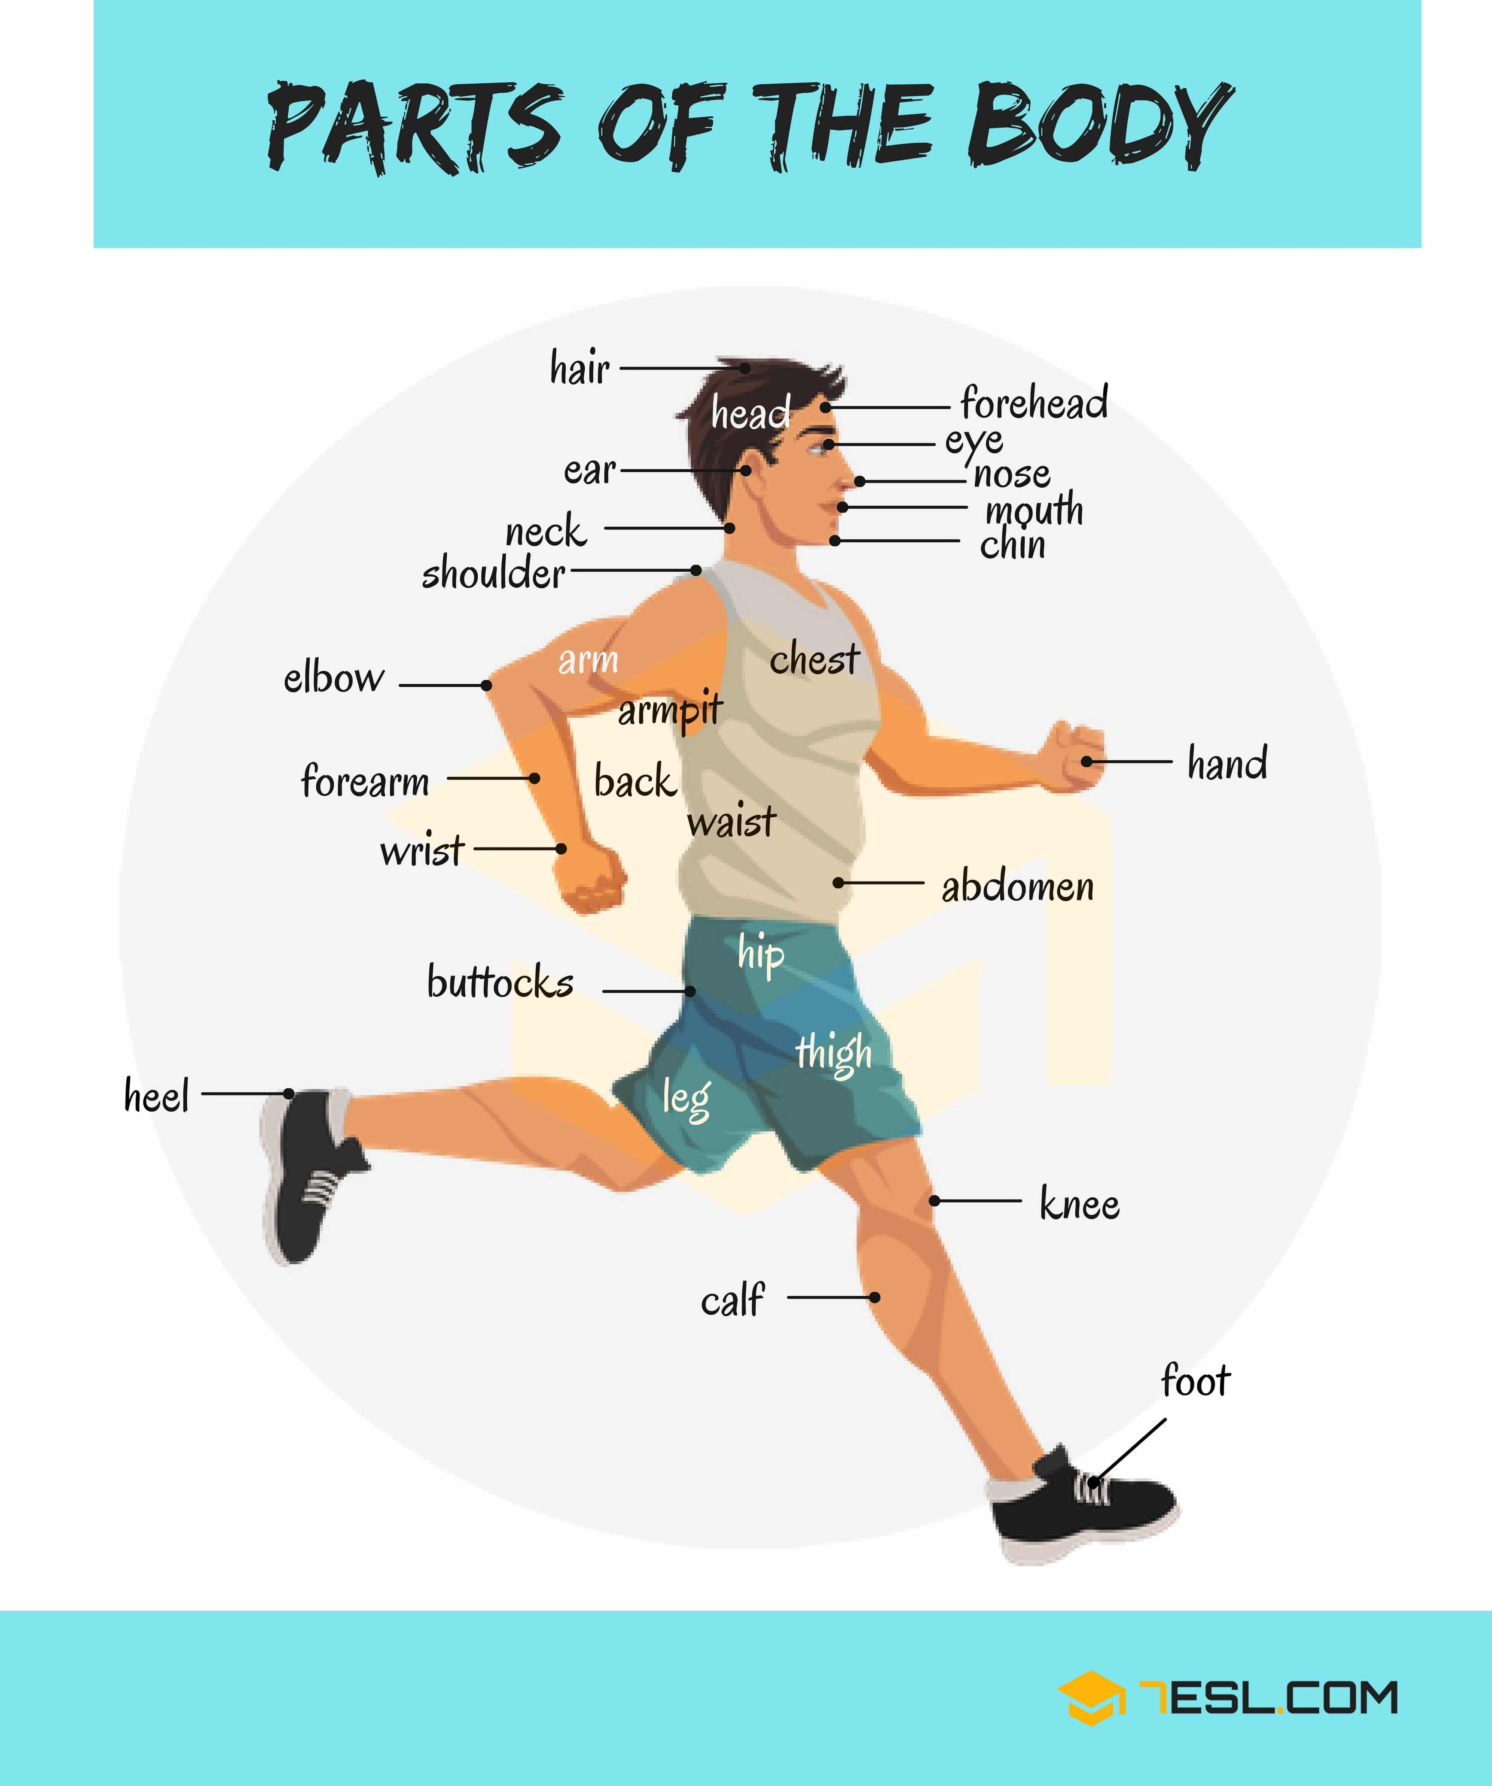
身体部位 a
Head 头
Neck 脖子
Shoulders 肩膀
Arm 手臂
Upper arm 上臂
Elbow 肘部
Forearm 前臂
Wrist 手腕子
Hand 手
Waist 腰
Hips 腿
Buttocks (but) 臀部
Leg 腿
Thigh 大腿
Knee 膝盖
Calf 腓肠 / 腓肠肌 / 小腿肚
1 Foot 脚
2 Feet 脚
Hand手
Fingers 手指
Palm of the hand 巴掌
Knuckles 指关节
Thumb 拇指
Foot 脚
Toes 脚趾
Ball of the foot 脚掌
Arch of the foot 足弓
Heel 鞋跟

Slide 3
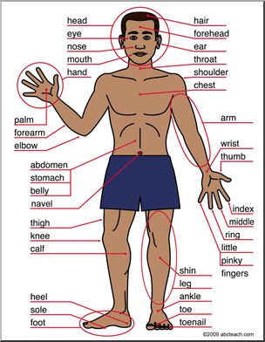
身体部位 b
Body parts b

Slide 4
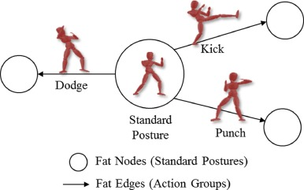
基本动作 Basic movements
Stance
战斗姿态
闪避
用拳猛击

Slide 5
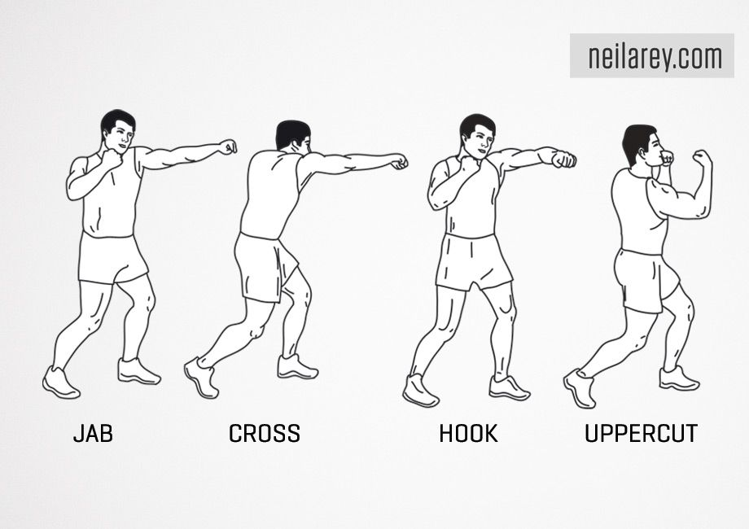
拳击基本词汇 Basic Boxing Vocabulary
Punches 打了一拳
Left 左
Right 右
Left Jab 左刺拳
Right Cross 右交叉拳
Hook 钩拳
Uppercut 上钩拳

Slide 6
拳法组合 Boxing Punch Combinations
左刺拳领先拳组合 LEFT JAB LEAD PUNCH COMBINATIONS
(https://www.ringsport.com.au/blogs/ringsport-blog/24-punching-combinations-that-work )
左 Left
右边 Right
刺拳领先拳 lead jab
组合 combination

Slide 7
拳法组合 Boxing Punch Combinations
左刺拳领先拳组合
Left Jab Lead Punch Combinations
Left jab - right cross 左刺拳 - 右交叉拳
Left jab - right cross - left jab 左刺拳 - 右交叉拳 - 左刺拳
Left jab - right cross - left hook 左刺拳 - 右交叉拳 - 左钩拳
Left jab - right cross - left hook - right cross
左刺拳 - 右交叉拳 - 左钩拳 - 右交叉拳
(https://www.ringsport.com.au/blogs/ringsport-blog/24-punching-combinations-that-work )

Slide 8
拳法组合 Boxing Punch Combinations
右交叉拳 RIGHT CROSS LEAD PUNCH COMBINATIONS
右交叉拳 - 左直拳 Right cross - straight left
右交叉拳 - 左直拳 - 右交叉拳 Right cross - straight left - right cross
右交叉拳 - 左钩拳 Right cross - left hook
右交叉拳 - 左钩拳 - 右交叉拳 Right cross - left hook - right cross
右交叉拳 - 左钩拳 - 右交叉拳 - 左上钩拳 Right cross - left hook - right cross - left upper cut

Slide 9
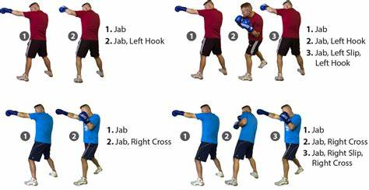
https://stillunfold.com/miscellaneous/8-powerful-boxing-combos-to-knockout-your-opponent

Slide 10
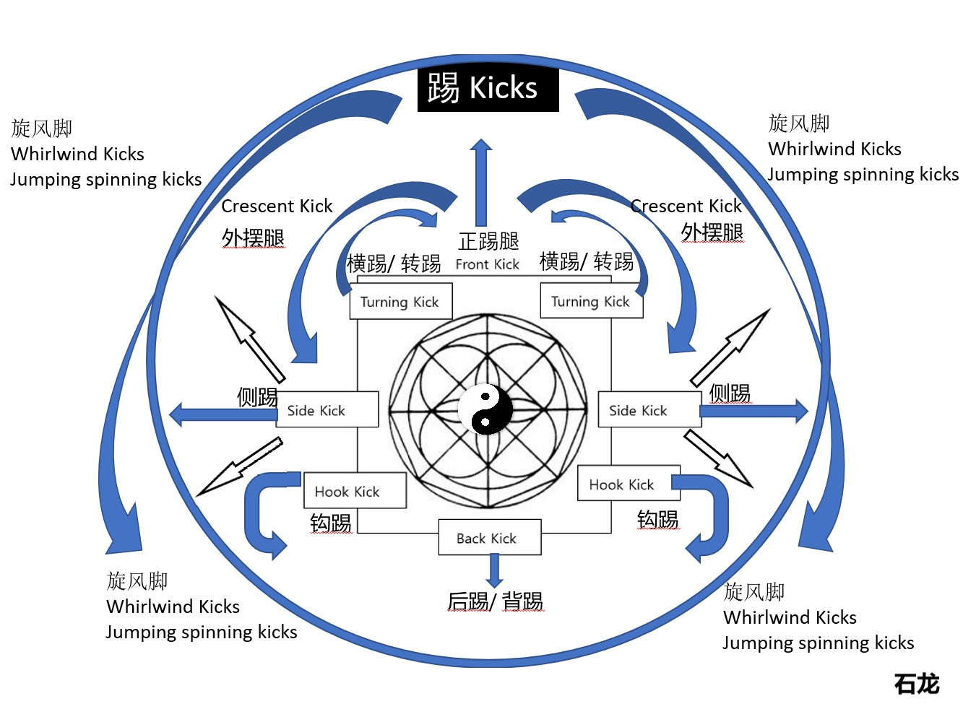
踢腿——大多数外国人用“跆拳道词汇”来形容踢腿 Most foreigners use Taekwondo Vocabulary for kicks

Slide 11
跆拳道踢腿词汇 Taekwondo Names for Kicks
side kick 侧踢
turning kick 横踢/ 转踢
front snap kick 前踢
back kick 后踢/ 背踢
twisting kick 内摆腿 (Inside swing kick)

Slide 12
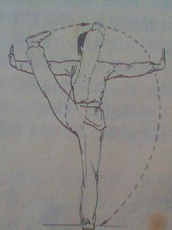
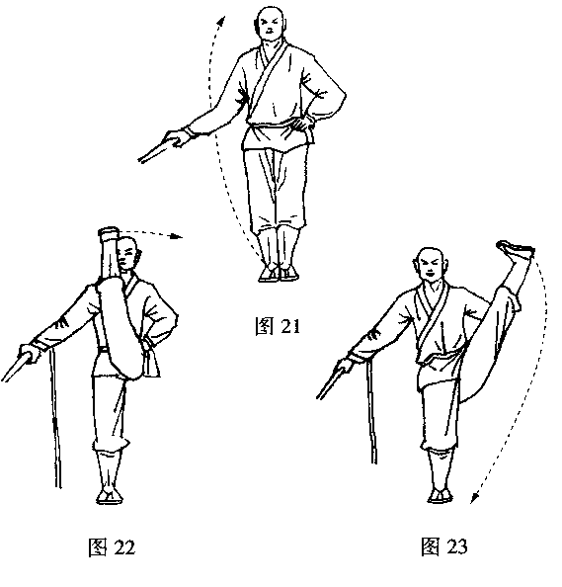
跆拳道踢腿词汇 Taekwondo Names for Kicks
Crescent kick 外摆腿
里合腿 - Inward swing kick
通常称为“里面 新月形踢”Usually called “Inside crescent kick”
外摆腿 - Outward swing kick - 通常称为“外面 新月形踢”
Usually called Outside Crescent Kick

Slide 13
跆拳道踢腿词汇 Taekwondo Names for Kicks
hook kick 钩踢
rising kick 上踢
side rising kick 侧身上踢
pushing kick 前推腿
double chop kick 双飞踢
hammer kick 下劈腿 / 劈腿

Slide 14
跆拳道踢腿词汇 Taekwondo Names for Kicks
Back spin kick 后旋踢
jumping side kick 跳步侧踢
jumping turning kick 跳步横踢
jumping snap kick 跳步前踢
jumping back kick 跳步后踢
jump hook kick 跳步钩踢
jump cut down kick 跳步下劈腿

Slide 15
跆拳道踢腿词汇 Taekwondo Names for Kicks
jumping twisting kick 跳高内摆腿
jumping crescent kick 跳高外摆腿
jumping side kick 跳高侧踢
jumping turning kick 跳高横踢
jumping snap kick 跳高前踢
jumping rising kick 跳高上踢
jumping double snap kick 跳高双前踢

Slide 16
跆拳道踢腿词汇 Taekwondo Names for Kicks
jumping over side kick / flying side kick 跳越侧踢
jumping over back kick / flying back kick 跳越后踢
reverse turning kick/ 360 turning kick 旋风踢
reverse hook kick 反身钩踢
reverse pushing kick 反身前推腿
reverse cut down kick 反身下劈腿
outside turning kick 外横踢/ 外转踢
back side kick 后侧踢

Slide 17
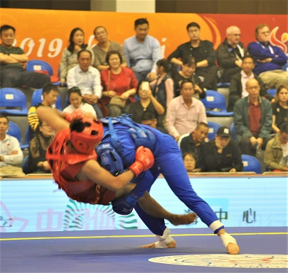
四种摔跤技术 Four wrestling takedown (摔) Techniques
1 双腿摔 Double Leg Takedown

Slide 18
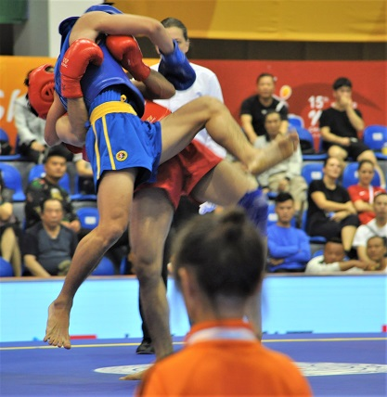
四种摔跤技术 Four wrestling takedown (摔) Techniques
2. 车身锁摔 Body Lock Takedown
有100种方法可以做到这一点摔
There are 100 ways to do this throw.

Slide 19
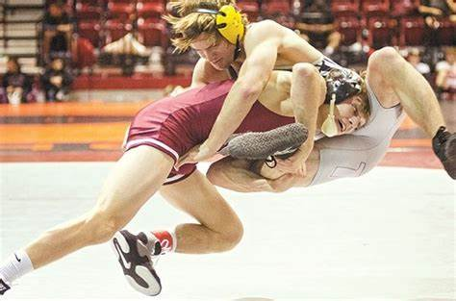
四种摔跤技术 Four wrestling takedown (摔) Techniques
3. 单支腿摔 Single Leg Takedown

Slide 20
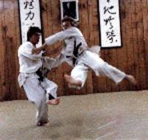
四种摔跤技术 Four wrestling takedown (摔) Techniques
4. 外部扫脚 Outside Foot Sweep

Slide 21
检查不同冲头的名称 Review names of punches
刺拳 _______________
右交叉拳 _______________
钩拳 _______________
上钩拳 _______________
1. Jab 2. Right cross 3. Hook 4. Uppercut

Slide 22
回顾四种摔跤技术 Review four wrestling takedown (摔) Techniques
1 双腿摔 ___
2. 车身锁摔 ___
3. 单支腿摔 ___
4. 外部扫脚 ___
Body lock takedown
Outside foot sweep
Double-Leg takedown
Single-leg takedown
1. C Double-Leg 2. A Body Lock 3. D Single Leg 4. B Outside foot sweep

