Slide 1
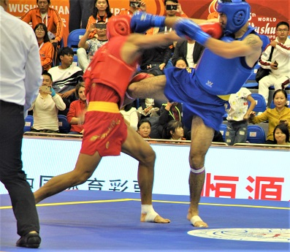
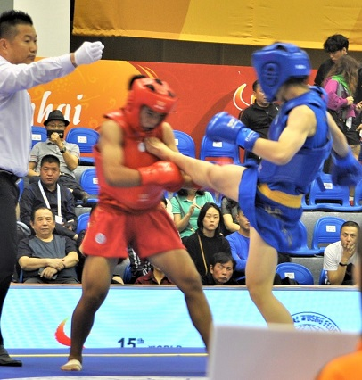
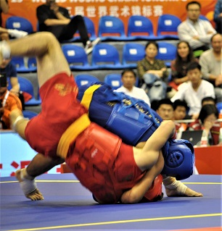
散打词汇 Sanda Vocabulary
English-Chinese Handbook for Martial Art Coaches
武术教练中英文手册
草案2019年9月14日 PPT 7 B
散打 B

Slide 2
拳法组合 Boxing Punch Combinations
左刺拳领先拳组合LEFT JAB LEAD PUNCH COMBINATIONS
(https://www.ringsport.com.au/blogs/ringsport-blog/24-punching-combinations-that-work )
左 Left
右边 Right
刺拳领先拳 Lead jab
组合 combination

Slide 3
回顾四种摔跤技术 Review four wrestling takedown (摔) Techniques
1 双腿摔 ___
2. 车身锁摔 ___
3. 单支腿摔 ___
4. 外部扫脚 ___
Body lock takedown
Outside foot sweep
Double-Leg takedown
Single-leg takedown
1. C Double-Leg 2. A Body Lock 3. D Single Leg 4. B Outside foot sweep

Slide 4
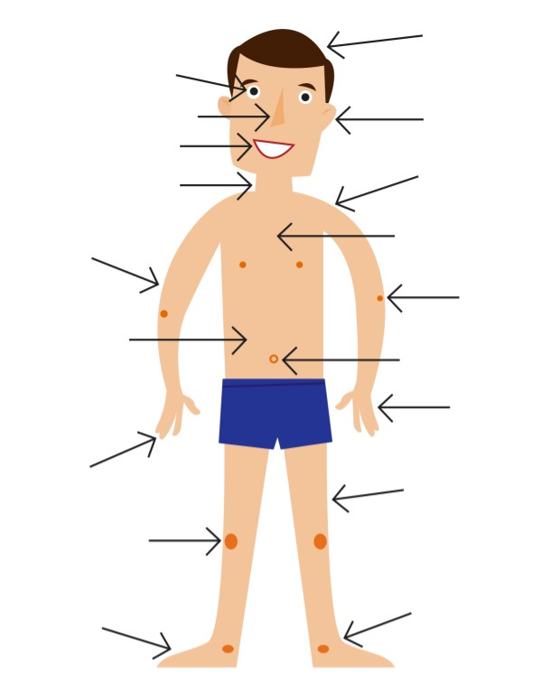
复习不同身体部位的名称 Review names of different body parts

Slide 5
复习不同踢腿的名字 Review Kicks
前踢 _______________________
横踢/ 转踢 ___________________
侧踢 __________________
后踢/ 背踢 ________________
外摆腿 __________________
1. Front kick 2. Turning kick 3. Side kick 4. Back kick 5. Crescent kick

Slide 6
位置=介词 Position = Prepositions
介词告诉我们事物相对于其他事物的位置
Prepositions tell us where things are in relation to other things.
In 在
On 上
Under 下
Next to 旁边的

Slide 7
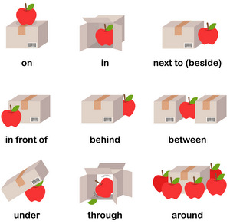

Slide 8
介词Prepositions - 练习题 Practice Questions
比赛中的拳击手手臂举得太高了。你攻击哪里？ A competition fighter holds his arms too high. Where do you attack?
_____________ his arms. ________他的胳膊。
比赛中的拳击手两臂分开。你应该攻击哪里？A competition fighter holds his arms very wide apart.
Where do you attack?
_____________ his arms. __________ 他的胳膊。
注意：出于学习介词的目的，这些练习题的明显答案是正确的答案。 但是，在现实生活中，经验丰富的竞争斗士会故意留下开口以吸引对手进攻。 经验丰富的竞争斗士将准备强大的反击。 换句话说，最容易的开放并不一定是最佳的攻击目标。Note: For the purposes of learning prepositions, the obvious answers to these Practice Questions are the correct answer. However, in real life, experienced competition fighters will intentionally leave openings to lure the opponent into attack. The experienced competition fighter will have strong counterattacks prepared. In other words, the easiest opening is not always the best target for attack.

Slide 9
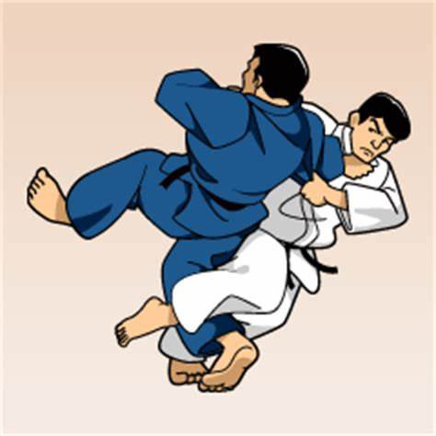
介词Prepositions - 练习题 Practice Questions
3. 竞技拳击手的防守很好。你该怎么攻击他？ A competition fighter has excellent defense. How should you attack him?
______________ the side. _________ 侧面。
4. 要进行柔道投掷称为“O索托加里”（主要的外部收割投掷），你需要让一条腿“紧挨着”他的腿，像镰刀割麦子一样切开他的腿。
To perform the Judo throw called “O soto gari” (Major outer
reaping throw) you need to get one leg ____________
his and cut through his leg like a sickle through wheat.

Slide 10
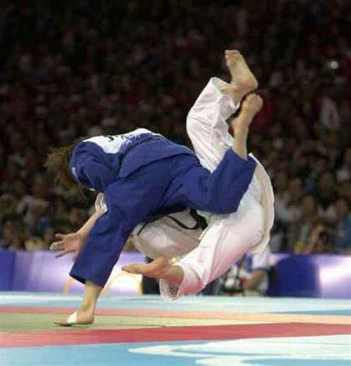
介词 Prepositions - 练习题 Practice Questions
5. 要表演O soto gari，你的身体必须 _________ 他至少一个短的瞬间。
To perform O soto gari your body must be ____________ his for at least one short instant.
6. 要做柔道投掷称为“Uchi mata”，你必须让一条腿“__________” 对手的两腿之间（把他拉紧，抬起并迅速转身）
To perform the Judo throw Uchi mata, you must get one
leg ____________ your opponent’s legs (pull him tight, lift
and turn very quickly)
Ans: 1. Under 2. Between 3. Around 4. Behind 5. Next to 6. Between

Slide 11
相对论 Relativity (比较级/最高级形容词 comparative/superlative adjectives)
Fast – faster – fastest 快-更快-最快
Slow – slower – slowest 慢——更慢——最慢
Strong – stronger – strongest 强壮-更强壮-最强
Beautiful - more beautiful – most beautiful 美丽-更美丽-最美丽
Good – better – best 好-更好-最好的
Flexible – more flexible – the most flexible 灵活-更灵活-最灵活

Slide 12
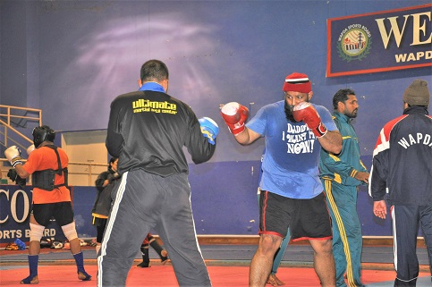
在武馆里 In the training hall
教练 Coach
练习对打 Sparring
陪练 Sparring partner; training opponent
轻接 Light contact
全功率 Full power
更衣室 Locker room

Slide 13
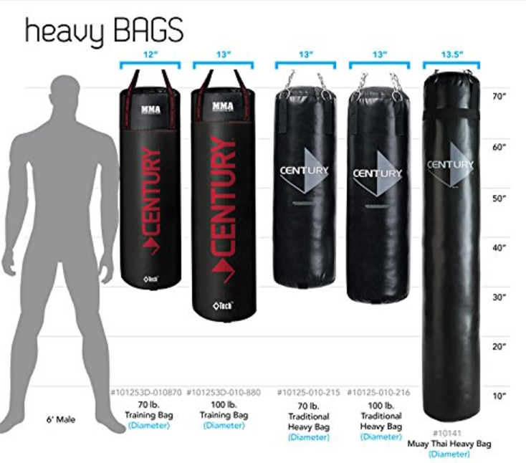
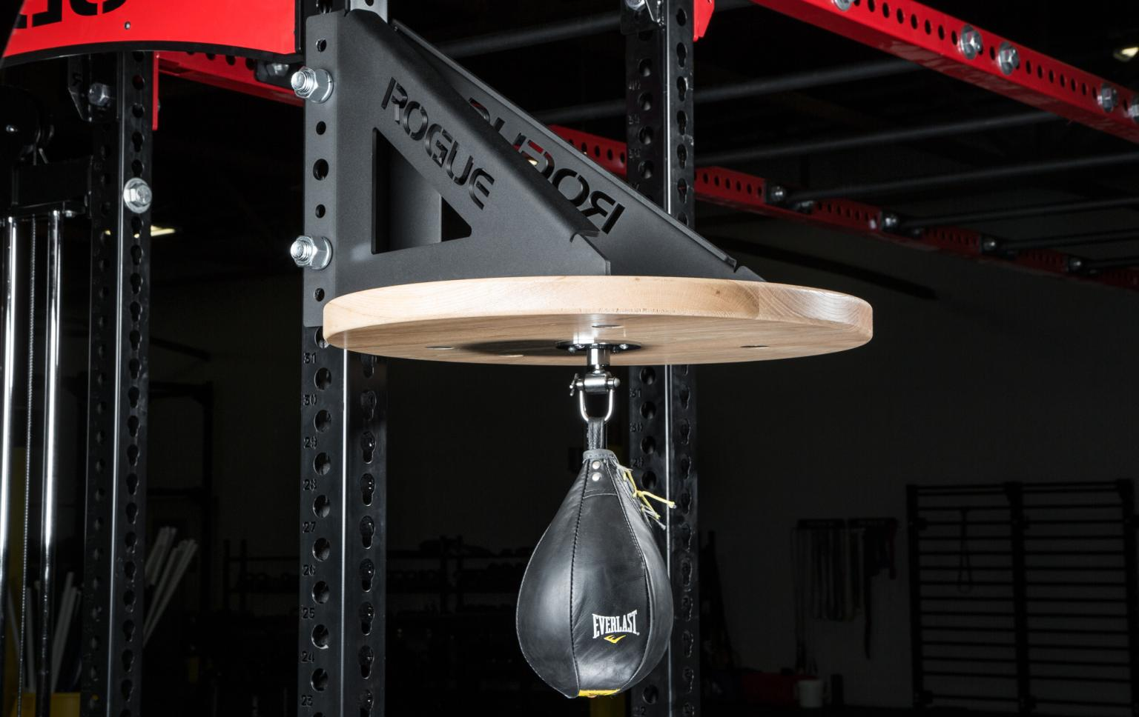
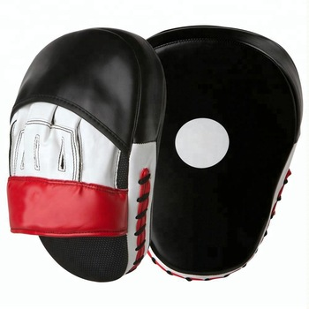
训练器材 Training Equipment
沙包 Heavy bag
小沙包 Light bag
速度袋 Speed bag*
Focus pad
https://www.roguefitness.com/rogue-rig-mount-speed-bag-platforms
https://www.alibaba.com/product-detail/Custom-Made-Focus-Mitt-Kick-Boxing_50038921289.html
* 如果你要买一个 速度袋，不要买便宜的。他们振动太多，你不能做高速和权力的打击，因为振动。If you’re going to buy a speed bag do not buy a cheap one. They vibrate too much and you can’t do high speed and power punches because of the vibrations.

Slide 14
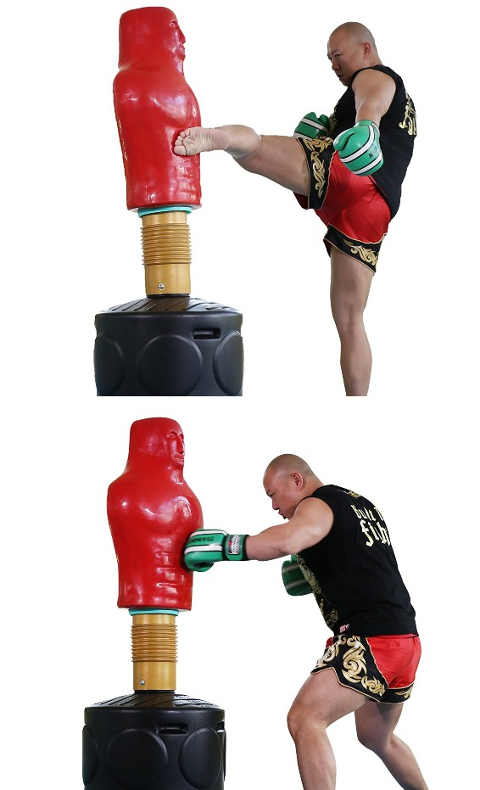
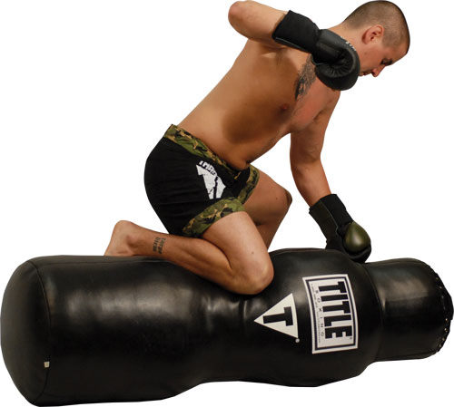
训练器材 Training Equipment
独立式假人 Freestanding dummy
摔跤 假人 Grappling dummy
https://gdgtify-exxponentllc.netdna-ssl.com
https://www.mixed-martial-arts-training.org/grappling-bags

Slide 15
散打比赛词汇 Sanda Competition Vocabulary
台上裁判员: referee
台下评分裁判员：judge; ringside official
推广人： promoter
场（包括若干回合）：match; bout; fight
回合：round

Slide 16
散打比赛词汇 Sanda Competition Vocabulary
辅导员；助手： second
第一辅导员： chief second
第二辅导员： assistant second

Slide 17
散打比赛词汇 Sanda Competition Vocabulary
体重分级： weight division [category; classification]
公斤: Kilogram (Kilo)
最大体重： weight limit
称量体重: weigh in
手套检查： glove inspection
裁判员口令： referee’s command
分开： break; separate; disengage; disentangle

Slide 18
散打比赛词汇 Sanda Competition Vocabulary
三次击倒规则： three-knockdown rule
读秒： count
强制性读秒数 8：standing-eight count
读完10秒： full count
被击倒后数10不起：counted out; down and out; take the count

Slide 19
散打比赛词汇 Sanda Competition Vocabulary
绝对胜利（对手数10不起）： knock-out
侥幸脱险（数秒不到10鸣锣停止比赛）： Saved by the bell
击败对手： outbox; outclass
击倒获胜： win by a knockout
技术击倒[获胜]: technical knockout (TKO)

Slide 20
散打比赛词汇 Sanda Competition Vocabulary
击倒：knock down; floor; flatten; deck; drop; pound to canvas
倒下： fall down
倒在围绳上： on the ropes
假装被击倒： “take a dive” Pretend to be knocked down (有些“斗士”是有偿输的，所以他们“跳水”Some “fighters” are paid to lose, so they “take a dive.”)
认输： throw [toss] in the sponge [towel] (quit, give up, surrender)
打出台外： Out of the ring; out of bounds

Slide 21
散打比赛词汇 Sanda Competition Vocabulary
分数超过对方： outpoint
得分获胜： win by decision [on points]
裁判员宣布停止比赛： referee stops contest
裁判员叫停获胜：win by “referee stops contest”

Slide 22
散打比赛词汇 Sanda Competition Vocabulary
因对方弃权而获胜： win by default
因对方未出场而获胜： win by walkover (absence; default)
胜局： winning round
金腰带： gold (champion) belt

Slide 23
散打比赛词汇 Sanda Competition Vocabulary
犯规拳 foul blows
腰下拳： low blow; hit below the belt
肾部拳： kidney blow
击后背： hit on the back
击后脑勺：rabbit punch; hit on the back of neck
卡脖子： throttle; stranglehold
击打倒地对手： hit opponent when he is down

Slide 24
散打比赛词汇 Sanda Competition Vocabulary
犯规拳 foul blows
拳背击人： backhander; backhand swing
开掌打击： open blow; hit with open gloves (会造成割伤 can cause cuts)
用手掌部位击打： hit with the inside of glove
拇指击眼部: gouge; thumb
头撞： headbutting
咬人： biting

Slide 25
挑战问题：您在下面的照片中称呼那个东西吗？Challenge Question: What do you call the thing in the photo below?

