Slide 1
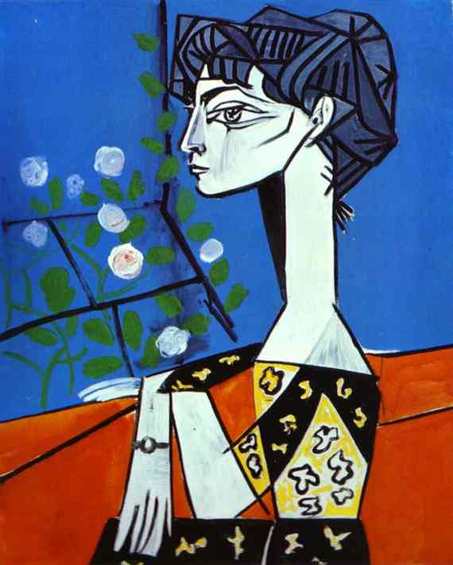
You go to an art gallery 美术馆měishùguǎn or a museum博物馆 bówùguǎn and you see a painting…
1. What do you feel 感受gǎnshòu?
2. What do you think?
3. What do you say?

Slide 2
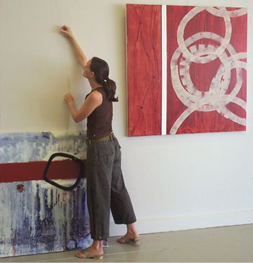
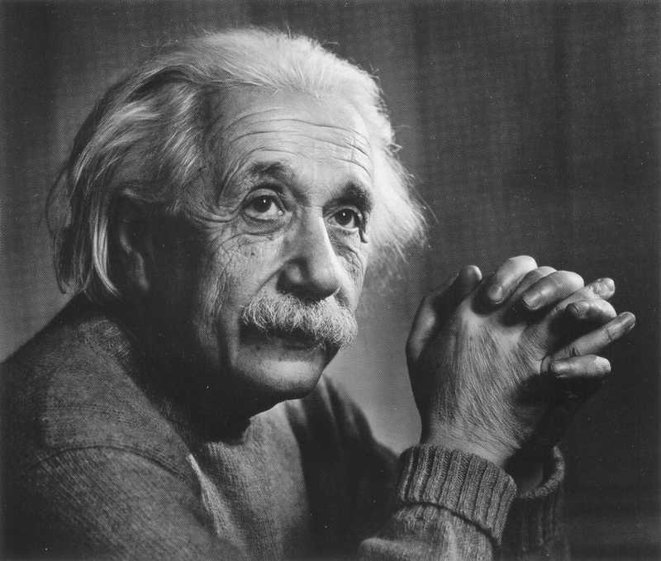
Art is about feeling 感受[gǎnshòu]
I am PRIMARILY 主要地zhǔyàode a FEELING person.
I am PRIMARILY 主要地zhǔyàode a THINKING person.
OR

Slide 3
European Art History
40,000 BCE – 800 BCE Prehistoric Art 史前的[shǐ qián de]
800 BCE – 400 ACE Classical antiquity
(Egypt, Greece and Rome)
500 - 1400 Byzantium (Christian)
1400 – 1650 Renaissance Art
(The golden age)
1600 – 1800 Baroque and Rococo Neo Classicism,
Romanticism,
Impressionism
Symbolism
1900 → present Modern and contemporary
Notes:
http://en.wikipedia.org/wiki/History_of_painting#Egypt.2C_Greece_and_Rome

Slide 4
Prehistoric Art 史前的shǐ qián de] 40,000 – 800 BCE
Venus of Willendorf 24,000 – 22,000 BCE Natural History Museum, Vienna, Austria
How does this lady make you feel?
What is she? 女神[nǚshén]
24 thousand years ago she was the Ultimate Woman!

Slide 5
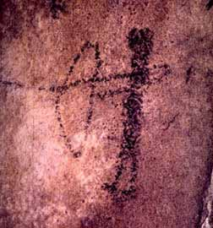
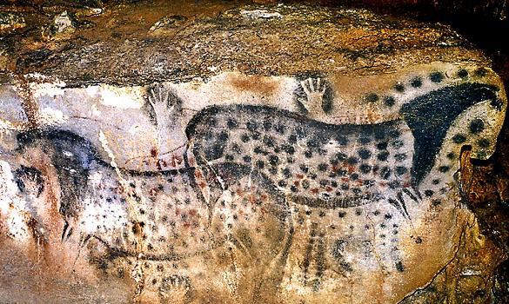
Prehistoric Art 史前的shǐ qián de] 40,000 – 800 BCE
Hunters: 猎人lièrén
Archer 18,000 - 10,000 BCE
Hunters: 18,000 to 10,000 years ago
Cave 山洞 shāndòng paintings
Pech Merle Caves, France 25,000 years ago

Slide 6
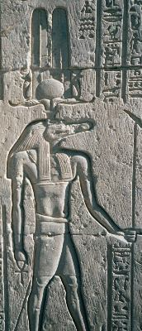
800 BCE – 400 ACE Classical 传统的 antiquity 古代 gǔdài (Egypt, Greece and Rome)
Ancient Egyptian art is the
painting绘画,
sculpture 雕塑 diāosù,
architecture 建筑学 jiànzhùxué
and other arts produced by
the civilization 文明 wénmíng
from 5000 BC to 300 AD.
Sobek: Crocodile 鳄鱼 èyú God 上帝 shàngdì

Slide 7
What do you think about…
Sobek: The Crocodile 鳄鱼 èyú God 上帝 shàngdì of Ancient Egypt?
I could believe信 in a God like that!
It’s ridiculous 荒谬的 huāngmiù!
It’s interesting.
It’s boring!
It’s beautiful!
In any case:
It’s ART!

Slide 8
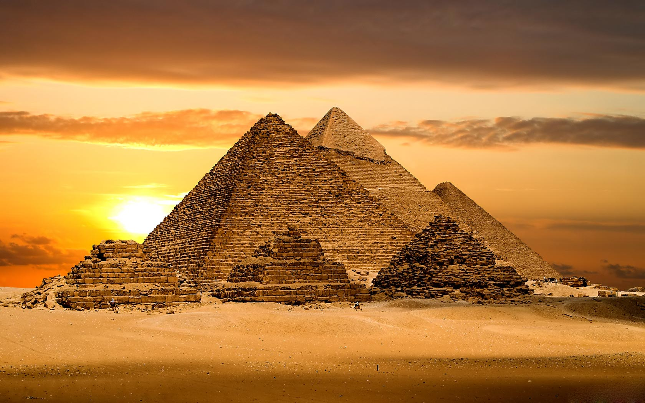
Egyptian Architecture 建筑学[jiànzhùxué] Pyramids 金字塔[jīnzìtǎ]

Slide 9
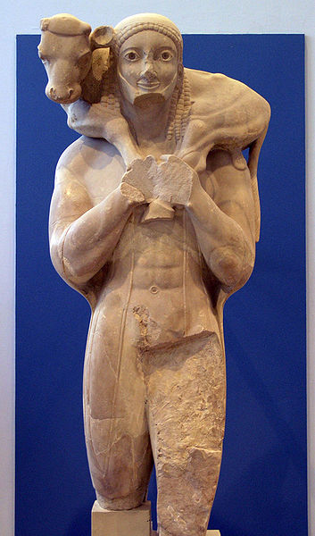
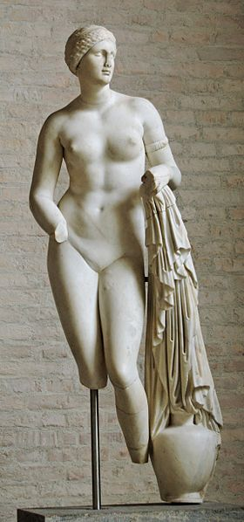
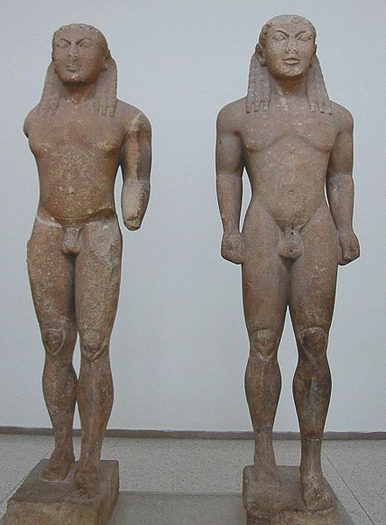
Classical Greek Art
Sculpture! 雕塑 diāosù!
From about 1,000 BC to 300 BC

Slide 10
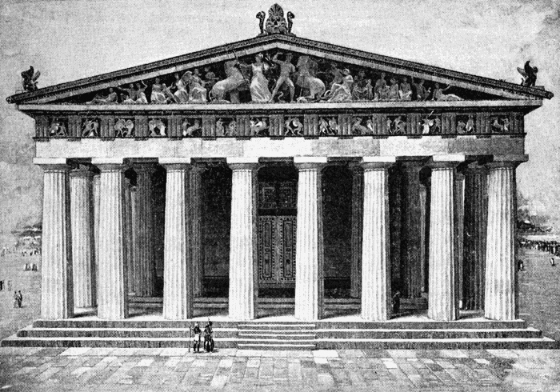
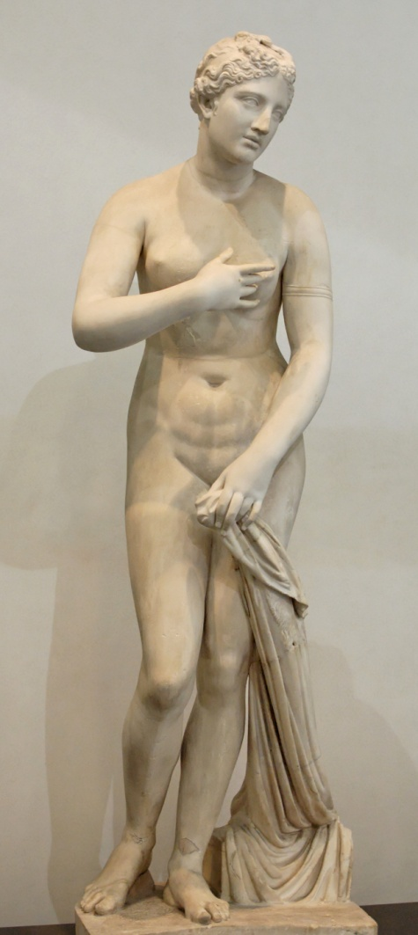
Greek Architecture 建筑学[jiànzhùxué]
447 BCE Greek Parthenon – Temple 庙宇 miàoyǔ for Greek Goddess 女神 Athena

Slide 11
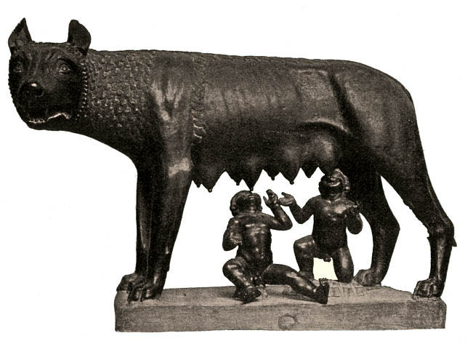
Roman Art 古罗马的 gǔluómǎde
The Roman Republic began around 509 BCE, and the Western Roman Empire was pretty much dead by 476 AD.
According to legend 传奇[chuánqí], Rome was started by Romulus and Remus, who were raised 抚养[fǔyǎng] by a wolf.
The Roman Empire帝国 dìguó lasted almost 1,000 Years!

Slide 12
Roman Architecture

Slide 13
The gladiators walked out into the arena at the Colliseum in Rome.
角斗士们走入位于罗马Colliseum的圆形竞技场。

Slide 14
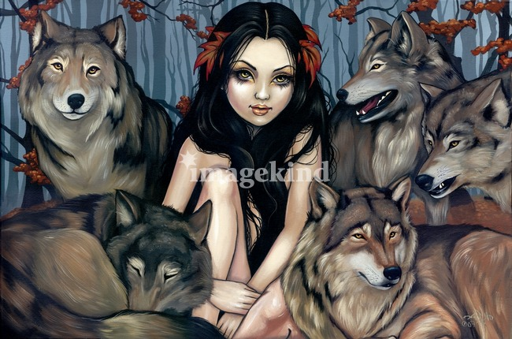
Discussion
I would like to be raised 抚养[fǔyǎng] by a wolf狼 láng.
I would not like to be raised by a wolf.
I was raised by a wolf!

Slide 15
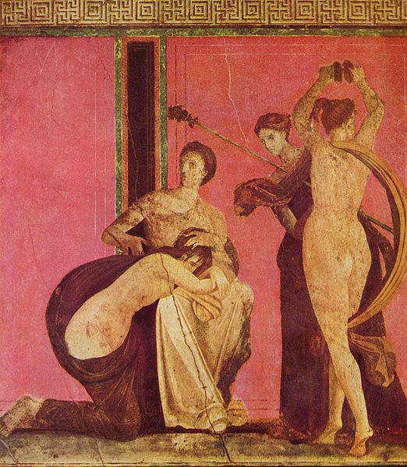
Rome 50 BCE
Painting
用刷状笔画

Slide 16
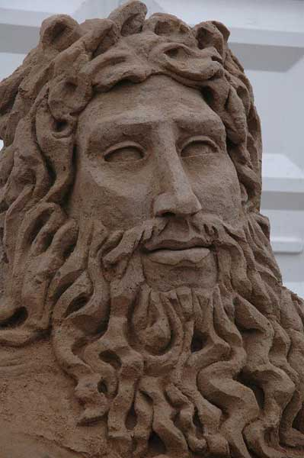
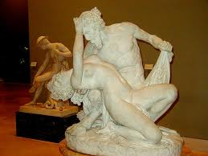
Roman Sculpture

Slide 17
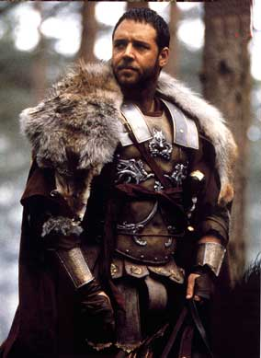
The Roman古罗马的 Army军队

Slide 18
By 475 The Roman Empire died

Slide 19
The Roman Empire enslaved使成为奴隶 the World.
And, some say they just
copied复制品 Greek art.
Would you like to have been Roman?
Yes, I’d like to have been Roman.
No, I wouldn’t like to have been Roman.

Slide 20
After the fall of Rome
罗马帝国的灭亡（公元476）
Europe went into the DARK AGES 黑暗时代

Slide 21
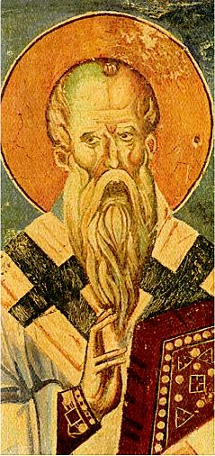
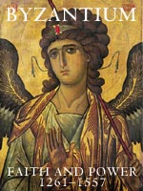
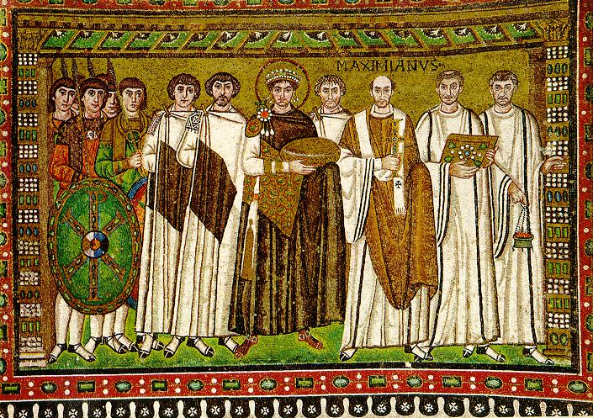
There was art but nothing new… or fresh 新鲜xīnxiān! For 900 years!!!!
Byzantium Art 500 ace - 1400 ace
DARK and MIDDLE AGES

Slide 22
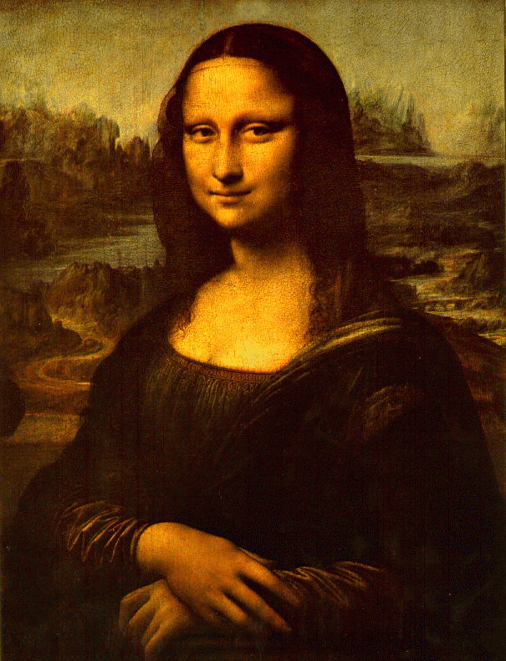
1400 – 1650 Renaissance Art (The golden age)
The Mona Lisa, by Leonardo De Vinci is probably the most famous renaissance painting. It’s famous for it’s 3-D effect, modern pose and other reasons.
So when the Renaissance came around in the 1400s it was a BIG, HUGE relief! 缓解 huǎnjiě

Slide 23
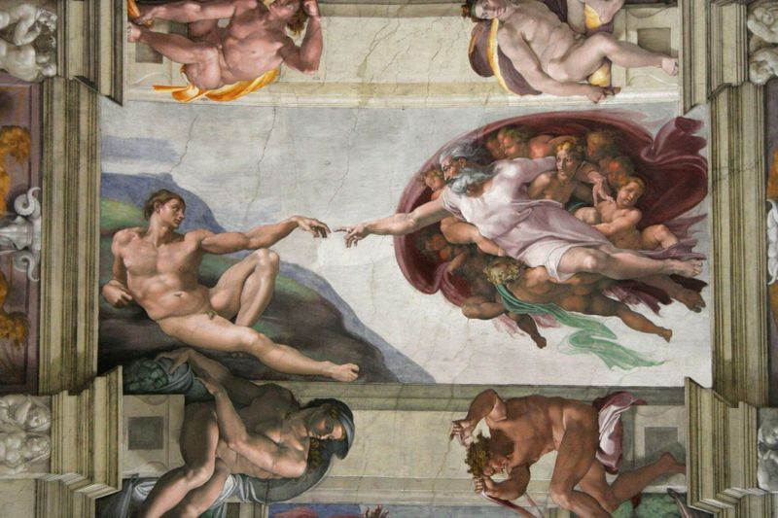
Michaelangelo

Slide 24
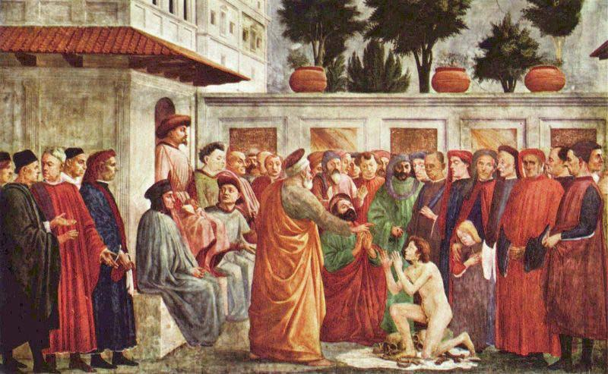
Other Famous Italian Renaissance painters include: Masaccio, Donatello, Brunelleschi and many others.

Slide 25
Transfiguration by Raphael!

Slide 26
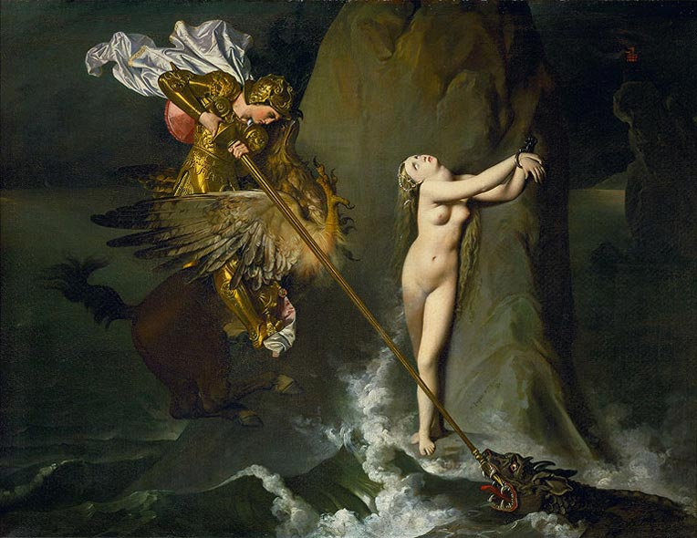
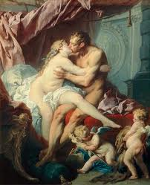
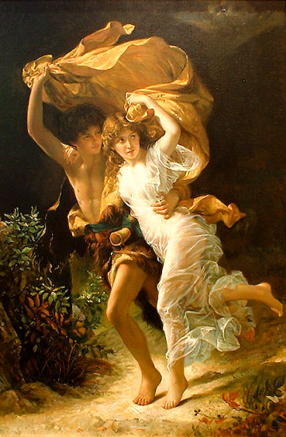
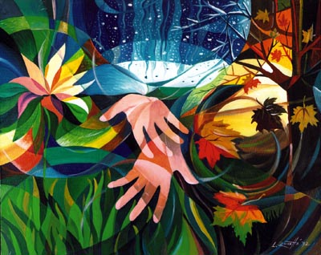
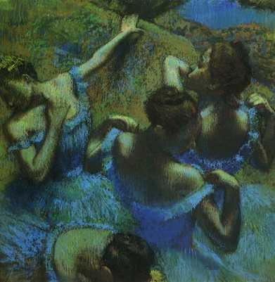
1600 – 1800 Baroque and Rococo, Neo Classicism, Romanticism, Impressionism, Symbolism
Neo Classicism
Rococo
Baroque
Symbolism
Impressionism
Romanticism

Slide 27
Title: “Bathsheba” A Baroque painting by Sebastiano RICCI
Note the richness of color, depth, detail, feeling and implied dynamic movement.
Painted around 1725.

Slide 28
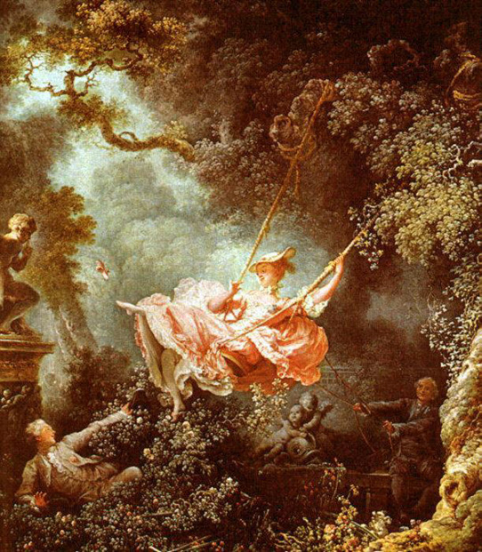
The Swing by Jean Honore Fragonard Rococo

Slide 29
Neoclassical: Jacques Louis David

Slide 30
Romanticism late 1700s & 1800s
This period is called the Age of Enlightenment (启蒙时代 qǐ méng shí dài )
Scientific and artistic rational expression was replaced by an emphasis on emotion and the unknown.

Slide 31
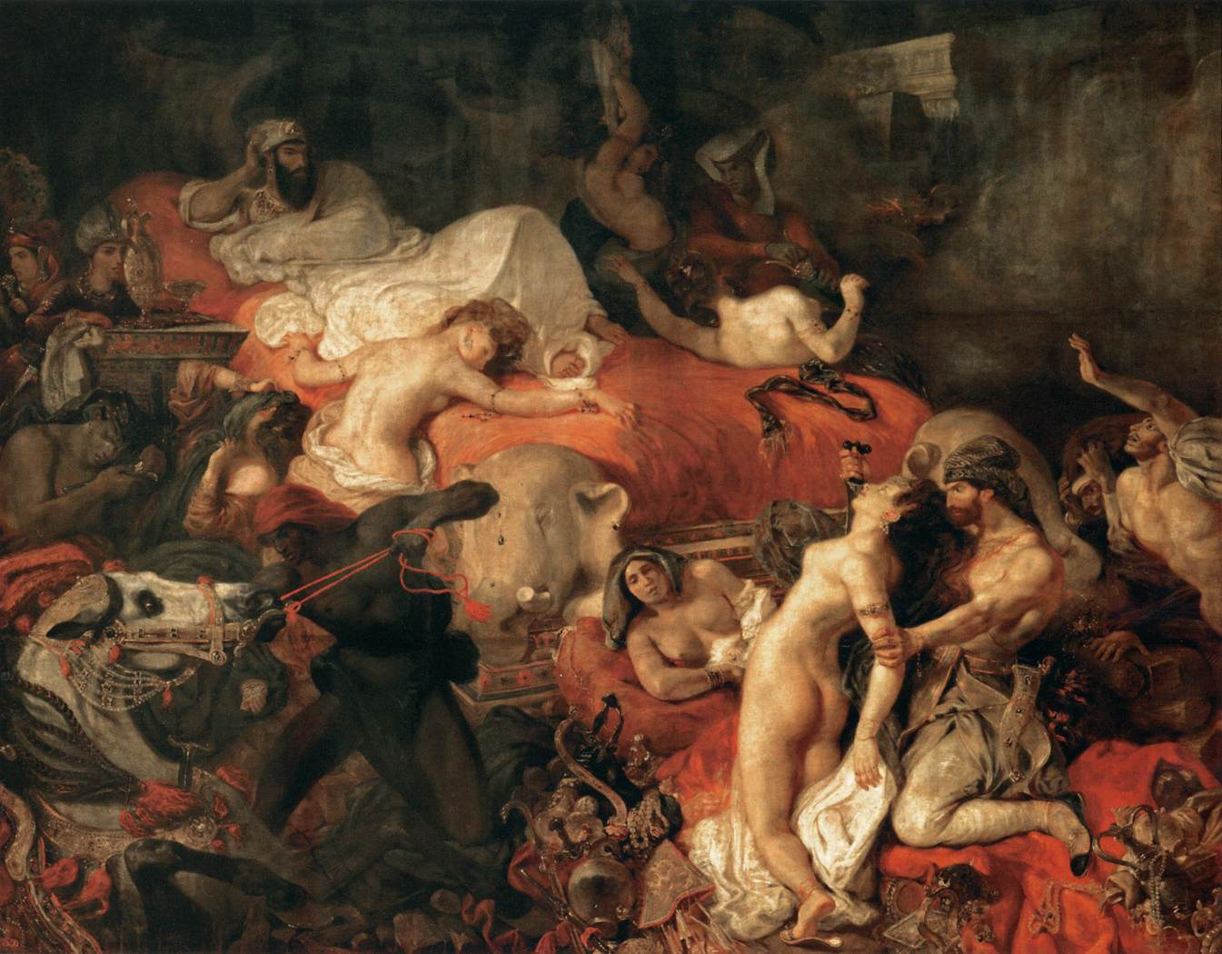
Sardan

Slide 32
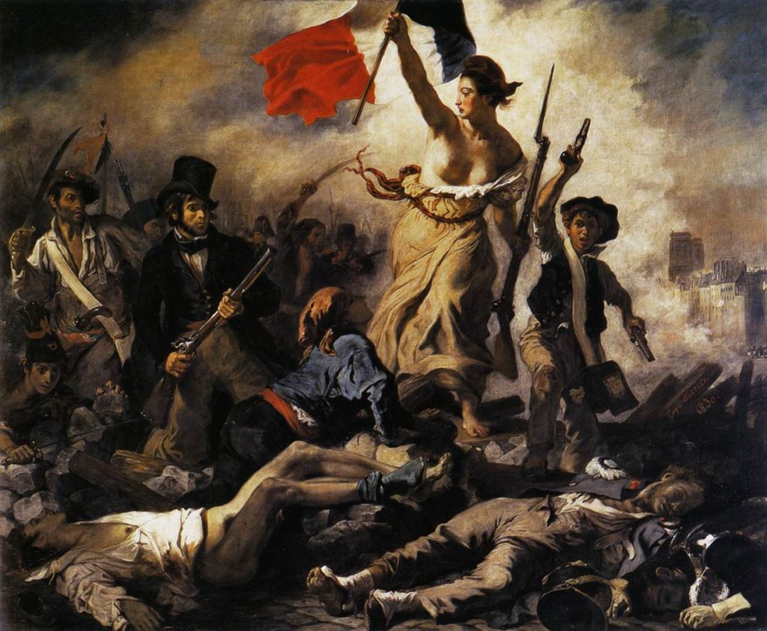

Slide 33
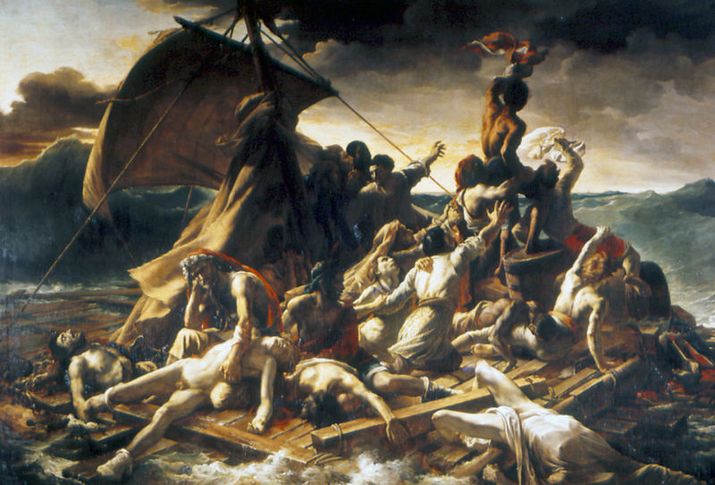
Théodore Géricault’s life-sized “Raft of the Medusa.” Although Romanticism art focuses on spontaneity, emotion and freedom, many of its pieces contain a tragic, real-life event.

Slide 34
Impressionism (Monet 1872)

Slide 35
Impressionism - Renoir

Slide 36
Degas – Behind the Scenes

Slide 37
Impressionism - Georges Seurat Sunday Afternoon 1884 - 1886

Slide 38
EdouardManet-A-Bar-at-the-Folies-Bergere-1882

Slide 39
1862 1918 Symbolism Gustav Klimt

Slide 40
Picasso’s “Guernica” and the Evolution of Consciousness
Bombing by Germans during Spanish Civil War

Slide 41
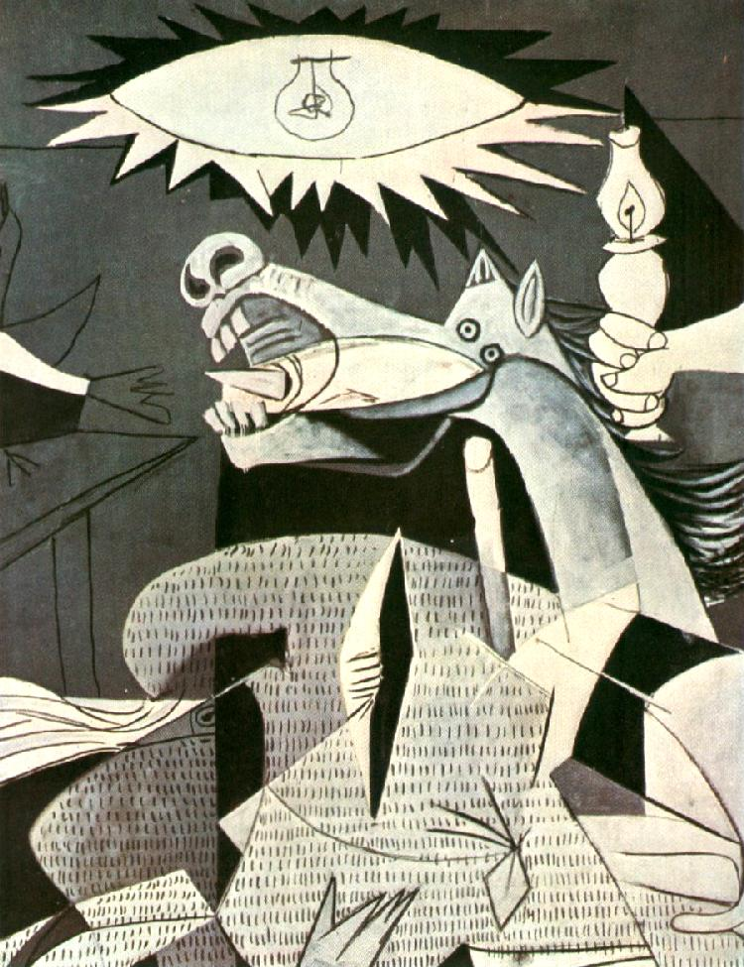
Guernica by Pablo Picasso

Slide 42
les demoiselles d avignon

Slide 43
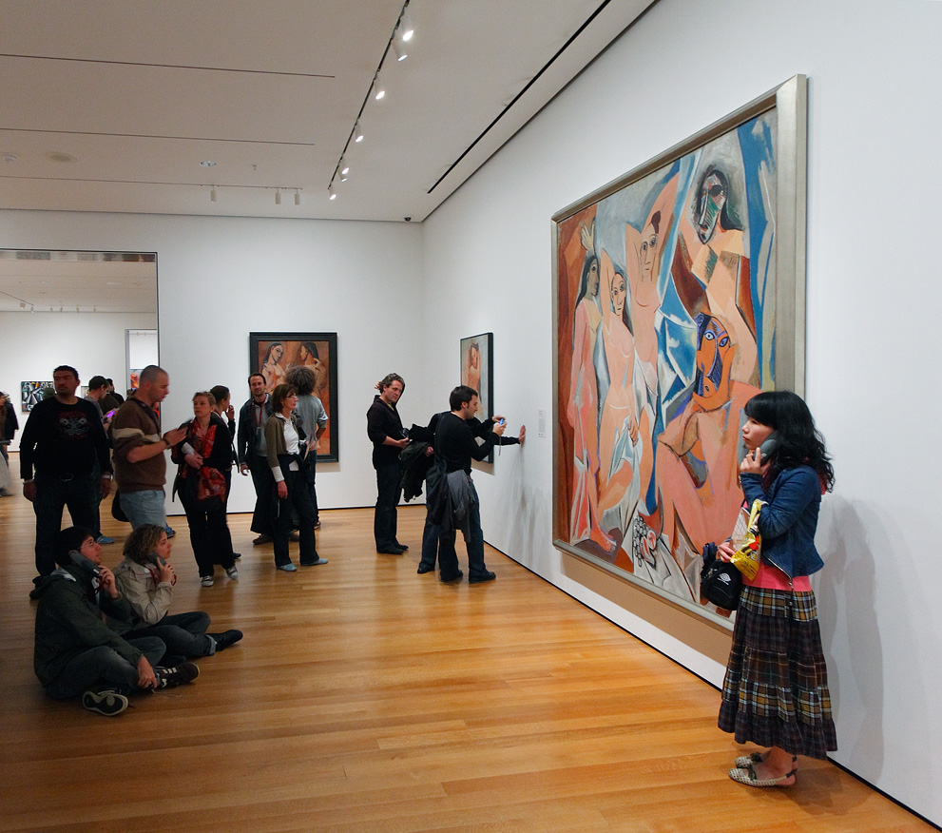
Does art reflect life? Or life reflect art?

Slide 44
Post modernist
Andy Warhol’s famous Campbell Soup Can
1962

Slide 45
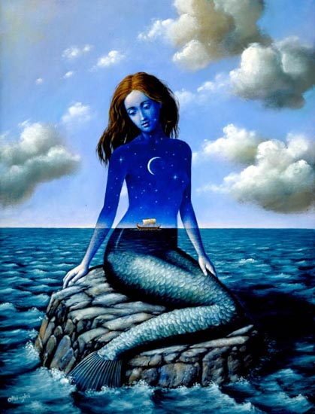
Contemporary art (New art)

Slide 47
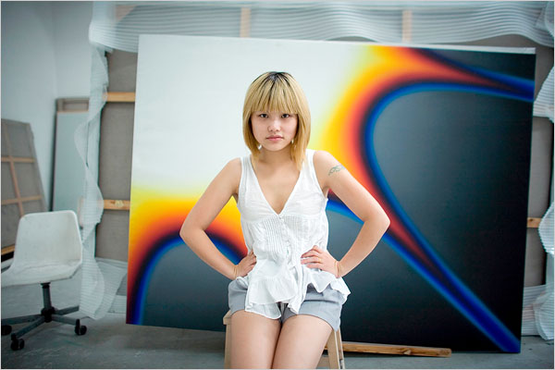

Slide 48
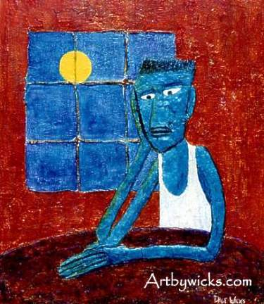

Slide 49
Abstact

Slide 50
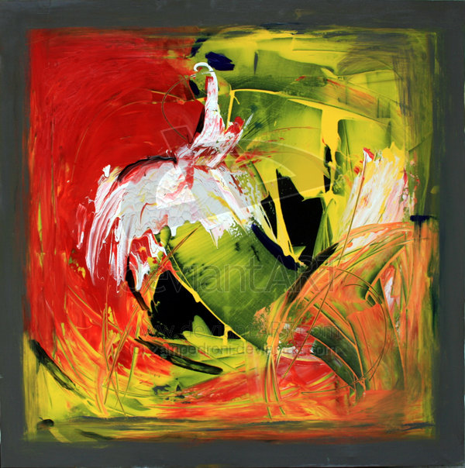

Slide 51
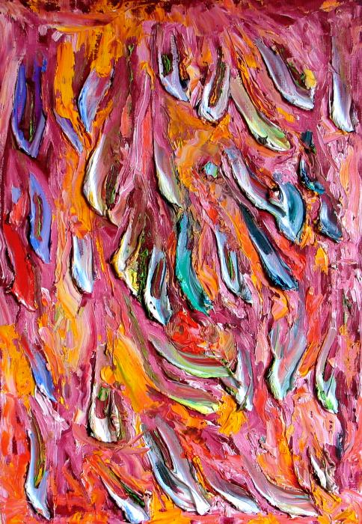
Abstract

Slide 52
Discussion
Which era/style of art do you prefer?
Prehistoric, Classical, Byzantium, Renaissance, Baroque, Rococo, Neo Classicism, Romanticism, Impressionism, Symbolism, Modern, Contemporary, or abstract?

