Slide 1
Hotel Dialogues
Making reservations预定, changing reservations,
check-in 入住 rùzhù and
check out 退房 tuìfáng.
Free other written dialogues and audio files for Hotel procedure at:
http://www.audioenglish.net/english-learning/english_dialogue_hotel_booking_a_room_2.htm
NCIKU.com Is an excellent on-line dictionary. They also have “learning center” on their menu, with a lot of vocabulary and audio files including travel.
Hotel vocabulary quiz: http://www.english-test.net/esl/learn/english/grammar/ai734/esl-test.php
Hotel check-in and check-out dialogue with quiz: http://www.englishclub.com/english-for-work/hotel-check-in-out.htm

Slide 2
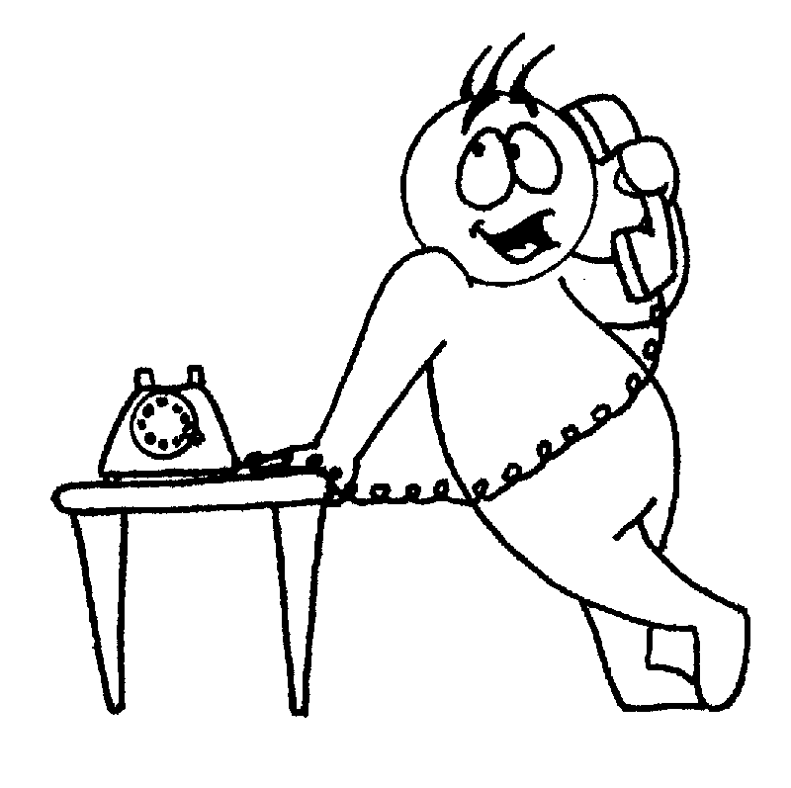
Making a hotel reservation
Reservation clerk (R.C.): Good morning, Hide-A-Way hotel. Room Reservation. May I help you?
Guest (G): Yes, I’d like to reserve a double room from the 4th to the 6th of July. I’d like a room overlooking the park please.

Slide 3
Making Hotel Reservation
R.C. One moment, please… Yes, we have a room available with a view of the park on those dates.
G. Fine. How much is the charge per night?
R.C. Would you like breakfast?

Slide 4
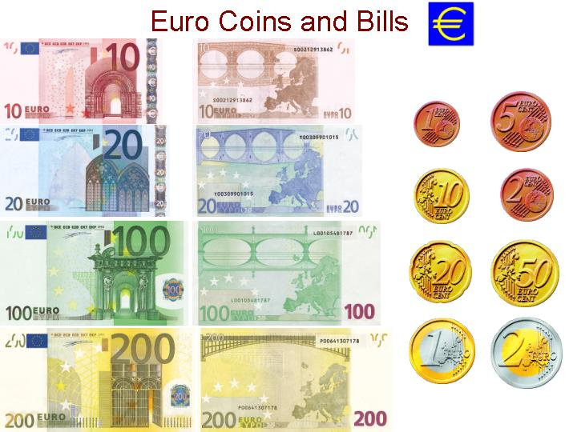
Reservation
G: No, thanks.
R.C. It´s eighty-five Euros per night excluding VAT (See next page for VAT).
G. That´s fine.
R.C. Who´s the booking for, please, madam?
G. Mr. and Mrs. Smyth, that’s S-M-Y-T-H.

Slide 5
VAT 增值税
VAT - Hotel and Transportation
When traveling abroad, Value Added Tax (VAT) is added to most Hotel and Transportation invoices. Such VAT incurred on Hotel and Transportation is refundable, to most North American companies, from the following countries:
Austria, Denmark, Finland, Germany, Japan, The Netherlands Sweden, United Kingdom
Original invoices have to be submitted to reclaim the VAT back.
Some companies specialize in helping others recover their VAC money:
http://www.eurovat.com/hotel.htm

Slide 6
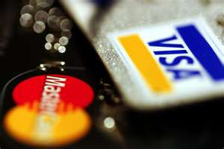
Making A Reservation
R.C. Okay, let me make sure I got that: Mr. and Mrs. Smyth. Double with bath for July 4th to the 6th. Is that correct?
G: Yes it is.
R.C. Will that be Visa or MasterCard?
G: Visa.

Slide 7
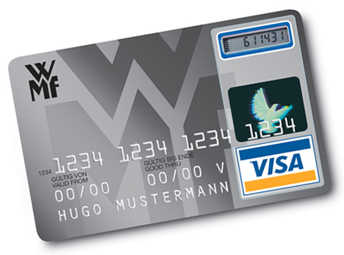
Making a reservation
R.C. May I your card number please?
G: Sure, it’s 0995 9488 9785 1234.
R.C. And the Expiration Date?
G: July, 2015

Slide 8
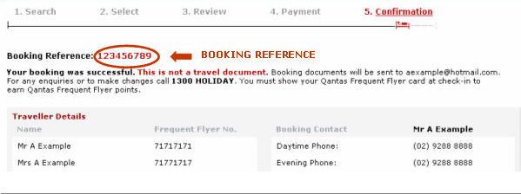
Hotel Reservation
R.C. Very good. Let me give you your confirmation number. It´s: 7576385. I´ll repeat that: 7576385.
If you give me a fax number or e-mail I will send you a confirmation immediately.
G: Yes, my e-mail is mrsmyth@yahoo.com

Slide 9
Making a reservation
R.C. Is there anything else I can do for you today?
G. No, that will be all.
R.C. Thank you for choosing Hide-a-Way Hotel. We look forward to seeing you on the 4th of July. Have a nice day.
G. Goodbye.

Slide 10
Changing a Hotel Reservation
R.C. Great Wall Hotel, may I help you?
G: This is Mr. Smyth calling from Paris. There has been a change in our itinerary (plan, schedule). I’ve reserved a double room for July 4th to the 6th, however need to change that to the 8th to the 10th. Will that possible?

Slide 11
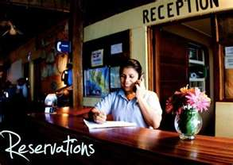
Changing a reservation
R.C. Just a moment, let me check… Yes, that will be fine. May I have your confirmation number please?
G. Yes, it’s 7576385.
R.C. Very good. Is there anything else I can do for you today?
No, that’s all. Thank you very much.
Thank you.

Slide 12
Reservation – Group Discount 折扣
Note: If you’re making a reservation for a group, be sure to ask if there is a group discount. Many hotels offer special rates.

Slide 13
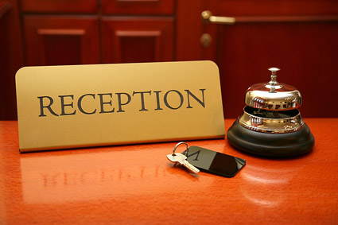
Check-in , check-in 入住 rùzhù
When you arrive at the hotel, a bell-hop 车童 will offer to carry your bags from
the taxi to the lobby. They will probably expect a tip 小费.
Go to the Reception Desk 接待处

Slide 14
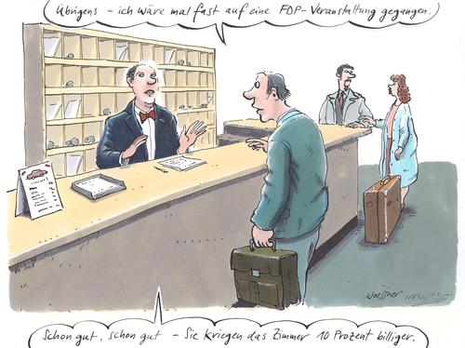
Check-in
G. Hello. I have a reservation for tonight.
Desk Clerk (D.C.) Your name please?
G. Mr. Smyth.
D.C. I’m sorry, we don’t seem to have that in our records.
G. Could you check again please? My confirmation number is 7576385.

Slide 15
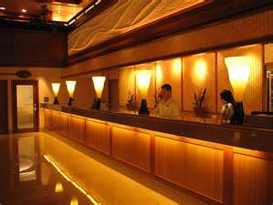
Check-in
D.C. Oh yes. That’s right. My apologies. May I have your passport 护照 hùzhào and Visa card please?
Guest: Sure, here you are.
D.C. Just one moment please…
Very good. Your room number is 1028.

Slide 16
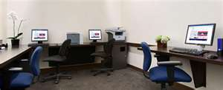
D.C. This is your room key-card.
Complimentary breakfast is served in the lobby between 8 and 10 am.
Our Business Center 商业中心 is on the 4th floor.
The dining room is on the main floor at the end of the hall.
The weight room and sauna are on the top floor.
Just call the front desk if you
need any extra towels or pillows.
Have a nice stay!

Slide 17
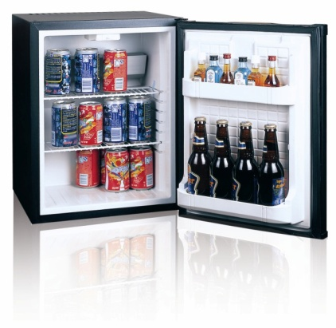
In the hotel room
1. Beware of the hotel room refrigerator (“mini-bar”) with drinks. Each one will cost 5 times the standard price. One small bottle of water may cost $10, 15 or $20.
2. Usually by the phone there will be a hotel telephone book with services like dry cleaning, restaurant(s), wake-up call, etc.
“She left a wake-up call for 7 a.m.”
我把闹铃响的时间设在早上7点

Slide 18
Check-out
At the reception desk…
D.C. May I help you?
Guest: Yes, I would like to check-out.
D.C. Very well Sir. If you’ll wait one moment we’ll prepare it immediately.
Guest: Thank you.
D.C. Here we go. The total is $3,284.65
How would you like to pay?

Slide 19
Check-out
Guest: I’m using a company expense card. Here you go.
D.C. Thank you. Just one moment please.
Very good. Here is your receipt and thank you for staying at the Great Wall hotel. I hope you return in the near future. A bellman will help you with your bags. Goodbye!

Slide 20
Note:
Smaller hotels may ask for a deposit
预付保证金[yù fù bǎo zhèng jīn] before they give you the key, especially if you pay in cash!
Check the receipt 发票[fāpiào] before you leave. Even very respectable hotels sometimes make mistakes.

Slide 21
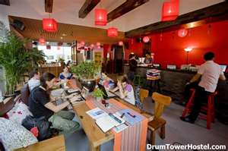
Traveling Cheaply
I sometimes stay at Youth Hostels.
They are nice, clean and very cheap, though you’ll have to share a room with one, two or more people!
They are a great place to meet people, often have a kitchen, and a lot of resources for travelers.

Slide 22
Traveling cheaply! A good trick is to…
Find a cheap hotel on the internet, but don’t make a reservation. Then, go there and walk around the neighborhood. You may well find a cheaper one that’s not on the internet!
I’ve done this many times and it almost always works!

Slide 23
Vocabulary
Reservations预定
Check-in 入住 rùzhù
Check out 退房 tuìfáng
Bell-hop 车童 chē tóng
Tip 小费 xiǎofèi
Reception Desk 接待处 jiēdàichù
Passport 护照 hùzhào
Deposit 预付保证金[yù fù bǎo zhèng jīn]
Receipt 发票 fāpiào

Slide 24
Quiz Questions

