Slide 1
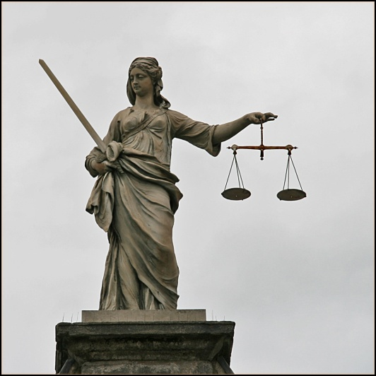
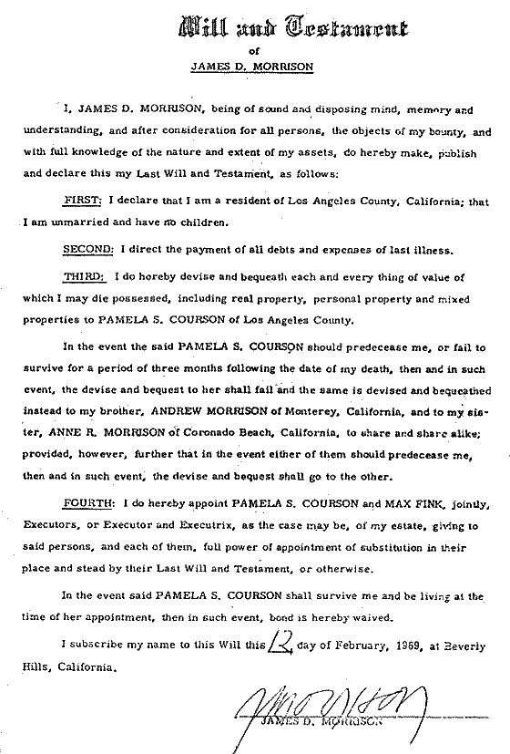
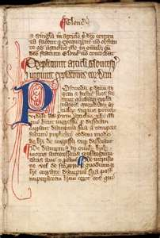
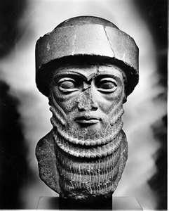
LAW 法律

Slide 2
INTRODUCTION
What are laws?
They are rules 规则 for a peaceful和平
civilized文明的; 有教养的 society 和平共处.
I think it’s a bond 结 between people to help
increase 添加 our freedom 自由.
For example, the law against stealing 盗 increases添加 our freedom自由 to own 拥有 things 东西.
The law against murder 杀害 increases our freedom to live 生活.

Slide 3
If someone:
Steals your i-Pod
and all your money…
Murders your whole family…
How would you feel?
What would you do to that person?

Slide 4
ALTERNATIVES 另外的 TO LAW
Anarchy 混乱 is the alternative to law.
Anarchy might sound like fun to teenagers, but when no-one works, and no-one gets an education…
..millions of people starve to death 饿死 èsǐ. Rape 强奸 and murder 谋杀 become commonplace 平凡.

Slide 5
ALTERNATIVES 另外的 TO LAW
There is also utopia! 乌托邦Wūtuōbāng;世外桃shìwàitáoyuán!
空想社会主义 kōngxiǎngshèhuìzhǔyì]
In a perfect world there is no need for laws, right? But, is utopia possible?

Slide 6
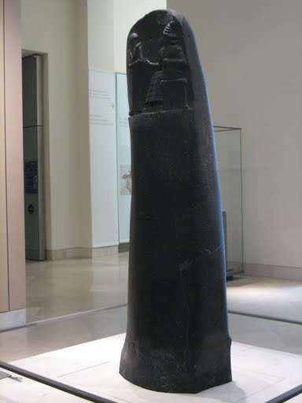
Short HISTORY OF LAW 历史
Code 法律 of Hammurabi
The Code of Hammurabi 汉穆拉比 is a Babylonian古巴比伦 law code, dating to about 1700 BC.
It is one of the oldest writings
in the world.

Slide 7
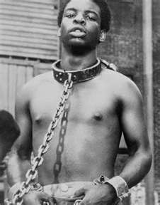
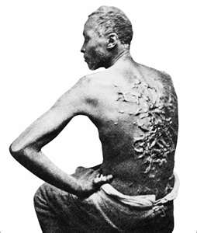
The 6th Babylonian king, Hammurabi, made the code. The Code has 282 laws, with different punishments刑. How much someone was punished 刑 depended据 on their status等级, 身份, for example a slave奴婢 was punished more than a free自由 person.

Slide 8
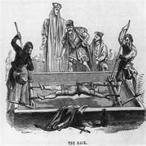
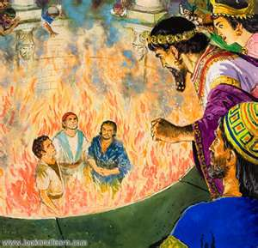
Some of Hammurabi’s laws:
22. If any one is robbing抢走
another person, then he shall be put to death.
53. If any one be too lazy懒惰 to
keep his dam大坝 in working,
and the dam break决堤 and all the fields农作物 be flooded大水, then shall he will be sold卖 for money.

Slide 9
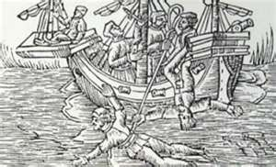
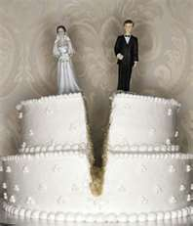
129: If a man's wife be surprised惊讶 having intercourse 性关系 with another man, both shall be tied系, 结, 绑 and thrown into the water, (drowned灭顶) but the husband丈夫 may forgive原谅 his wife老婆 and the king his slaves.
Adultery通奸tōngjiān

Slide 10
195. If a son strike打 his father, his hands shall be cut off. 断线, 阻隔, 斩断
WHAT DO YOU THINK ABOUT THIS?
196: If a nobleman贵族, 君子, 显贵 put out the eye of another nobleman, his eye shall be put out.

Slide 11
What do you think should be the penalty for:
Crimes 罪行zuìxíng
Robbery 抢走 盗 dào?
Murder 杀害 shāhài?
Rape 强奸 qiángjiān?
A son striking 打 his father?
Tax evasion 偷税 tōushuì?
Possible punishments 惩罚 chéngfá
Jail? 监狱 How long?
Execution 处死 chǔsǐ How? Hang 吊死? Shoot? Drowning 溺水，淹死?

Slide 12
The history of religion 宗教[zōngjiào]
…is really the history of law. Amazing!
Each religion created a set of laws that they thought would made a good world.
Mostly they say they say the same thing:
BE GOOD!

Slide 13
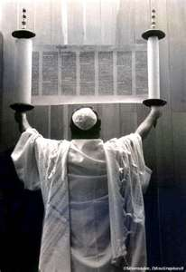
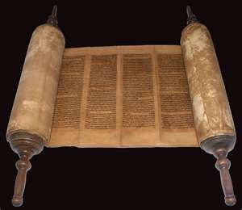
Hebrew 希伯来的 Law, The Torah 律法
According to Jewish犹太 yóutài tradition传说 the Torah was given by God 神 shén to Moses摩西, in 1312 BC at Mount Sinai
The most important laws are these:

Slide 14
Dsf

Slide 15
Christian law 基督教的jīdūjiàode
Christian Law is different from Jewish law.
Jewish law says “an eye for an eye.”
→ Revenge: 复仇 fùchóu
Christian law says “forgive 原谅 yuánliàng people.”
What do you think about revenge?
Year 0 to 35 or so…

Slide 16
Islamic 伊斯兰教的 Law
Islamic law is based on teachings by Mohammed (570-632) and is similar 相似的[xiāng sì de]
to Jewish law because they believe an “eye for an eye.”
But it’s more modern in other ways, because it gives women more rights in some ways.
Islam came later in history and
includes some Roman law.

Slide 17
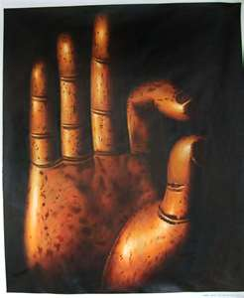
Buddhism 佛教
Buddhism is mainly based on the teachings of Gautama Buddha (486 and 483 BCE ) may be the most peaceful religion because they believe they should never kill anything even
animals, insects 昆虫, and worms 蚯蚓, so they are vegetarian 素食者[sùshízhě].

Slide 18
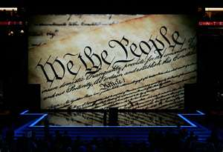
American law
The most important American laws are in the Constitution. 宪法 xiànfǎ

Slide 19
American law is complicated 复杂的 fùzá de because there are many kinds of law, including statutory laws 成文法, state laws 州法律, municipal laws 市政法 and laws based on precedence 优先权 from judges 法官 fǎguān. American courts 法庭 will also consider British Common law 普通法.

Slide 20
SOME MAJOR BRANCHES 分科 OF LAW
Trade Law 贸易法 and
International Trade Law
Tax Law 税法 shuì fǎ
Family Law 家庭法 jiātíngfǎ
Real Estate Law 房地产法 fáng dì chǎn fǎ
Patent Law 专利法 zhuānlìfǎ
Wills 遗嘱 yízhǔ
Criminal Law 刑法 xíngfǎ

Slide 21
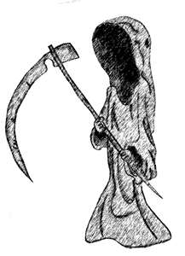

Slide 22
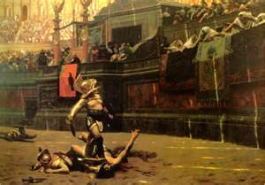
Vocabulary
Law 法律 fǎlǜ
Rules 规则 guīzé
Anarchy: 混乱 hùnluàn
Starve (to death) 饿死 èsǐ
Civilized 文明的 wénmíng de
Peaceful 和平 hépíng
Bond 结 jié
Increase 添加 tiānjiā
Freedom 自由 zìyóu

Slide 23
Steal = rob 盗 dào
Own 拥有 yōngyǒu
Things 东西 dōngxi
Murder 杀害 shāhài
Rape 强奸 qiángjiān
Live 生活 shēnghuó
Code of Hammurabi – ancient 古老的 gǔlǎo de laws from 1700 BC
Babylonian 巴比伦尼亚 bā bǐ lún ní yà
Punishments 刑 xíng

Slide 24
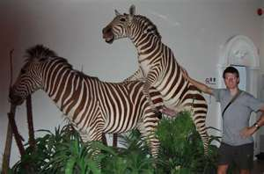
Depending on 依 yī
Status 等级 děngjí
Slave 奴隶 núlì
Lazy 懒惰 lǎnduò
Surprise 惊讶 jīngyà
(very surprised is: astonished)
Intercourse: 性关系 xìngguānxì
Adultery 通奸) tōngjiān
Forgive 原谅 yuánliàng

Slide 25
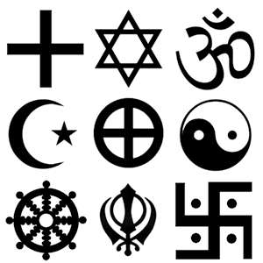
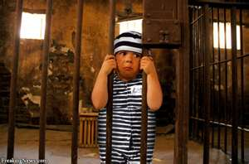
Strike 打 dǎ
Crimes 罪行 zuìxíng
Punishments 惩罚 chéngfá
Jewish 犹太 Yóutài de
God 神 shén
Christian 基督教 jīdūjiào
Islam 伊斯兰教
Buddhism 佛教
Respect 尊敬 zūnjìng
Magna Carta 大宪章 dà xiànzhāng
Court 法庭 fǎtíng
Judge 法官 fǎguān

Slide 26
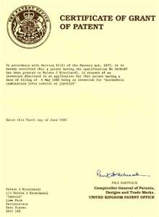
Complicated 复杂的 fùzá de
Branches 分科 fēnkē
Trade Law 贸易法 mào yì fǎ
Tax Law 税法 shuì fǎ
Family Law 家庭法 jiā tíng fǎ
Real Estate Law 房地产法 fáng dì chǎn fǎ
Patent Law 专利法 zhuānlìfǎ
Wills 遗嘱 yízhǔ
Criminal Law 刑法 xíngfǎ

