Slide 1
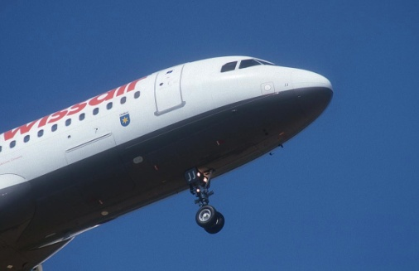
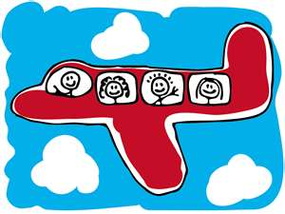
“I’m leaving on a jet plane…” ♪
Language to help you take an international flight 班机[bānjī] .
Airport procedure
Making reservations 预定 yù dìng – changing 改变 reservations –
Airport procedures

Slide 2
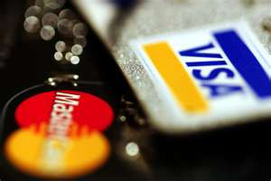
Making reservations 预定
These days a lot of people make reservations on-line 在线.
Sometimes people get great deals便宜的.
Sometimes not!
Of course当然dāngrán, you need a credit card.
Travel agents 旅行代理人 lǚxíngdàilǐrén can sometimes get the best deals too.

Slide 3
Making reservations 预定
Call your travel agent (T.A.) 旅行代理人 lǚxíngdàilǐrén
or preferred airline. 航空公司 hángkōnggōngsī
Traveler: I’d like to make a reservation for a flight to Timbuktu, on December 1st, leaving from Beijing Airport.
T.A: Will that be one-way 单程[dān chéng], or round-trip ticket 往返票[wǎngfǎnpiào]?

Slide 4
Making Reservations (cont.)
Traveler: I’d like a one-way ticket please.
T.A. We have a flight on China Airlines leaving at 5:30 am on December 1st and arriving at Timbuktu at 10:30 pm Beijing time.
Vocabulary:
Leaving at = departing at (Noun → Departure 离去)
Arriving at (noun → arrival)

Slide 5
About Timbuktu

Slide 6
Making Reservations = Booking a flight
T.A. Would you like business or economy?
Traveler: Economy
T.A. And would your prefer a direct flight?
Traveler: Yes, please.
T.A. Would you like a window or aisle seat 靠走道的座位?
Traveler: Window seat please.
T.A. OK, Your flight will leave on December 1st at 5:30 am from Beijing International Airport, airport, arriving Timbuktu, Africa at 10:30 pm Beijing Time, and will be a one-way, economy flight, with a window seat. Is that correct?

Slide 7
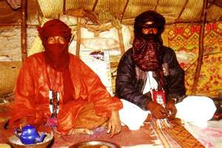
Reservation cont.
Traveler: Yes that’s correct.
T.A. The total flight cost will be 8,840 RMB, and your flight number 航班号，班次 is CN2038
May I have your Visa or MasterCard number please?
Traveler: Yes, that’s Mastercard 888-8888-8888.
T.A. And your card expiration date?
Traveler: Oct, 2014.

Slide 8
Reservation
T.A. please remember that check-in time is two hours before scheduled departure time, and your maximum luggage weight is 20 Kilos.
Traveler: That sounds OK. Thank you.
T.A. We will e-mail a ticket within the hour. Take it with you at check-in and they issue you a boarding pass. Thank you for doing business with Greg’s Travel agency. We hope you have a great trip!

Slide 9
Changing reservations
Traveler: Hello, I have to change my reservation for a flight departing from Beijing to Timbuktu, Mali on December 1st.
T.A. May I have your name and flight number please?
Traveler: Yes, my name is Frank N. Stein and the flight number is CN2038.
Changing reservations
http://www.nciku.com/conversation/listview?place=airport&topic=booking%20a%20flight&by=place&categoryLanguage=en

Slide 10
Changing Reservations
T.A. and when would you like to leave?
I’d like to leave tomorrow if that’s possible.
T.A. Certainly, however the ticket price will be 4,850RMB more. May I have your credit card number?

Slide 11
Changing Reservations
Traveler: Yes, that’s MasterCard 888-8888-8888.
T.A. And your card expiration date?
Traveler: Oct, 2014.
T.A. Very well, the plane will depart September 1st at 10:45 am, arriving at Timbuktu International Airport at 11:59 September 1st Beijing Time. We will e-mail you your ticket within the hour.
Traveler: Thank you!

Slide 12
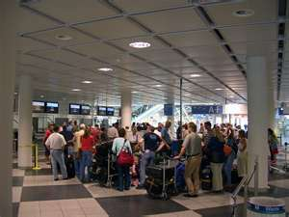
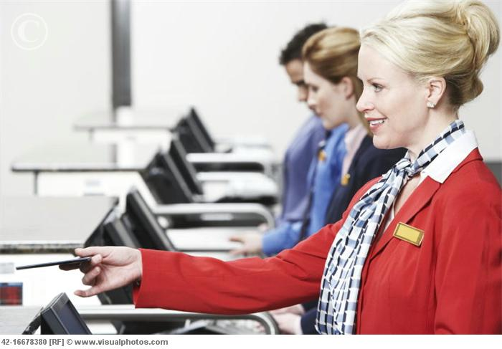
Airport Procedure
Go to the airport a couple of hours before your flight is scheduled to depart.
The first thing you do when you get to the airport is find your airline office and show them your ticket and passport. This is where you check-in 旅客验票台 your suitcases/bags.

Slide 13
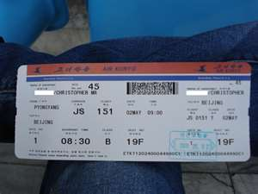
Airport Procedure
Usually you can bring one “carry-on” bag onto the airplane with you. The attendant there will give you a boarding card登机卡.

Slide 14
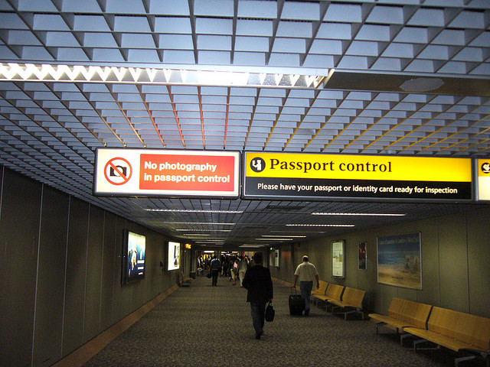
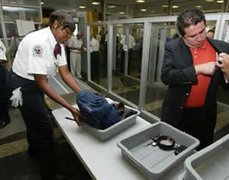
Airport procedure
Next you go through passport control 验照处and put your hand luggage (carry-on bag) through a machine at the baggage check. (There may be a long line so go early.)

Slide 15
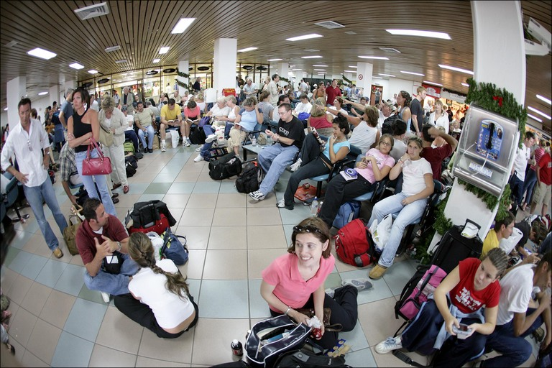
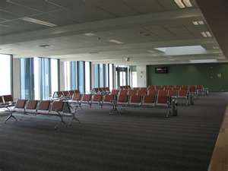
Airport Procedure
In the Departure lounge [候机厅 hòujītīng] you first want to find the gate登机口 from which your plane will leave.

Slide 16
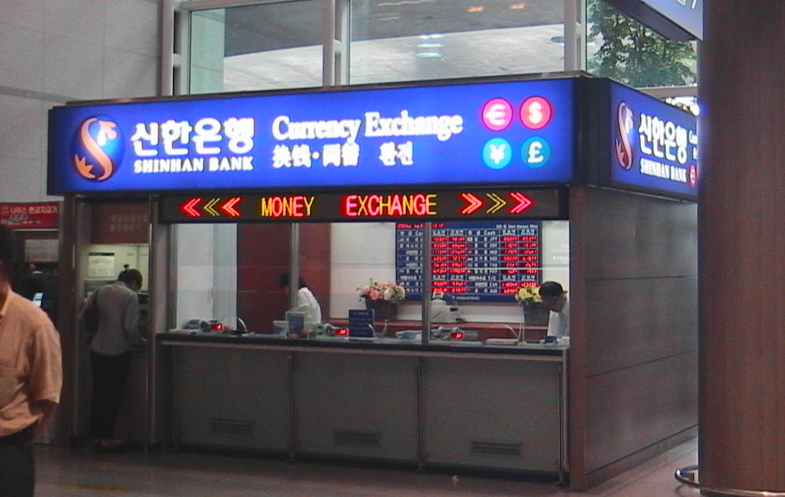
Airport procedure
Then you might want to exchange some money while you wait for your flight to be called for boarding, although airport exchange rates are usually very bad!
Money exchange = currency exchange =
汇兑，货币兑换

Slide 17
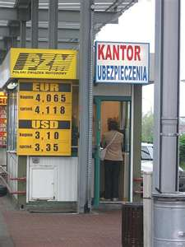
Airport Procedure
Note on currency exchange:
If you’re going somewhere obscure, like Timbuktu, it might be a good idea to exchange some at the airport, because you may need some for a bus or taxi when you depart the plane, before you can find a better exchange rate in the city.

Slide 18
Airport procedure
When your flight is called over the loudspeaker, you go to the gate and show them your boarding card and passport 护照.
Then you just follow the line of other passengers getting on your plane and find your seat.

Slide 19
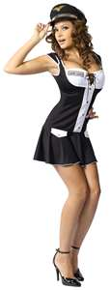
Airport procedures
LAYOVERS (stops along the way to your destination i.e. Beijing to L.A. may have a layover in Hong Kong.)
If you have a layover and it’s less than a few hours, don’t leave the airport. The airlines should forward your luggage行李 to the next flight. Usually you just have to go to the next gate and wait.
But, you can use that time wisely,
by getting some phone numbers.

Slide 20
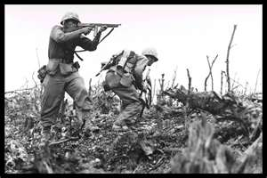
Airport procedure
I usually try to get direct flights, but layover flights are usually cheaper.
Anecdotal evidence: 轶事证据
Once when I was very poor I had to get from Bangkok to Vienna, Austria. I got a ticket on Sri Lanka Airlines, for about $100, with a week stopover in Sri Lanka and one day in Paris. There was a war in Sri Lanka and a transportation
strike 罢工[bàgōng] in Paris.

Slide 21
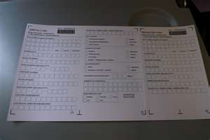
Airport Procedure
Before you get off the plane, the flight attendant will give you an Immigration [移民局检查 Yímínjú] Card to fill out, asking questions about where you will stay and for how long. Fill it out before the plane lands.

Slide 22
Airport procedure
Note about immigration card:
In recent years I’ve noticed many of them have a question about your religion 宗教. You can check: None, or have fun and write one of the following:
Druid 德鲁伊特
Shaman 萨满教僧人；萨满教巫师
Money grubber 小气的人，吝啬鬼
It’s probably not a good idea to write: “Fundamentalist Muslim” – as airport security doesn’t have much of a sense of humor.

Slide 23
Airport procedure
After the plane lands…
Exit the plane
Follow the line of passengers as they go to Immigration.
At immigration they will ask you:
how long you intend to stay in the country you are visiting,
where will you stay,
what is the purpose of your visit
then they stamp your passport with an Entry Visa 入境签证 (or send you off to prison!)

Slide 24
Dialogue Exercise
Immigration Officer: How long will you stay in Mali?
Visitor: Six weeks.
Immigration officer: What is the purpose of your visit?
Visitor: I’m an archeologist working on a research a research project.
Immigration officer: Where will you be staying? have a reservation at the Hilton Hotel.

Slide 25
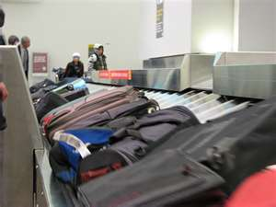
Airport procedure
Next follow the line of passengers to the luggage carousel where you usually have to wait a few minutes to get your suitcases.

Slide 26
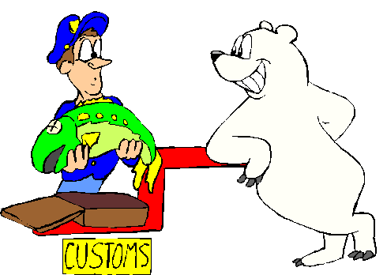
Airport procedure
Remember that after retrieving your luggage from the baggage carousel, you have to pass through the customs. 记住，从传送带上取回行李后，还要办理通关手续

Slide 27
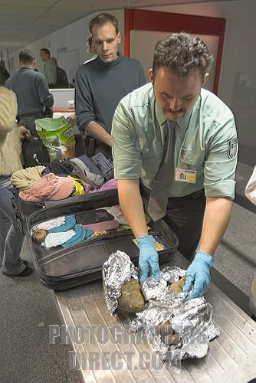
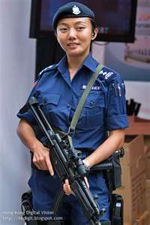
Airport Procedure
Follow the other passengers to customs 关税 guānshuì. They may ask you to open your suitcases. They usually ask you if you have anything to declare 报关. The answer is “No” unless you are bringing in more than $10,000, or an animal or something.

Slide 28
Dialogue
Customs officer: Do you have anything to declare?
Visitor: Yes, I have $1,000,000 in dirty money from organized crime I hope to launder in your country.
Customs officer: Please wait one moment while I call security.
Organized crime: 有组织犯罪辛迪加
[yǒu zǔ zhī fàn zuì xīn dí jiā]
Money laundering: 洗黑钱[xǐhēiqián

Slide 29
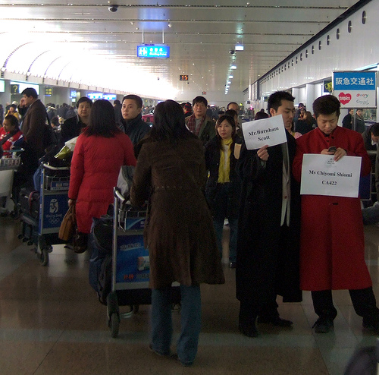
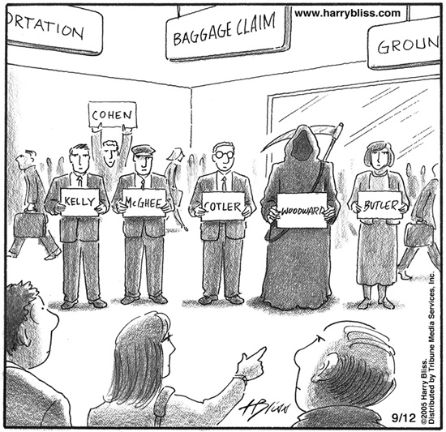
Airport procedure
If someone is waiting for you they will probably meet you just outside the Customs area. If no-one is meeting you, you’ll probably want to go to tourist information or the airport bookstore and get some local maps.

Slide 30
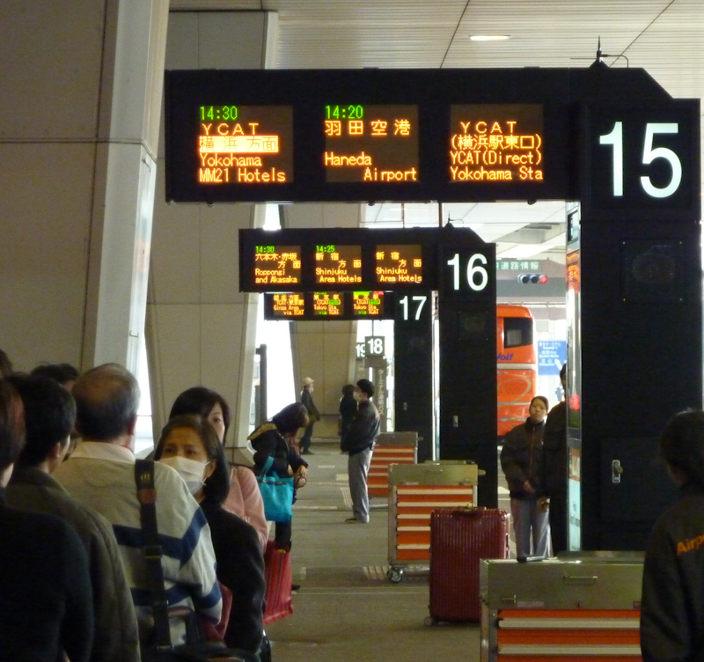
Airport procedures
Then there is usually a shuttle bus from the airport to the nearest major town or city.
At this point you’ll probably want to get a taxi to take you to a hotel.

Slide 31
Air flight Vocabulary
Making reservations 预定 yù dìng
= Booking a flight 班机[bānjī] .
Changing 改变 reservations
on-line 在线
Travel agents 旅行代理人 lǚxíngdàilǐrén
One-way 单程 dān chéng
Round-trip 往返票 wǎngfǎnpiào
Leaving at = departing at (Noun → Departure 离去)
Arriving at (noun → arrival到达[dàodá] )

Slide 32
Air Flight vocabulary
Business class (Expensive seats): 头等舱
Economy (cheap seats): 经济舱
Direct flight: 直航
Layover: 转航
Flight number 航班号，班次
Expiration Date：截止日期
Check-in 旅客验票台[lǚkèyànpiàotái]
Boarding card 登机卡
Passport control 验照处

Slide 33
Air Flight Vocabulary
Departure lounge 候机厅 hòujītīng
Money exchange = currency exchange =
汇兑，货币兑换
Passport 护照[hùzhào]
luggage行李
Strike 罢工bàgōng
Immigration [移民局检查 Yímínjú]
Entry Visa 入境签证

Slide 34
Air flight Vocabulary
Customs 关税 guānshuì
declare 报关
Organized crime: 有组织犯罪辛迪加 yǒu zǔ zhī fàn zuì xīn dí jiā
Money laundering: 洗黑钱xǐhēiqián
Shuttle bus: 区间公共汽车

