Slide 1
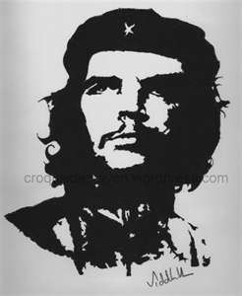
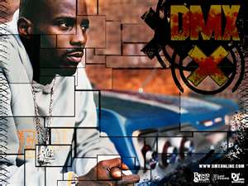
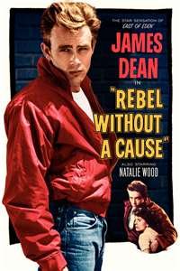
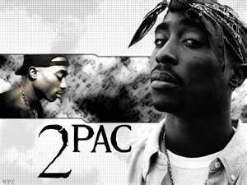
Teen Rebel 青少年反叛
Fight the power!
Teenager: qīng​shào​nián​

Slide 2
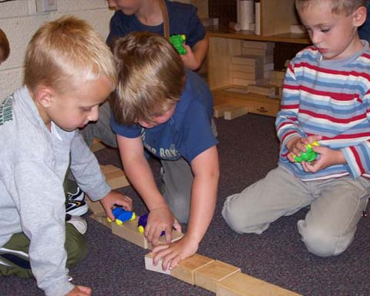
When children are between ages 4 – 7 they learn a lot. They learn how to share分享, how to play cooperatively 合作, and how to follow the rules规则.
These are generally good things.
2 & 3 year olds can’t do that (the terrible 2s!
Do you have younger brothers or sisters?
For 2 & 3 year olds, it’s ALL ABOUT ME, ME, ME!

Slide 3
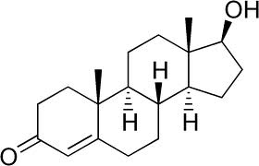
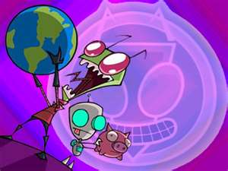
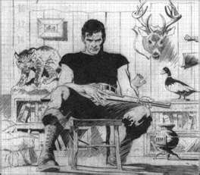
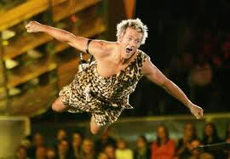
But, between ages 12 – 14 they become teenagers. Hormones 雄性激素 suddenly start jumping around, and they often become rebels反叛.
This can be good or bad.
Testosterone

Slide 4
Save the dolphins! 海豚 hǎi​tún​

Slide 5
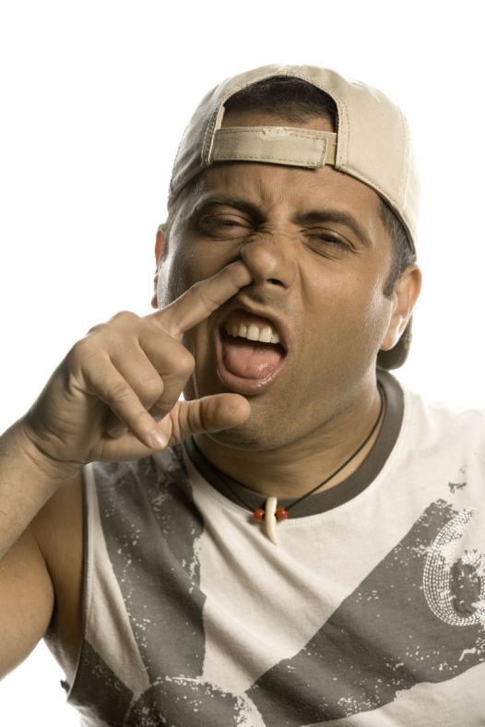
As part of the development发展 into young adults 成人, teenagers must develop an identity身份 independent自主 from their parents and an ability to make independent decisions 决定.

Slide 6
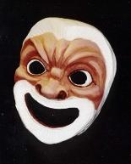
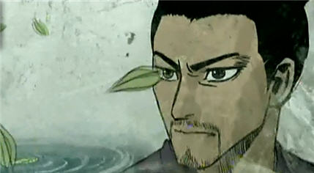
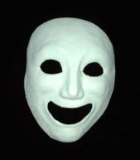
They experiment 试验 with different roles 装, behaviors 行为, and ideologies 思想 as part of their process 经过 of developing a unique 特制 independent自主 identity真面目.
Teenage rebellion 变 happens in all races人种, cultures 文化, and classes 阶级. It’s a natural thing.

Slide 7
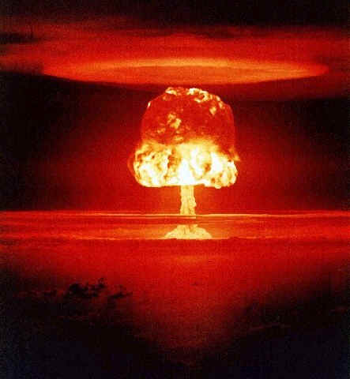
But, like I said before, some rebellions are good, some are bad.

Slide 8
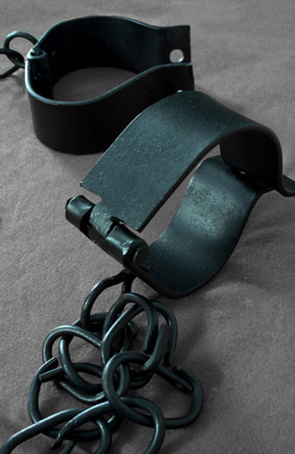
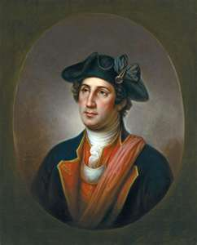
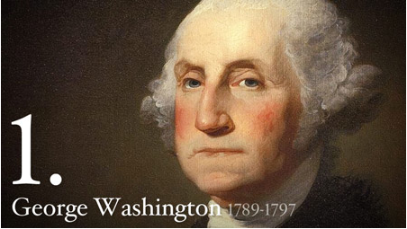
For example, the first American President
总统 George Washington 华盛顿 was the General 将 of an armed rebellion 叛乱 that fought 战 against the British army 英军 because they wanted independence 独立战争 from the English; not to be a colony 殖民地 of England.
REBEL 反叛!
Young George Washington

Slide 9
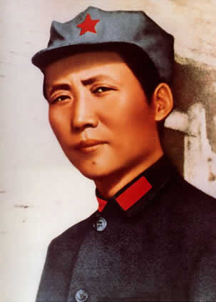
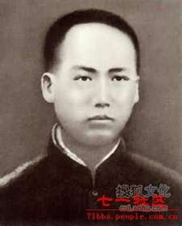
This is much the same as the young Mao Zi Dong, who was also the general将 of a rebel army叛乱 that fought战 against many foreign invaders侵入者 because they wanted independence 独立战争; not to be a colony 殖民地 of foreign countries.
Young Mao Zidong
REBEL! 反叛

Slide 10
Save the dolphins!

Slide 11
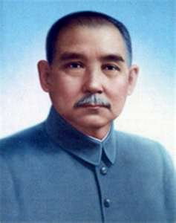
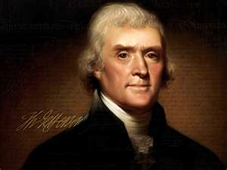
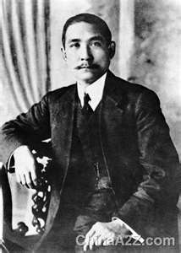
Though history always puts great generals 将 first, I personally admire 尊崇 Sun Yat Sen 孙中山 in China, and Thomas Jefferson in the U.S. the most.
So, some rebels 反叛 are great!

Slide 12
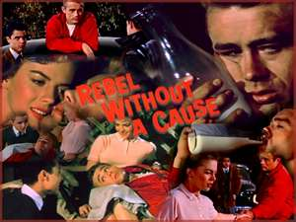
But, some rebels are just stupid二.
James Dean was a famous American rebel. He was a movie actor and made a very famous movie called: Rebel without a cause.
He liked to drive fast cars and drink a lot of alcohol. People warned 提醒 him not to drive so fast, but he didn’t listen and he died in a car crash when he was very young. This is a sad but true story of a teen rebel.

Slide 13
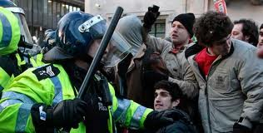
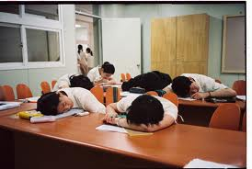
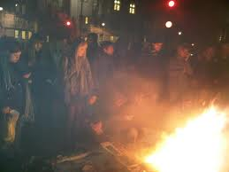
Of course, now in China and the U.S. people have a lot of freedom 自由, and foreigners do not control our countries. So, teens sometimes don’t know what to rebel against.
So, they often just rebel against parents, teachers, and society 社会 in general.

Slide 14
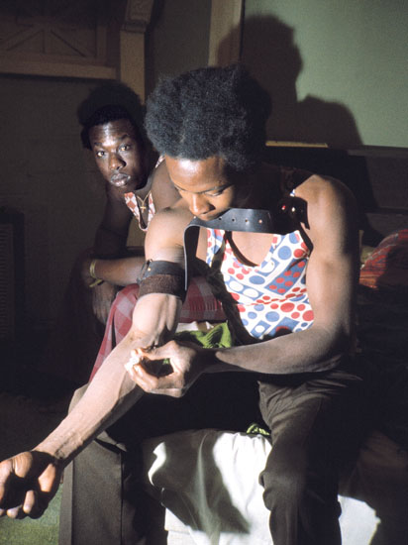
That’s an easy rebellion. You punish 处罚 your parents and teachers by doing nothing in school or just doing badly. Play games all night and sleeping through class is the coward’s 孬种rebellion变 . It’s the same as drug addiction. 毒瘾

Slide 15
So, what is a good rebellion? Here are some questions to ask yourself.
Thoughts FOR REBELS 反叛
What good will come of this rebellion 变? (Will it help 帮助 me or anyone?)
Is this the smartest 聪明 rebellion I can do, or is it stupid?
When I am older, will I be proud 自豪 or embarrassed 尴尬 by this rebellion?
What would be a good rebellion now?

Slide 16
How about… Save the Dolphins?

Slide 17
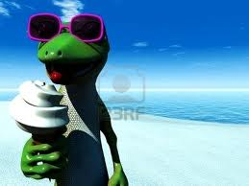
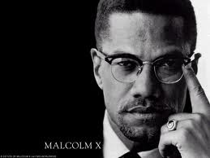
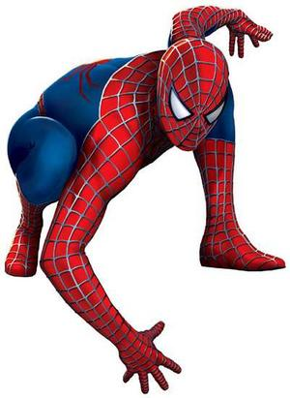
And some other ideas:
Be unique 特制 by being the best 最佳 ​ at what you do.
Copying 效 other people is a boring 无聊 没有意思 rebellion.
For me, I want to be smart and strong.
So, I have to eat gooooood food.
I would start my rebellion by eating better than anyone else!

Slide 18
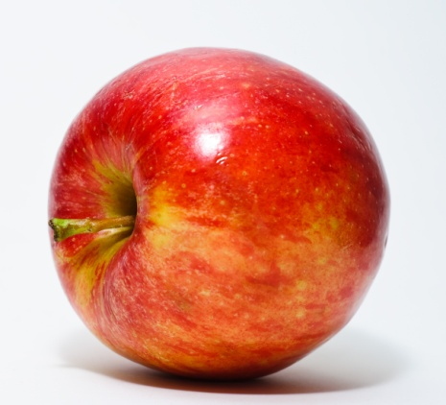
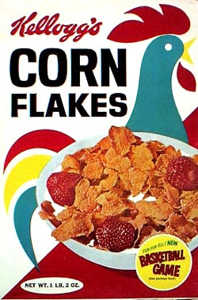
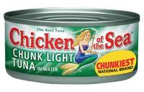
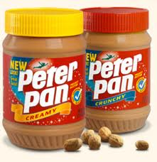
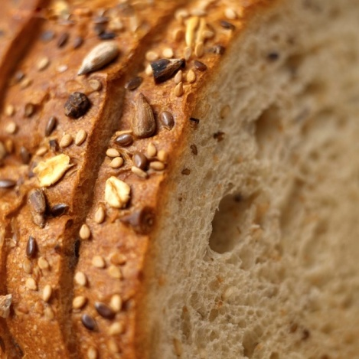
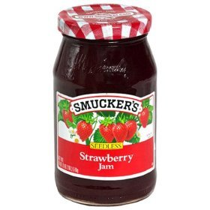
I’d bring from hom:
…a bag of different fruits 水果 to school.
… a jar of peanut butter 花生酱 and jam 果酱
and whole wheat bread 麸皮面包
….cans of tuna fish 吞拿 金枪鱼
… and other healthy
foods

Slide 19
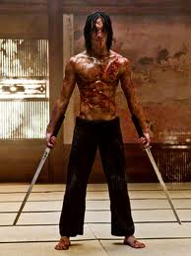
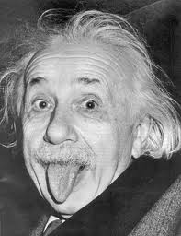
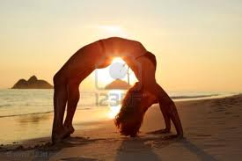
I’d go to Greg’s Martial Art 武术 Club
and become a real Martial Art Master
奇能异士 qí​néng​yì​shì​
I’d choose one thing in school to become
really, really good at.
I’d sleep earlier and wake up earlier than anyone else & do Yoga.
Work for a cleaner and more beautiful environment 周围环境 – everywhere.

Slide 20
And, save the dolphins!

Slide 21
I’d read the newspaper 时报 or watch the news every day so I know what’s going on the world.
Try to spend a little more time with mom and dad (if possible) because though they may seem stupid and boring, they might surprise you sometime！
如果可能的话和你的父母多在一起，因为尽管他们看上去有点傻和 无聊，他们有时也会给你带来意想不到的收获！

Slide 22
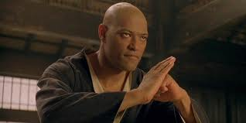
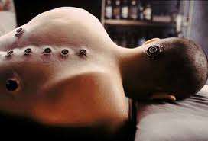
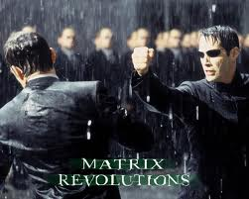
UNPLUG FROM THE MATRIX
Try some REAL WORLD STUFF>>><<<

Slide 23
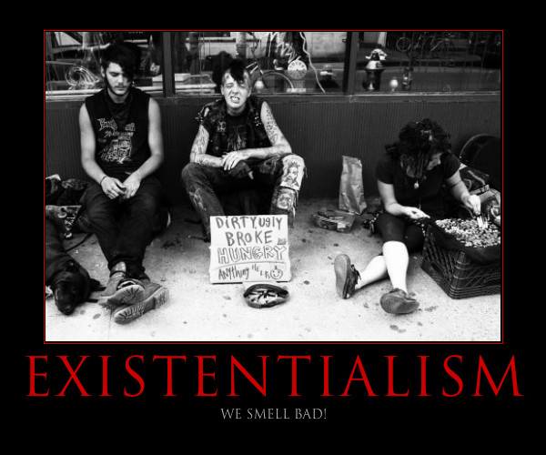
I’M SO BAD!
I’m so bad
I’m so cool
So buck the teacher
and buck the rules! (Buck = go against)
Fight the machine
Live MY dream
Play games all night
And sleep though school
Good boy, nice boy (or good girl, nice girl)
Just ain’t me (ain’t = isn’t)
Live fast, live tough tough: 坚韧, 牛皮, 最牛
Born to die free Born: 诞生, Die 死亡, Free 自由 zì​yóu​
I got money,
I got fame
Why do I need
To play this stupid game?

Slide 24
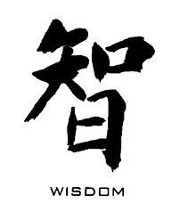
WISER 吃一堑，长一智
My friends tell me
It’s cool to sleep through school
Well I don’t know but…
I think they’re stupid fools
They’re living in a dream world
Never really awake
Can’t handle true reality Reality 实际
So they live the big escape Escape: 避, 逃
They’re just burning daddy’s money Burn: 燃烧
Thinking it’s a joke Joke: 笑话
But the laugh will be on them
When they end up broke! Broke: 不名一文

Slide 25
DISCUSSION
What is an issue 问题 that you really care about and think is important in your life, the school and the world?
How can you make the school, the world and yourself better?

Slide 26
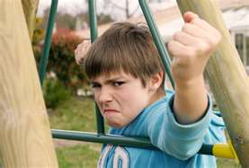
Professional non-learners (PNL) 不想 学习
(Advanced negative rebels – maybe 5% of students)
These interesting and complex 复杂 individuals don’t want to learn, and work very hard to make sure nobody else can learn either.
Why?
Anger usually at a parent.
Misery loves company.
Extreme inferiority complex
→ 自卑心理 → 自卑情绪
Making the teacher feel bad makes the PNL feel good!

Slide 27
Don’t forget: Save the dolphins!

Slide 28
Strategies手段 of the Professional non-learners 不想 学习
Denial: I did my homework! I don’t sleep in Class! I don’t play games in class! (Lies! 谎)
Triangulation:否定
1 parent or teacher
The other parent or a school principal
Student tries to provoke 挑起
conflict 冲 突
between parents or teachers/
principal
To dad: Mom said…
To Principal: The teacher is boring, bad, not-prepared!
Student
Usually bullies 欺凌 other students too!

Slide 29
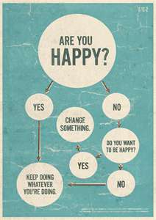
The good news is…
By age 18 – 22 or 23, most people get bored 无聊 of the rebel 反叛 stage of life 步!
They want so succeed 成功 and realize 体会 that rebellion 谋反 usually doesn’t help!

Slide 30
VOCABULARY
Share 分享 fēn​xiǎng​
Cooperate: 合作 hé​zuò​
Rules: 规则 guī​zé​
Hormones 雄性激素 male hormone / testosterone
Teenager: 青少年 qīng​shào​nián​
Rebel: 反叛 fǎn​pàn​
Development: 发展 fā​zhǎn​
Adult: 成人 chéng​rén​
Identity 身份 shēn​fèn​
Independent自主 zì​zhu​
Decisions 决定 jué​dìng​

Slide 31
Experiment 试验 shì​yàn​
Role: 装 zhuāng​
Behaviors 行为 xíng​wéi​
Ideologies 思想 sī​xiǎng​
Process 经过 jīng​guò​
Unique 特制 tè​zhì​
Identity真面目 zhēn​miàn​mù​
Rebellion 变 biàn​
Race 人种 rén​zhǒng​

Slide 32
Cultures 文化 wén​huà​
Classes 阶级 jiē​jí​
President 总统 zǒng​tǒng​
George Washington: 华盛顿 Huá​shèng​dùn​
General 将 jiàng​
Armed rebellion 叛乱 pàn​luàn​
Fight/fought 战 zhàn​
British army 英军 Yīng​jūn​
Invaders侵入者 qīn​rù​zhě​
War of independence 独立战争 dú​lì​zhàn​zhēng​

Slide 33
Colony 殖民地 zhí​mín​dì​
Coward 孬种 nāo​zhǒng​
Rebellion 变 biàn
Drug addiction 毒瘾 dú​yǐn​
Smartest 最为 (most) 聪明 cōng​ming (smart)​
Proud 自豪 zì​háo​
Embarrassed 尴尬 gān​gà​
Help帮助 bāng​zhù​
Admire 尊崇 zūn​chóng​

Slide 34
Best 最佳 zuì​jiā​
Copying 效 xiào​
Unique 特制 tè​zhì​
Boring 无聊 wú​liáo​ 没有意思 méi​yǒu​yì​si​
Peanut butter 花生酱 huā​shēng​jiàng​/ 花生醬｜花生酱
Jam 果酱 guǒ​jiàng​
Whole wheat bread 麸皮面包 fū​pí​miàn​bāo​
Tuna fish 吞拿 tūn​ná​ 金枪鱼 jīn​qiāng​yú​
Martial Art Master 奇能异士

Slide 35
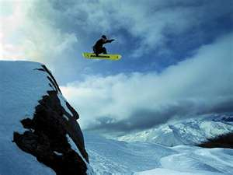
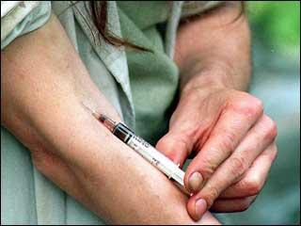
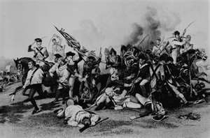
Environment 周围环境 zhōu​wéi​huán​jìng​
Newspaper 时报 shí​bào​
Issue 问题 wèn​tí​
Reality: 实际 shí​jì​
Escape 避, 逃 táo​
Joke: 笑话 xiào​huà​
Burn: 燃烧 rán​shāo​

Slide 36
Remember: Save the dolphins!

Slide 37
Endangered species 濒危物种 bīn​wēi​wù​zhǒng​
The Chinese alligator or Alligator simplified Chinese: 扬子鳄, (yáng zǐ è) is one of two known living species of Alligator, a genus in the family Alligatoridae. The Chinese alligator is native only to China.
IS REALLY ENDANGERED!
http://en.wikipedia.org/wiki/Endangered_species

