Slide 1
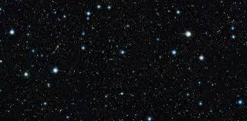
Start 开始
Please repeat after me 请在我之后重复
Qǐng zài wǒ zhīhòu chóngfù
2.
One star. 一星。
Two stars. 两颗星
Three stars. 三颗星
Millions of stars! 数百万颗星！
1. Stars星 (starz)
3.
Learning English!
学习英语
With phonics practice与语音练习

Slide 2
Self-Introduction 自我介绍 zì​wǒ​jiè​shào
请在我之后重复。Please repeat after me. (Qǐng zài wǒ zhīhòu chóngfù.)
你好。我的名字是_____________
Hello. My name is __________ (Hel-lo mai nam iz ___)
我来自 ___________
I am from ____________. (Ai am from ____)
您的城市 your city (si-tee)

Slide 3
Dialogue对话 Duìhuà
A: 很高兴认识你 It’s nice to meet you.
Itz nais 2 mit yu.
B: 也很高兴认识您。 Nice to meet you too.

Slide 4
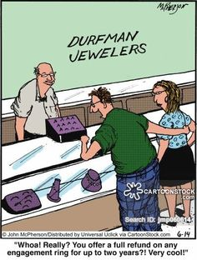
Shopping 购物 Gòuwù
Beautiful! 美丽！Měilì
Be-yu-tee-ful
How much is it? 多少钱？
Hao muc iz it?

Slide 5
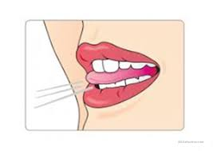
Counting 算数
One 一
Two (tu) 二
Three 三
Four (For) 四
Five (faiv) 五
The “Th” sound. “ Th”声 shēng
Thank you!谢谢！
This 这个 Zhège
That 那 Nà
Those 那些 Nàxiē
Them 他们 Tāmen
Thirty three (33)三十三
Three hundred thirty-three 333 三百三十三

Slide 6
Counting 计数 /算数
六 Six (Siks) 6
七 Seven (sevin) 7
八 Eight (eit) 8
九 Nine (nain) 9
十 Ten 10

Slide 7
Counting 计数 /算数
十一 Eleven (ee-le-vin)
十二 Twelve (tu-el-v)
十三 Thirteen (Thir-teen)
十四 Fourteen (For-teen)
十五 Fifteen (Fif-teen)

Slide 8
Counting 计数 /算数
十六 Sixteen (siks-teen)
十七 Seventeen (seven-teen)
十八 Eighteen (eit-teen)
十九 Nineteen (nain-teen)
二十 Twenty (tu-en-tee)

Slide 9
Counting 计数 /算数
20点以后用英语计数很容易。After 20 counting in English is easy.
二十一 Twenty one
二十二 Twenty two
二十三 Twenty three
二十四 Twenty four
二十五 Twenty five
二十六 Twenty six
二十七 Twenty seven
二十八 Twenty eight
二十九 Twenty nine
三十 Thirty

Slide 10
Counting 计数 /算数
三十 Thirty
四十 Forty
五十 Fifty
六十 Sixty
七十 Seventy
八十 Eighty
九十 Ninety
一百 One Hundred

Slide 11
Counting 计数 /算数
一百零一 One hundred and one
一百零二 One hundred and two
一百零三 One hundred and three
一百零四 One hundred and four
一百零五 One hundred and five
一百零六 One hundred and six
一百零七 One hundred and seven
一百零八 One hundred and eight
一百零九 One hundred and nine
一百一十 One hundred and ten
一百一十一 One hundred and eleven
以此类推到200 And so on till 200

Slide 12
以下是什么数字？ What are the following numbers?
A. 12 _________
B. 29 _________
C. 303 _________
D. 333 _________
E. 100 _________
F. 999 _________
1,000 = One Thousand

Slide 13
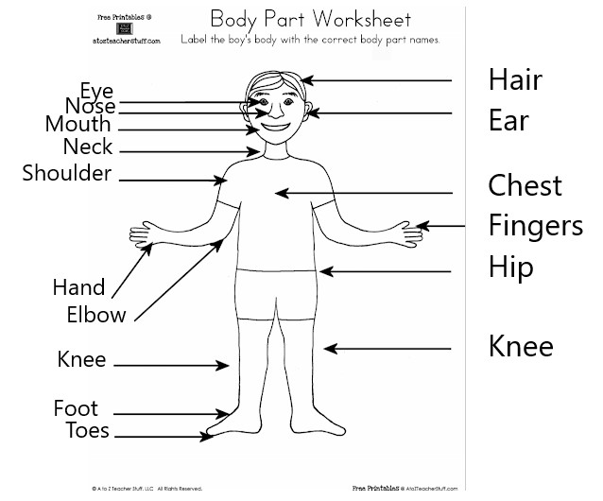
身体部位Body Parts

Slide 14
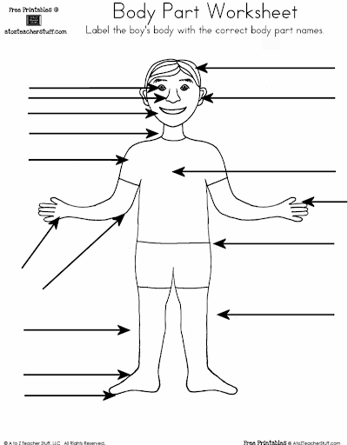
身体部位评论Body Part Review

Slide 15
Ordering food in a restaurant
Menu菜单
Order food 点餐
Salad 萨拉德
Soup汤
Beef牛肉
Chicken鸡
Fish鱼
Rice白饭
Noodles面条
Drink 饮料
Tea 茶
That’s all 仅此而已
A. 我可以看看菜单吗？ May I see the menu please?
B. 想点什么？What would you like to order?
我想要这个。 I would like rice with beef.
您还要喝一杯吗？Would you like a drink also?
A. 是的，请给我们一些热茶。Yes, please give us some hot tea.
B. Would you like anything else?
A. 就这样，谢谢。That’s all, thank you.

Slide 16
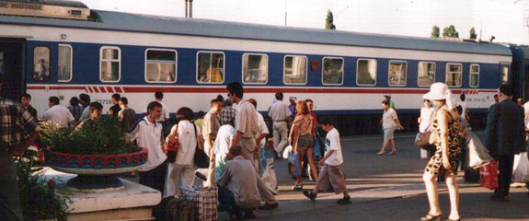
Buying a ticket at the train station
A. 我想要一张去阿拉木图的票。I would like a ticket to Almaty please.
B. 我可以看看你的护照吗？ May I see your passport?
这个给你。Here you are.
您想什么时候离开？ When would you like to leave?
A.下一班火车。 The next train please.
B. 那将是12,732.24坚戈。 That will be 12,732.24 Tenge please.
这个给你。 Here you are.
这是你的票。 一路顺风。
Here is your ticket. Have a nice journey.
A.谢谢。 Thank you.

Slide 17
有用的短语 Useful phrases
你好 Hello
谢谢 Thank you
对不起 Excuse me
洗手间在哪？ Where is the toilet?
什么时间离开？ What time does it leave?
我们将在几点抵达？ What time will we arrive?

Slide 18
你从哪里来的？Where do you come from?
人们经常问我：“你来自哪里？”People often ask me: “Where do you come from?”
有时我会回答：“我来自星星。”Sometimes I answer: “I came from the stars.”
那可笑吗？Is that ridiculous?
不，这是简单，诚实和真实的。No. It’s simple, honest and true.
真？Really?

Slide 19
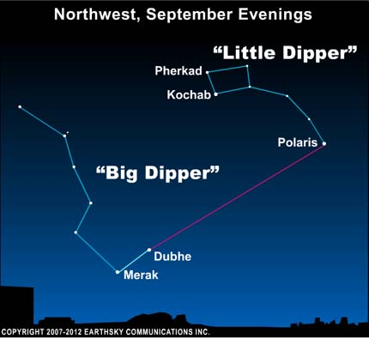
多元宇宙起源于大约148亿年前。 The multiverse originated about 14.8 billion years ago.
地球是一块破碎的恒星，它冷却了。The earth is a piece of broken off star that cooled down.
我们来自地球。We came from the earth.
因此，我们最初来自星星。Therefore, we originally came from a star.
要在星空中找到回家的路，请寻找北极星。 上面是找到它的地图。
To find your way home in the stars look for the North Star. Above is a map to find it.

Slide 20
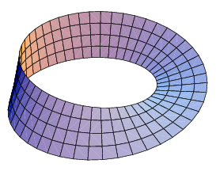
如果时间就像一条莫比乌斯长条 If time is like a Mobius Strip
谁能说出它真正的开始和结束？
Who can say where it really begins and ends?

