Slide 1
Movie Reviews
How to review a movie

Slide 2
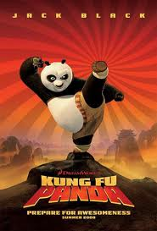
1. What is the genre类型?
Action动作片
Comedy喜剧
Romance 爱情
Thriller 惊险
Horror 惊悚
Drama戏剧
Science Fiction科幻 [kēhuàn]
What kind of movie was this?

Slide 3
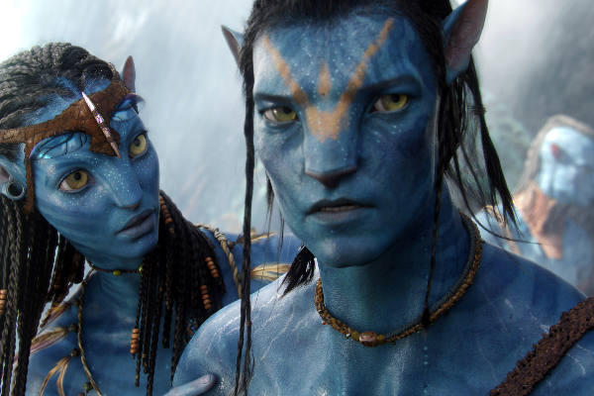
How to write it…
The plot…剧情 jù​qíng​
What is the movie about?

Slide 4
The Protagonist 主人公zhǔ​rén​gōng​
Who is the protagonist? The protagonist the hero or main character.
Who is the antagonist?
敌手 dí​shǒu​
What is the conflict? 冲突?
Corrupt腐败 fǔbài

Slide 5
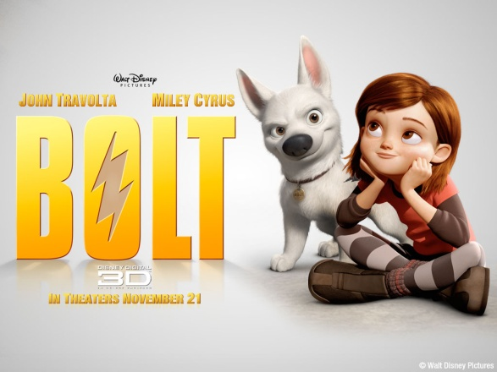
Sample review
Action
This ______________ action movie is about….
(violent 暴力? dramatic 戏剧性? powerful 强? brilliantly directed导演 [dǎoyǎn] )
Romance
This ______________romance movie is about….
(beautiful, wonderful, touching 打动, low quality)
Thriller
This ______________ thriller is about….
(suspenseful悬念 [xuánniàn] , thought provoking 刺激性, idiotic)

Slide 7
Movie REVIEW: STEP UP #3 D
IN this dramatic action dance movie, the protagonist is a man named __________who runs a large dance school and night club in New York. But, he has money problems and needs his crew 组 [zǔ] to win a…
… big dance contest较量 to have enough money to keep the school.
Rent:

Slide 8
After that…
He meets a beautiful dancer girl ________ and falls in love with her. But, she gives a video of their dance routine to the antagonists _____________ because the leader is her brother.
Later she regrets后悔hòuhuǐthis and has an argument 闹翻 nào​fān​ with her new love.
In the end, they win the big contest and the lovers are reunited.

Slide 9
Review of ____________
In this ____________ ___________ movie, the protagonist ___________
______________________________
The antagonist _____________
The conflict_______________
In the end, the _____________.

Slide 10
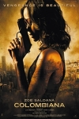
Review 2011
In the action film "Colombiana", Cataleya, a young woman grows up to be an assassin after witnessing the murder of her parents as a child. Though working for her uncle she remains focused on her ultimate goal: to hunt down and get revenge on the mobster responsible for her parents' deaths.
Who is the protagonist?
Who are the antagonists?
What is the conflict?
How do you think it ends?

