Slide 1
Directions, Finding Places and Transportation 方向、地点和交通
English-Chinese Handbook for Martial Art Coaches
武术教练中英文手册
草案2020年9月10日 PPT 3
How to find what you need to find, and get to where you need to go
如何找到你需要找到的，并到达你需要去的地方

Slide 2
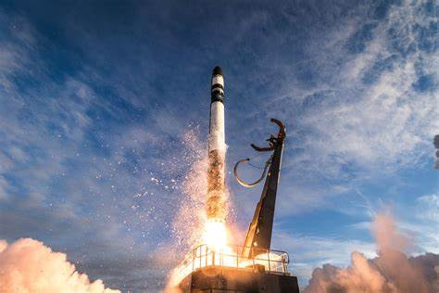
发射场 - 基本词汇1 Launchpad – Basic Vocabulary 1
5 very important “W” questions words:
Who? 谁 Who would know? 谁会知道？
What? 什么？What’s the matter? 怎么啦?
When? 什么时候？When does it leave? 它什么时候走？
Where? 在哪里？Where is it? 它在哪里？
Why? 为什么？Why is it late? 为什么晚了？

Slide 3
发射场 - 基本词汇2 Launchpad – Basic Vocabulary 2
And that very important “H” word:
还有那个非常重要的“H”字：
→ How? 如何 / 怎样 / 如何多少/ 多么 / 不然 /
This handbook writer especially likes the word “how.”
这本手册的作者特别喜欢“如何”这个词
Why? Because the word “how” explains processes.
为什么？因为“如何”一词解释了过程。
Traveling is a process. 旅行是一个过程。

Slide 4
发射场 - 基本词汇3 Launchpad – Basic Vocabulary 3
How do I get there? 我怎么到那里？
How does it work? 它是如何工作的？
How can I buy a ticket? 我怎样才能买票？
How can I get food and water? 我怎样才能得到食物和水？
“How” is really the most interesting “question word” in my opinion.
在我看来，“如何”真的是最有趣的“问题词”。

Slide 5
This PPT is really about: 这个PPT实际上是关于： HOW to get from here to there? 怎么走
Really though, all the question words (5 Ws) are essential.
实际上，所有的疑问词（5ws）都是必不可少的。
From 从
Here 这里
To 到
There 那里

Slide 6
___________________在哪？ Where is __________? 你能告诉我去________的路吗？ Can you give me directions to _______?
a good restaurant? 好餐馆
a Chinese restaurant? 中国餐馆
a grocery store? 杂货店
a bookstore with foreign language books? 有外语书的书店吗

Slide 7
___________________在哪？ Where is __________? 你能告诉我去________的路吗？ Can you give me directions to _______?
the Chinese Embassy? 中国大使馆
the Olympic training center? 奥林匹克训练中心
the Wushu Gymnasium? 武术馆
the toilet? 厕所
the Motel 6? 6号汽车旅馆

Slide 8
___________________在哪？ Where is __________? 你能告诉我去________的路吗？ Can you give me directions to _______?
a bank? 银行？
a money exchange center? 兑换货币的地方？
a hospital? 医院？
the emergency room? 急诊室？
a laundromat? 自助洗衣店？

Slide 9
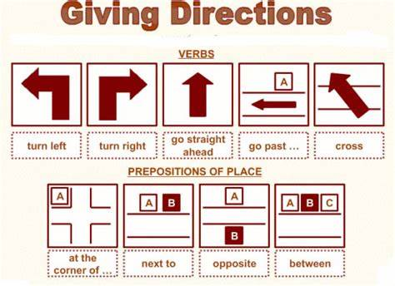
Asking for Directions 问路 [wèn lù]
How can I get to ____?
你能告诉我去________的路吗？
Where is the __________?
___________________在哪？

Slide 10
Direction words 方向词
Go straight 直走
Turn right 右转
Turn left 然后左转
Next to 旁边
Across from 对面
Opposite 对面
Between 中间
Cross (the street) 过马路

Slide 11
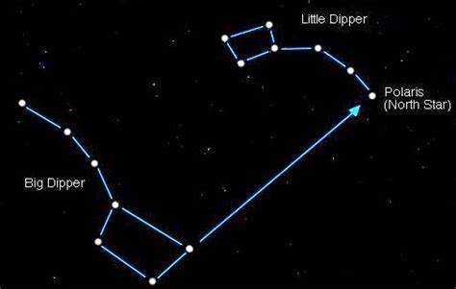
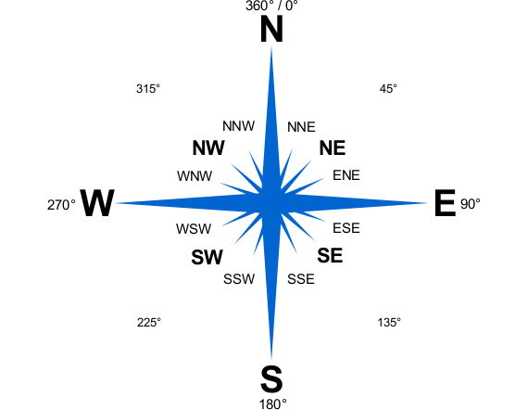
North 北
The sun rises in the east.
太阳从东方升起
Find the North Star 找到北极星
West 西部
East 东方
The Sun sets in the west.
太阳从西边落下
South 南方

Slide 12
At the first intersection 在第一个十字路口
At the first crossroads 在第一个十字路口
At the first corner (“corner”) here means intersection 在第一个拐角处（“拐角”）这里指的是十字路口
At the first stoplights (this may or many not be the first intersection!) 在第一个红绿灯处（这可能是也可能不是第一个十字路口！）
First 第一
Second第二
Third 第三
Fourth 第四
Fifth 第五
Sixth 第六
Seventh 第七
Eighth 第八
Ninth 第九
Tenth 第十

Slide 13
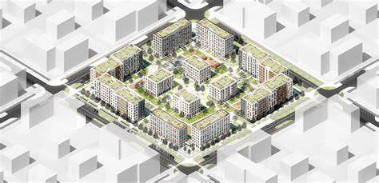
At the second intersection 在第二个十字路口
At the third intersection 在第三个十字路口
City block, one block, two blocks… 城市街区，一个街区，两个街区…
One block
一个街区

Slide 14
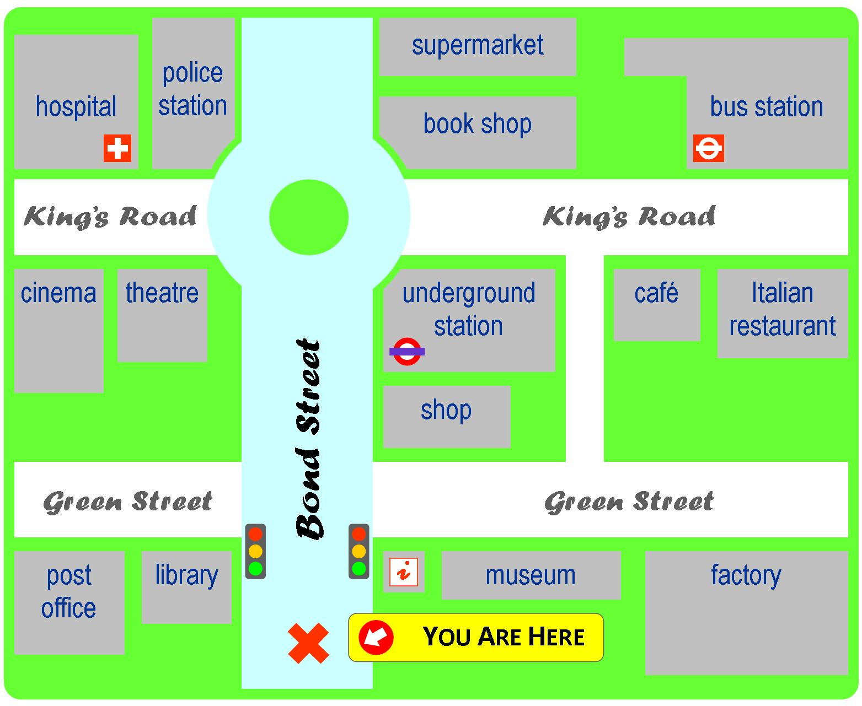
Practice!
Hospital 医院
Police station 警察局
Cinema 电影院
Theatre 剧场
Post office 邮局
Library 图书馆
Supermarket 超市
Book shop 书店
Underground station = Subway station 地铁站
Shop = store 商店
Museum 博物馆
Bus station 公交站
Café 咖啡
Italian Restaurant 意大利餐厅
Factory 工厂
环岛 Roundabout
Go straight 直走
Turn right 右转
Turn Left 左转
You will find it on your right/left 你会发现它在你的（右）（左）

Slide 15
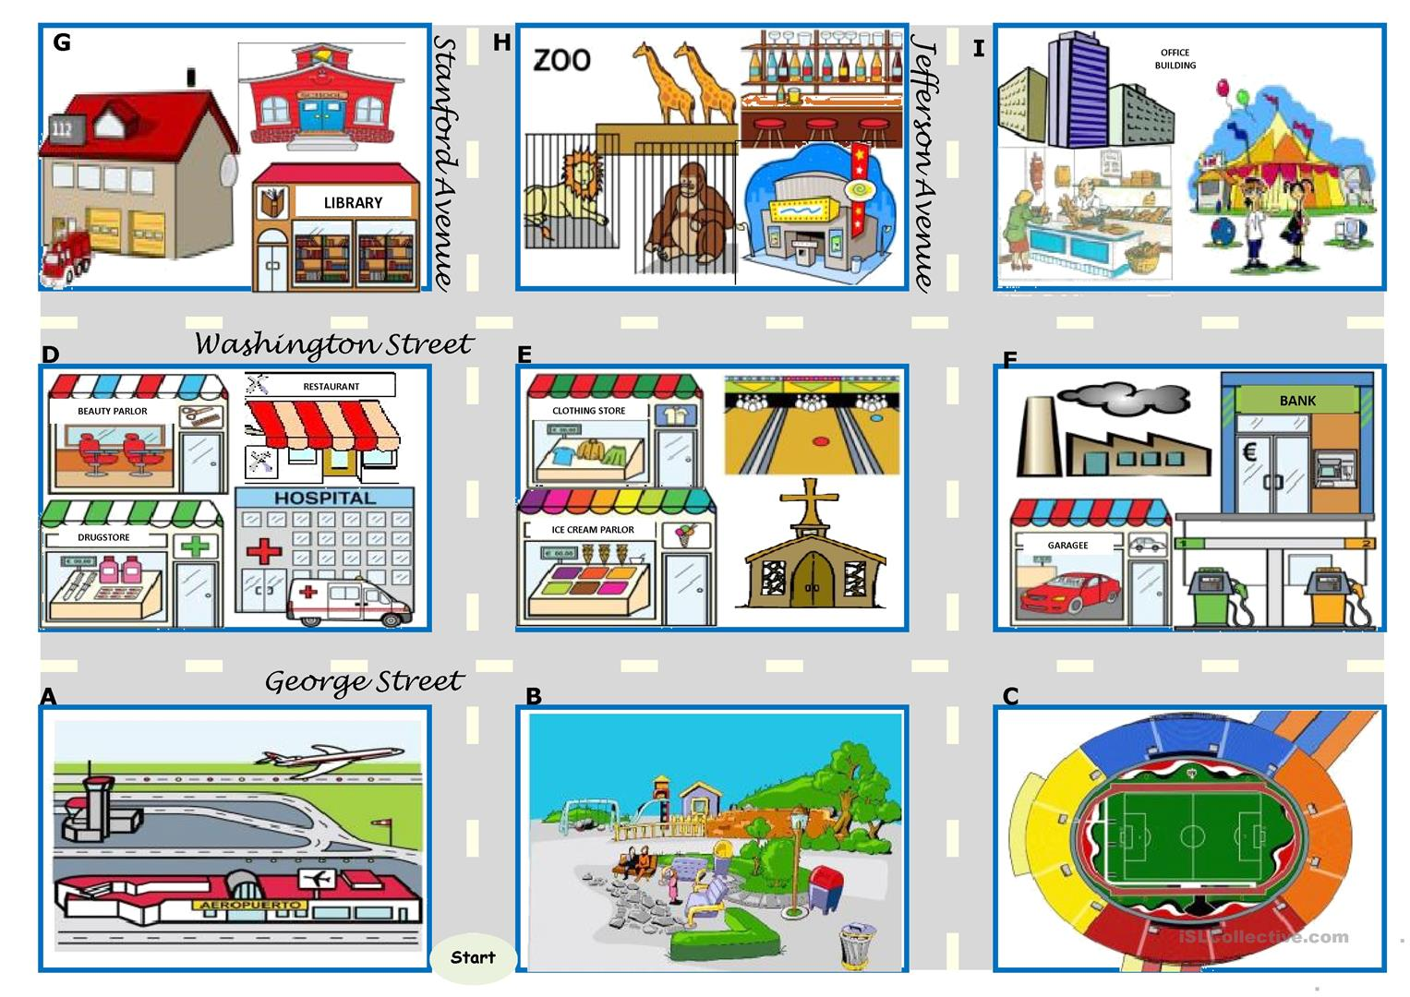

Slide 16
交通运输 Transportation
Taxi 出租车
Subway 地铁
Subway station 地铁站
Bus station 公交站
Train 火车站
Airport 机场
Arrival 进站
Departure 出站
Walking 行走
City Bus 城市巴士
Long Distance Bus Station 长途汽车站
International Bus Station 国际汽车站

Slide 17
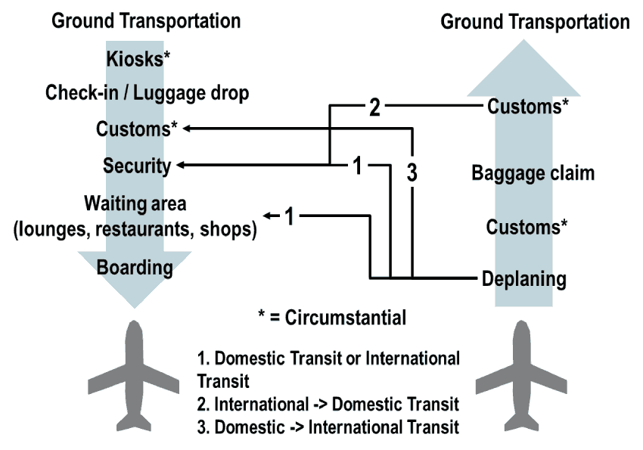
Airport 机场
Domestic Terminal 国内终端
International Terminal 国际航站楼
Check-in 取登机牌
Boarding Pass 登机牌
Security Check安全检查
Immigration 移民
Baggage claim/carousel 行李传送带
Customs 海关
Shuttle Bus 机场巴士

Slide 18
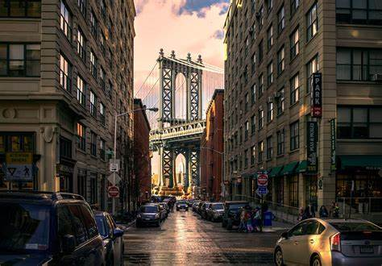
Kinds of streets 1 不同类型的街道
Lane – a small street 小巷一条小街
Road - a small street 小巷一条小街
Street – a big road usually in a city 街道——通常在城市中的一条大路

Slide 19
Kinds of streets 2 不同类型的街道
Avenue – a big street
Boulevard – a big street often lined with trees 林荫大道——一条常绿树成荫的大街
Highway – major streets often connecting different cities with high speed limits; also called parkway · throughway · freeway · expressway · turnpike 高速公路-主要街道通常连接不同的城市，有高速限制；也叫公园路·高速公路·高速公路·高速公路·收费公路

Slide 20
在出租车上 In a taxi
Please take me to ________________. 请带我去____________
a good restaurant. 好餐馆.
a Chinese restaurant. 中国餐馆.
a grocery store. 杂货店.
a bookstore with foreign language books. 有外语书的书店吗.
the Chinese Embassy. 中国大使馆.
the Olympic training center. 奥林匹克训练中心.
Motel 6. 6号汽车旅馆.

Slide 21
中餐馆：就像家一样 Chinese Restaurants: Just like home
重要提示：如果你在国外遇到问题，可以去中国餐馆。以我个人的经验，他们总是乐于帮助，即使是我，一个外国人。为什么？有时我需要现金。我的微信里有钱，但没有现金。外资银行往往不会接受人民币！Important note: If you have a problem in a foreign country, go to a Chinese restaurant. In my personal experience they are always happy to help, even me, a foreigner. Why? Sometimes I need cash. I have money in my WeChat, but no cash. Foreign banks often will not take Chinese Yuan!

Slide 22
Challenge 1! Directions 挑战1！方向
1.Go straight __
2. Turn left __
3. Turn Right __
4. Go past __
5. Next to __
6. Opposite __
7. Between __
A. 旁边
B. 双方
C. 对面
D. 左转
E. 直走
F. 过去
G. 右转

Slide 23
Answers 答案
Challenge 1! Directions 挑战1！方向
1. E
2. D
3. G
4. F
5. A
6. C
7. B

Slide 24
Answers 答案
Challenge 1! Directions 挑战1！方向
1.Go straight E
2. Turn left D
3. Turn Right G
4. Go past F
5. Next to A
6. Opposite C
7. Between B
A. 旁边
B. 双方 / 中间
C. 对面
D. 左转
E. 直走
F. 过去
G. 右转

Slide 25
Challenge 2! Directions 挑战2！方向
North __
South __
East __
West __
南方
西
北
东

Slide 26
Answers 答案
Challenge 2! Directions 挑战2！方向
1. C
2. A
3. D
4. B

Slide 27
Answers 答案
Challenge 2! Directions 挑战2！方向
North C
South A
East D
West B
南方
西
北
东

Slide 28
Challenge 3! Locations/Places - 挑战3！地点/地点
1. Intersection
2. Stoplights = traffic lights
3. Block
4. Crossroads
5. Roundabout
A. 交通信号灯
B.路口
C. 环岛
D.街区
E. 路口

Slide 29
Answers 答案
Challenge 3! Locations/Places - 挑战3！地点/地点
B or E
A
D
B or E
C

Slide 30
Answers 答案
Challenge 3! Locations/Places - 挑战3！地点/地点
1. Intersection B or E
2. Stoplights = traffic lights A
3. Block D
4. Crossroads B or E
5. Roundabout C
A. 交通信号灯
B.路口
C. 环岛
D.街区
E. 路口

Slide 31
挑战4-运输 Challenge 4 - Transportation
1. Airport __
2. Taxi __
3. Subway __
4. Subway station __
5. Bus station __
6. Train __
7. Walking __
A. 公交站
B. 出租车
C. 火车站
D. 行走
E. 地铁
F. 机场
G. 地铁站

Slide 32
挑战4-运输 Challenge 4 - Transportation
Answers 答案
1. F
2. B
3. E
4. G
5. A
6. C
7. D

Slide 33
挑战4-运输 Challenge 4 – Transportation Answers
Answers 答案
1. Airport 机场 F
2. Taxi 出租车 B
3. Subway 地铁 E
4. Subway station 地铁站 G
5. Bus station 公交站 A
6. Train station 火车站 C
7. Walking 行走 D
A. 公交站
B. 出租车
C. 火车站
D. 行走
E. 地铁
F. 机场
G. 地铁站

Slide 34
Challenge 5 Airport - 挑战5 – 机场
1. International Terminal __
2. Domestic Terminal __
3. Check-in __
4. Arrival __
5. Departure __
6. Shuttle Bus __
7. Baggage claim/carousel __
机场巴士
到达
行李传送带
离港
国际航站楼
进站
国内终端

Slide 35
Challenge 5 Airport - 挑战5 – 机场
Answers 答案
E
G
F
B
D
A
C

Slide 36
Challenge 5 Airport - 挑战5 – 机场
Answers 答案
International Terminal E
Domestic Terminal G
3. Check-in F
4. Arrival B
5. Departure D
6. Shuttle Bus A
7. Baggage claim/carousel C
机场巴士
到达
行李传送带
离港
国际航站楼
进站
国内终端

Slide 37
与去机场的出租车司机交谈 Conversation with taxi driver going to the airport
1. Taxi Driver: Where do you want to go?
2. You: _______________
3. Taxi Driver: Which terminal are you going to?
4. You: _______________ (or 或) _______________
5. Taxi Driver: Do you want the arrivals door or departures?
6. You: _________________
The airport please
Domestic Terminal (or) International Terminal // 国内航站楼（或）国际航站楼
Arrivals (if your friend is flying in and you will meet him/her) // departure (if you are flying out) 抵达，如果你的朋友正在飞过来，你会见到他/她 // 如果你要飞出去，就离开

Slide 38
中国教练计划在海外生活和工作的小贴士 Tips for Chinese Coaches planning to live and work overseas
祝贺 你！Congratulations!
当你到达时，你当地的新朋友应该去机场接你。
Your new friends should pick you up at the airport when you arrive.
如果你有一部华为智能手机，它确实有一些很好的海外旅行功能，比如Skytone。但是，有一些并发症。
If you own a Huawei smart phone it does have some great features for traveling overseas, like Skytone. But, there are some complications.

Slide 39
中国教练计划在海外生活和工作的小贴士 Tips for Chinese Coaches planning to live and work overseas
谷歌和苹果可以识别华为手机，不会让你下载他们的应用程序。你将需要他们的谷歌地图应用程序，和本地出租车应用程序。Google and Apple can recognize Huawei phones and won’t let you download their apps. You will need their apps for google maps, and local taxi apps.

Slide 40
中国教练计划在海外生活和工作的小贴士 Tips for Chinese Coaches planning to live and work overseas
另外，使用Skytone，你的新国家的当地人会认为打电话给你是一个长途电话。你不会接到很多电话的。Also, using Skytone, local people in your new country will think calling you is a long distance phone call. You won’t get many phone calls.
然而，Skytone将使您在中国给您的家人和朋友打电话变得简单和便宜。Skytone however will make it easy and cheap to call your family and friends back in China.

Slide 41
中国教练计划在海外生活和工作的小贴士 Tips for Chinese Coaches planning to live and work overseas
为了满足新国家当地的商业和社交需求，你最好买一部三星、诺基亚或苹果手机，然后把新的本地sim卡放在那里。For local business and social needs in your new country you are much better off buying a Samsung, Nokia, or Apple phone and putting your new local sim card in there.

Slide 42
只要你能沟通… As long as you can communicate…
和你的新朋友（在你的新国家）
With your new friends in your new country…
还有你在中国的家人和朋友…
And your family and friends back home in China…
一切都会好起来的！Everything will be fine! = It will be all good!

Slide 43
出入境卡 Departure and arrival card
大多数国家都有这种情况。 Most countries have something like this. 我用这个是因为它有中英文翻译。但是，他们都差不多。I’m using this one because it has Chinese English translations. But, they are all about the same.

Slide 44
我用很多种语言填了这些卡片，我都数不清了。I’ve filled those cards out in so many languages I can’t count them all.
通常在某个地方会有一个长柜台，上面贴着英文翻译。 很多次我在飞机上睡觉时都没有得到这张卡。 然后，当我试图通过移民时，我不得不回去，用卡找到柜台，然后填写一张。 这就是我旅行时总是随身带笔的原因之一。 有时有很多人在做同样的事情，没有笔！ 哈哈！ 我喜欢旅游！Usually there’s a long counter somewhere with English language translations taped on the backboard. Many times I was sleeping on the airplane and didn’t get this card. Then, when trying to get through immigration I had to go back, find the counter with the cards, and fill one out. This is one reason I always carry a pen when I travel. Sometimes there’s a lot of people doing the same thing, and there are no pens! Ha, ha! I love traveling!

Slide 45
旅途愉快！ Bon voyage! (French language for have a good trip!

