Slide 1
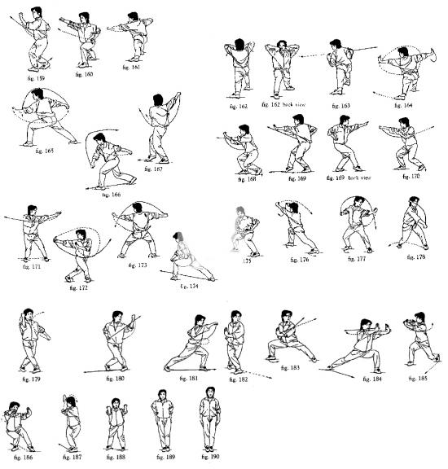
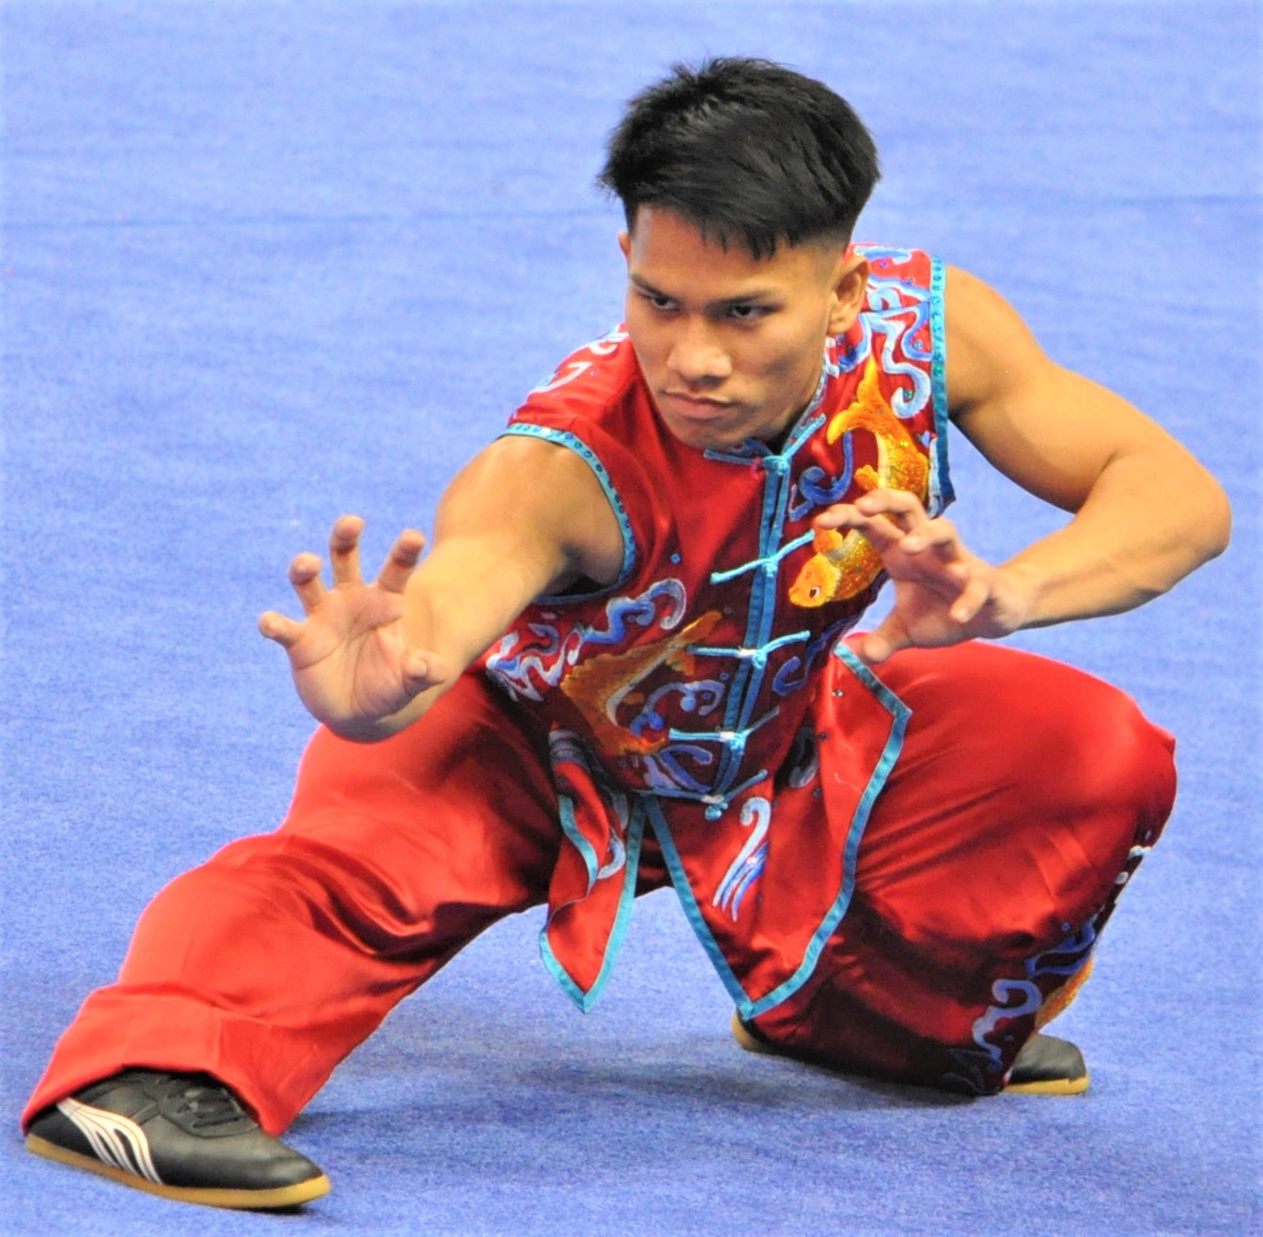
武术套路词汇 Wushu Taolu Vocabulary
English-Chinese Handbook for Martial Art Coaches
武术教练中英文手册
草案2019年9月14日 PPT 6 B Taolu
套路b
https://bradenhalterman.net/marten-river/shaolin-kung-fu-techniques-pdf.php

Slide 2
4b.腾空动作：Advanced Movements
旋子 - butterfly spinning
旋子转体一圈360⁰ - 360 degrees butterfly spinning
侧空翻 - side flip

Slide 3
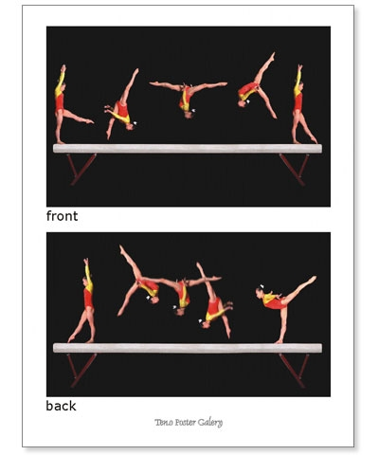
4c.腾空动作：Advanced Movements
侧空翻转体 - side flip rotating 360 degrees
后空翻 - back aerial
前空翻 - front aerial

Slide 4
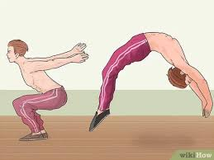
4d.腾空动作：Advanced Movements
后手翻 - Back handspring
空手翻 - no hand cartwheels
侧空翻 - aerial cartwheels

Slide 5
5a. 南拳步型 Nanquan step type
半马步 -- semi-horse riding stance
骑龙步 -- dragon-riding stance
跪 步 -- squatting stance

Slide 6
5b. 南拳步型 Nanquan step type
单蝶步 -- single fold step
麒麟步 -- qilin step
虚步 -- empty step

Slide 7
武术基本词汇 Wushu basic vocabulary
这些翻译来自These translations from: http://blog.sina.com.cn/s/blog_623e668d0100fg4m.html
Wushu competition routines武术竞赛套路
Wushu traditional routines武术传统套路
Wushu morality 武德
Fist palm salute抱拳礼

Slide 8
武术基本词汇 Wushu basic vocabulary
Shadow boxing 太极拳
Long fist 长拳
Southern fist 南拳
Sword play 剑术
Broadsword play 刀术
Staff 棍术

Slide 9
武术基本词汇 Wushu basic vocabulary
Spear 枪术
Nunchakus双截棍
three-section staff (cudgel) 三节棍
nine-section whip九节鞭

Slide 10
武术基本词汇 Wushu basic vocabulary
Internal style boxing 内家拳
external style boxing 外家拳
Flexibility柔韧性
Explosive power爆发力

Slide 11
武术基本词汇 Wushu basic vocabulary
Smash fist 砸拳
Chop fist 劈拳
Punch fist 冲拳
Push palm 推掌

Slide 12
描述速度 Describing speed
非常慢-好像你的身体浸在水里 Very slow – as if your body is immersed in water
慢 Slow
中速 Medium speed
快 Fast
非常快 Very fast
闪电速度 Lightning Speed

