Slide 1
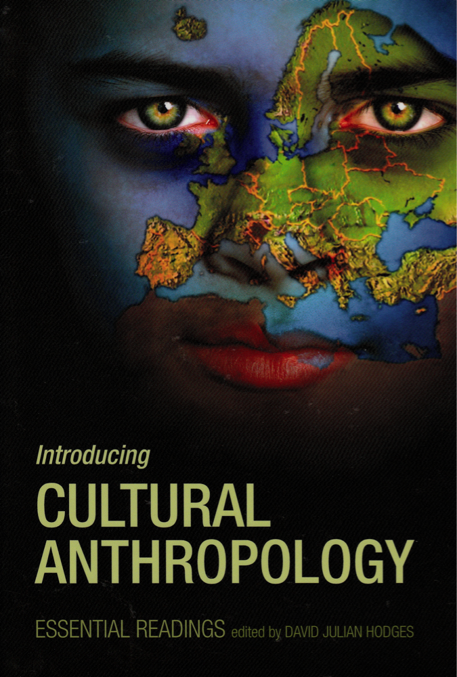
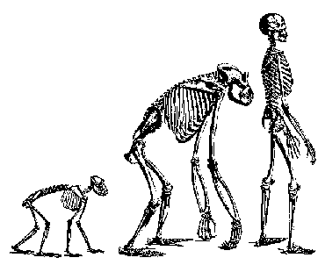
人类学 rénlèixué
Anthropology
The study of humanity

Slide 2
Anthropology
Cultural
= Social
Anthro.
文化人类学
Physical
Anthro.
人体人类学
Linguistic Anthro.
语言人类学
yǔyán rénlèixué
Archeology
考古kǎogǔ

Slide 3
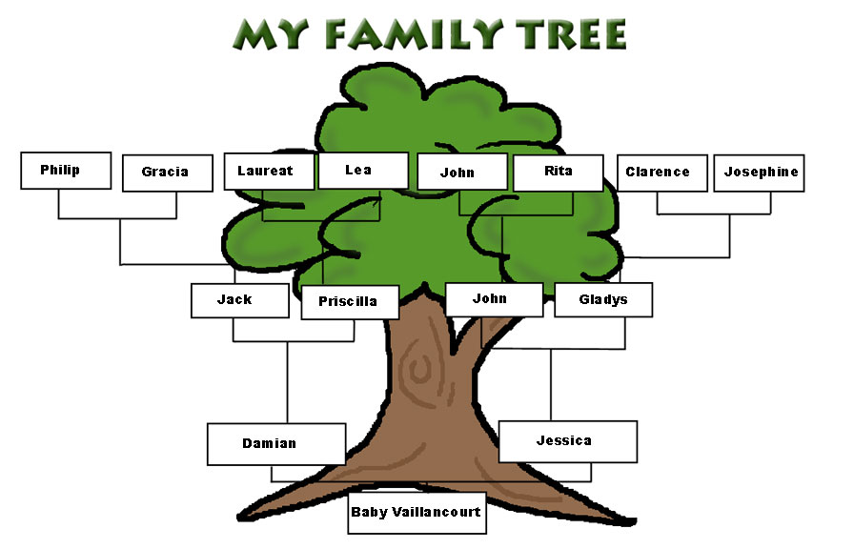
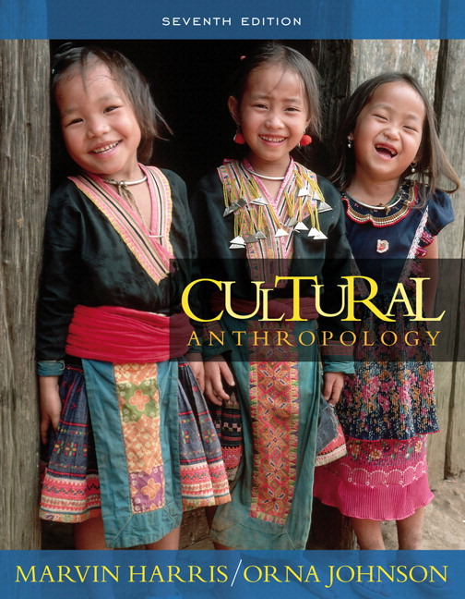
Cultural= Social Anthropology 文化人类学
Studies how human cultures are organized 有组织的 yǒuzǔzhīde, for example there are
matriarchal 母系社会 and
patriarchal 宗法制度 zōng fǎ zhì dù cultures.

Slide 4
Cultural anthropology Question
Who “wears the pants” (is the boss) in your family?
I think my father has more power than my mother in my family.
OR
I think my mother has more power than my father in my family.

Slide 5
Is it possible…
Cultural
Anthropology
for humans to live together 共同生活 gòng tóng shēng huó in peace和平 with no wars战争zhànzhēng, and no fighting 搏斗 bódòu?
Yes, I think people can live together in peace.
OR…
No, I don’t think people can live together in peace.

Slide 6
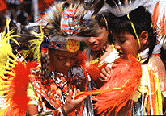
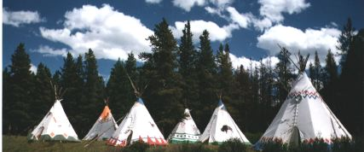
Cultural Anthropology
The Hopi Indians of the American South West were famous 著名 zhùmíng for having a peaceful society, with no wars or fighting. Their language did not have words for these things.
Hopi means “peaceful people.”

Slide 7
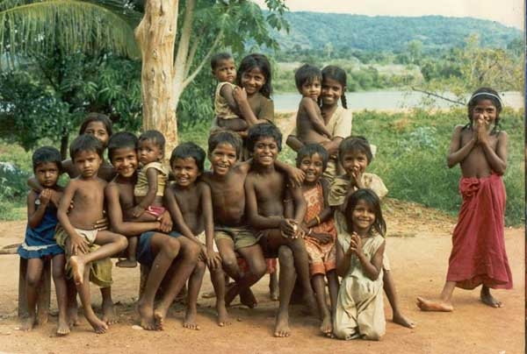
The Semai people of Malaya
They have a gift礼物 lǐwù economy经济 jīngjì. The Semai have no police警察 jǐngchá, no courts法庭[fǎtíng] , and no government政府 zhèngfǔ.

Slide 8
The Hopi and Semai show…
…that people can live together in peace.
Would you like to live like that?
→Yes, I’d like to live in a non-violent
非暴力的 culture.
→No, I wouldn’t like to live like that.

Slide 9
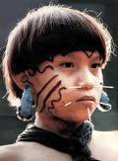
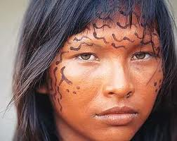
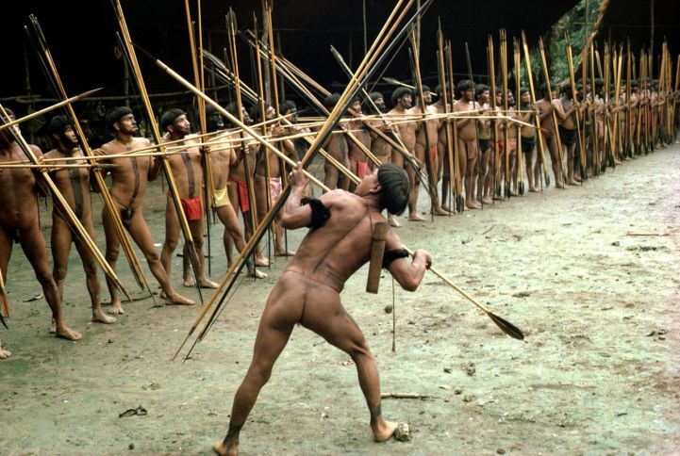
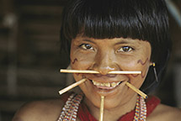
Cultural anthropologists人类学家
Have also found very violent暴力的 cultures…
Yanomano Indians of the Amazon jungle.

Slide 10
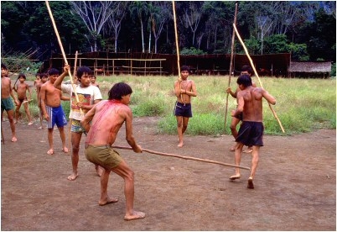
Yanomano club fights
Look like fun?

Slide 11
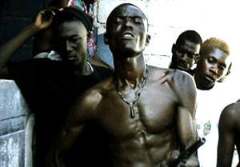
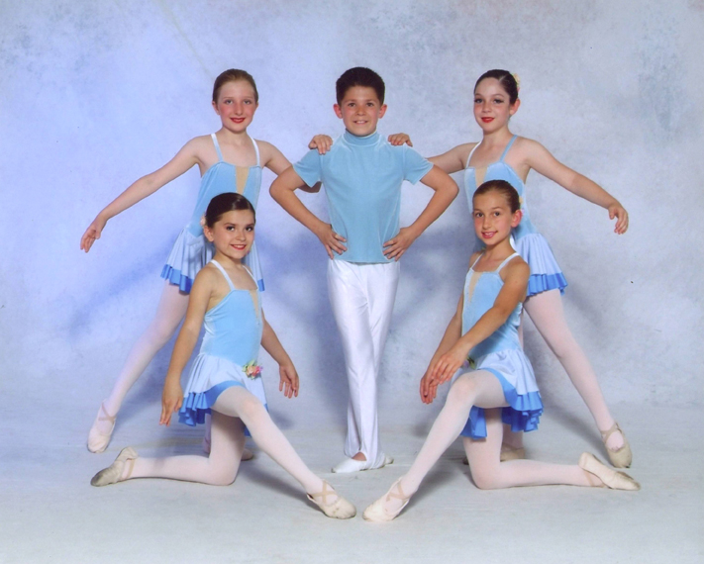
Cultural anthropologists
Can study any culture文化[wénhuà] , anywhere…!

Slide 12
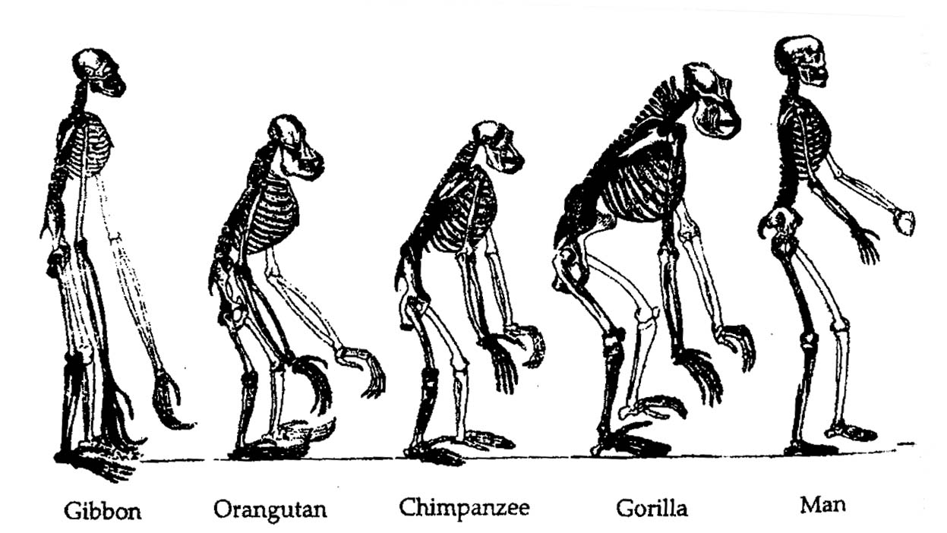
Physical anthropology 自然人类学 zì rán rén lèi xué
Studies mainly evolution进化[jìnhuà] and bones骨头 gǔtou.

Slide 13
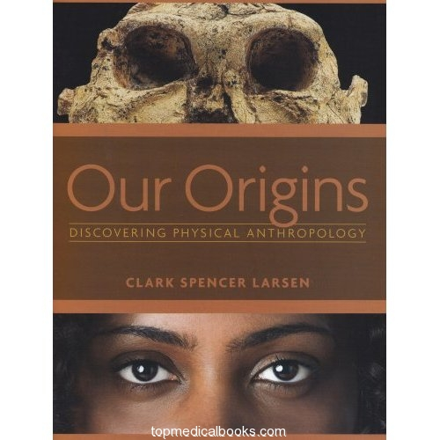
How did humans evolve?
What animals are closest to us?
Why are we designed the way we are?

Slide 14
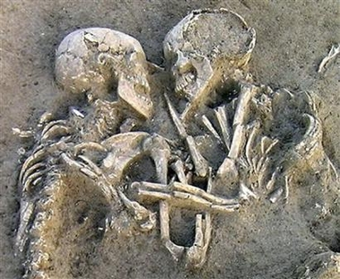
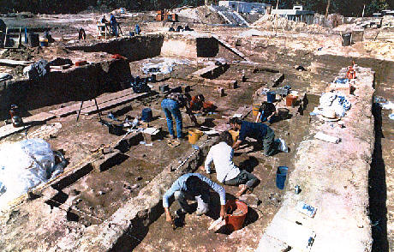
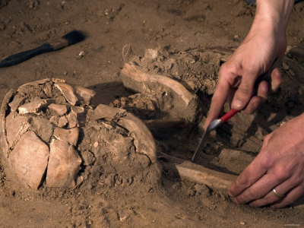
Archeology考古[kǎogǔ]
Is the scientific study of past human culture from things they left behind.

Slide 15
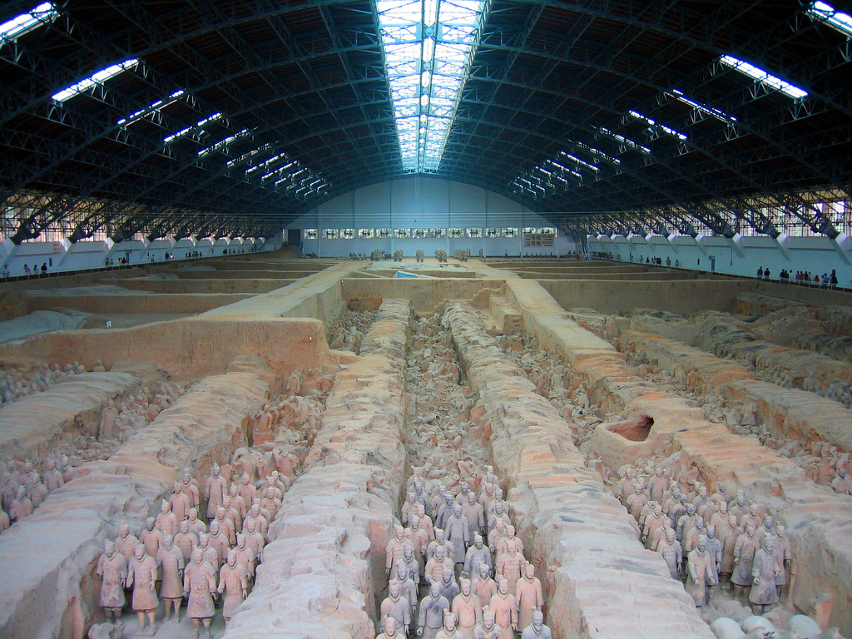
Archeology

Slide 16
Archeology – Uncovering the past

Slide 17
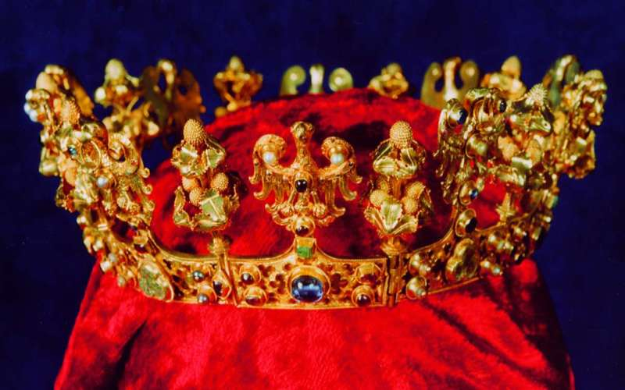
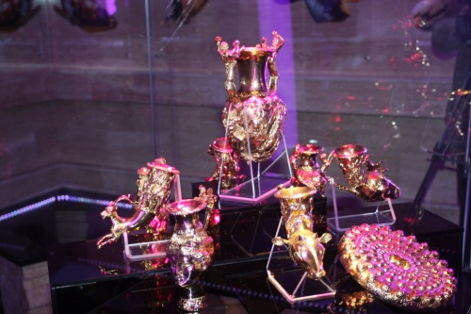
Archeologists can find treasure!

Slide 18
Linguistic anthropology 语言人类学
Linguistic anthropology explores how language shapes决定 juédìng communication交流 jiāoliú, and builds→
social identity社会认同 shè huì rèn tóng
group membership组成员关系[zǔ chéng yuán guān xì],
cultural beliefs 文化信念[wén huà xìn niàn] and
ideologies意识形态[yìshíxíngtài] .

Slide 19
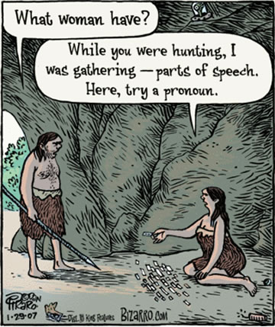
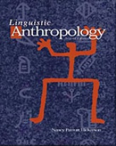
Linguistic anthropology

Slide 20
Does language change things?

Slide 21
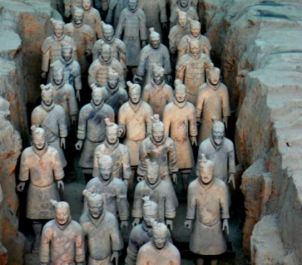
Of the four kinds of anthropology
Cultural anthropology
Physical anthropology
Archeology
Linguistic anthropology
Which do you find most interesting?

