Slide 1
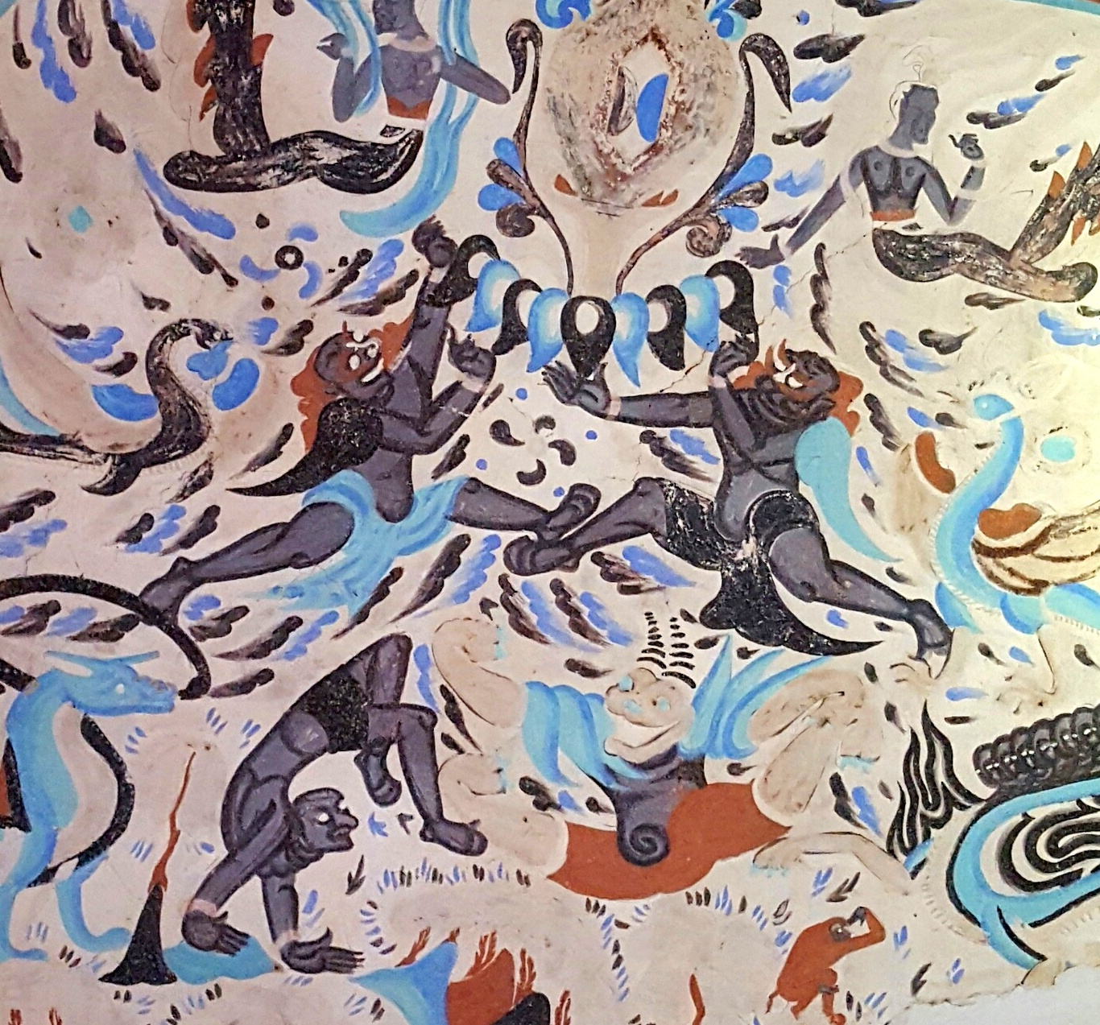
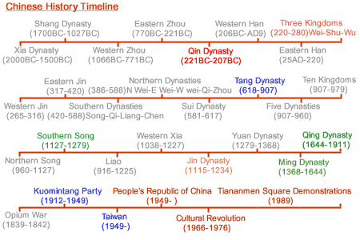
附录1武术概论Appendix 1 Introduction to Chinese martial arts
English-Chinese Handbook for Martial Art Coaches
武术教练中英文手册
草案2019年9月12日 附录1
http://www.asianinfo.org/asianinfo/china/pictures/china_history.gif

Slide 2
A Wushu coach will be asked many questions… 学生可以问很多问题
大多数中国武术教练都知道中国古代武术的历史。但是，能够用英语交流这段浩瀚的历史是一个挑战。这篇PPT报告试图总结古代历史，并对中国武术的几种主要风格进行系统的分析和归类。
Most Chinese martial art coaches know the ancient history of Chinese martial arts. But, being able to communicate that vast history in English can be a challenge. This PPT tries to summarize the ancient history, and systematically analyze and categorize at least a few major styles of Chinese Wushu Kung Fu.

Slide 3
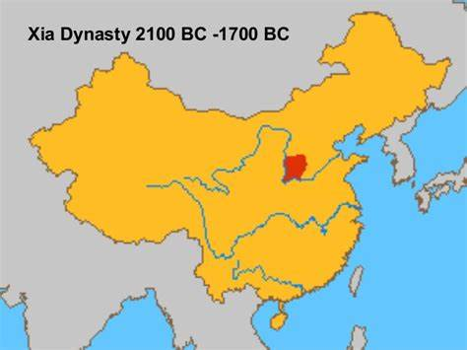
真正古老的历史 Truly Ancient History
中国武术功夫的历史可以追溯到夏朝至少4000年。 至少有2,000种不同风格的中国功夫。 由于功夫年龄极端，战斗方式千差万别，有人称中国功夫为所有武术的祖母。
Chinese Wushu Kung Fu has a history going back at least 4,000 years to the Xia Dynasty. There are at least 2,000 different styles of Chinese Kung Fu. Because of its extreme age and wide variation of fighting styles, some people refer to Chinese Kung Fu as the “grandmother of all martial arts.”

Slide 4
在历史上，中国武术是一种秘密的艺术 Historically Chinese martial arts were secret arts
从历史上看，中国武术是在家庭内部传承的。 他们是战争艺术，是秘密。 “军事”一词是指战争，因此是杀戮。 从技术上讲，现代体育搏击艺术不是“武术”，因为它们是体育运动，并非为杀戮而设计。
Historically Chinese martial arts were passed down within families. They were killing arts and they were secret. The word “martial” refers to war. Technically speaking modern sport fighting arts are not “martial” as they are sports and not designed for killing.

Slide 5
自然界中唯一不变的就是变化。 The one constant in nature is change.
但是“武术”一词的含义在过去一百年中已经发生了变化，现在包括空手道，跆拳道和现代武术功夫等体育艺术。 然而，某些功夫风格仍然是世界上一些军事机构和学校/俱乐部所采用的真正的武术。
Clearly, the meaning of the phrase “martial arts” has changed over the past hundred years and now includes sport arts like Karate-Do, Taekwondo, and modern Wushu Kung Fu. Some styles of Kung Fu however remain true martial arts as practiced in some military institutions and some schools/clubs around the world.

Slide 6
少林寺 The Shaolin Monastery
少林寺始建于河南省嵩山市495 ACE。 没人知道少林功夫何时真正出现。 然而，少林寺在元朝初期（1277-1368年）举办了大型的全国武术比赛。 在此之前，它可能已经有了高度发展的功夫体系，但是肯定会保留这些风格的秘密。
The Shaolin temple was built in 495 ACE in the Song mountains in Henan province. Nobody knows when Shaolin Kung Fu really emerged. However the Shaolin Monastery hosted large national martial art contests during the early Yuan Dynasty (1279–1368). It may well have had highly evolved systems of Kung Fu before that, however would certainly have kept those styles secret.

Slide 7
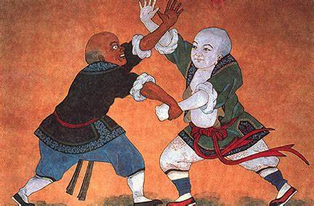
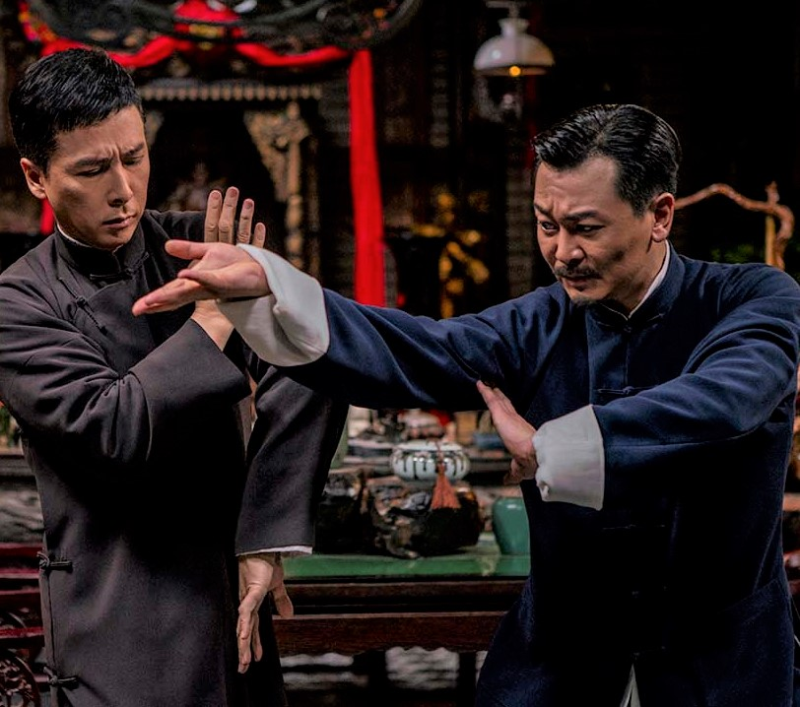
扩大圆圈 Expanding the circle
保存完整的有关少林功夫的著作直到明朝（1368–1644年）才出现。 即使在20世纪初，在家庭之外，尤其是对外国人讲授功夫，也引起了很大争议，甚至是危险的。
Well preserved writings regarding Shaolin Kung Fu did not emerge until the Ming Dynasty (1368–1644). Even in the early 20th century teaching Kung Fu outside a family, and especially to foreigners was highly controversial and even dangerous.
http://www.iwuf.org/history-of-wushu
Ip Man 4

Slide 8
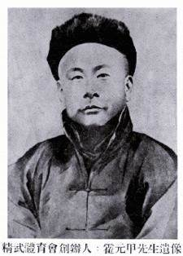
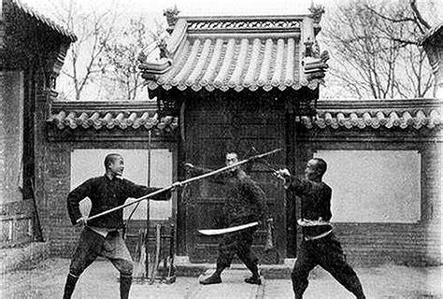
李静武（1912-1997）
然而，李静武（1912-1997）开始了一种在家庭和中国之外教授中国武术的潮流。李师傅是吴式太极拳和陈式太极拳的专家。他与当时那些风格卓越的大师们一起学习。1910年7月7日，他在中国上海成立了一个国际武术教育组织——精武运动会，他是一位伟大的大师。这一努力并非没有阻力。
Li Jingwu (1912-1997) however started a trend teaching Chinese martial arts outside of families and China. Master Li was an expert in both Wu style Tai Chi as well as Chen style Tai Chi. He studied with some of the preeminent masters of those styles at that time. He was a great master and also became famous for starting the Jing Wu Athletic Association, an international martial arts education organisation founded in Shanghai, China July 7, 1910. That effort was not without resistance.

Slide 9
中国武术的不同门类 Different categories of Chinese martial arts
中国功夫样式可以通过几种方式进行分类。
Chinese Kung Fu styles can be categorized in several ways.
例如，在中国，人们说：“南拳，北腿”，意思是“南拳”（拳击）和“北腿”（指踢腿）。一般来说，北方风格的功夫使用更多的踢腿，因为历史上他们更高，胳膊和腿更长。在中国南方，人们往往身材矮小、粗壮、上身力量更大，因此他们更擅长拳击。
For example, in China they say: “Nan Chuan Bei Tui” which means “south fist,” (boxing) and “north leg” (referring to kicks). Generally northern styles of Kung Fu use more kicks because historically they were taller and had longer arms and legs. In the south of China people tended to be shorter, stockier and had greater upper body strength and so they were more specialized in fist fighting.

Slide 10
中国功夫的风格也可以分为内部风格和外部风格。Chinese Kung Fu styles can also be categorized according to Internal vs. External styles
内部风格基于“气”的发展和使用，“气”是一种普遍现象，通常被称为“本能”，流经宇宙，地球和人类。 内部风格的例子包括三种内家拳“内部”武当风格：太极拳，兴义拳（兴一川）和八卦掌（八卦掌）。
Internal styles are based on the development and use of “qi,” a universal phenomenon often referred to as “intrinsic energy” that flows through the universe, the earth and humans. Examples of internal styles include the three Neijiaquan “internal” Wudang styles: Tai Chi, Xingyiquan (Hsing-I Chuan) and Bagua Zhang (Ba Gua Zhang).

Slide 11
比较外部和内部风格 Comparing External and Internal Styles
人们通常用少林功夫作为一种外在风格的例子。然而，少林风格也使用气。不同之处在于训练中力量与放松的相对重要性。少林风格的训练是为了加强和稳固身体，而更纯粹的内在风格不这样做，他们培养放松和冥想到了一个极端的程度。外部风格从训练中产生的效果更快，在现实世界中使用，而内部风格通常需要更长的时间来充分发展在现实世界中使用的能力。
People usually use Shaolin Kung Fu as an example of an external style. However Shaolin styles also make use of qi. The difference is the relative emphasis of strength vs. relaxation in training. Shaolin styles do training exercises to strengthen and firm the body, whereas more pure internal styles don’t do that, they cultivate relaxation and meditation to an extreme degree. External styles yield faster results from training to use in the real world, whereas internal styles usually take longer to fully develop the ability to use in real world fighting.

Slide 12
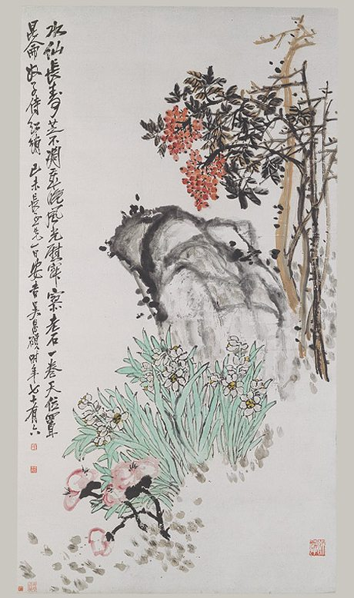
今天的功夫界一般分为“功夫”和“武术” Today the Kung Fu world is generally divided between “Kung Fu” styles and “Wushu styles.”
汉语中的“武术”一词意为“武术”。 “功夫”一词意味着高超的艺术和纪律，是一个广义术语，不仅包括武术，还包括许多艺术。 因此，写诗和插花就是功夫的一种。 武术是一种功夫。
The word “wushu” in Chinese means “martial arts.” The word “Kung Fu” means highly skilled art and discipline and is a broader term including many arts not just martial arts. Thus writing poetry and flower arranging are kinds of Kung Fu. Wushu is one kind of Kung Fu.

Slide 13
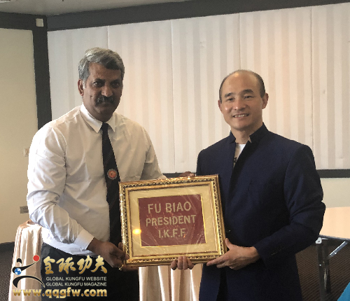
功夫联合会和武术联合会 Kung Fu and Wushu Federations
在武术界，功夫和武术是一回事，但是中国的旗舰武术联合会是国际武术联合会（IWUF）。 近年来，它已私有化，它不是政府组织。
有两个大型的国际功夫联合会。最负盛名的是总部设在北京昌平区的北京少林学校傅彪大师。另一家总部设在阿塞拜疆巴库。
In the martial arts world, Kung Fu and Wushu are the same thing, however China’s flagship martial art federation is the International Wushu Federation (IWUF). In recent years it has become privatized and it is not a government organization.
There are two large International Kung Fu Federations. The most prestigious is headquartered in Changping District of Beijing led by Grandmaster Fu Biao of Beijing Shaolin School. Another is headquartered in Baku Azerbaijan.
傅彪大师 Grandmaster Fu Biao on right.

Slide 14
功夫联合会和武术联合会 Kung Fu and Wushu Federations
武术联合会和功夫联合会有什么区别？ 除了国际武术联合会（IWUF）规定的变化，混合动力和创新风格外，没有多少其他东西。 功夫联盟要求遵守传统的功夫套路。What’s the difference between the Wushu Federation and Kung Fu Federations? Not much except the International Wushu Federation (IWUF) is open to variations, hybrids and innovative styles, whereas the Kung Fu Federations require adherence to traditional Taolu. The IWUF also preserves traditional styles, but innovative movements are a mandatory part of Wushu Taolu competition.
Beijing Shaolin Wushu School

Slide 15
散打 Sanda
散打的字面意思是“自由搏斗”，它很像泰国拳击，包括膝盖和肘部摔跤，以及从摔角，柔道和摔跤中摔跤/摔跤。 散打似乎是散打的较新名称，尽管仍有一些“散打”比赛。 差异可以出现在规则系统中，并且通常可以在得分系统中找到。
Sanda literally means “free-fighting” and is rather like Thai boxing including knee and elbow strikes, and takedowns/throws. Takedowns from Shuai Jiao, judo and wrestling all permitted. It appears Sanda is the newer name for Sanshou, though some “Sanshou” competitions are still held. The differences can appear in the rule systems and found in the point scoring systems. Nonetheless, they are the same thing.

Slide 16
中国武术的划分 Divisions within Chinese martial arts
中国武术的划分并非完全独特。 例如，韩国跆拳道分为韩国政府批准的世界跆拳道联盟（WTF）。 WTF跆拳道是一项奥林匹克运动，总部位于韩国首尔。 国际跆拳道联合会（ITF）的总部位于奥地利维也纳。 两者在世界各地都非常受欢迎。
The divisions within Chinese martial arts are not totally unique. For example, Korean Taekwondo is divided between the South Korean government approved World Taekwondo Federation (WTF) which is an Olympic sport, headquartered in Seoul, South Korea and the International Taekwondo Federation (ITF) headquartered in Vienna, Austria. Both are hugely popular around the world.

Slide 17
中国武术与奥运 Chinese Wushu and the Olympics
大多数国家/地区拥有独立的IWUF和IKF办公室，但是一些国家的体育部将它们合并为一个大型组织.
Most countries have separate IWUF and International Kung Fu Federation offices, however some country’s sports ministries combine them into one large organization.
中国将武术纳入奥林匹克运动之路漫长，但是到2020年1月，一些好消息浮出水面。
China’s road to getting Wushu included as an Olympic sport has been a long one, however in January 2020 some great news emerged.

Slide 18
中国武术首次亮相2022年达喀尔青年奥林匹克运动会 Wushu to make its Youth Olympics debut as official sport in Dakar 2022
2020年1月8日January 8, 2020
新华社洛桑1月8日电-在2008年北京奥运会和2014年南京青年奥运会上作为特殊展览活动出现后，被称为中国功夫的武术将在2022年达喀尔作为一项正式运动首次亮相。 国际奥委会在周三的执行委员会会议上确认了青年奥林匹克运动会…
LAUSANNE, Jan. 8 (Xinhua) – After appearing as special exhibition events at both the 2008 Beijing Olympic Games and the 2014 Nanjing Youth Olympic Games, Wushu, widely known as Chinese Kungfu, will make its debut as an official sport at the 2022 Dakar Youth Olympic Games, the International Olympic Committee confirmed at Wednesday’s executive board meeting…
http://www.xinhuanet.com/english/2020-01/08/c_138688316.htm

Slide 19
不同的观点 - 同一座山 Different perspectives – Same mountain
尽管一些功夫传统主义者嘲笑中国武术允许的创新，但奥林匹克运动总体上奖励具有创造力的高技能创新。 例如，在体操自由体操比赛中，有些动作是强制性的，但要为表现出色的创造性创新加分。 奖励与体育或艺术主题相一致的创意创新，可以使它以新颖的方式（在大多数情况下为出色的方式）发展。
Although some Kung Fu traditionalists scoff at the innovations permitted in Chinese Wushu, Olympic sports in general reward creative highly skilled innovations. For example, in gymnastics floor exercise competition there are compulsory movements, however points are added for well performed creative innovations. Rewarding creative innovations consistent within the thematic outlines of a sport or art keep it growing in new and in most cases excellent ways.

Slide 20
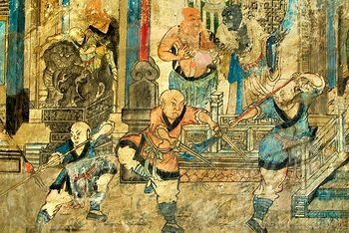
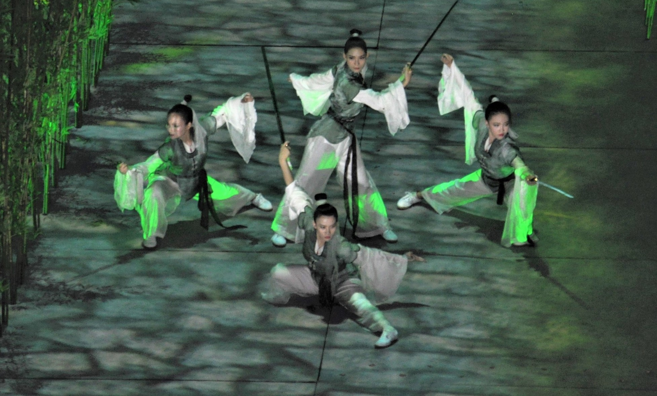
扩大武林 Expanding Wushu Circles
从秘密搏击到奥林匹克运动，中国武术功夫一直在不断发展，并逐渐成为世界上最受尊敬和最现代的武术之一。
From secret fighting arts to Olympic sport, Chinese Wushu Kung Fu is always evolving and gaining popularity and recognition as one of the world’s most venerable and modern martial arts.

Slide 21
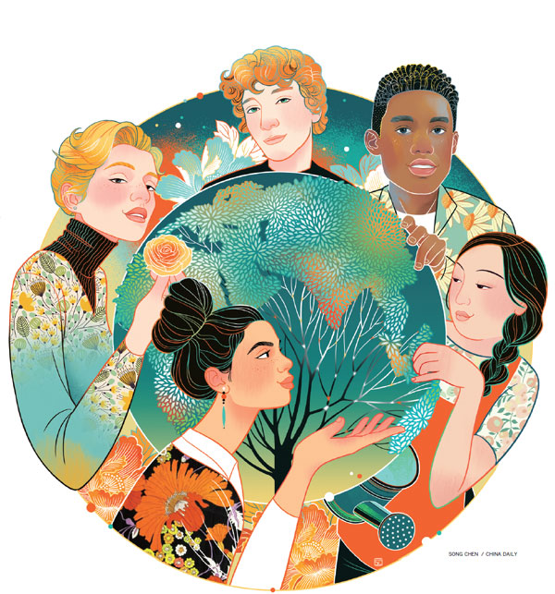
http://www.chinadaily.com.cn/china

