Slide 1
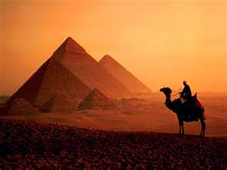
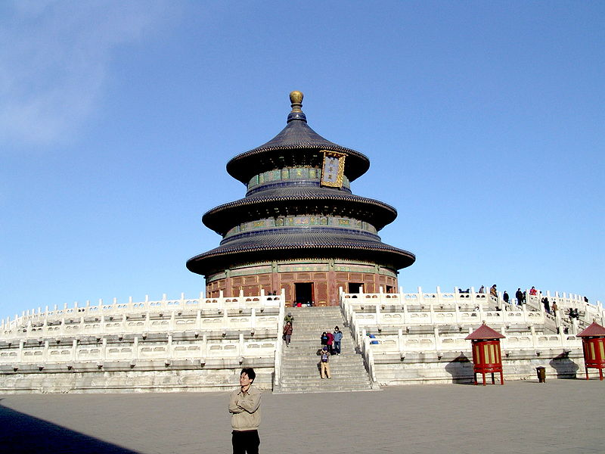
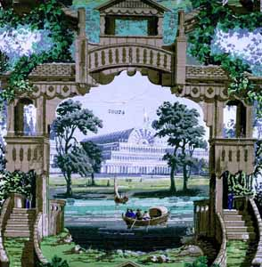
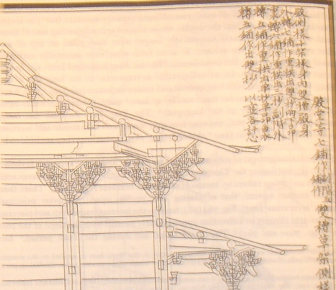
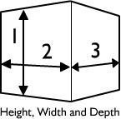
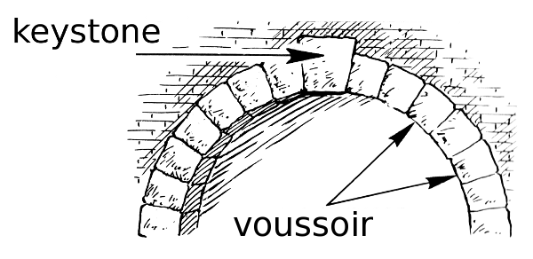
History 历史 lìshǐ of Architecture 建筑学 jiànzhùxué

Slide 2
Would you like to live (住 zhù) here?
* Yes, I think it’s very ______
- elegant 秀 xiù
- funny 可笑的 kěxiàode
- Impressive 神气 shénqì
* No, I think it’s very _______
- ugly 丑 chǒu
- ridiculous 荒谬的 huāngmiùde
- stupid 笨的 bènde

Slide 3
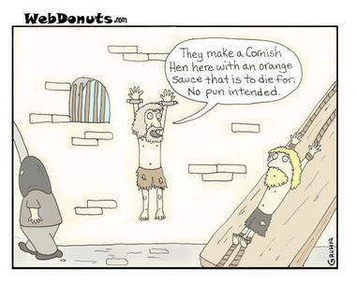
Would you like to work here?
- Yes I would.
- No I wouldn’t.
Maybe if they paid资 fā gōngzī) me a lot诸多 zhūduō

Slide 4
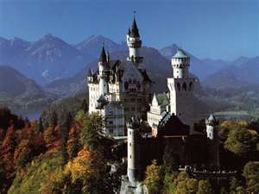
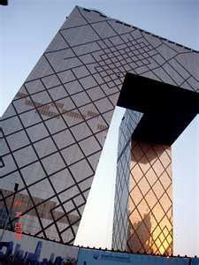
Why not live and work in places like that?
Because where you live and work tells the world who you are.

Slide 5
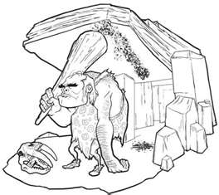
Our ancestors lived in trees and caves
But I’m going to start this history of Architecture around 2,600 BCE

Slide 6
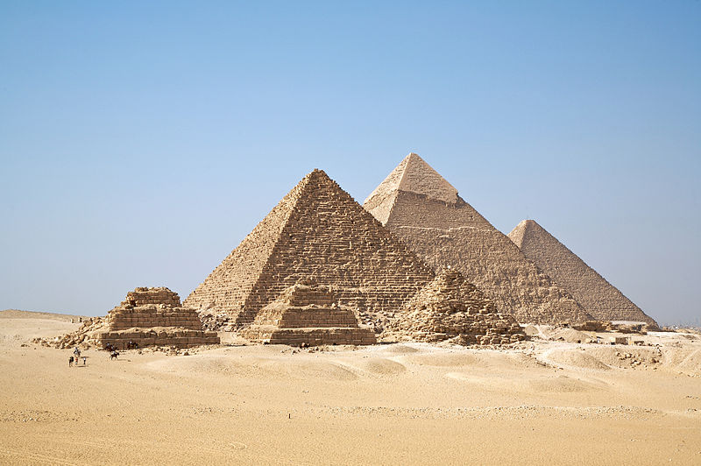
2630 BCE – Egypt 埃及 āijí
The oldest Egyptian pyramids (金字塔 jīnzìtǎ) were built (建设 jiànshè) about 2630 BCE–2611 BCE. The most famous Egyptian pyramids are those found at Giza (埃及金字塔 Āijí Jīnzìtǎ) (2589–2566 BCE), outside Cairo (开罗 kāiluó).
BCE = 公元前 gōng​yuán​qián

Slide 7
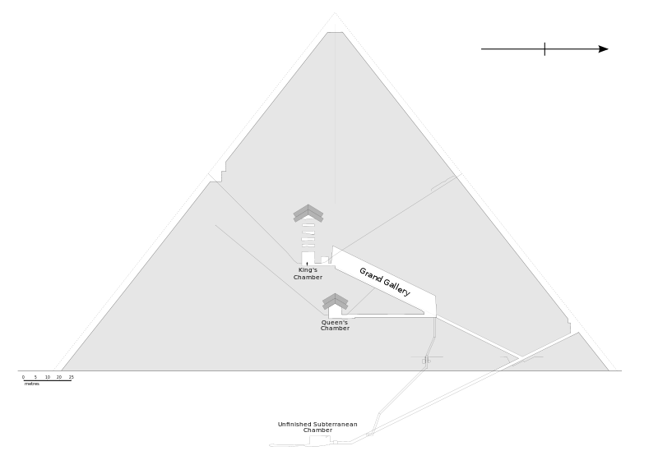
Egyptian Pyramids!
Impressive (神气 shénqì) they are, but they had very little interior (室内 shìnèi) space (空间 kōngjiān). They were built for the burial (葬礼 zànglǐ) of their kings called “Pharaohs” (法老 fǎlǎo).

Slide 8
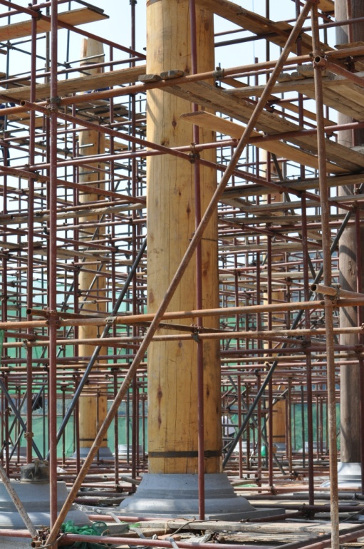
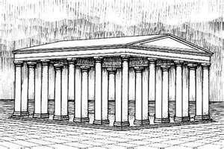
The history 历史 lìshǐ of architecture 建筑学 jiànzhùxué
…is really the history of making increasingly (越来越 yuèláiyuè) large (大) interior (室内 shìnèi) space (空间 kōngjiān) without pillars (pillar = column 支柱 zhīzhù) all over the place.

Slide 9
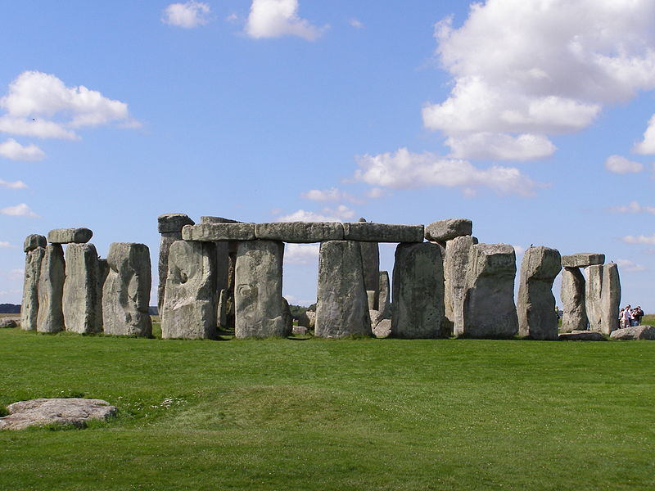
2400–2200 BCE - England
Stonehenge (巨石阵 Jùshízhèn) is in England. Stonehenge served as a burial (葬礼 zànglǐ) ground from its earliest beginnings.
Human bones
(骨头 gǔtou) from
3000 BC were found.

Slide 10
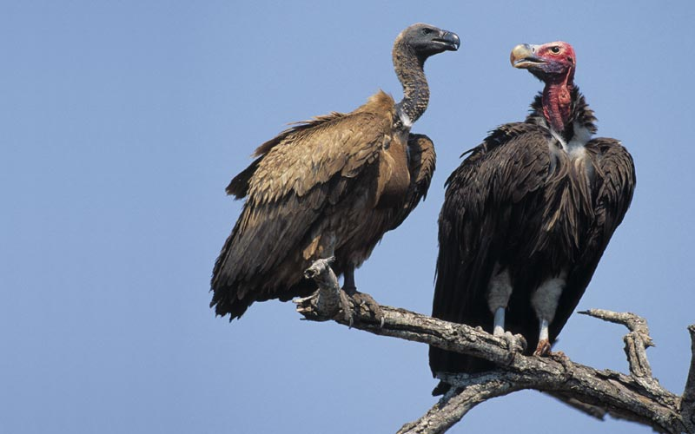
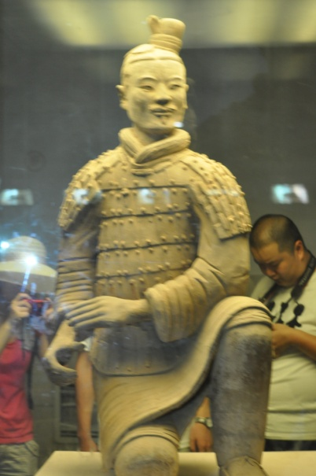
How about you?
Some ancient kings liked to be buried (葬礼 zànglǐ) in fancy (高档的) places.
When I die I’d like to…
A. be eaten by birds
B. be cremated 火化 huǒhuà
C. be put in a pyramid
D. kill my friends and bury them with
me.
OR: I will never die!

Slide 11
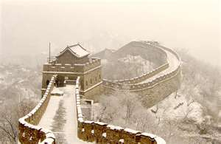
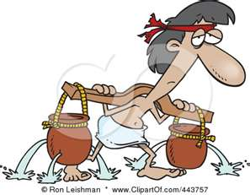
7th Century BCE – 206 BCE China
This was the beginning of the Great Wall of China (长城 chángchéng) which was built (建设 jiànshè) of stone (石头 shítou), brick (砖 zhuān), earth (泥土 nítǔ), and wood 木材 mùcái.

Slide 12
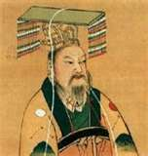
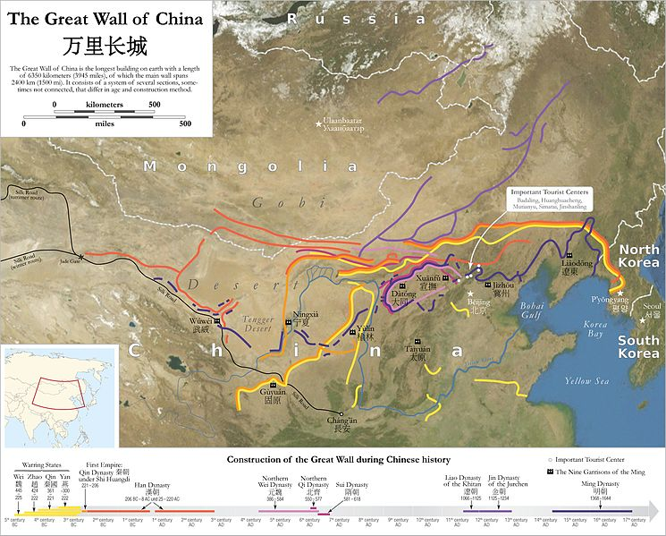
Between 220–206 BCE…
…the first Emperor (皇帝 huángdì ) of China, Qin Shi Huang made the Great Wall stronger and longer and in the Ming Dynasty (朝 cháo; 14th Century), it grew to a length (长度 chángdù) of around 21,196 kilometers (公里 gōnglǐ).

Slide 13
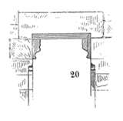
GREECE 希腊 xīlà AND ROME 罗马 luómǎ
In Greek architecture a single stone lintel (楣 méi) can reach between columns (= pillars 支柱 zhīzhù) at most 6.5 meters apart.

Slide 14
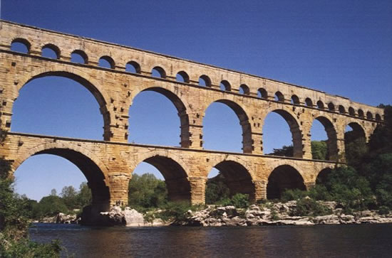
The Roman Arch
But a Roman brick (砖 zhuān) arch (拱状 gǒng zhuàng) can span (跨度 kuàdù) 50 meters.

Slide 15
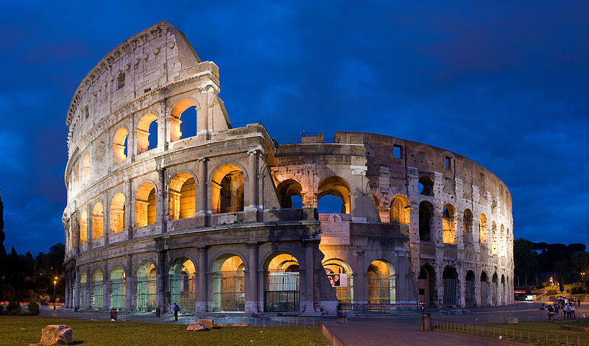
Roman Colosseum 72 ACE
Seated 50,000 spectators and was used for gladiatorial 角斗士 jiǎo​dòu​shì​ fighting. The architecture was beautiful but what went on inside not so beautiful.

Slide 16
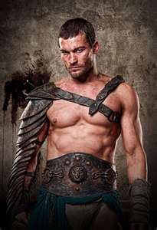
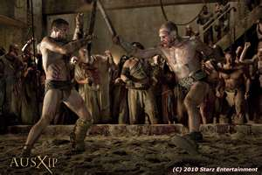
IF there were gladiator games…
Would you pay to go see them?
Yes, I’d go often.
Maybe I’d go sometimes.
Probably可能 not.
Definitely 一定[yídìng]not.

Slide 17
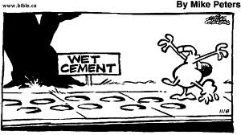
Concrete 发明 fāmíng
The Roman invention (发明 fāmíng) of concrete (混凝土 hùnníngtǔ) helped their architecture a lot.

Slide 18
Review 1-a 复习 fùxí
About when did they start building the Egyptian pyramids? 2630 BC
Did the Egyptian pyramids have a lot of interior (室内 shìnèi) space (空间 kōngjiān)? No
The history of architecture is really the history of making:
A. …more slaves work.
B. …increasingly (越来越 yuèláiyuè) large (大) interior (室内 shìnèi) space (空间 kōngjiān)

Slide 19
Review 1-b 复习 fùxí
About when did they start building the Great Wall of China? 7th Century BC
A Greek stone lintel (楣 méi) can reach between columns (= pillars 支柱 zhīzhù) at most _____ meters apart.
A. 6.5 meters B. 65 meters C. 650 meters
A Roman brick (砖 zhuān) arch (拱状 gǒng zhuàng) can span (跨度 kuàdù) ____meters.
A. 5 meters B. 50 meters C. 500 meters

Slide 20
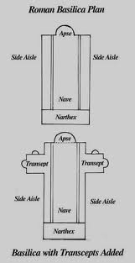
Basilica 带有圆顶的巴西利卡式教堂 dài yǒu yuán dǐng de bā xī lì kǎ shì jiào tang
The Roman public hall, known as a basilica, (带有圆顶的巴西利卡式教堂
dài yǒu yuán dǐng de bā xī lì kǎ shì jiào tang)
is a rectangular (矩形 jǔxíng)
building design also
often used for
Christian 基督教 jīdūjiào
churches 教堂 jiàotáng.

Slide 21
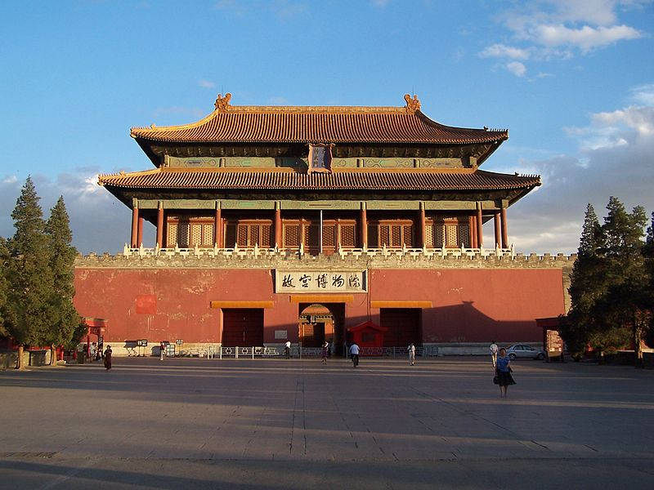
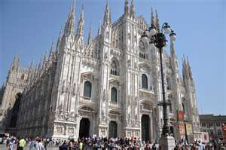
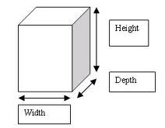
Chinese and European 欧洲的 ōuzhōude differences 差异 chāyì
Chinese architecture is different from Western 西方 xīfāng) in that length (长度 chángdù) and breadth (宽度 kuāndù = width) are more important than height 高度 gāodù, as in Western (西方 xīfāng) European (欧洲 ōuzhōu). (Except for Towers!)

Slide 22
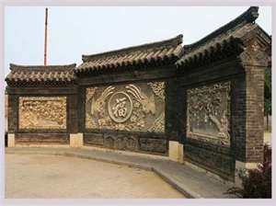
Chinese and European differences
Also, Chinese architecture uses a lot of Feng Shui (风水 fēng​shuǐ) like the use of the Screen walls
(屏风 píng​fēng​) to face the main entrance (入口 rùkǒu) of the house, because of the belief that evil (邪恶 xié'è) things travel in straight 笔直的 bǐzhíde lines.
QUESTION: Is there another reason why a screen wall might be a good idea?

Slide 23
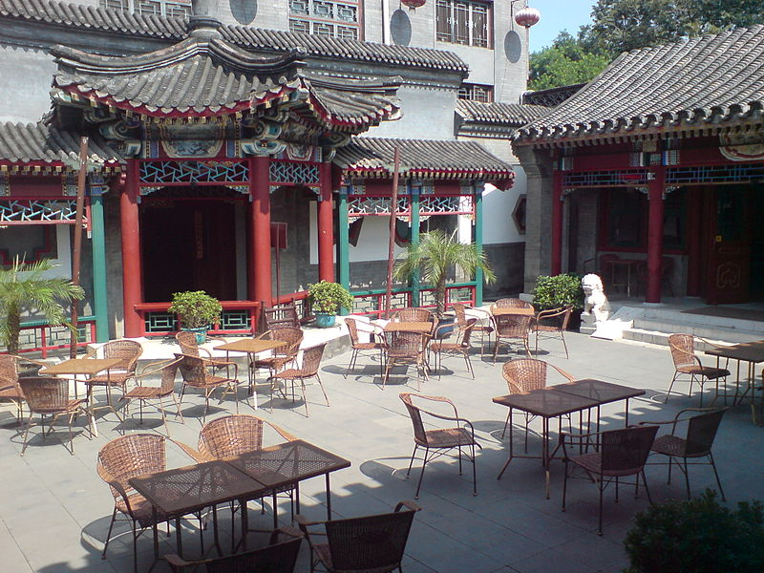
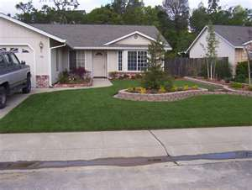
Chinese and European differences
Also, Western (西方 xīfāng) buildings usually have a yard in front (前院 qiányuàn) and back, but in traditional Chinese architecture, there is often or usually a courtyard (大院 dà​yuàn)​ in the middle. (sì​hé​yuàn​ 四合院).

Slide 24
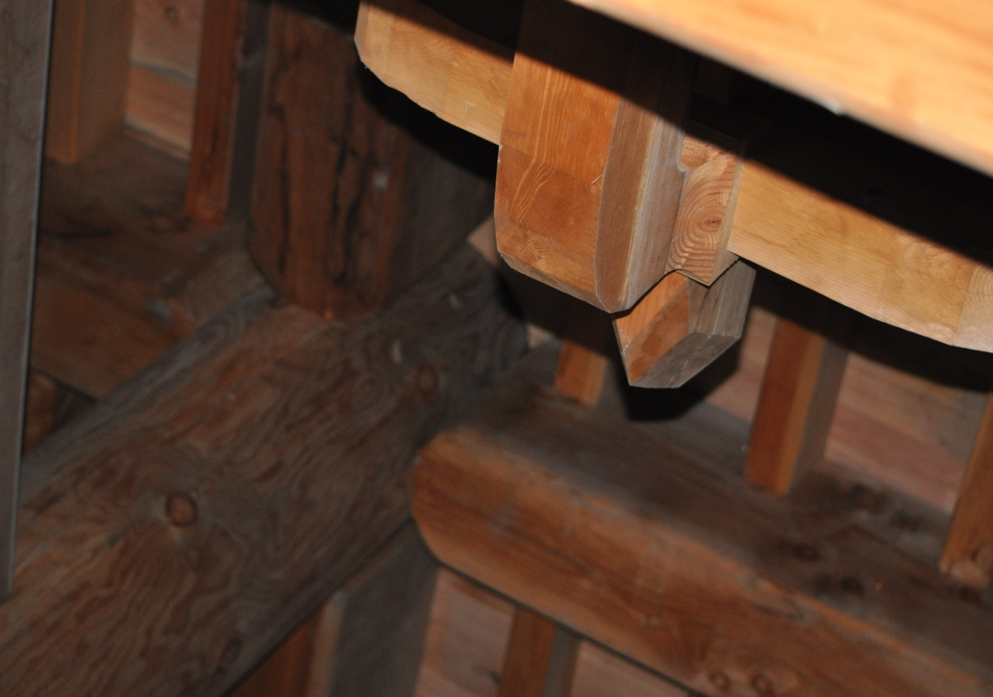
Chinese and European differences
Another difference between Chinese and Western architecture is that ancient Chinese architects usually used wood (木材 mùcái) frames (框架
kuàngjià) made
with interlocking
(斗拱 dǒugǒng)
logs (原木
yuán mù).

Slide 25
Chinese European Similarity 相似的
But, like Western architecture, Chinese architecture likes things big, very big! That’s usually because kings and emperors (皇帝 huángdì ) like things big to show how great they and their (civilization 文明) wénmíng are.

Slide 26
Review 2-a 复习 fùxí
Chinese architects were more interested in
a. length(长度chángdù) and breadth(宽度kuāndù =width
b. Height 高度 gāodù
European architects were more interested in
a. length(长度 chángdù) and breadth(宽度kuāndù=width
b. Height 高度 gāodù

Slide 27
Review 2-b 复习 fùxí & a Q…?
Chinese architecture uses a lot of
a. Feng Shui (风水 fēng​shuǐ)
b. Pizza
QUESTION:
I think Feng Shui is ____________
interesting 有趣的 yǒuqù de
nonsense 胡说 húshuō
important 重要 zhòngyào
?_________________?

Slide 28
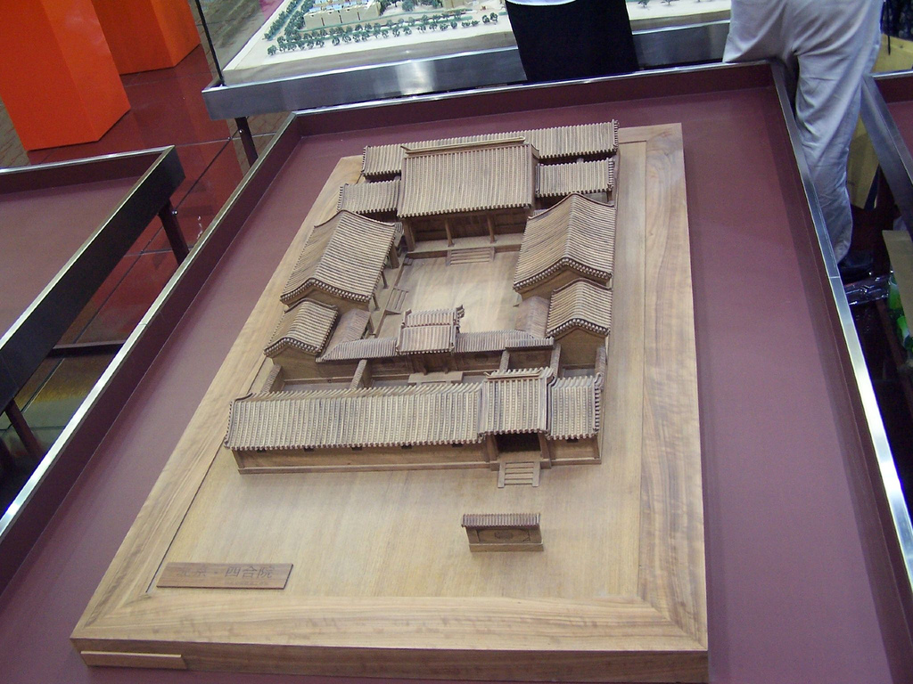
Review 2-c 复习 fùxí
In traditional 传统的 chuántǒngde Chinese architecture, there is often or usually a
a. courtyard (大院 dà​yuàn)​ in the middle. (sì​hé​yuàn​ 四合院 OR
b. yard in front
(前院 qiányuàn)
and back

Slide 29
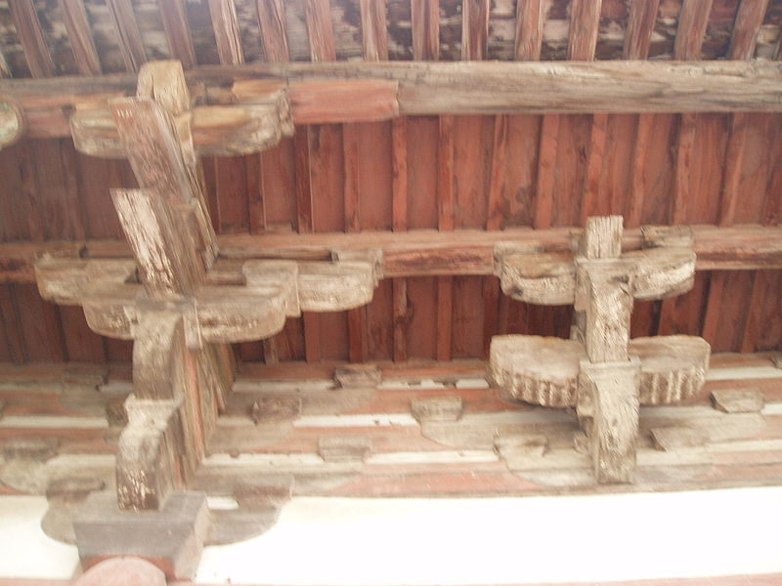
Review 2-d 复习 fùxí
Traditional Chinese architects usually used wood (木材 mùcái) frames (框架 kuàngjià) made with ______.
a. interlocking (斗拱 dǒugǒng)
logs (原木 yuán mù)
b. the use of nails (钉子
dīngzi)

Slide 30
Review 2-e 复习 fùxí
Chinese and European kings and emperors 皇帝 huángdì liked buildings 建筑物 jiànzhùwù
a. small because they’re cheap 便宜的!
b. medium 中等的 size
c. big
WHY?

Slide 31
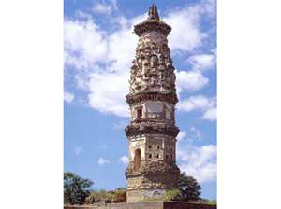
1st Century BCE (-100 → year O)
An interesting architectural design of southeast Asia 亚洲 yàzhōu is the Buddhist stupa (Stupa 塔 tǎ), known in India (印度) from before the 1st century BCE.

Slide 32
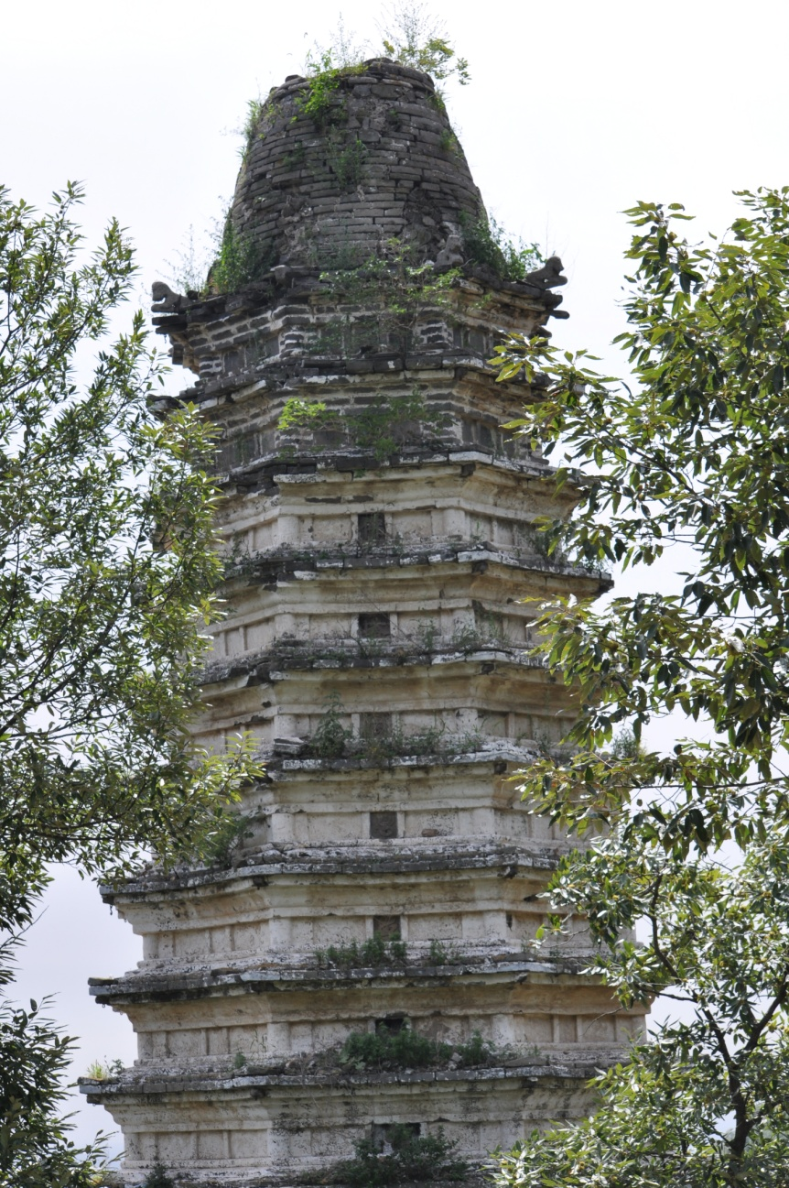
Stupa = pagoda = tower = 塔 tǎ
The stupa provides the architectural model (榜样 bǎngyàng) for Hindu (印度教信徒 yìndùjiāoxìntú) temples (庙宇 miàoyǔ ) in India, for Buddhist (佛教的 fójiàode) temples in southeast Asia and for pagodas (塔 tǎ) in China and Japan.

Slide 33
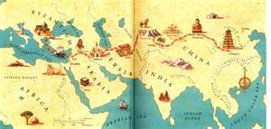
Religion 宗教的 zōngjiàode and Technology 技术 jìshù -> SILK ROAD
Buddhism made its way across Asia 亚洲 along the Silk Road (丝绸之路 sīchóuzhīlù).
From China many religions (宗教的 zōngjiàode) and technologies (技术 jìshù) moved to Japan 日本.

Slide 34
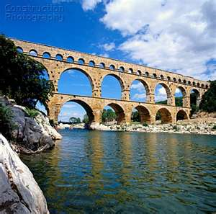
Roman aqueducts-20 ACE 输水道 shū shuǐ dào
In about 20 ACE the Romans built the great aqueduct (输水道 shū shuǐ dào) at Nîmes, known as the Pont du Gard - Bridge of the Gard. (bridge (桥 qiáo)
The water flows gently downhill for a distance of almost 50 km.

Slide 35
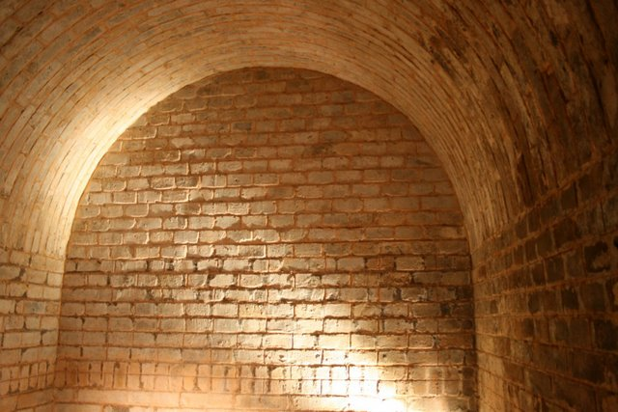
At the same time in China
A vaulted (穹 qióng) tomb (坟墓 fénmù) chamber in Luoyang, built during the Eastern Han Dynasty (AD 25–220) shows use of arches (拱状 gǒng zhuàng) and vaults.

Slide 36
Roman bridges (桥 qiáo).
A fine surviving example, built in ACE 105, in Spain, at Alcántara. Its two very wide central arches, above the river, are made of granite (花岗石 huāgāngshí).

Slide 37
Pantheon(罗马万神庙) in Rome ACE 120
The roof (屋顶 wūdǐng) of the Pantheon in Rome is the most amazing example of the Roman genius. For example, in the center of the arches (万神殿式圆屋顶 wàn shén diàn shì yuán wū) is a circular (圆形的 yuán xíng de) open space.
The Pantheon, built by Hadrian in about 120 ACE, has been a place of worship (崇拜 chóngbài) for nearly 2000 years.

Slide 38
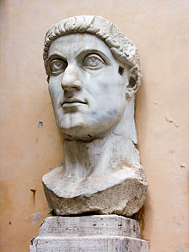
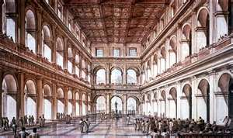
4th Century ACE (= 300 → 399 ACE)
When Emperor (皇帝) Constantine (康斯坦汀 kāngsītǎntīng) made Christian churches and public buildings in the 4th century ACE, the basilica (带有圆顶的巴西利卡式教堂 dài yǒu yuán dǐng de bā xī lì kǎ shì jiào táng) was the form he chose.

Slide 39
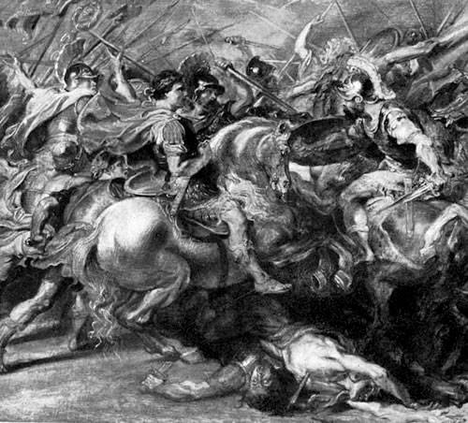
Emperor Constantine
The picture below is Roman Emperor Constantine Fighting Maxentius in the Battle of Milvian.
Roman Emperor Constantine invented (发明 fāmíng) the religion (宗教的 zōngjiàode )of Christianity using the philosophy of Jesus 基督 jīdū. He also conquered 征服 zhēngfú most of his neighbors 邻居 línjū.

Slide 40
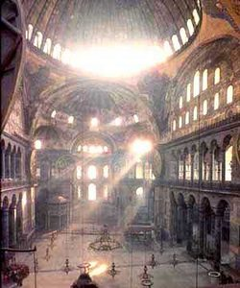
537 ACE – Dome 圆屋顶 yuánwūdǐng ; 穹 qióng
In Santa Sophia in Constantinople (康斯坦丁诺普尔 Kāngsītǎndīngnuòpǔ'ěr - the architects invented a new and amazing technology - placing a vast circular (圆形的 yuán xíng de) dome on top of a square formed of four arches in the now world famous Justinian library 图书馆 tú shū guǎn .

Slide 41
QUESTION…?
Have you been to the AOHUA library?
a. Yes, I often go to the AOHUA library.
b. No, I’ve never gone to the AOHUA library.
c. Yes, once or twice maybe.
Do you like libraries?
a. Yes I really love libraries.
b. I have mixed feelings* about libraries.
c. No, I don’t like libraries.
* [Mixed feelings = 交集 jiāojí = like and don’t like)

Slide 42
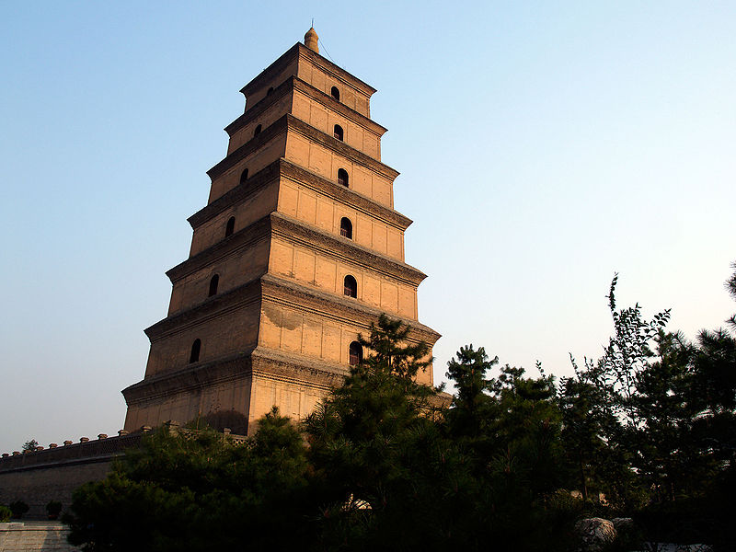
90 years later In China… 652 ACE
The Giant Wild Goose Pagoda (大雁塔 Dà​yàn​tǎ​) in Xi'an, built during the Tang Dynasty is a massive (巨大的 jùdàde), very tall beautiful structure.

Slide 43
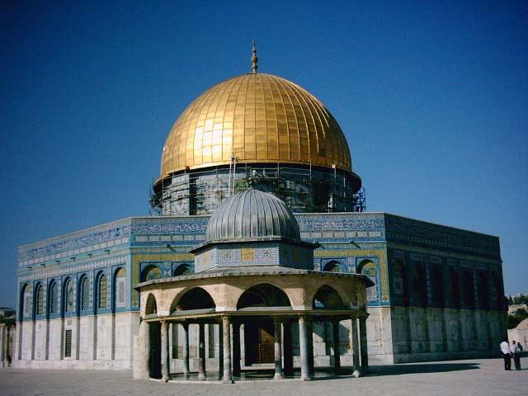
691 ACE Islamic 伊斯兰教的 yīsīlánjiàode Architecture
The Dome (圆屋顶 yuánwūdǐng ; 穹 qióng) of the Rock, completed in 691 and the oldest surviving (幸存 xìngcún) example of
Muslim (穆斯林
mùsīlín) architecture,
borrows the design
of domed roof.
It’s in Jerusalem
(耶路撒冷 yēlùsālěng)
Notes:
50 years earlier the Muslims had taken Jerusalem from the Christians. They also used Christian architectural design.

Slide 44
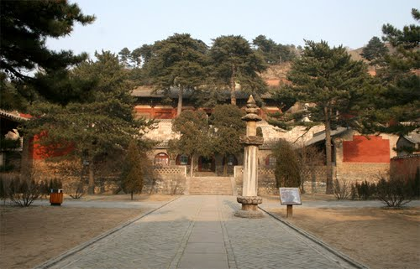
9th & 11th Centuries – China
Dougong 斗拱 Foguang Temple (庙宇 miàoyǔ), built in 857 during the Tang Dynasty used bracket arms, and interlocking wooden brackets (斗拱; dǒugǒng), one of the most important elements in traditional Chinese architecture.

Slide 45
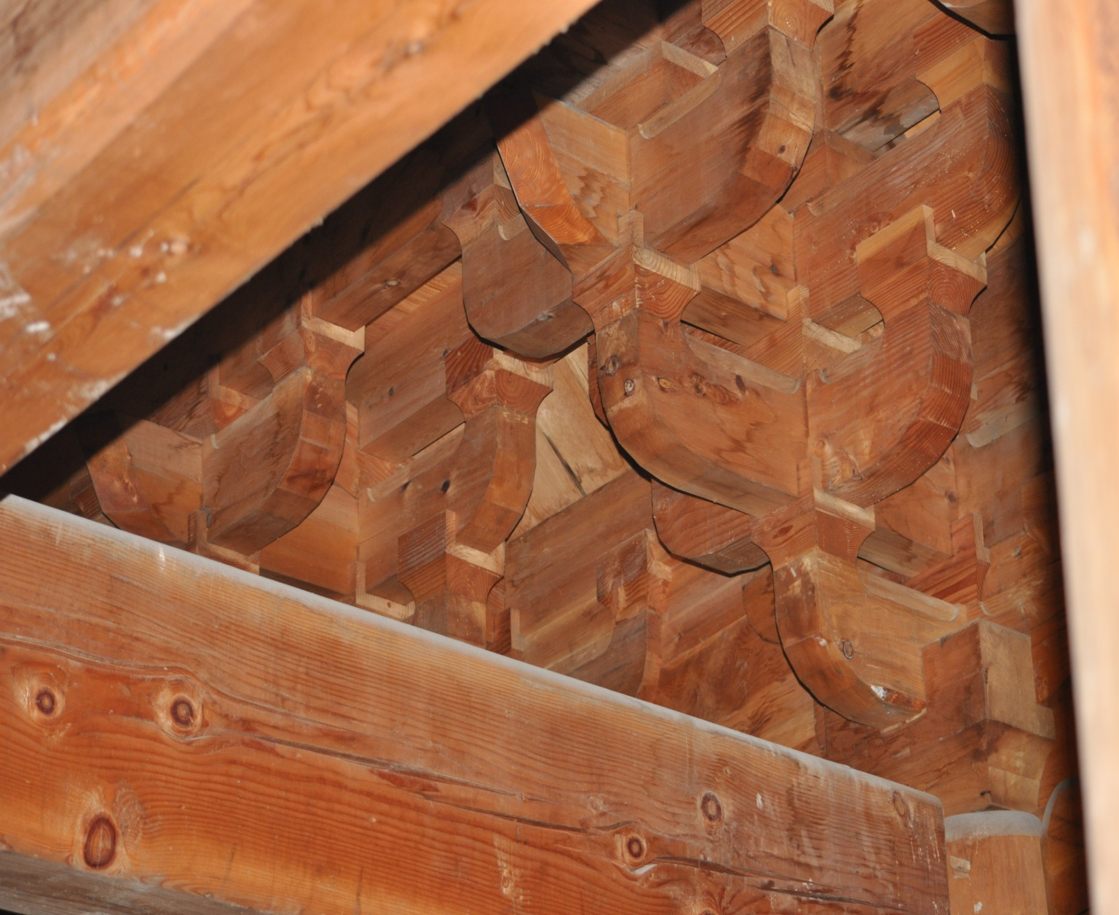
interlocking wooden brackets斗拱 dǒugǒng

Slide 46
Three Pagodas of Chong Sheng Temple, Dali City - 9th and 10th Centuries

Slide 47
1001 – 1055 ACE The Liaodi Pagoda 料敌塔
Tallest (最高 zuìgāo) brick (砖 zhuān) pagoda (塔 tǎ) in the world, it was built in the 11th century during the Song Dynasty (960-1279). It has survived (幸存 xìngcún) several earthquakes (地震 dì​zhèn​).

Slide 48
9th – 13th ACE - European 欧洲 ōuzhōu Medieval 中世纪的 zhōngshìjìde castles 古堡 gǔbǎo
During the 12th century stone (石头 shítou) walls (墙 qiáng) and towers (塔 tǎ) become more common in European castles.
Below is Krak Des Chevaliers castle
Built by crusaders (十字军战士) on their way east
by the Knights of St. John

Slide 49
1103 – China Graceful: 优美 yōuměide
In China they had an advanced (先进的) system of architecture that was very different. This is an original picture from the Yingzao Fashi standard building manual published by the Chinese official and architect Li Jie in the year 1103, during the Song Dynasty. The curve (曲线 qūxiàn) of the roof (屋顶 wūdǐng) is well seen. Lever (杠杆 gànggǎn) arms are also present.

Slide 50
1406-1420 CHINA 故宫
The Forbidden City (故宫 gùgōng) was built between 1406 and 1420. It has 980 buildings and covers 720,000 m2 and traditional (传统的 chuántǒngde) Chinese palatial (宫 gōng) architecture, and has influenced cultural and architectural developments in East Asia and elsewhere.

Slide 51
Forbidden City (故宫 gùgōng)
The Forbidden City was declared a World Heritage Site (世界遗产 shìjièyíchǎn) in 1987 and is listed by UNESCO (联合国教科文组织 liánhéguójiàokēwénzǔzhī as the largest collection of preserved ancient wooden structures in the world.

Slide 52
Temple of Heaven (天坛 tiāntán)
1406-1420 The Hall of Prayer for Good Harvests (祈年殿 qí nián diàn) is a circular (圆形的 yuán xíng de) building, 36 meters in diameter and 38 meters tall, built on three levels of marble (大理石 dàlǐshí) stone foundation (地基 dì​jī​), where the Emperor (皇帝 huángdì) prayed (祈祷 qídǎo) for good harvests (收成 shōucheng).

Slide 53
1406-1420 Temple of Heaven
The Hall of Prayer for Good Harvests has four inner, twelve middle and twelve outer pillars (支柱 zhīzhù), representing the four seasons (季节 jìjié), twelve months and twelve traditional Chinese hours. All the buildings within the Temple have special dark blue roof (屋顶 wūdǐng) tiles (琉璃瓦 liúliwǎ), representing the Heaven.

Slide 54
GOTHIC Architecture (哥特式建筑 gē tè shì jiàn zhù) 12th – 15th Centuries - Europe
Mostly used for great cathedrals (大教堂 dàjiàotáng) of Europe.
Above: Gothic make-up

Slide 55
Questions
How do you feel about Gothic?
I like gothic style because it’s __________.
I don’t like gothic style because it’s ________.

Slide 56
Gothic has another side too.
The interior gives an impression of lightness (重量轻 zhòngliàng qīng) and height (高度 gāodù), with slender columns framing large tall windows and reaching up to support a delicately ribbed stone roof and flying buttresses.

Slide 57
Flying buttresses: Gothic!
Flying buttresses are amazing because
the arch 拱状 gǒng zhuàng goes outside (户外的 hùwài de) the building!

Slide 58
Italian Gothic - Venice (威尼斯).
Doge's Palace, built in its present form between 1340 and about 1500.

Slide 59
14th – 15 Centuries - Domes (圆屋顶 yuánwūdǐng ; 穹 qióng) in Islamic Architecture
14th century Mongol tomb at Soltaniyeh in northern Iran (伊朗 yīlǎng).

Slide 60
Islamic domes – Mamluk Tombs
Mameluke tombs in Cairo

Slide 61
16th – 17th Centuries – Age of Domes
The 16th and 17th centuries were the age (时代 shí​dài) of the dome (圆屋顶 yuánwūdǐng ; 穹 qióng) in Europe and the Islamic Worlds.
Christianity reaches it when the Renaissance (文艺复兴 Wén​yì​fù​xīng​) breaks the long medieval traditions of Romanesque and Gothic.
Left: Shah mosque Isfahan Iran 17th century

Slide 62
My favorite Islamic Palace (16th & 17th Century
Is in Spain… called El Escorial!

Slide 63
St. Peters Dome, Rome (on left) 1590
Rome (罗马 luómǎ) achieves the most impressive (神气 shénqì ; 威风 wēifēng) dome of the 16th century, with the completion of St Peter's (圣彼得 Shèng​ Bǐ​dé​ 大教堂 dà​jiào​táng) in 1590.
What and where is the building above?

Slide 64
17th century ACE Bernini 贝尔尼尼 Italian architect – St. Peters

Slide 65
1767 -1771 China (18th Century)
Putuo Zongcheng Temple, built from 1767 to 1771 during the reign of Qianlong, represents a fusion (融合 rónghé) of Chinese and Tibetan (西藏的 Xīzàng) architectural
style. Buddhist
佛教的
Fójiàode temple
complex built
by Qianlong
Emperor
(1735–1796).

Slide 66
Modern 现代 xiàndài
Beginning of the modern age – Europe - glass 玻璃 bōli, iron 铁 tiě and prefabrication 工厂预制 gōng chǎng yù zhì : AD 1837-1851
Joseph Paxton’s Crystal Palace in England was the beginning of the modern era in architecture…!

Slide 67
Joseph Paxton’s Crystal Palace
Though Chinese had used iron (铁 tiě) in buildings centuries before, Paxton’s Crystal Palace was the first building to use modular (模块单元 mó kuài dān yuán) prefabricated (工厂预制 gōng chǎng yù zhì) parts and be made mainly 主要 zhǔyàode of iron 铁 and glass 玻璃 bōli.
3,300 iron 铁 columns
293,635 panes of glass 玻璃!

Slide 68
What architectural style do you prefer?
Chinese?
What dynasty 朝 cháo? Tang? Song? Liao? Jin? Western Xia? Yuan? Ming? Qing? Modern?
European?
Greek? Roman? Castles? Gothic? Renaissance? Modern?

Slide 69
References
Include:
http://www.historyworld.net/wrldhis/PlainTextHistories.asp?groupid=1519&HistoryID=ab27&gtrack=pthc
www.wikipedia.org

Slide 70
Lesson Plan教案 jiào'àn Goals 目标 mùbiāo
What trends (趋势 qūshì) can be found in the architectures of China, Europe (欧洲) and the Islamic (伊斯兰教的) world?
The history of architecture is really the history of making increasingly (越来越 yuèláiyuè) large (大) interior (室内 shìnèi) space (空间 kōngjiān) without pillars (pillar = column 支柱 zhīzhù) all over the place. This requires [=needs (需要 xūyào]) better design (建筑设计 jiànzhùshèjì) and materials (建筑材料 jiàn zhù cái liào).
Use of symbolism (象征 xiàng​zhēng​ ; 代表 dàibiǎo)

Slide 71
Similarities and Differences
Understand the similarities (相似的 xiāng sì de) and differences (差异 chāyì) between Chinese, European (欧洲的 ōuzhōude) and Islamic (伊斯兰教的 yīsīlánjiàode) architecture.
What were the main (主要 zhǔyào) features (特点 tèdiǎn) of Chinese architecture?
→Use of interlocking beams 斗拱 dǒugǒng (not nails)
→Feng shui & symbolism (象征 xiàng​zhēng​ ; 代表 dàibiǎo) in design (图案 tú'àn) and art
→Use of wood in construction (木材 mùcái)

Slide 72
Chinese architecture
What were the main (主要 zhǔyào) features (特点 tèdiǎn) of Chinese architecture?
→Use of interlocking beams 斗拱 dǒugǒng (not nails)
→Feng shui & symbolism (象征 xiàng​zhēng​ ; 代表 dàibiǎo) in design (图案 tú'àn) and art
→Use of wood in construction (木材 mùcái)

Slide 73
European Architecture
What were the main features 特点 tèdiǎn of European 欧洲的 ōuzhōude architecture?
Increasingly large arches (拱状 gǒng zhuàng) that even went outside (户外的 hùwài de) the building: flying buttresses
Christian (基督教 jīdūjiào) symbolism (象征 xiàng​zhēng​ ; 代表 dàibiǎo)
Use of stone (石头 shítou) in construction

Slide 74
Islamic Architecture
What were the main features of Islamic architecture?
Use of increasingly large domes (yuánwūdǐng ; 穹 qióng)
Islamic symbolism & geometric designs (图案 tú'àn)

Slide 75
Iron (铁 tiě) in construction
Who used iron (铁 tiě) in construction first, Chinese or European?
→ Chinese used it centuries before Europeans

Slide 76
Modern (现代 xiàndài) architecture
Modern (现代 xiàndài) architecture often uses lots of glass (玻璃 bōli) and steel (钢铁 gāngtiě) and has a modular (模块单元 mó kuài dān yuán) design. What was the first building that used lots of glass and iron and had a modular design?
Joseph Paxton's “Crystal Palace” built for the Great Exhibition of 1851 in England.

