Slide 1
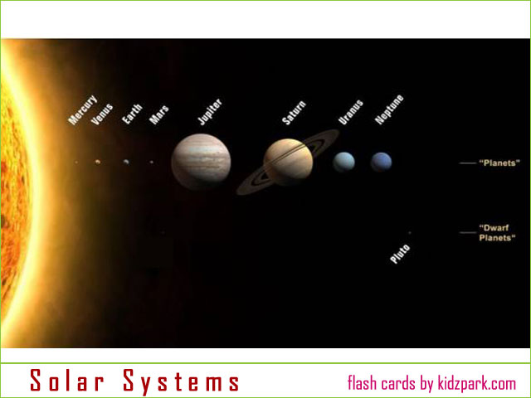
Astronomy 天文学 tiānwénxué

Slide 2
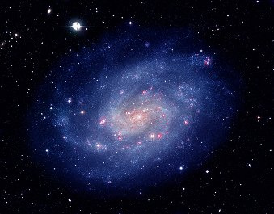
The origin 起源qǐyuán of the Universe 宇宙yǔzhòu
Scientists think the universe began with the “Big Bang”
生活大爆
Shēnghuó dà bào

Slide 3
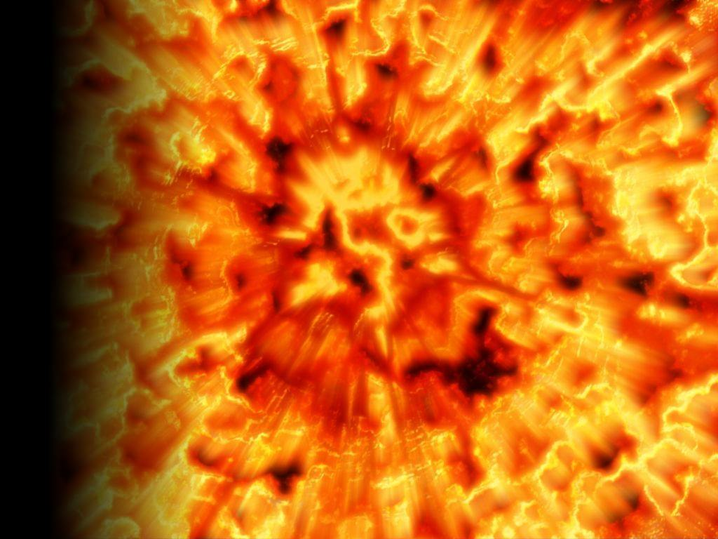
Age of the Universe
Astronomers think the big bang happened between 12 and 14 billion years ago.
→12,000,000,000 – 14,000,000,000 years ago.
BANG!

Slide 4
Discussion topic
The BIG BANG was the biggest
EXPLOSION 爆炸 bàozhà in all of time.
Would you like to watch it?
→ I’d like to see the BIG BANG!
→ I wouldn’t like to see it.

Slide 5
Our Solar System 太阳系tàiyángxì
Our solar system has 9 planets:
1. Mercury
2. Venus
3. Earth (our home)
4. Mars (the red planet)
5. Jupiter (the biggest)
6. Saturn (the most beautiful)
7. Uranus
8. Neptune
9. Pluto (Some say it’s not a real planet!)

Slide 6
Age of the solar system
Astronomers think
the solar system is about 4.5 billion years old.
4,500,000,000 years old!
Yes, older than me!

Slide 7
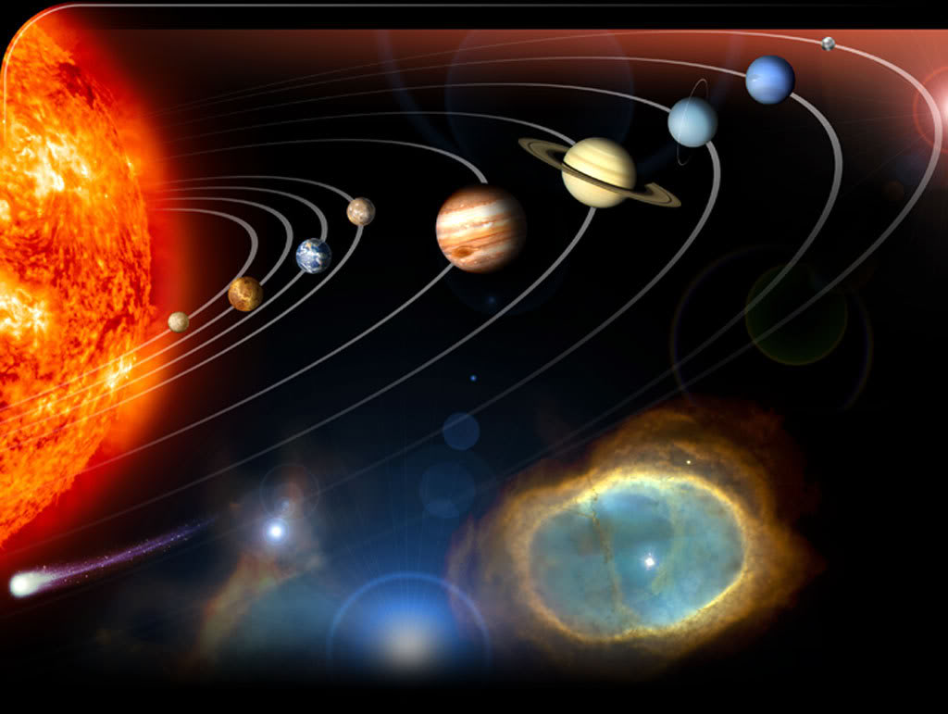
What is this called? Name the planets.

Slide 8
Where did the Solar System come from?
Astronomers think our solar system is broken off pieces of a star that cooled down.
We come from the earth.
So, if the earth came from the stars, we too are made from a star.

Slide 9
Discussion topic
Do you really believe we are made from stars?
→ Yes, I believe people are really made from stars…
→ No, I don’t believe people are really made from stars…
…because ______________.

Slide 10
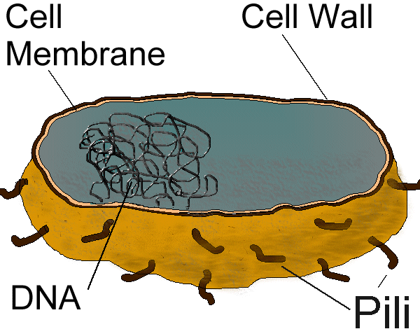
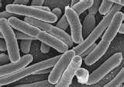
When did life 生物 shēngwù on earth begin?
Scientists think life began on earth about 3.75 billion years ago.
The first living things were a bacteria 细菌xìjūn - one-celled prokaryotes 原核生物.

Slide 11
Other things in space 太空tàikōng
Include:
Galaxies 银河系 yínhéxì
Black holes 黑洞 hēidòng
Comets 彗星 huìxīng
Asteroids 小行星 xiǎoxíngxīng

Slide 12
When will the universe die?
Trillions of years in the future, the universe will burn out 精疲力竭 jīngpílìjié and there will be no more light.
All, everywhere, everything will become dark 黑暗 hēi'àn again.
After that, maybe, there will be a new BIG BANG, and the whole show will start again.

Slide 13
“Darkness born from darkness.
The beginning of all understanding.”
From the Tao Te Ching 道德经 dàodéjīng

Slide 14
Vocabulary
Astronomy 天文学 tiānwénxué
Origin 起源 qǐyuán
Universe 宇宙 yǔzhòu
The Big Bang 生活大爆 Shēnghuó dà bào
Solar System 太阳系 tàiyángxì
Space 太空 tàikōng
Galaxies 银河系 yínhéxì
Black holes 黑洞 hēidòng
Comets 彗星 huìxīng
Asteroids 小行星 xiǎoxíngxīng
Burn out 精疲力竭 jīngpílìjié

Slide 15
TIME LINE 时间链
3.75 billion years ago: Origin of life on earth
Trillions of years in the future: The universe will burn out, and all will be dark again.
2.3 million years ago:
Origin of first humans in Africa
13 billion years ago : the Big Bang
4.5 billion years ago: origin of Solar System
--------------------------------------------------------------

Slide 16
Final Thought
Einstein said that:
Time = Space
They are the relationship between objects in motion. A day is the relationship between the rotation of the earth and the sun.
People only know time on our planet.
Maybe from the “outside” of time, the past and future are ONE.

Slide 17
Discussion topic
I think astronomy is a…
…really interesting science
…little interesting
… little boring
… really boring
…subject!

