Slide 1
Chemistry 化学huàxué
Science of the 114
elements元素 yuánsù
What they are
How they interact

Slide 3
There are two kinds of chemistry
Inorganic: Not living 无机的
Organic: Living 有机化学
Single elements, like on the Periodic Table are not living

Slide 4
Some of the elements you should know:
1. Hydrogen 氢 qīng 1st element on periodic table. Has one electron 电子[diànzǐ]. Mixes with Oxygen to make air.
2. Helium 氦[hài] Lighter than air! Good for balloons 气球[qìqiú] Has two electrons
6. Carbon 碳[tàn] Has six electrons – all living things have carbon!
8. Oxygen 氧气[yǎngqì] Has eight electrons: mixes with Hydrogen to make air.
11. Sodium 钠[nà] Has eleven electrons: Mixes with chloride to make table salt 盐.
19. Potassium 钾[jiǎ] Listed as “K” on the periodic
table. Needed for producing electricity in human nerves. 神经[shénjīng]
20. Calcium 钙[gài] Needed for strong bones and teeth.
26. Iron 铁[tiě] Needed to help blood carry oxygen, and make steel.

Slide 5
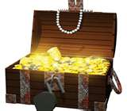
You should also know:
47. Silver (AG)
79. Gold (AU)

Slide 6
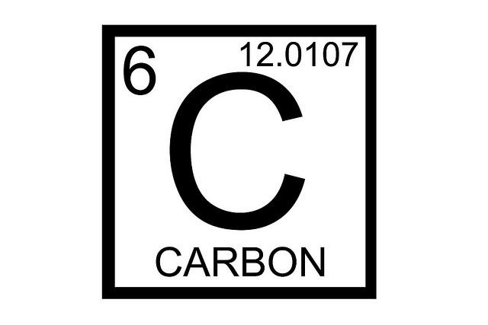
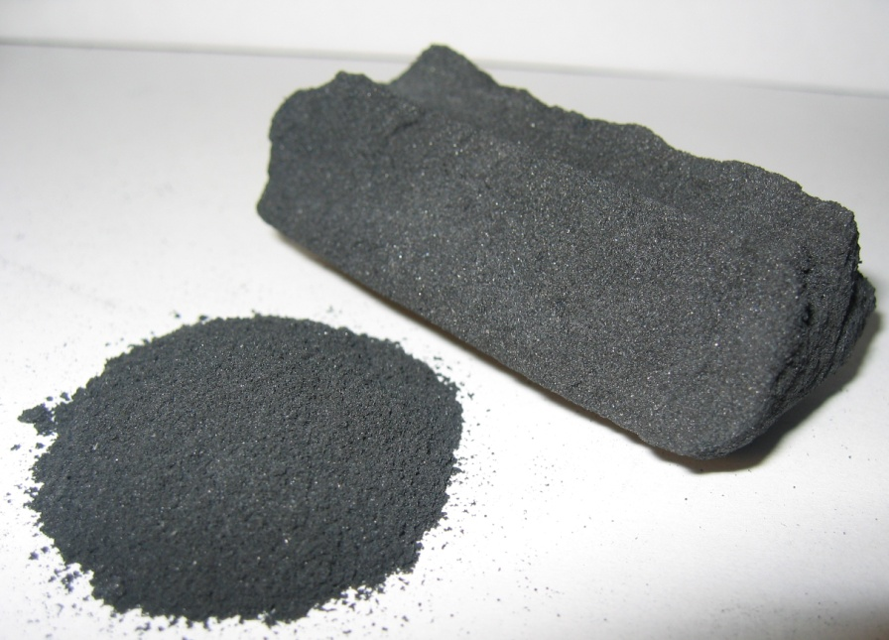
Organic chemistry 有机化学 about living things. All living things have carbon.

Slide 7
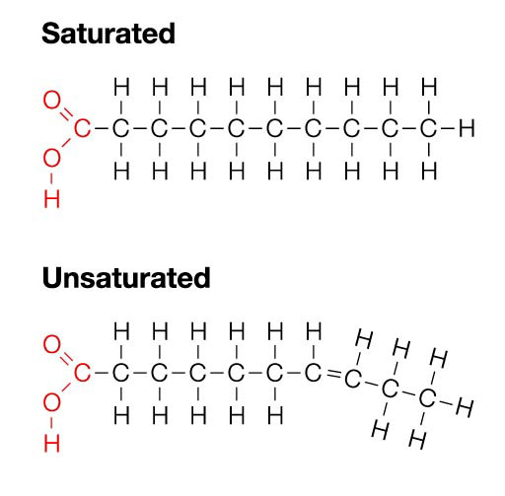
Carbon Chains 碳链[tàn liàn]
These are two kinds of fat.
Saturated: 脂肪
Unsaturated: 食用油

Slide 8
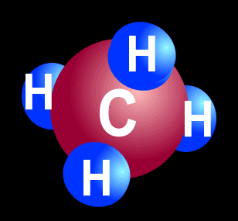
Petroleum 石油 shíyóu
= Crude oil
Question: Would this be organic, or inorganic chemistry?

Slide 9
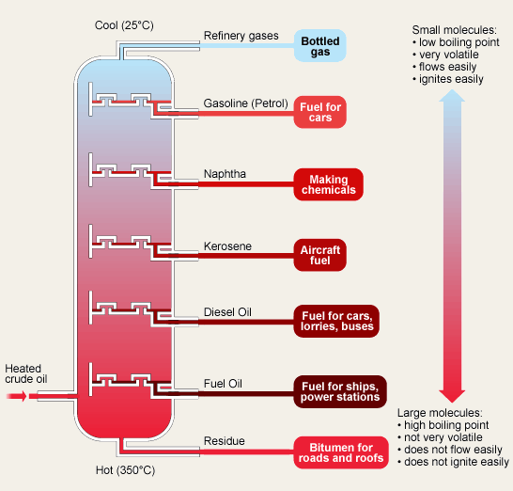
To make gasoline 汽油 qìyóu = petrol
You need an oil refinery!

Slide 10
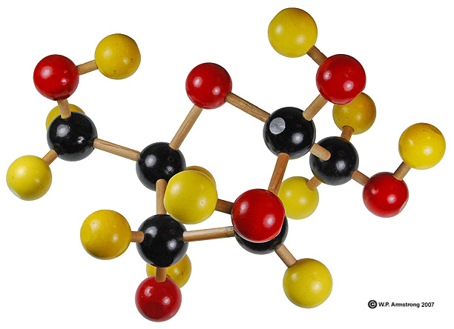
Here is fruit sugar = Fructose

Slide 11
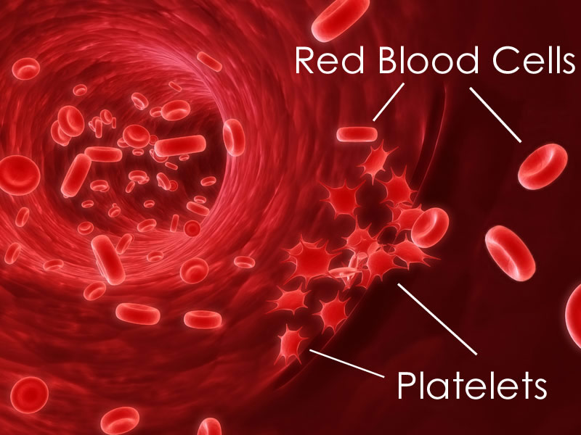
And healthy blood 血液[xuèyè]

Slide 12
Nomenclature
Formulas and Names of Binary Metal-Nonmetal Compounds
The name of the metal is first (ie: NaCl, sodium chloride)
The name of the nonmetal has -ide added (ie: NaCl sodium chloride)
IF the metal has more than one possible charge
With the Stock Method you must indicate which ion using the charge in roman numerals (ie: FeCl₂ Iron (II) chloride).
Alternatively the common name may be used if the metal has more than one possible ion. Here use the Latin root and then add -ous for the lower charge. -ic for the higher charge.
FeCl₂ ferrous chloride
FeCl₃ ferric chloride
More examples showing the two different systems:

Slide 13
Nomenclature
Formulas and Names of Binary Nonmetal-Nonmetal Compounds
Systematic Nomenclature:
For names start with element to the left side on the periodic table
add -ide to the second element
use Greek prefixes for number of atoms: mono, di, tri, tetra, penta, hexa, hepta, octa, nona, deca
Example:
CO carbon monoxide
CO₂ carbon dioxide
N₂O₅ dinitrogen pentoxide
Common names: -ous and -ic (-ic has greater charge, OR has fewer atoms). Examples

