Slide 1
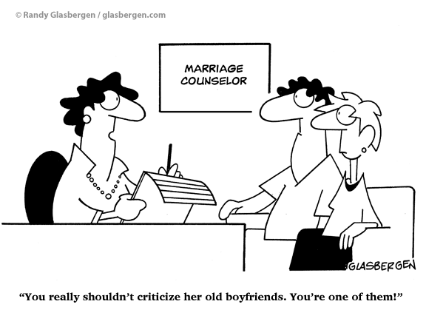
Conversation
Intermediate level
Everybody needs a counselor sometimes!
咨询心理学 (Counseling Psychology)

Slide 2
Interaction互动hùdòng is golden!
Do you have problems?
Heck yeah! Everybody has problems sometimes.
Today I’m going to give you more problems!
Ha ha. Not real problems, fake problems, and you’re going to help each other solve those problems.

Slide 3
Speed Survey:
A: Do you have any problems?
B: Yes, no, maybe
A: [If “yes” or “maybe”:] How many? Be honest now!
You don’t have to tell us your problems, just how many you have.

Slide 4
Too shy?
Don’t worry! The problems I give you are fake!
So, just relax. Take a deep breath. Stretch a little!
Have fun!

Slide 5
Counselor questions
1. How can I help you? (OR) What can I do for you? (OR) What seems to be the matter?
2. How do you feel about that?
3. Is this the first time something like this has happened to you? [or, “When did it start?”]
4. What do you think you should do?
5. Do you have any other ideas?
6. Do you have friends or family you can talk to? (If “no” counselor says, “you can always come and talk with me.”)
7. What is the best thing for you to do now?

Slide 6
YEP! Seven little questions!
1. How can I help you? (OR) What can I do for you? (OR) What seems to be the matter?
First, you’ve got to sound like you care. Make your voice soft and gentle. The sound of your voice is very important!

Slide 7
2. How do you feel about that?
How many feelings can you name?
_________________
_________________
_________________
_________________
_________________
_________________
_________________
_________________
Counselors believe people think too much and don’t pay enough attention to feelings.

Slide 8
3. Is this the first time something like this has happened to you? [or, “When did it start?”]
Don’t ask this question if someone is dying, or their cat died. It sounds kind of stupid!
Instead just go to the next question…

Slide 9
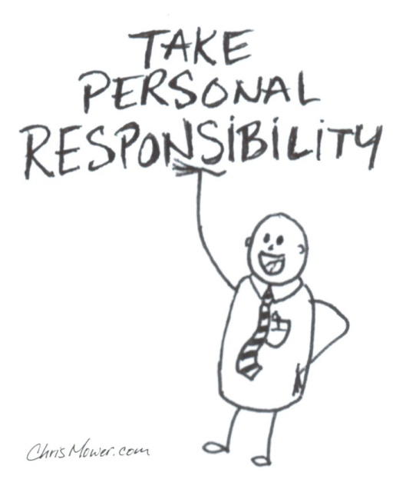
4. What do you think you should do?
This question makes the point that people have their own best answers. The counselor gently pulls the answer from the person.
Advice can go terribly wrong, so never give advice忠告. That’s my advice!
Ha ha.

Slide 10
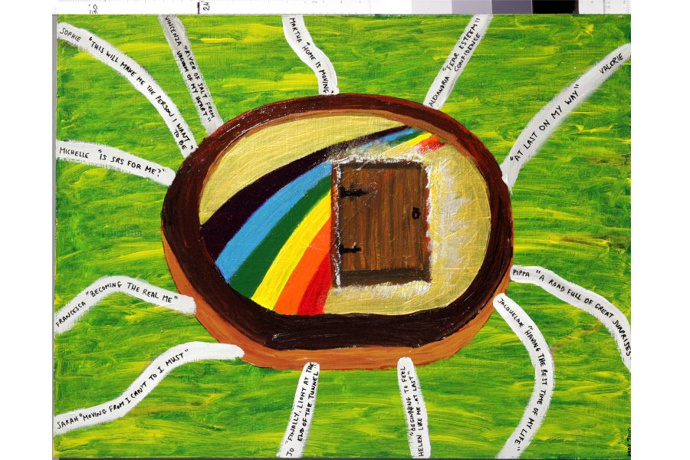
5. Do you have any other ideas?
Sometimes that first idea is a bad idea.
Like: “Kill that guy!”
So, the counselor helps the client explore explore options…

Slide 11
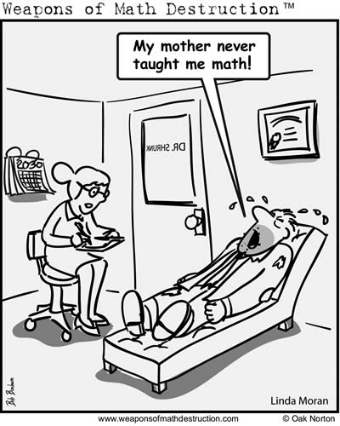
6. Do you have friends or family you can talk to?
If “no” counselor says, “you can always come and talk with me.”
People often have resources (like family and friends), but don’t think to use them.
But, if someone has HIV/AIDS, they might not want to talk about it with their mom or friends!

Slide 12
7. What is the best thing for you to do now?
This means to prioritize the problems, and get ready to put a solution into action. A very important step!

Slide 13
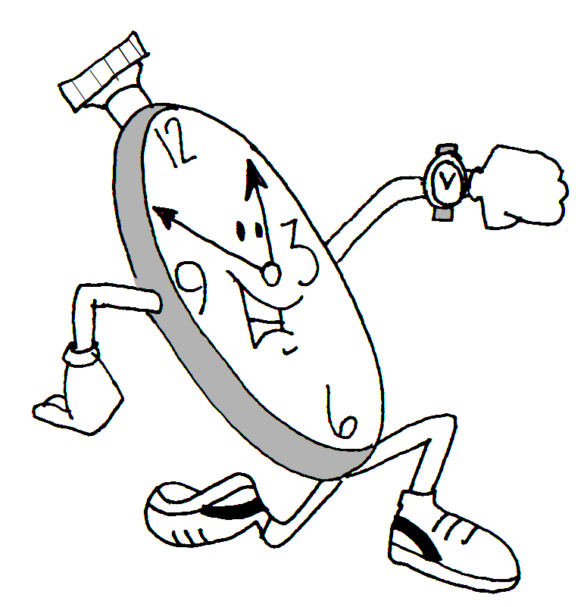
QUESTIONS? Comments?
Now, it’s time to start.
I have a list of problems for you. You can choose a number… 1 – 20. I’ll read the problem. Another person will just go through the counseling questions with you.
It’s easy!!!
Ready?

Slide 14
Problems… TOP SECRET!!!
1. You always smell bad.
2. Your mother is an alien.
3. A vampire bit you.
4. You are going crazy.
5. A witch turned you into a frog.
6. You have a drug problem.
7. You are pregnant (or your girl friend is pregnant).
8. You just found out you have AIDS.
9. Your 17 year old daughter just ran away.
10. You are really stupid and ugly.
11. You’re going to prison for murder but you’re innocent.
12. Nobody loves you.
13. You just found out your brother is gay.
14. All your hair is falling out.
15. Everybody thinks you are gay but you’re not.
16. Your parents moved away without telling you because they don’t like you.
17. Aliens are following you.
18. Your English teacher hates you.
19. You have a date with a pop star but you have a huge pimple on your nose.
20 Pink monkeys from mars are stealing your underwear.
After showing the client the problem, leave slide 5 up so the counselor can read the questions!

Slide 15
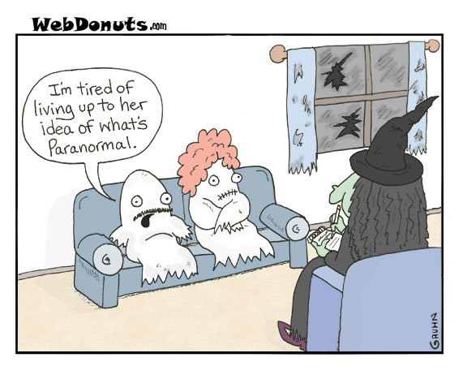
By the way…
These are real counselor questions.
They can be very useful in the real world.

Slide 16
By the end…
Both the client and the counselor has to feel comfortable with the solution. If either isn’t maybe exploring more options is a good idea.

