Slide 1
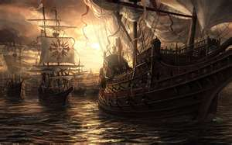
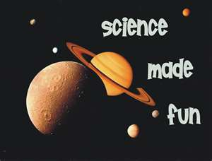
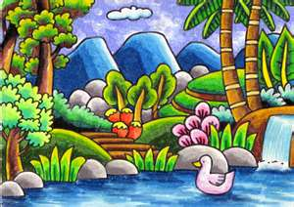
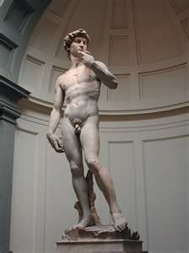
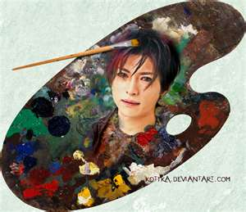
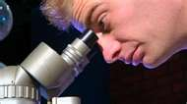
What are arts and sciences?
Define下定义 arts艺术
and sciences科学

Slide 2
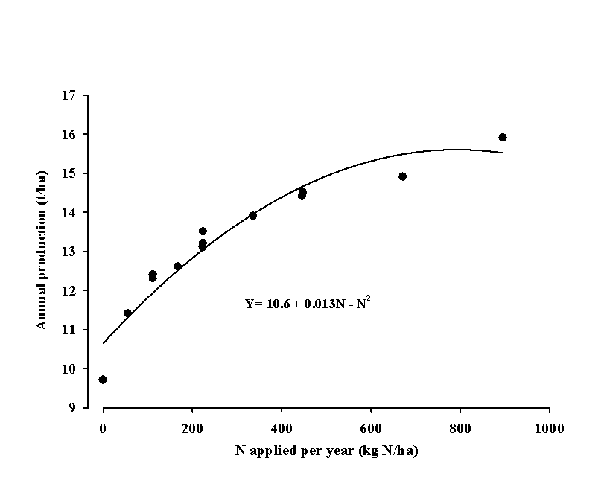
What is science?
Science is the search for
lawful法律 relationships关系 between events事件 in nature自然.
Why does this
happen?
* What is the
relationship?
搜查

Slide 3
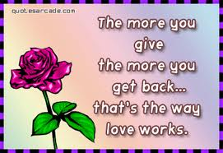
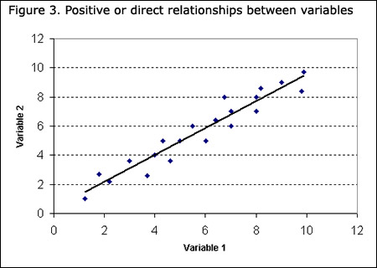
What is the relationship关系 between
Studying and getting good scores评分 on tests?
The love you give and the love you get?
Yeah, this is science!
And, love will probably cause the best and worst events in your life! Ha, ha!

Slide 4
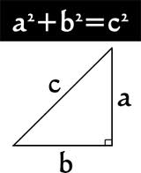
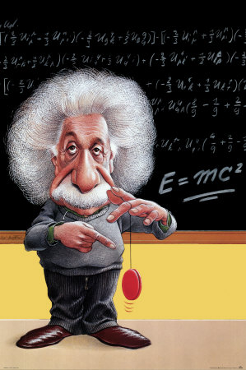
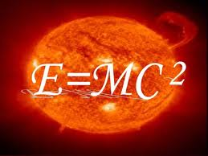
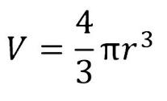
Lawful合法 relationships
“a” squared + “b” squared ALWAYS = “c” squared.
IT’s A LAW法!

Slide 5
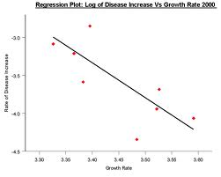
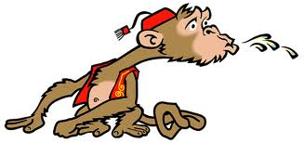
What is the relationship between…
Spitting吐痰 on people and making friends?
That’s a natural relationship… spit on someone and they will not like you!

Slide 6
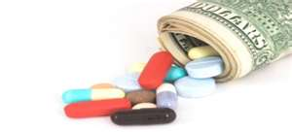
Science is also..
Science is also a way to find the truth证明 by making theories理论 and testing them with experiments实验.
I think this medicine医药 is good for a cold感冒. I test this theory by giving it to people with colds to see if they get better.
If they get better it tells me my theory is good. If they die, my theory is bad!

Slide 7
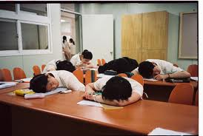
We are all scientists
We all test theories.
Student test teachers…
What will the teacher do if I..
Play games on my phone
Sleep
Don’t take the test…

Slide 8
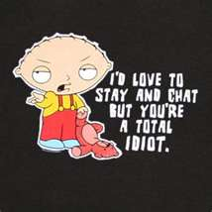
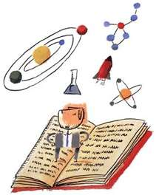
What is your theory 理论?
The teacher can do nothing! Ha, ha!
But, you’ll get a lower grade… 40%?
A lawful relationship!

Slide 9
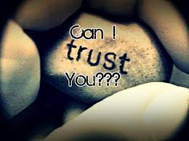
Really…
Science is about the search 查 chá for truth 证明 zhèng​míng​.
We need good medicines.
We need someone to be honest 实 shí​
We need to trust some things.
Trust: 信任, 信赖; 管理, 照顾; 托管, 信托; 托拉斯, 企业联合

Slide 10
Science Vocabulary
search查 chá​
Lawful合法 hé​fǎ​
relationship关系
experiments实验 shi yan
Truth 证明 zhèng​míng​
Theory 理论 lǐ​lùn​
Scores 评分 píng​fēn​
Trust: 信任, 信赖; 管理, 照顾; 托管, 信托; 托拉斯, 企业联合

Slide 11
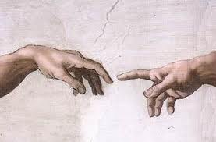
Review
What is science?
Science is the search for lawful relationships between events in nature.

Slide 12
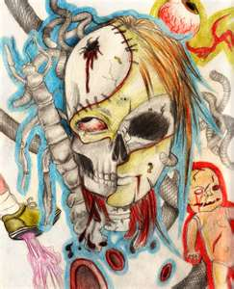
What are Arts
There are many ways to define arts…
For example:
1. Art is whatever a person
does best.
That’s their art!
Arts

Slide 13
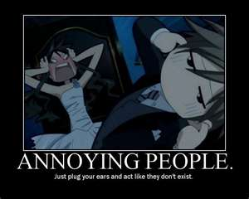
Some people are very…
Annoying
气人, 搅, 烦人, 惹毛
That’s their
Art!

Slide 14
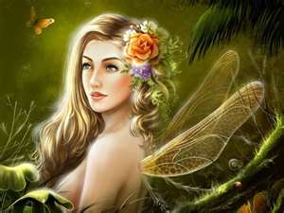
Some people are very…
Beautiful!
That’s their
Art!

Slide 15
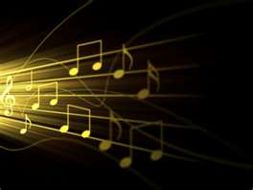
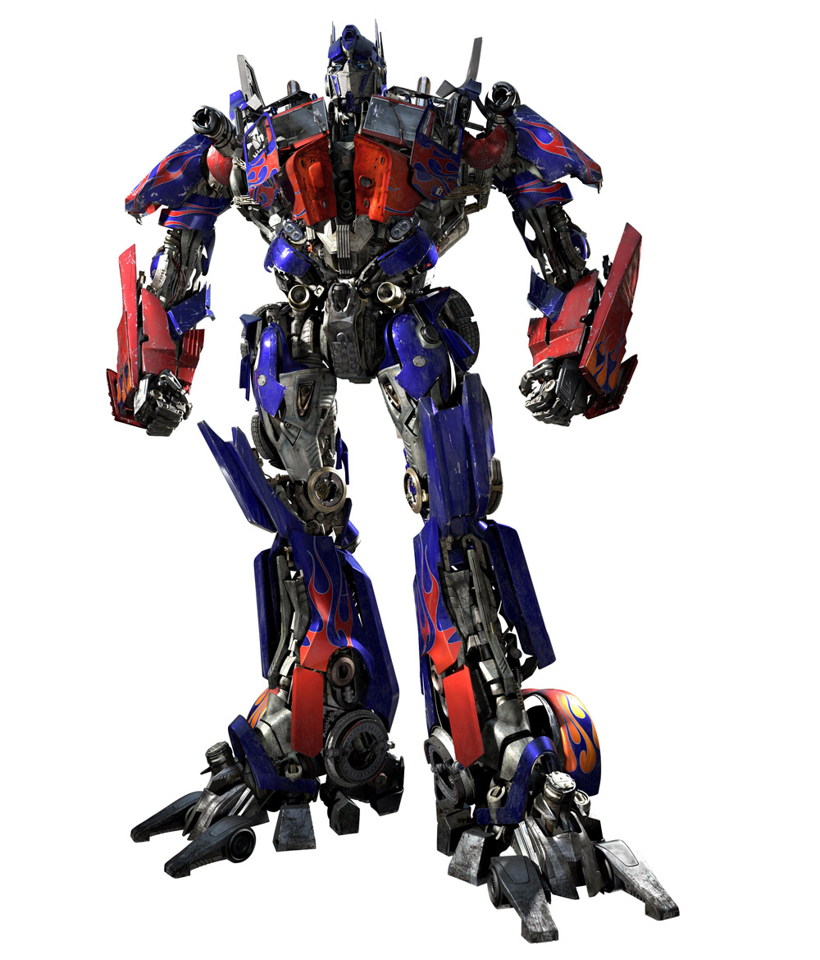
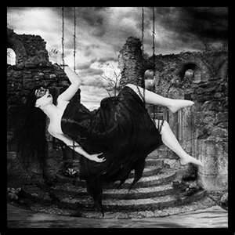
2. Art also is a…
… Transformation…
转型, 点化, 变换
…process 历程, 工序
一条龙
I feel love, so I write a love song.
I feel sad, so I paint a beautifully sad painting.

Slide 16
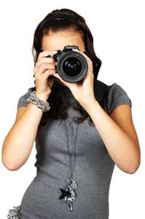
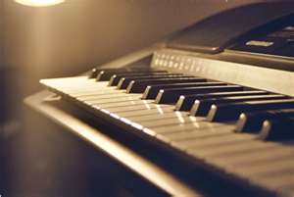
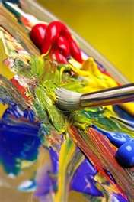
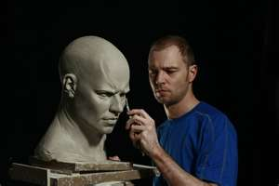
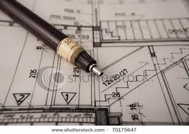
Art can transform feeling 情感
Paint brushes
Through an instrument…
工具, 追,
Musical
Even scientific instruments like web design 网页设计, etc.

Slide 17
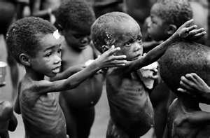
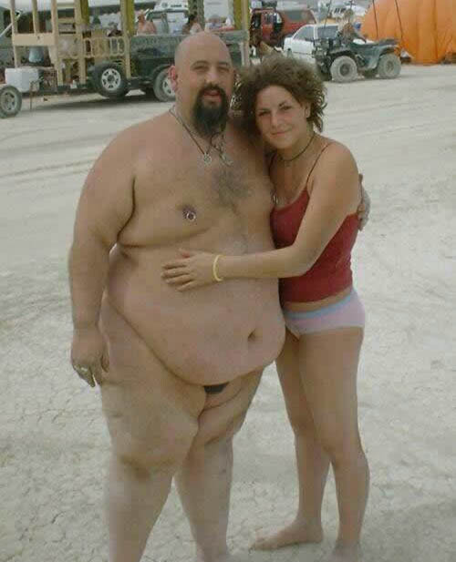
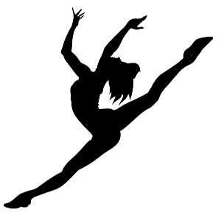
3. Art should also…
Make you feel something!
Is this art?
Does it make you feel something?
What do you feel when you look at these? Anything?

Slide 18
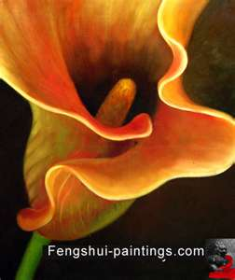
What arts do you like the best?
Painting 画
Poetry 诗
Sculpture 雕刻品
Music 音乐
Dancing 跳舞
Comedy 喜剧
Being annoying? 缠
Photography? 摄影

Slide 19
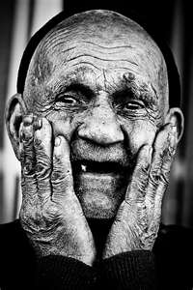
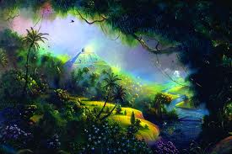
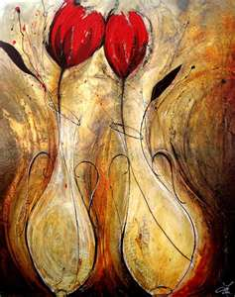
What is art? Review考核
Art is whatever a person does best.
Art is a transformation process.
Art should make you feel something.
It can be beautiful or ugly

