Slide 1
Geography地理[dìlǐ]
The science of the earth’s surface 表面[biǎomiàn] (mountains, oceans海洋[hǎiyáng] , rivers河[hé] , countries国家guójiā, people and atmosphere大气层 dàqìcéng.

Slide 2
1600 World Map

Slide 3
Geography Trivia Questions
How many countries are there in the world?
What is the tallest mountain, the two longest rivers, the deepest ocean, the largest glacier冰川[bīngchuān] ,
What is the International Dateline?
194 (Not including Taiwan)
Mount Everest
Nile River, Amazon River
In the Western Pacific, south of Japan and north of New Guinea, and to the east of the Mariana Islands is the lowest elevation of the surface of the Earth's crust. Known as the Mariana Trench, the trench is nearly 1,580 miles (2,550 kms) long and 43 miles (69 km) wide, its deepest part is known as the Challenger Deep.
The Lambert Glacier, located in East Antartica, is the largest on Earth. 250 miles (400 km) long, 60 miles (100 km) wide, and 2,500 meters deep.

Slide 4
What time is it now?
The International Dateline
The Prime Meridian is the meridian of longitude that passes through Greenwich, England. On the opposite side of the Earth at 180 ° longitude lies an imaginary line called the International Dateline.

Slide 5
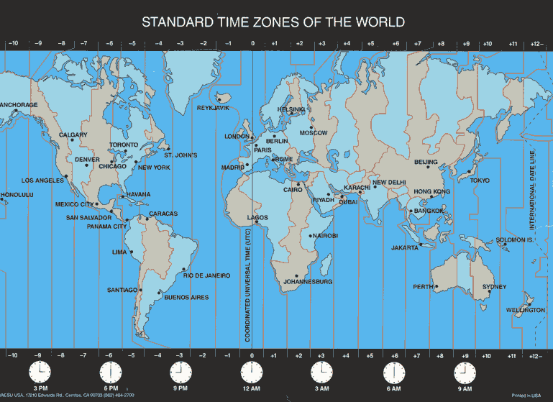
Greenwich Mean Time
格林尼治标准时间gélínnízhìbiāozhǔnshíjiān

Slide 6
International Dateline

Slide 7
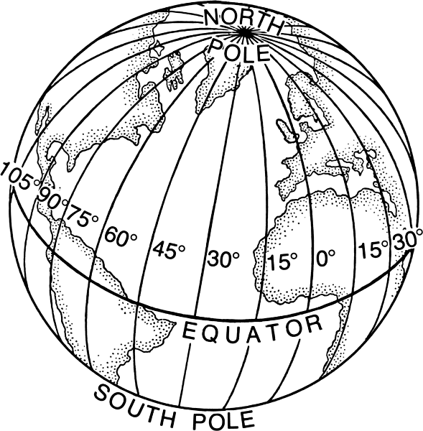
Latitude & Longitude
Latitude 纬度 wěidù
Longitude 经度 jīngdù

Slide 8
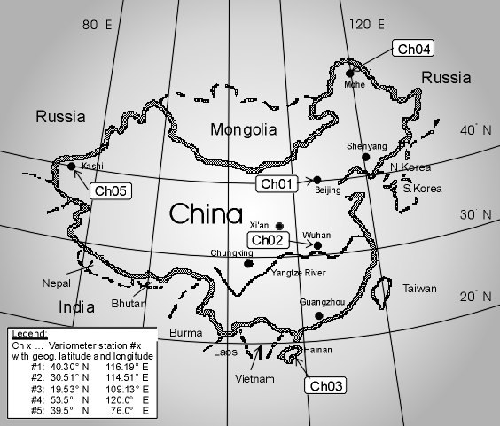
Latitude and longitude of Beijing
Beijing, China: 39 : 55 N : 116 : 25 E :

Slide 9
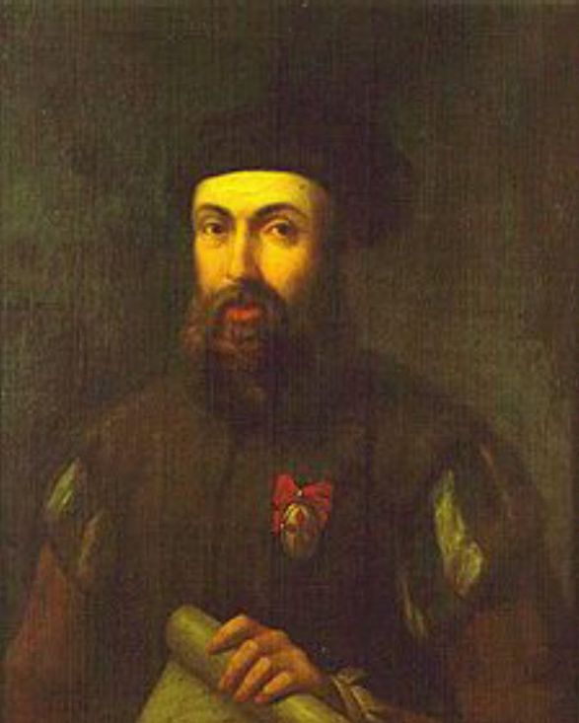
Magellan!
If you took a cruise on a ship, traveling around the whole world, you would understand the importance of an international dateline. Ferdinand Magellan did just that in the year 1519. Magellan along with 241 men set out to travel around the entire Earth. When they returned, they found that their calendars were off by one day with the calendars of everyone in their home countries. What happened? How did these men loose an entire day? The day was not lost all at once. It was lost little by little, as the traveled around the Earth.

Slide 10
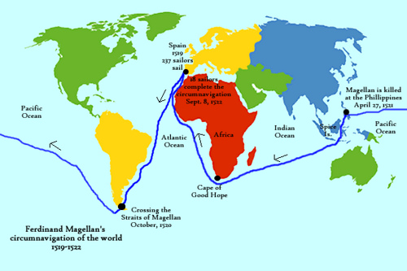
Magellan’s Travels

Slide 11
North East South West
What countries are East of China?
What countries are North of China?
What countries are South of China?
What countries are West of China?
What country is North of the U.S.?
What countries are South of the U.S.?
What ocean is East of the U.S?
What ocean is West of the U.S.?

