Slide 1
Liberal Vs. Conservative
What are you?

Slide 2
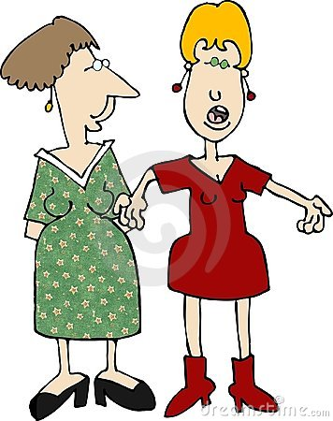
Do you think you know…
The person sitting next to you?
Let’s find out!

Slide 3
Every country, culture and family has them!
MODERATE
LIBERAL
CONSERVATIVE

Slide 4
LIBERALS
Freedom is the most important thing.
Sex before marriage is OK.
Gay is OK
High taxes to help poor people are OK.
Bright colors are best.
Art is more fun than science.
CONSERVATIVES
Being careful is the most important thing.
Sex before marriage is NOT OK.
Gay is NOT OK.
Taxes should be kept low to help business!
Black, white and gray are best.
Science is more valuable than art.

Slide 5
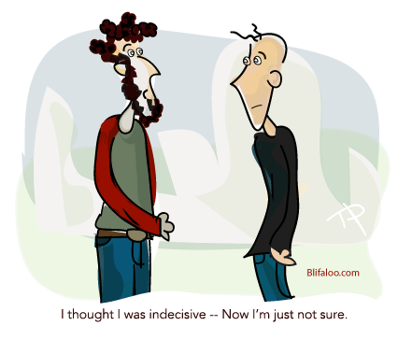
MODERATES are…
A mixture of liberal and conservative believes.
If you believe mostly liberal things, you’re probably liberal.
If you believe mostly conservative things, you’re probably conservative.
BUT… if you are split about 50/50 between liberal and conservative believe, you’re a MODERATE!
PLEASE… BE HONEST! If everyone says they’re moderate, that’s very boring!!!©

Slide 6
Now… What are you?
I am a _____________________ because I believe
(liberal, moderate or conservative)
________________ and __________________.
Choose either two liberal things, two conservative things, or one from each side if you’re a moderate.
Be prepared to answer the teacher’s questions. Each issue has pros and cons!
Teacher: Read slides 8 and 9 so you can question the students about their beliefs. Leave page 4 on the overhead projector for the above question so students can answer this question easily.

Slide 7
Questions for you…
Who is more liberal, young people or older?
(Usually younger people, but not always!)
Do you think the U.S. is liberal or conservative?
(Actually the U.S. is split 50/50 between the two. Only Hollywood makes it look like almost everyone is liberal.)
What about France?
(France is extremely liberal! That’s why they pay 50% of their income in taxes.)
Do you think China is liberal or conservative?
(It’s fairly conservative now, but the younger generation may be a lot different from their parents!)
Do you think that President Clinton was liberal or conservative?
(He was extremely liberal.)

Slide 8
Problems with liberalism
1. Freedom is the most important thing.
What if your 15 year old daughter wants to live with her boyfriend?
If everyone was totally free, would anyone go to school, work, or save money?
2. Sex before marriage is OK.
What about HIV/AIDS? What if someone gets pregnant?
3. Gay is OK
What about HIV/AIDS? Is it OK if your son or daughter is gay or lesbian? Is it OK if your son’s teacher is gay?
4. High taxes to help poor people are OK.
Just how high a tax will you pay? 20% or your income? 30% ? 50%? In France they pay close to 50%. Is that OK?
5. Bright colors are best.
Should everyone wear rainbows?
6. Art is more fun than science.
If everyone were artists, wouldn’t other countries conquer us? Don’t we need science for health?

Slide 9
Problems with conservatives
1. Being careful is the most important thing.
Would anyone ever be creative if we’re so busy being careful?
Wouldn’t being so careful prevent us from having any fun? (No drinking, no dancing, no adventure?)
2. Sex before marriage is NOT OK.
What about two 70 year old people that are too poor to marry? Can they have sex? If your favorite movie star or singer asked you to have sex, would you say “no?”
3. Gay is NOT OK.
What should we do with all the gay people? Kill them? Put them in prison?
4. Taxes should be kept low to help business!
What should we do with all the poor people? Kick them? Tell them to go away? Just let them steal from us instead?
5. Black, white and gray are best.
Would a life with no color really appeal to you?
6. Science is more valuable than art.
Do you have any art in your apartment? A picture on the wall perhaps? Or, maybe just scientific equations?

Slide 10
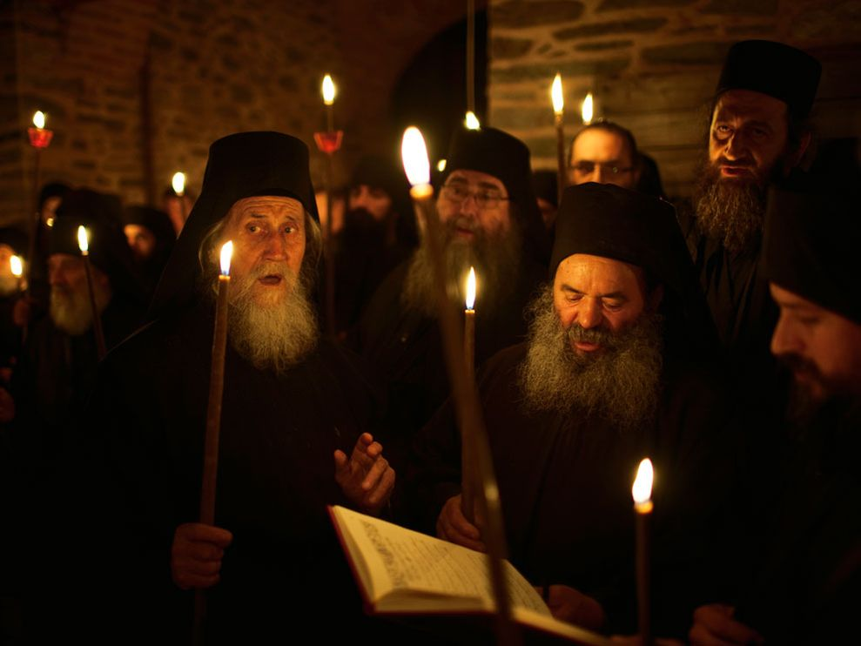
Additional question for teachers
To make things more fun, you can ask some students what another student will say he or she is, before they answer the question on page 4.
Everyone may be surprised at some of the answers!

