Slide 1
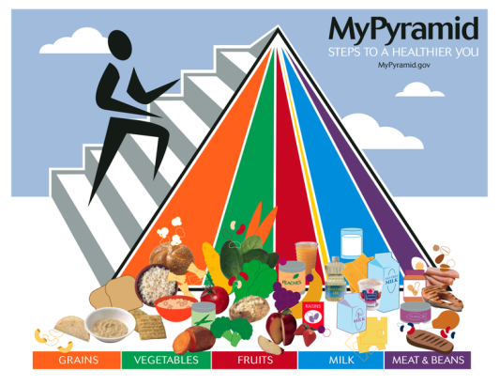
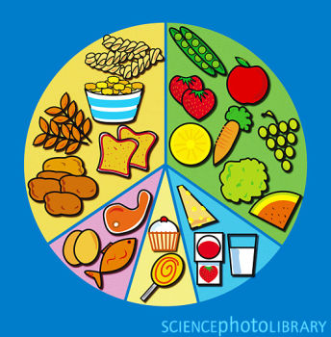
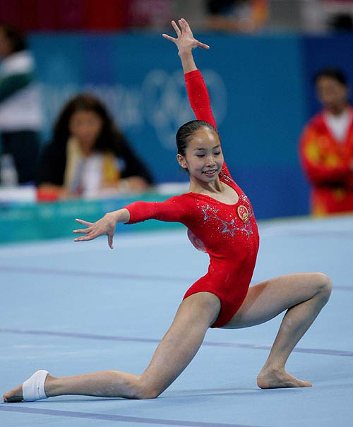
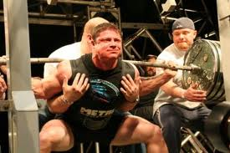
Nutrition 营养yíngyǎng Science
Key to health健康, happiness and long life 长寿[chángshòu] , as well as beauty, power 效力xiàolì and feeling good!

Slide 2
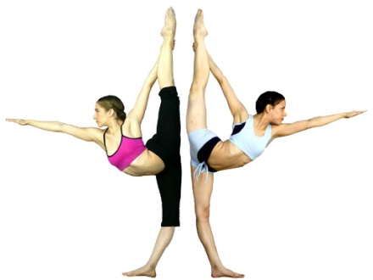
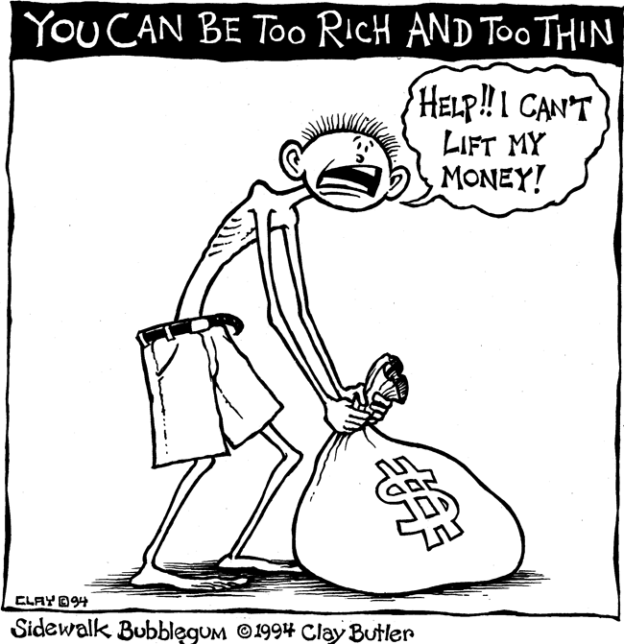


Are you healthy?
Do you have lots of energy精力[jīnglì] ?
Do you feel good most of the time?
Do you sleep well?
Do you look healthy?

Slide 3

What did you eat
In the last 24 hours?
?

Slide 4
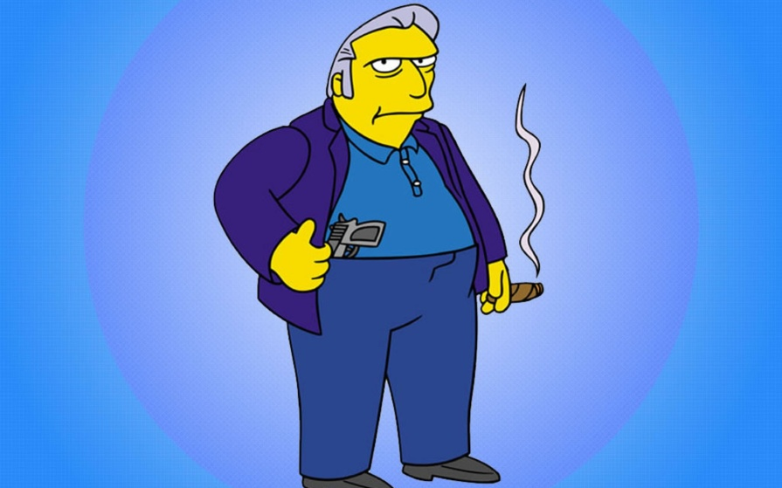

We all have habits 习惯 xíguàn
To be healthy, we need to change our habits, and it isn’t easy!
Too thin?
Too big?

Slide 5
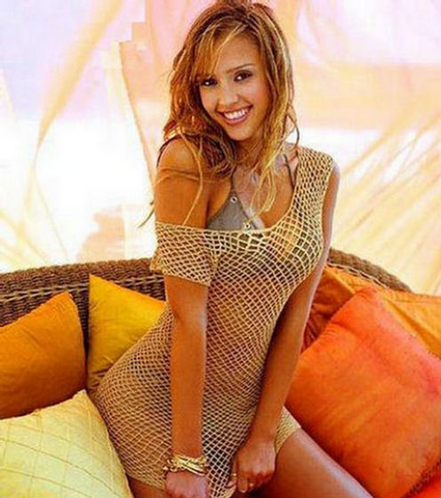
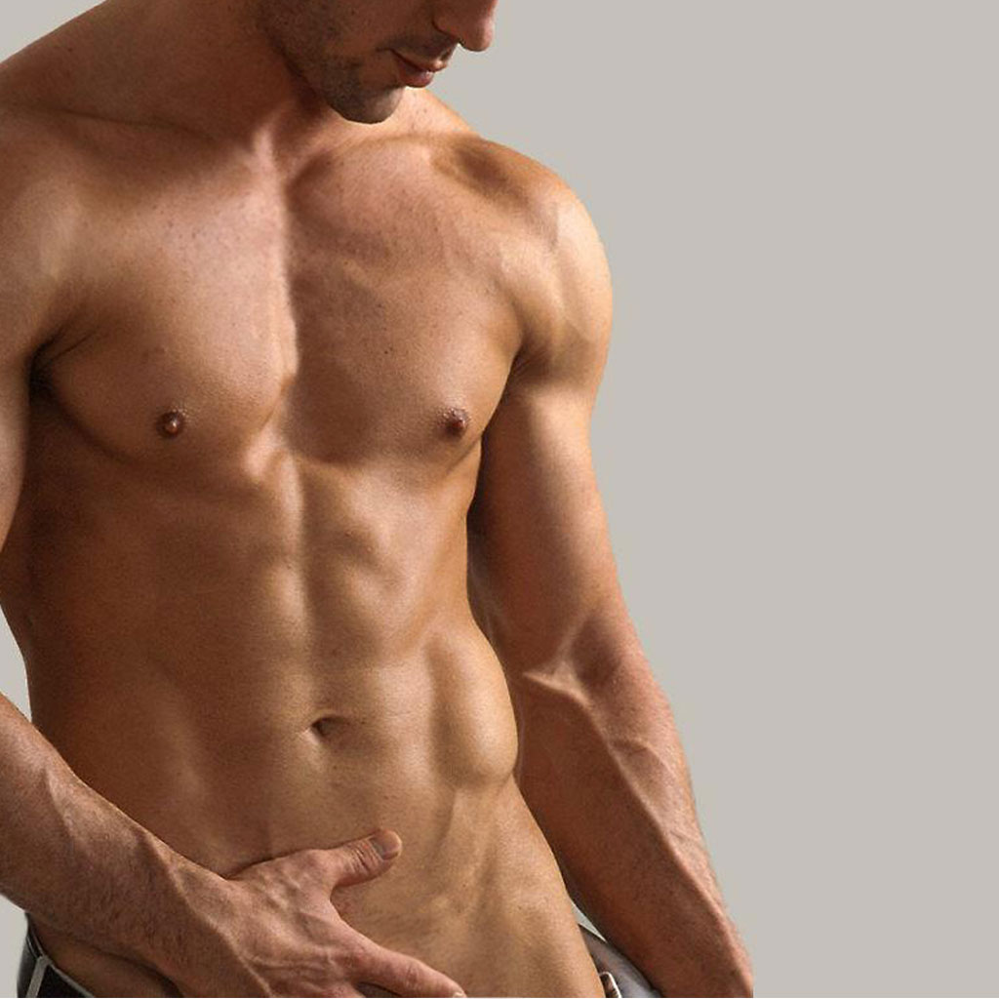
Believe it or not…
You can have any body you want!

Slide 6
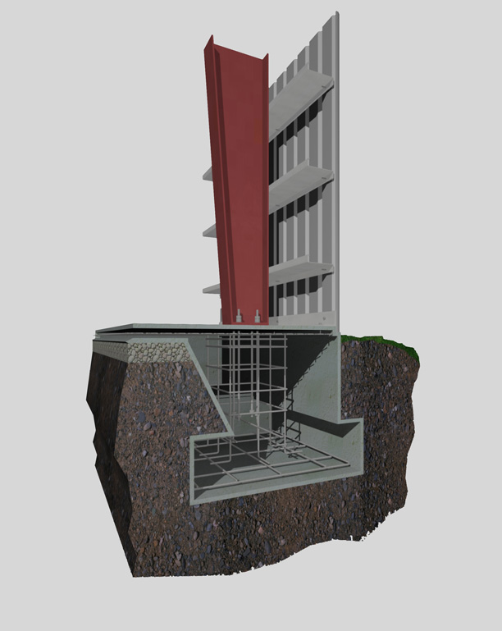
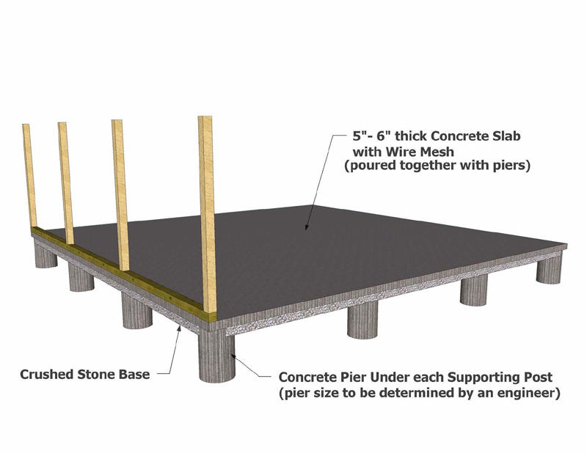
Nutrition is
The foundation基础[jīchǔ] of a healthy健康的 happy life.

Slide 7
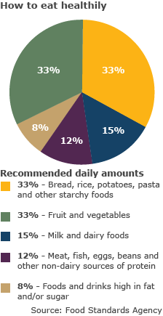
A good diet饮食[yǐnshí] is→
Balanced
均衡饮食
    jūn héng yǐn shí

Slide 8
33% complex carbohydrates碳水化合物: Bread, rice, potatoes, pasta
33% simple carbohydrates: 简单糖 fruits and vegetables
15% Milk and other dairy foods乳制品的 (Yogurt!)
12% protein 蛋白质 : meat, fish, eggs, beans
8% fats 肥胖的 and sugars 糖

Slide 9
Simple:
66 – 15 – 12 – 8
66% Carbohydrates (complex & simple)
15% Dairy 乳制品的 (also has protein!)
12% protein 蛋白质
8% fat 肥胖的 & sugar 糖
But, because I do a lot of sports, I eat maybe 20% protein, and a little less carbohydrates…

Slide 10
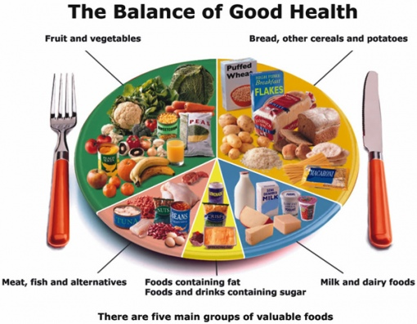

Slide 11
The rainbow diet
Different colored fruits and vegetables have different vitamins. So, eating different colors: carrots (orange) tomatoes (red) spinach, broccoli (green), blueberries, etc. is a LOT healthier than just eating one. Every day we need at least three different colored fruits and vegetables!

Slide 12
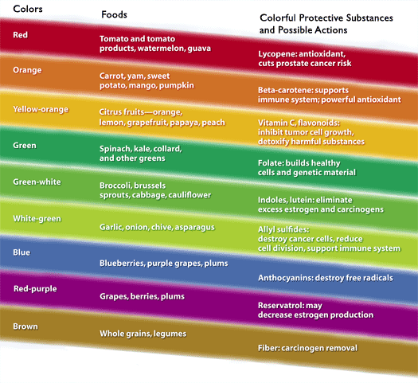

Slide 13
Every day we need
3 different colored vegetables蔬菜[shūcài]
3 different colored fruits
3 complex carbohydrates (rice, noodles, bread…)
3 servings of meat, fish, beans or other protein

Slide 14

White versus brown grains 谷粒[gǔlì]
White rice and white bread are not so healthy!
Whole rice 整米 zhěng mǐ and
Whole wheat bread 麸皮面包 fūpímiànbāo
are much, much healthier (and delicious too)!

Slide 15
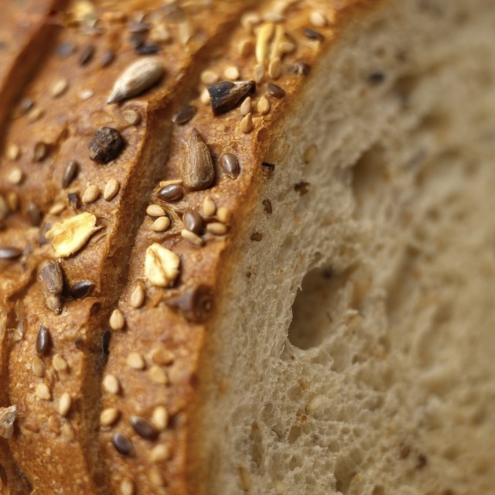
Whole wheat bread

Slide 16
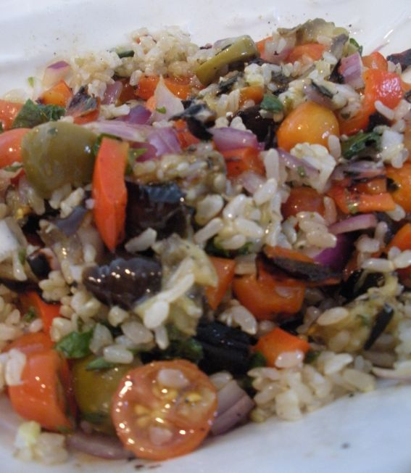
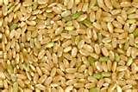
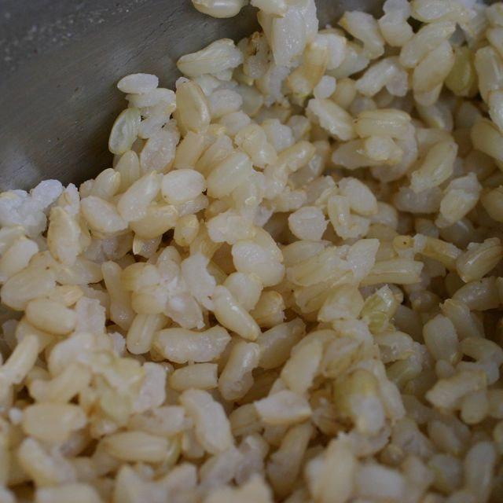
Brown Rice
Tastes good !
Tastes good !

Slide 17
Did you ever try whole rice?
Whole wheat bread?
If yes, how did it taste?
If no, would you like to try it?
Do you know what fiber is?
可食纤维[kě shí xiān wéi]

Slide 18
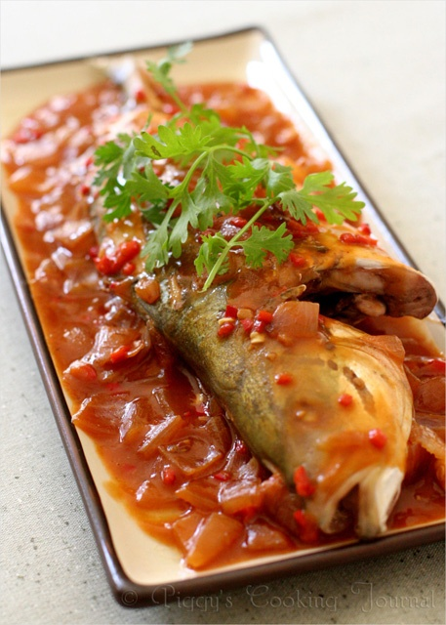
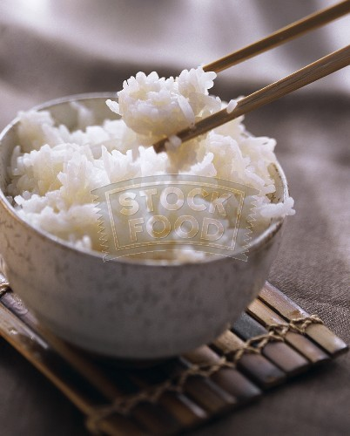
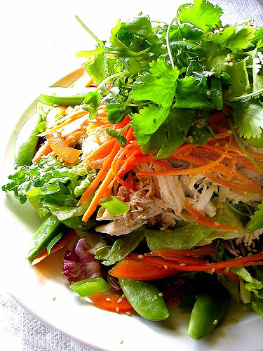
What’s wrong不恰当的 with:
A big delicious fish
Small bowl of white rice &
A medium salad

Slide 19
Answer
But the fish dinner above is:
15% complex carbohydrate
15% complex carbohydrate
0% Dairy product
65% protein
5% fats and sugar
BALANCED:
33% complex carbohydrates碳水化合物: Bread, rice, potatoes, pasta
33% simple carbohydrates: fruits and vegetables
15% Milk and other dairy foods乳制品的
12% protein: meat, fish, eggs, beans
8% fats and sugars

Slide 20
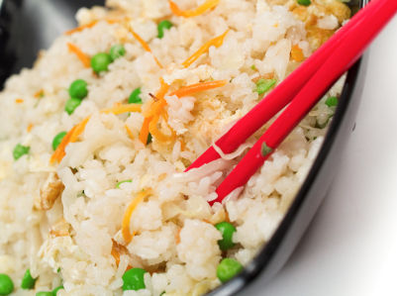
Fried rice…?
Maybe down in South China they make good fried rice, but the fried rice I’ve been getting in Beijing is:
70% complex carbohydrate (white rice)
5% simple carbohydrate
5% protein
20% fat (oil or pork fat)
Tastes good but not balanced: way too much rice, not enough protein or vegetables.

Slide 21
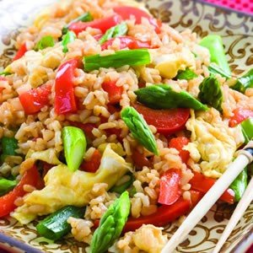
My fried rice is balanced!

Slide 22
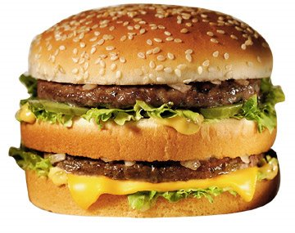
How about McDonalds Big Mac?
33% Carbohydrate (complex and simple)
52% Fat
16% Protein
(Not enough carbohydrates, way too much fat, but the protein is about OK.)

Slide 23
How many calories 卡路里kǎlùlǐ
do you need in one day?
Most high school students need about 2,000 calories a day.
If you do sports you need more.
How many calories are there in a…?

Slide 24
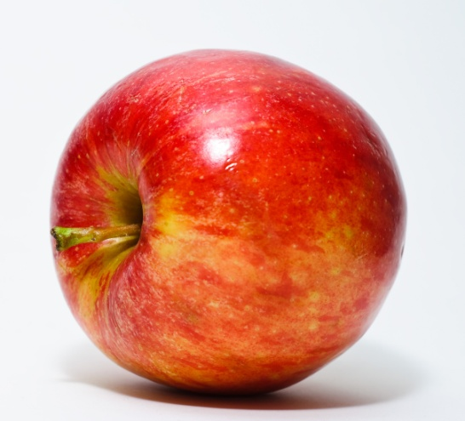

Calorie chart
1 medium potato 100 calories
1 apple 60 calories
1 tomato 35 calories
1 small spoon sugar 20 calories
1 McDonalds Big Mac 576 calories
1 KFC chicken sandwich 280 calories
1 Snickers bar 273 calories
1 instant noodles 540 calories

Slide 25
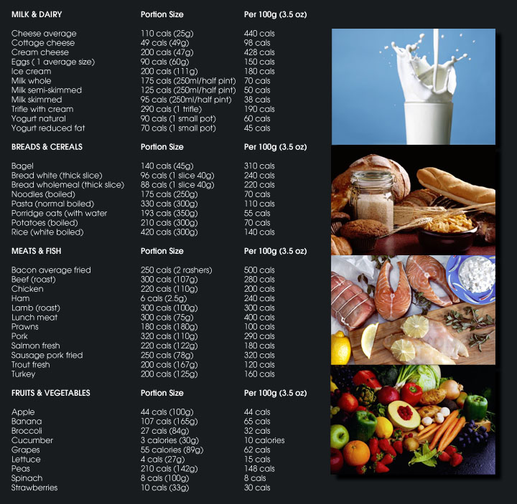

Slide 26
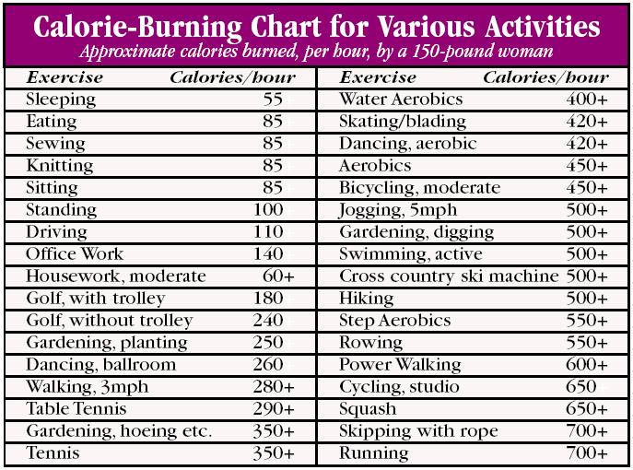

Slide 27

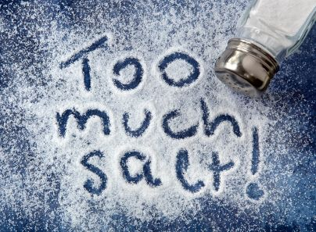
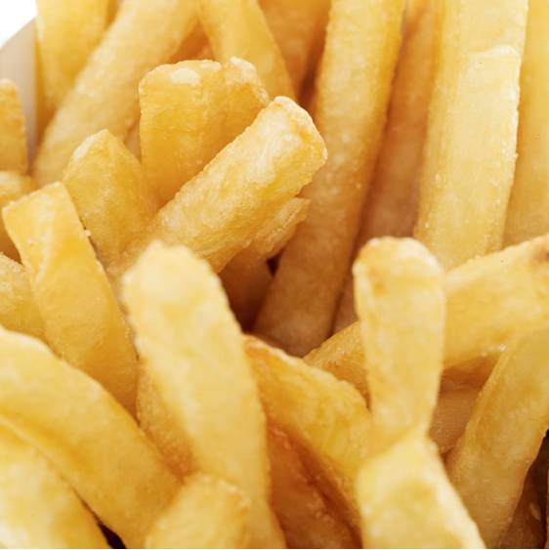
SALT 盐
MSG 味精 wèijīng causes headaches in some people

Slide 28
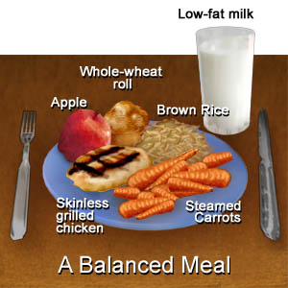
What to eat?
A balanced diet, with lots of fresh vegetables, fruits, and lean meat or fish!
+

Slide 29

Also…
Try to think happy thoughts when you’re eating. I really think it helps!

Slide 30

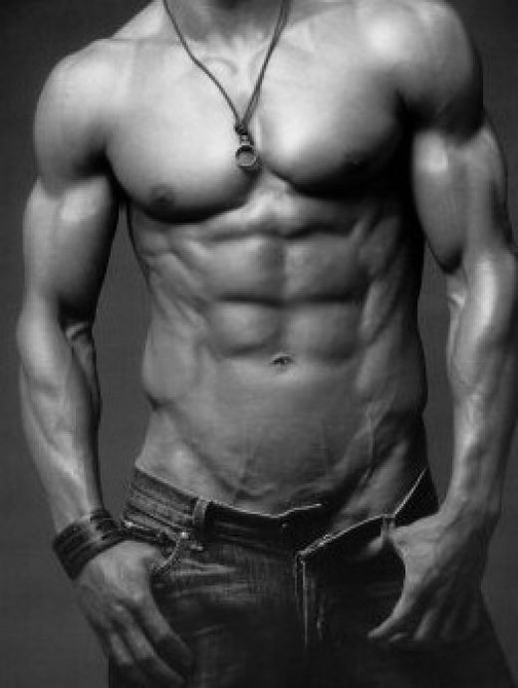
Changing your food habits
May be a little difficult, but the rewards…
May be worth it!

Slide 31
Recipes
Some things I like that are nutritious and delicious…

Slide 32
Chicken soup
Onion
Carrot
Potato
Chicken breast (no skin)
Spinach
Broccoli
a little salt

Slide 33
Tuna fish and noodles
1 can tuna fish (hot, spicy)
Vegetable noodles
Onion
Boiled carrot
Cheddar cheese (real, not processed cheese)
A tablespoon of mayonnaise
A little salt

