Slide 1
What is Philosophy?
Just boring无聊 wú​liáo​
old guys talking a lot
of nonsense狗屁 gǒu​pì​
?

Slide 2
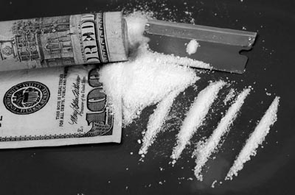
Maybe not…
Your friend is selling cocaine可卡因 in school to other students.
I would…
Do nothing, just ignore 不理 bù​lǐ​ it.
Talk to him or her?
Tell a teacher?
Call the police?
The answer depends on your philosophy!

Slide 3
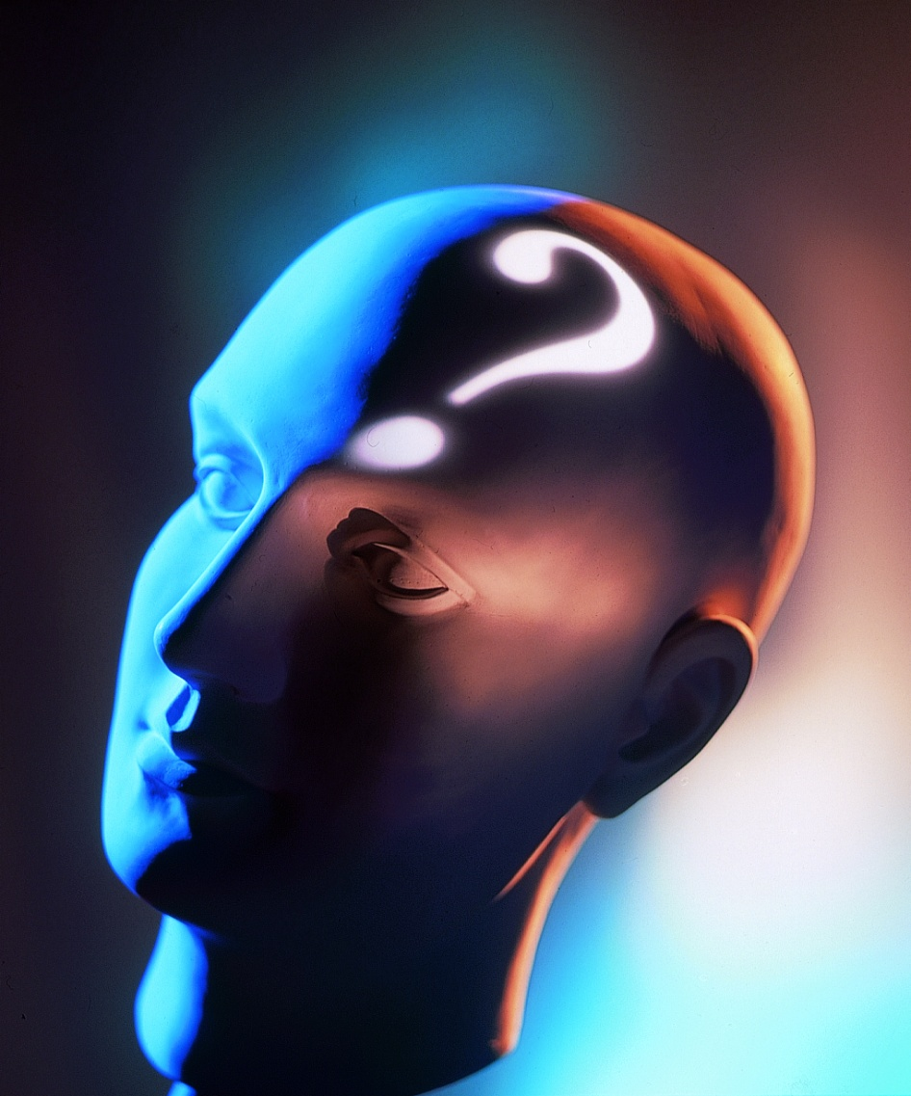
Everybody has their own
PHILOSOPHY!
Yeah!
Really!

Slide 4
Most of the philosophers were Rebels 反叛 fǎn​pàn​
Not the fake假的, lazy kind that just sleeps in class, but real rebels that governments政府
hate 恨之入骨 and
kill 杀死 shā​sǐ​
Real, baby, real REBELS!

Slide 5
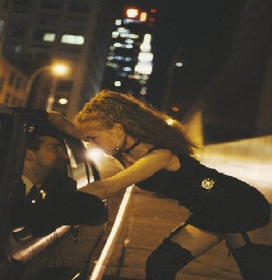
Is selling sex for money…
OK?
The answer depends on your philosophy.

Slide 6
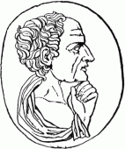
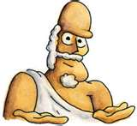
WESTERN Philosophy
Started with the Greek Philosophers
Socrates苏格拉底 Sū​gé​lā​dǐ​,
Plato柏拉图Bó​lā​tú​ and
Aristotle 亚里士多德 Yà​lǐ​sī​duō​dé​

Slide 7
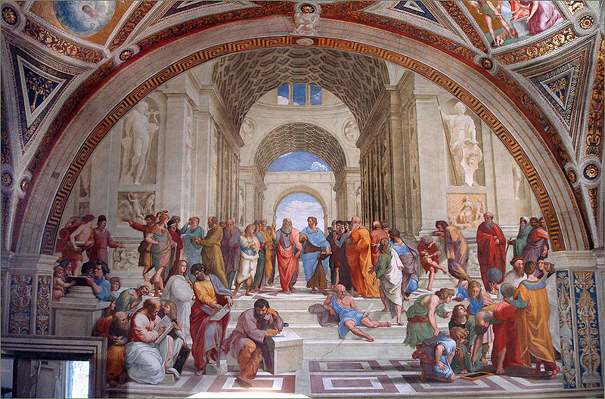
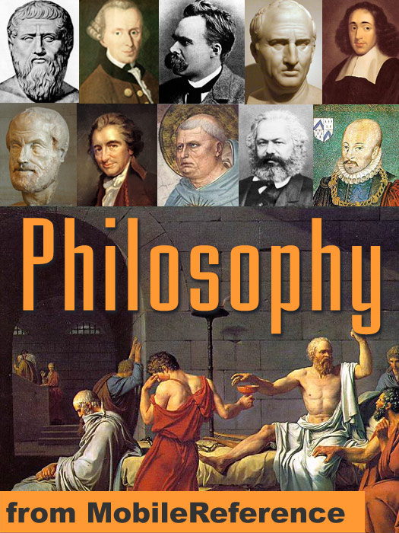
Philosophy哲学zhé xué
Western

Slide 8
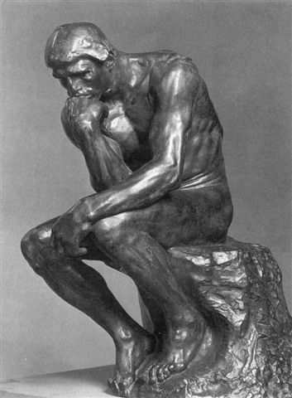
How is Philosophy different…
…from religion宗教 ? zōng​jiào​
Religions require faith信教 xìn​jiào​
Religions tell people there is life after they die.
→ Philosophies are based on reasoning思路sī​lù​
.

Slide 9
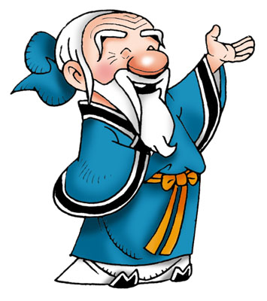
Western and Chinese Philosophers were the same…
In some ways….
For example, Confucius孔夫子 couldn’t keep a government job, because they didn’t like him. Why?
He was too honest实在shí​zài​ !

Slide 10
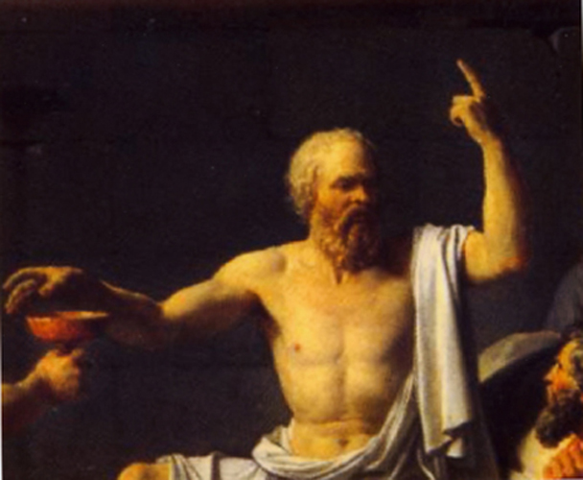
Socrates苏格拉底Sū​gé​lā​dǐ​(470-399 BCE)
He liked to
confront 面 对 miàn duì
hypocrisy 假仁假义 jiǎ​rén​jiǎ​yì​
and was very good at arguing 善辩 shàn​biàn​
ethics 道德 dào​dé​
. He is famous for being the teacher of Plato. He did not like democracy 民主 mín​zhǔ​ or sophistry 强词夺理 qiǎng​cí​duó​lǐ​
Early in life he was a soldier. 战士 zhàn​shì​

Slide 11
Do you…
confront 面 对 miàn duì
hypocrisy 假仁假义 jiǎ​rén​jiǎ​yì​ ?
Do you cheat on your girlfriend/boyfriend?
Would you kill the person next to you for a million dollars?
If not, why not?
I’m afraid I’ll be caught. (You’re a coward.)
It’s wrong. (you have some philosophy!)

Slide 12
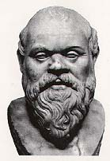
As a teacher…
Socrates believed in asking 问 wèn​
students questions 提问 tí​wèn​
rather than 与其 yǔ​qí​
answering 回答 huí​dá​ them.
Why do you think he did that?

Slide 13
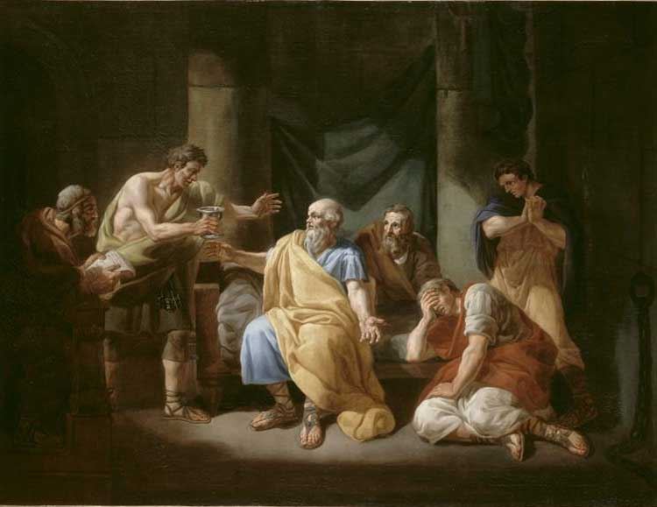
Because of his love of truth 真相 …
…and wisdom 智zhì​
he was sentenced 死囚 sǐ​qiú​ to death 处死 by drinking poison 服毒.
He could have escaped 逃命 táo​mìng​
but didn’t.

Slide 14
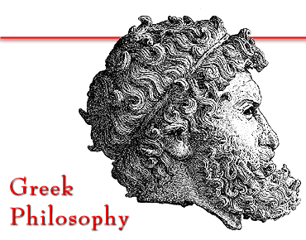
Plato 柏拉图Bó​lā​tú
Born in about 428 BC, and a student of Socrates, Plato asked the questions:
How to live a good life?
What is an ideal country理想国lǐ​xiǎng​guó​?
What is justice 道义 dào​yì​?

Slide 15
Plato said that a nation 理想国lǐ​xiǎng​guó​
should have four great virtues 有道yǒu​dào :
1) Courage 勇气yǒng​qì​ + 振振有词 zhèn​zhèn​yǒu​cí​
2) Wisdom 智慧 zhì​huì​
3) Temperance 蕴藉 yùn​jiè​
4) Justice 道义 dào​yì​
Do you have the courage to follow your dreams?
DO you have the courage to be happy every day?
Do you have the wisdom to choose a good dream?
Can you show temperance when those around you don’t?
Can you practice justice in an unjust world?

Slide 16
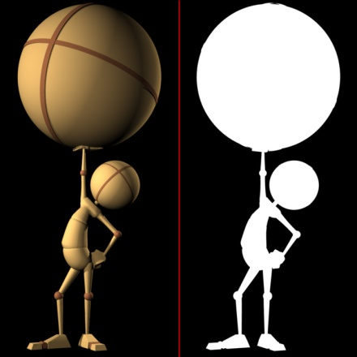
Plato divides people into
Those with:
A. Intelligence 智慧 zhì​huì​
B. Strength and 强 状qiáng​zhuàng​
C. Courage 勇气yǒng​qì​ + 振振有词 zhèn​zhèn​yǒu​cí​
Those who are intelligent, virtuous有道yǒu​dào​
and brave should govern治理zhì​lǐ​ a nation国家guó​jiā​
.
People lacking不足bù​zú​ these should be farmers农人 and laborers蓝领 lán​lǐng​

Slide 17
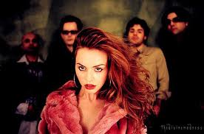
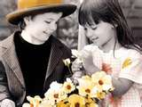
On love, Plato believed…
1) That love is divine 神 shén​ madness. 疯癫 fēng​diān​
And in
2) the possibility of “Platonic love,” a love that is not sexual...
Is it possible?
What would Freud think?

Slide 18
Plato also believed that
People are born with a clean slate空白 kòng​bái​ and are intrinsically内在 nèi​zài​ good.

Slide 19
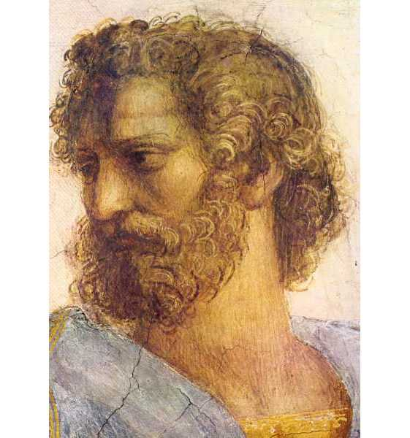
Aristotle 亚里士多德 was not from Athens 雅典. He was not from a rich family like Plato.

Slide 20
Aristotle亚里士多德 Early Years
When Aristotle was a young man, about 350 BC, he went to study at Plato's Academy 院校.

Slide 21
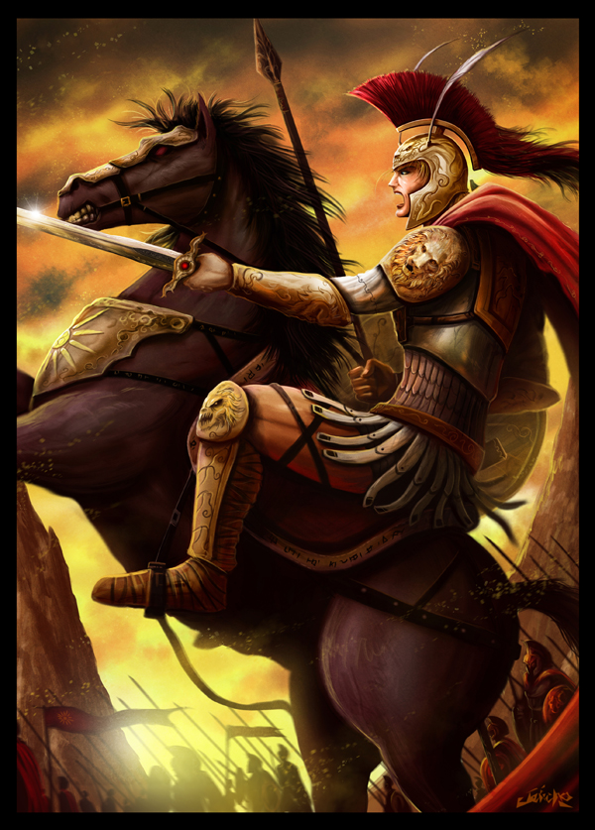
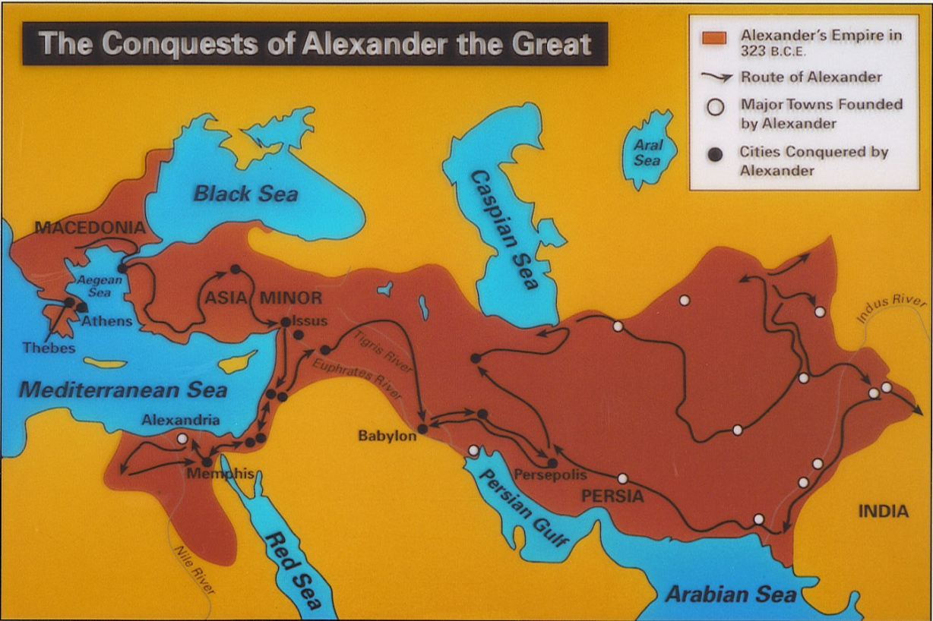
Soon afterwards, Aristotle left Athens to be the tutor 导师 of the young prince Alexander, who grew up to be
Alexander the Great 亚历山大大帝.

Slide 22
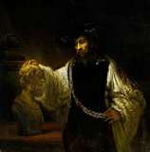
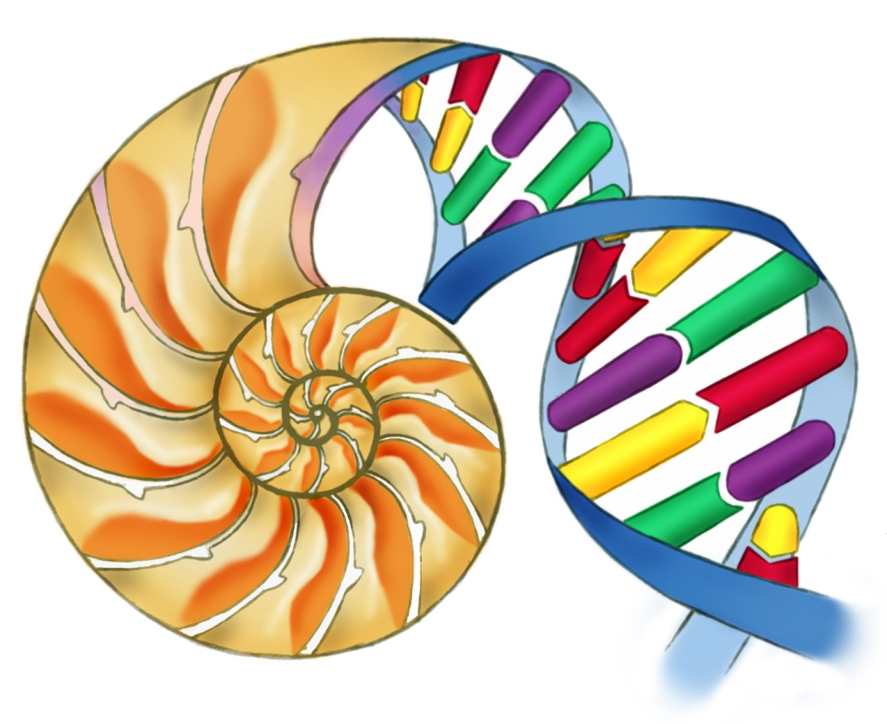
Aristotle was more interested in science than Socrates or Plato, maybe because his father was a doctor. Aristotle was especially interested in biology.
Natural Science

Slide 23
Political science
Aristotle created a classification system of
governments:
Monarchies 君主制 jūn​zhǔ​zhì​
Oligarchies 寡头政治 lǐng​dǎo​céng​
Tyrannies 霸道 bà​dào​ ,
Democracies 民主 mín​zhǔ​ and
Republics 共和国 gòng​hé​guó​
What is China?

Slide 24
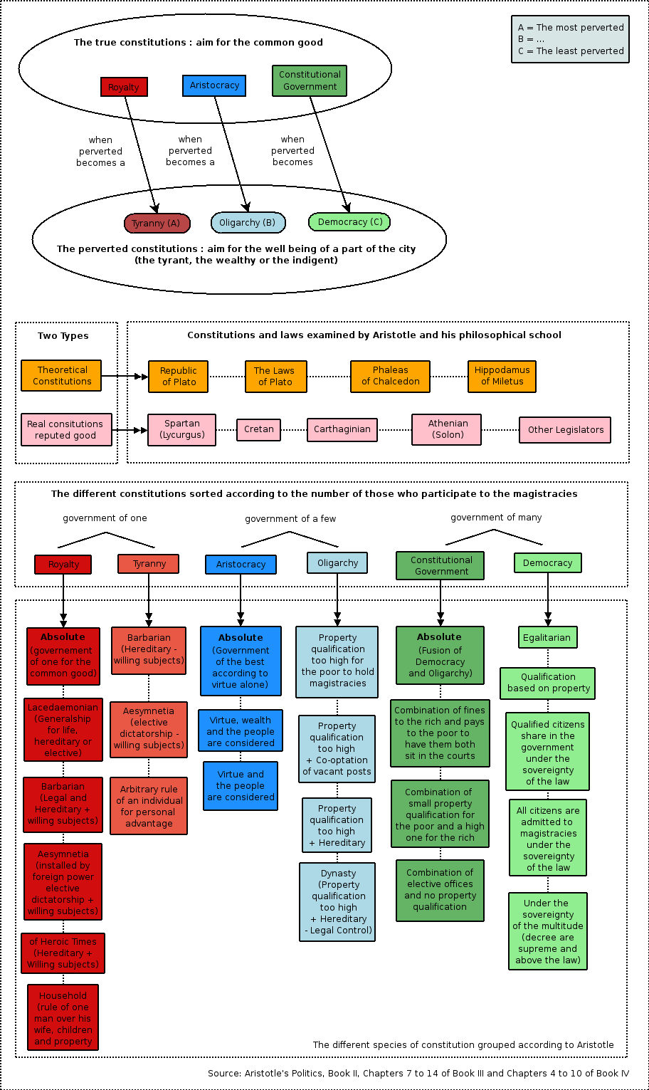
Government of ONE: Royalty and tyranny
Government of a few:
Aristocracy, oligarchy
Government of many:
Constitutional and
Democracy

Slide 25
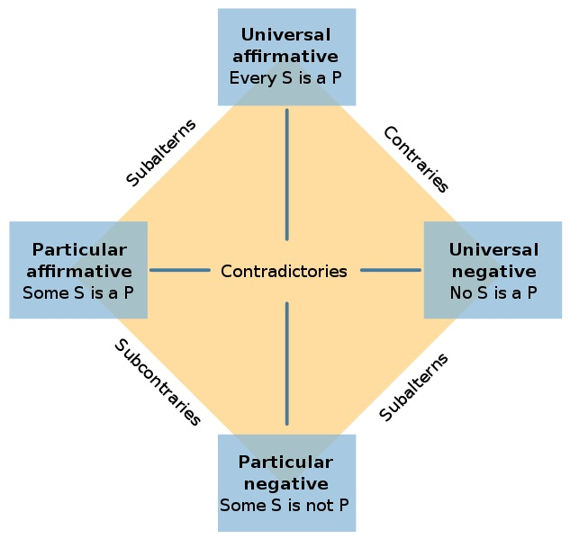
Aristotle’s Logic逻辑
Premise 1:
All Chinese are human. Premise 2:
All humans are mortal 会死. Conclusion:
All Chinese are mortal 会死.

Slide 26
The best revenge is living well.
Aristotle believed that there exists some ultimate极致 good which is the goal of all human actions – which can be described as happiness (eudaimonia) which in Greek also means: “Living well.”

Slide 27
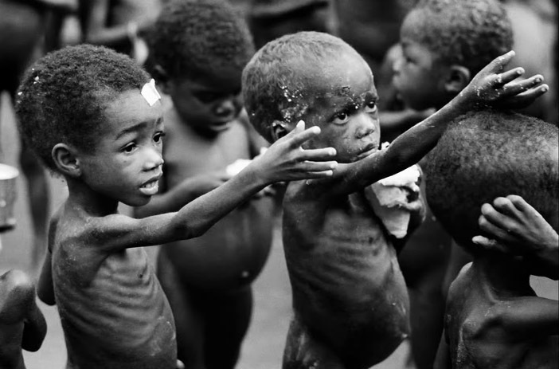
Aristotle’s Generosity 慷慨kāng​kǎi​ test
For Aristotle, we must give to the right people, at the right time and with the right intentions 意.
Did you give money to the poor 穷人qióng​rén​???

Slide 28
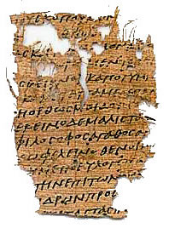
Aristotle final years
When Alexander died in 323 BC, people accused 控 him of being secretly on the side of the Macedonians (and maybe he was; he was, like Plato, no democrat). He left town quickly, and spent the last years of his life back in the north again where he had been born.

Slide 29
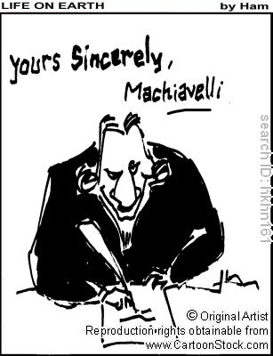
Niccolò Machiavelli 马基雅弗利 1469-1527
He wrote a book called “The Prince.”
In it he wrote:
“It is better to be feared than loved.”
“Politics have no relation to morals 世风 shì​fēng​. “
He believed hypocrisy 假仁假义 jiǎ​rén​jiǎ​yì​
is best to get and keep power 权力 quán​lì​
→ Destroying 破 pò​ people was fine with him.

Slide 30
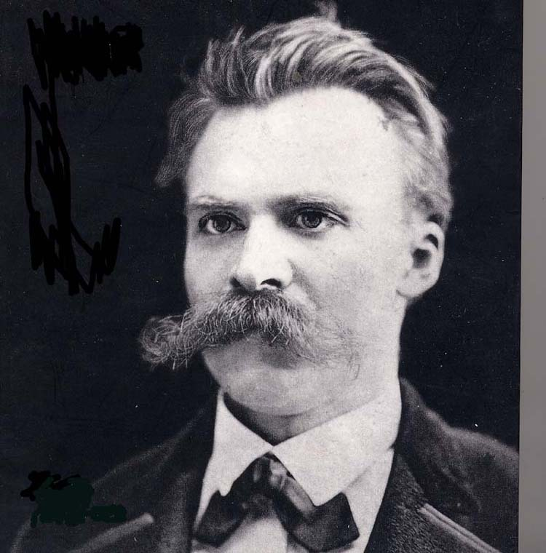
Modern Philosophers - German
1844 - 1900
Friedrich Nietzsche was famous for
Existentialism 存在主义 cún​zài​zhǔ​yì​
Nihilism 虚无主义 xū​wú​zhǔ​yì​ &
Post-modernism 后现代主义 hòu​xiàn​dài​zhǔ​yì​

Slide 31
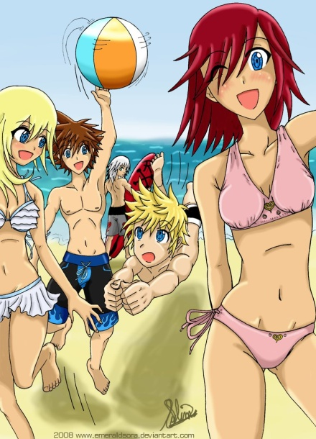
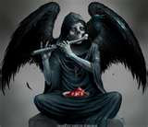
Existentialism is
A study of people’s quiet struggle 拼搏 with the meaninglessness 无谓 wú​wèi​ of life and how to escape 跑 pǎo​ from boredom 散心解sàn​xīn​jiě​mèn​
Friedrich Nietzsche is famous for saying that: “God is dead.”
He also “invented” “Superman” believing that everyone should enjoy this life.
What 3 things are most meaningful in your life?

Slide 32
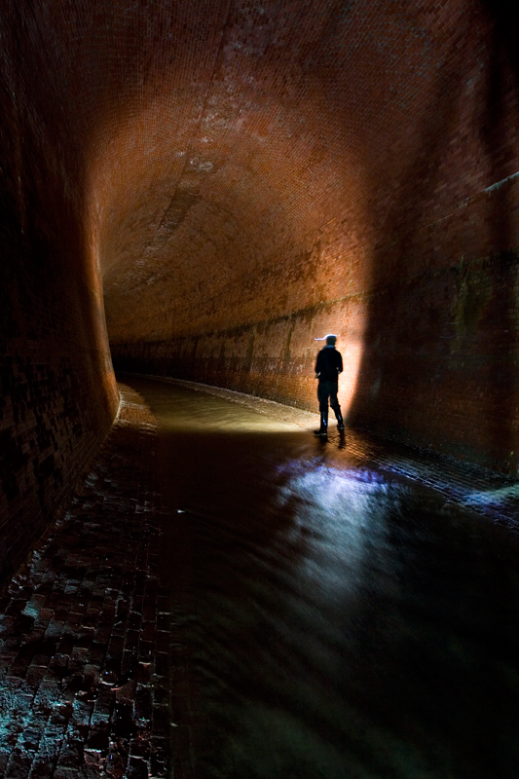
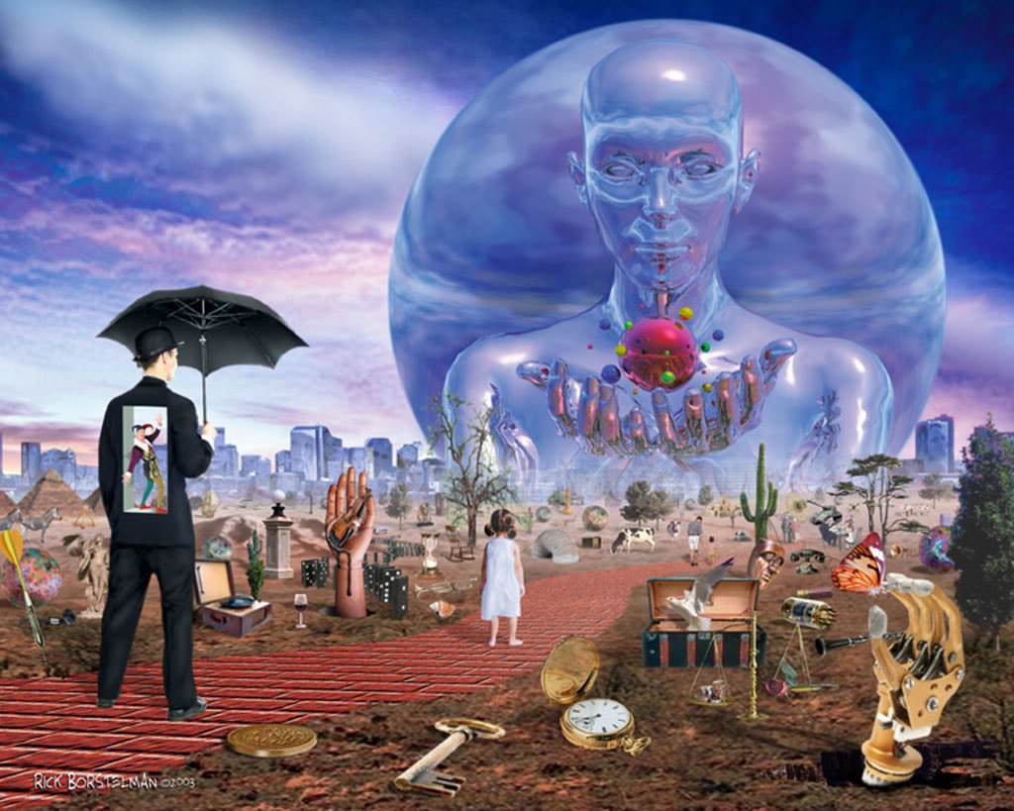
Two sides of existentialism

Slide 33
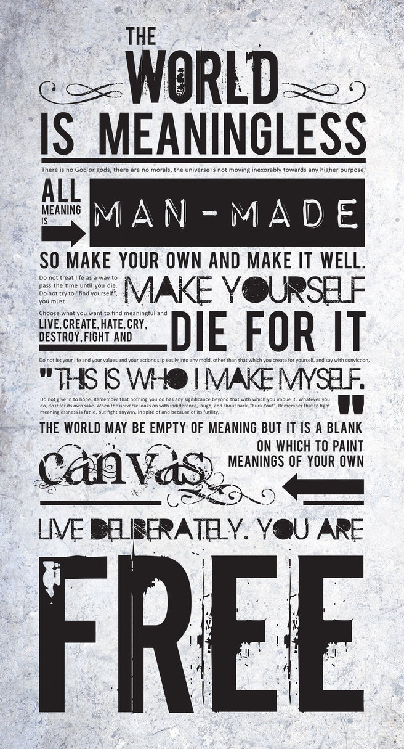

Slide 34
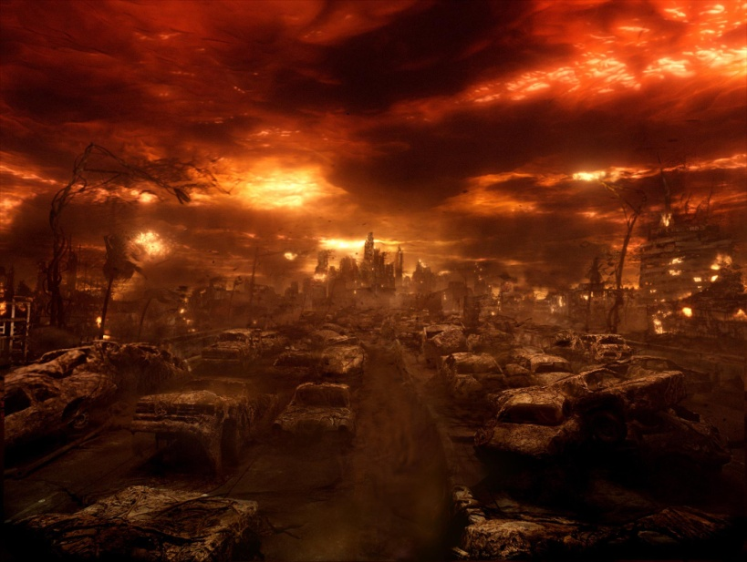
Nietzsche also believed in…
Nihilism: The belief in nothing 空空 kōng​kōng​
Life is meaningless 无谓 wú​wèi, and has no real morality 道德 dào​dé​
Crisis 危机 wēi​jī​ caused by the difference between the way the world could be and the way it is.

Slide 35
French Philosophers
Jean-Jacques Rousseau (1712–1778) Believed that that art and science are corruptors 腐败 fǔ​bài of human morality 公共道德 gōng​gòng​dàode​. (Arts and sciences are BAD!)
卢梭(1712-1778), 名Jean Jacques, 法国启蒙思想家, 哲学家, 教育家和文学家 However he also believed that man is good by nature 性格 but corrupted腐败 fǔ​bài​ by society, which is a contradiction 矛盾 of the Christian 基督徒 Jī​dū​tú​ belief of original sin.
Who else believed that people are good by nature?
Plato

Slide 36
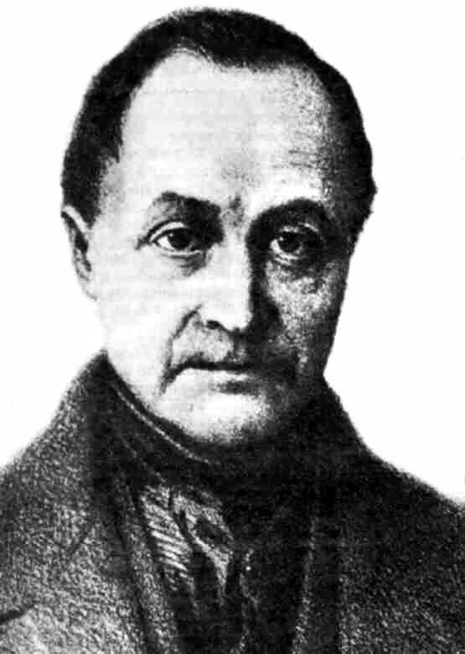
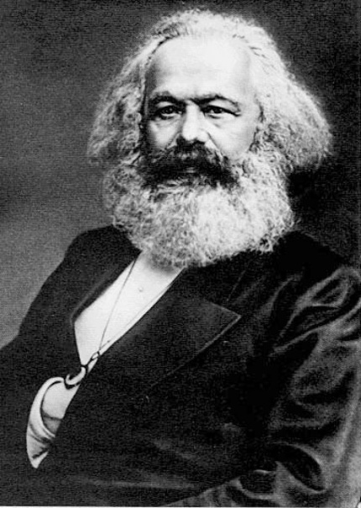
Auguste Comte (1798–1857)
…was a philosopher born in Montpellier. He was the founder 创始人 of sociology and the doctrine of positivism 实证主义, and may be regarded as the first philosopher of science in the modern sense of the term

Slide 37
Altruism 舍己救人
He heavily influenced 19th Century thinkers including Karl Marx.
He created and defined the word “altruism” which is total concern for the
welfare 公益事业 of others, while ignoring the self (selflessness).

Slide 38
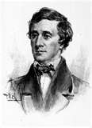
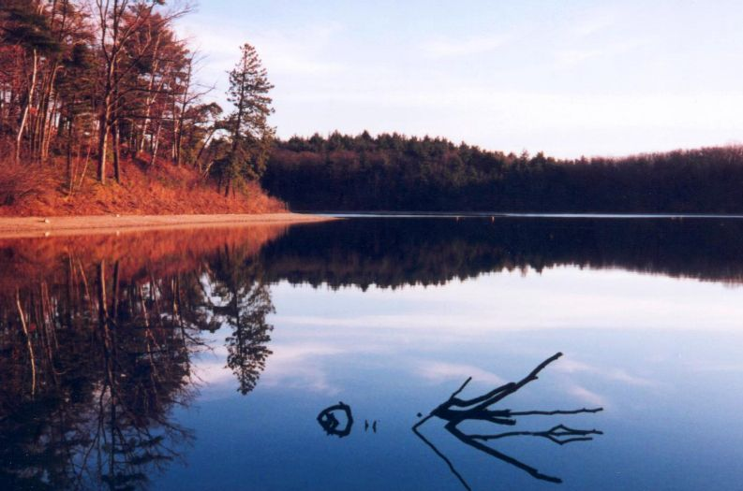
Henry David Thoreau 1817-1862
American philosopher, poet,
& naturalist 自然主义
He believed in simple living with nature, and also that civil 国内 disobedience 乖迕, 乖忤 can be a good thing.
He refused 不予 to pay taxes 缴税 because he didn’t like the Mexican American War and slavery 奴役.

Slide 39
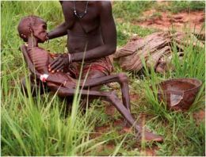
British philosopher: Bertrand Russell罗素 Luó​sù​
…a liberal自由派, socialist社会主义者 and pacifist 和平主义 and rationalist 理性主义wrote that:
"No one can sit at the bedside of a dying child and still believe in God."

Slide 40
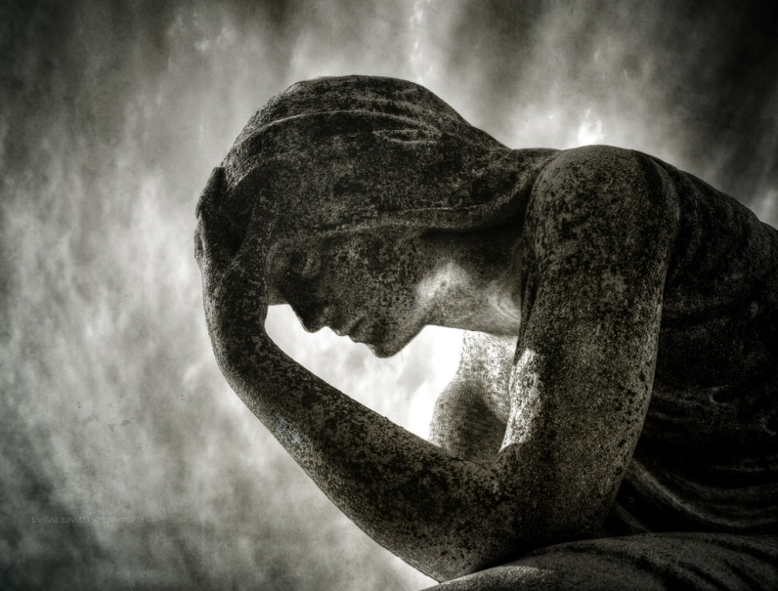
Before making your philosophy
About 10 million children die of hunger every year.
3.6 million people die every year from water-related disease症.
Over a million people kill themselves every year.
About a million people a year die in wars, but most are not reported.

Slide 41
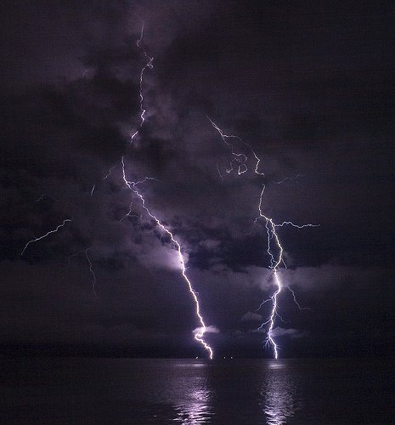
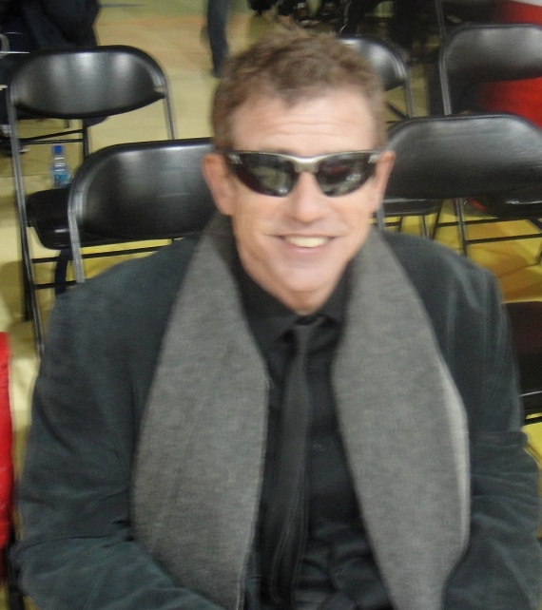
FINALLY…
I don’t want you to be a robot 机器人 that copies 复制品 me!
I do want YOU to think and make YOUR own philosophy.

