Slide 1
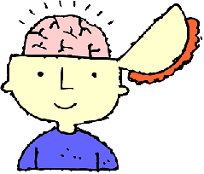
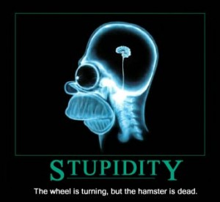
Psychology心理学
Science科学[kēxué] of the mind 想法 Xiang fa and behavior行为[xíngwéi] .

Slide 2
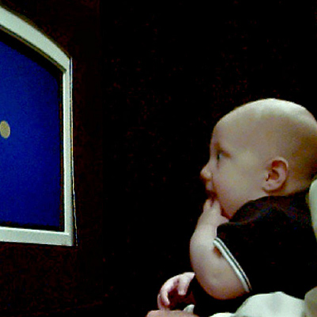
There are two kinds of psychology:
Clinical psychology 临床心理学[lín chuáng xīn lǐ xué]
→ Helping 帮助[bāngzhù] people be happy and healthy directly - face to face见面[jiànmiàn). Helps people with problems.
Experimental psychology 实验心理学[shíyànxīnlǐxué]
→ Doing research 研究 in psychology

Slide 3
A person that does psychology
Is called a “psychologist.”
DIALOG
Q: “What is your job?”
A: “I’m a psychologist.”
Q: What kind of psychologist are you?
A: I’m a clinical psychologist.

Slide 4
Discussion
Which do you think is more interesting?
Clinical psychology 临床心理学 lín chuáng xīn lǐ xué OR
Experimental psychology 实验心理学 shíyànxīnlǐxué] ?
I think ________________ is more interesting.
I think both are equally interesting.
I think both are boring.

Slide 5
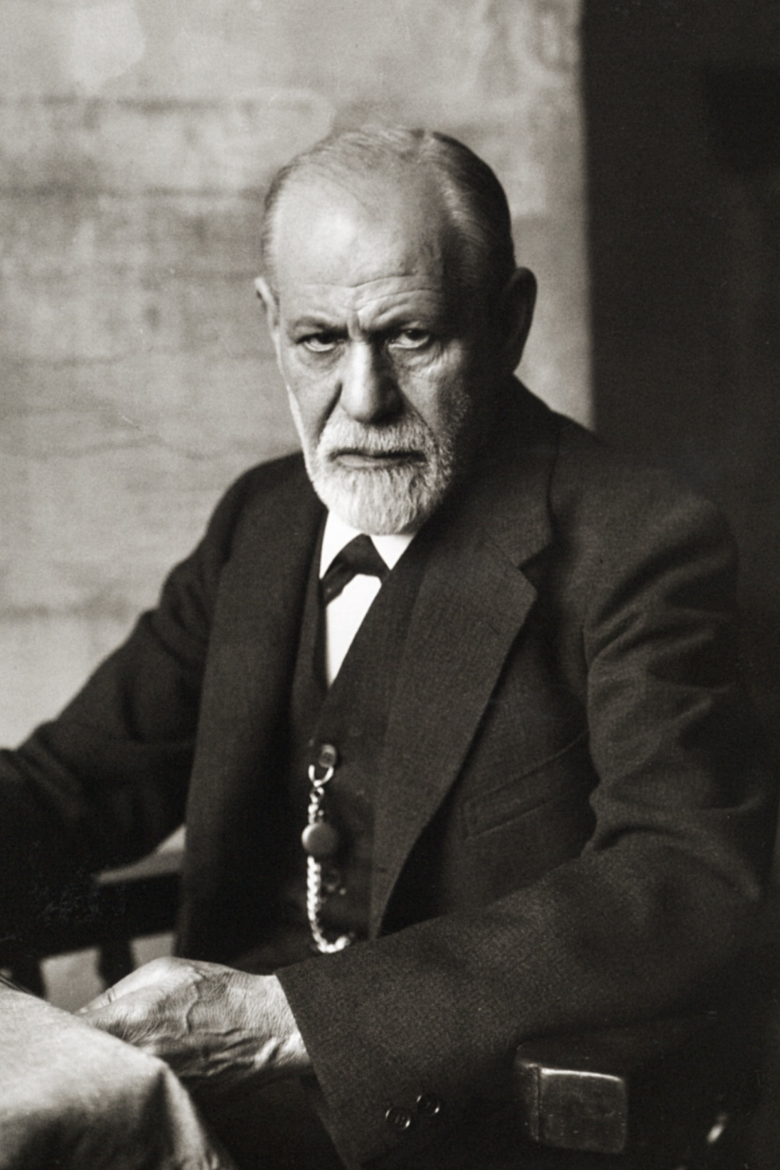
Sigmund Freud
(Clinical psychology 临床心理学)
was the founder 创始人[chuàngshǐrén] of the modern science of psychology. He believed that people are primarily主要地[zhǔyàode] motivated士气高涨的shìqìgāozhǎngde by unconscious潜意识 qiányìshí forces.

Slide 6
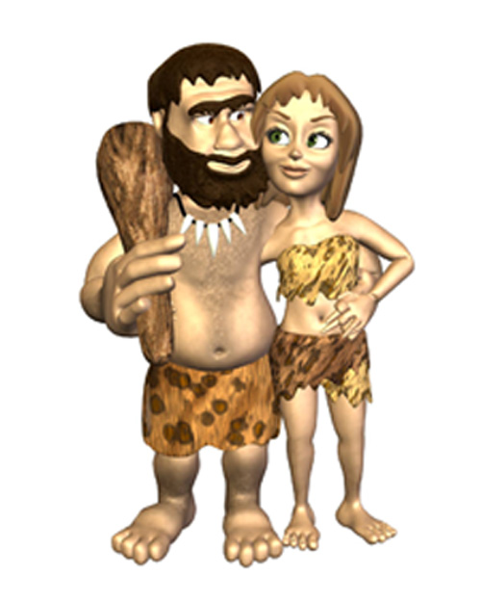
He thought that people…
(Clinical psychology 临床心理学)
Are motivated 士气高涨的shìqìgāozhǎngde mainly by sex 性交xìngjiāo and aggression 搏斗 bódòu.

Slide 7
More modern 现代 xiàndài
…psychologists 心理学家 believe people are also motivated by things like:
Love
Transcendence 超然存在[chāo rán cún zài]
Hope 希望 xīwàng
Greed贪心[tānxīn] , fear 害怕, envy妒忌的

Slide 9
What motivates you?
Sex?
Aggression? 搏斗 bódòu; 侮
Money?
Love?
Transcendence? 超然存在[chāo rán cún zài]
Hope? 希望 xīwàng
Fear? 害怕
____________________?

Slide 10
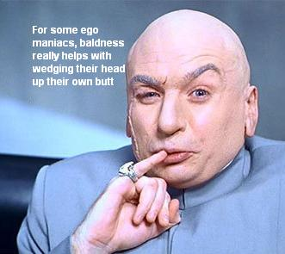
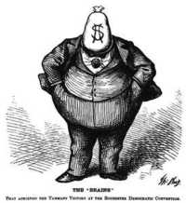
Freud also believed in
(Clinical psychology 临床心理学)
something called the “Ego” 自尊 zìzūn which are your feelings about yourself.
→ If you have a big ego, you think you’re so great.
→ If you have a small ego, you think you’re not good, stupid 笨的 bèn de, ugly 丑陋的 chǒulòu, worthless 毫无价值的 háowújiàzhíde.

Slide 11
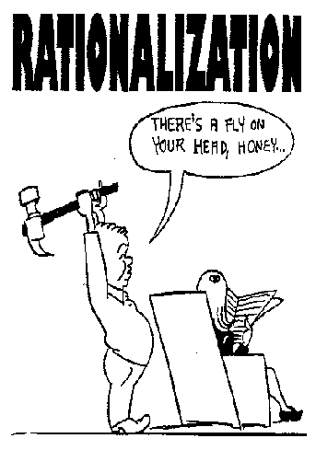
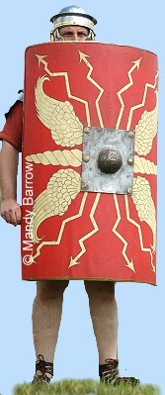
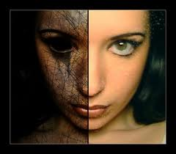
He also believed in
Ego Defenses（防守)
Denial : 固执己见的
Rationalization 满肚借口
Projection 矛头指向他人的 （不从自身找原因的 ）
Passive aggression 爱莫能助
Dissociation 幻想成他人
Regression 想象自己是孩子
Withdrawal 逃避现实

Slide 12
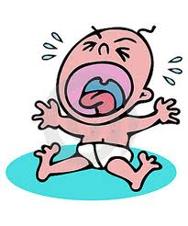
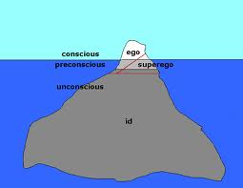
Freuds Personality 个性 theory 个性
Freud believed we all have three personalities in us:
Id = Creative, selfish 自私的, childish 本我 běn wǒ
Ego = Conscious mind 清醒 qīngxǐng & 自尊 zìzūn
Superego = responsible, a parent-like self 超我

Slide 13
I am…
_______% childish 幼稚的 yòuzhì de
_______% adult 成年人 chéngniánrén
________% responsible 可靠的
like a parent 父母 fùmǔ

Slide 14
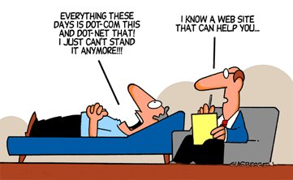
Freudian psychology is called→
Psychoanalysis 精神分析学
In psychoanalysis the therapist
治疗专家[zhìliáozhuānjiā] helps the client患者[huànzhě] explore their dreams 梦的解释 and early childhood traumas. 童年期创伤[tóng nián qī chuàng shāng

Slide 15
Another branch of psychology is
Called: Transactional Analysis or T.A.
相互作用分析[xiāng hù zuò yòng fēn xī]
They believe:
I’m OK and
You’re OK! And
everyone deserves respect尊重[zūnzhòng] .

Slide 16
T.A.
Parent: Controlling 控制[kòngzhì] and authoritarian, can be good or bad
Adult成年的: Realistic 现实的[xiàn shí de] balanced 不偏不倚的
Child: helpless, 眼睁睁
rebellious反叛的, self-pity自怜[zìlián]

Slide 17
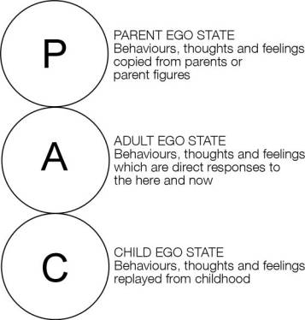
T.A.
(Clinical psychology 临床心理学)
Part of being happy and healthy in T.A. is letting go of 松开[sōngkāi] childhood games like helpless, 眼睁睁, rebellious反叛的, self-pity自怜[zìlián], and becoming responsible可靠的kěkào de.

Slide 18
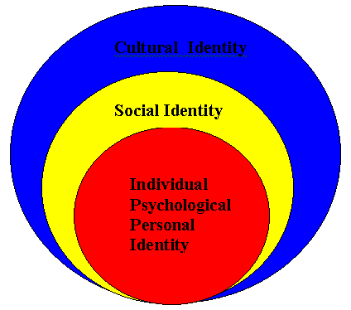
T.A.
Another part of T.A. is that you choose挑选[tiāoxuǎn] your own story. You don’t have to 甭[béng] re-play重新比赛[chóngxīnbǐsài] old games, but can make your own destiny命运.

Slide 19
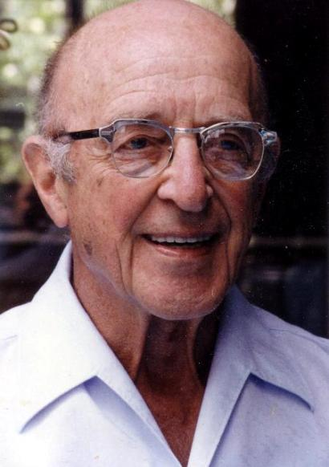
Another branch of psychology…
(Clinical psychology 临床心理学)
Humanistic Psychology is the 2nd major branch of psychology. It started mainly with Carl Rogers who believed
1. people are basically healthy健康的 and need to develop their
2. full potential 十足潜力 and have a
3. self actualization need. 自我实现需要[zì wǒ shí xiàn xū yào]
The love psychologist →

Slide 20
What percent of your potential…
…are you using?
I use ____ % of my potential….
→ …at work
→ …in my social life
I use _____% of my physical potential.
I use _____% of my intellectual potential.
Why don’t you use a larger part of your potential?

Slide 21
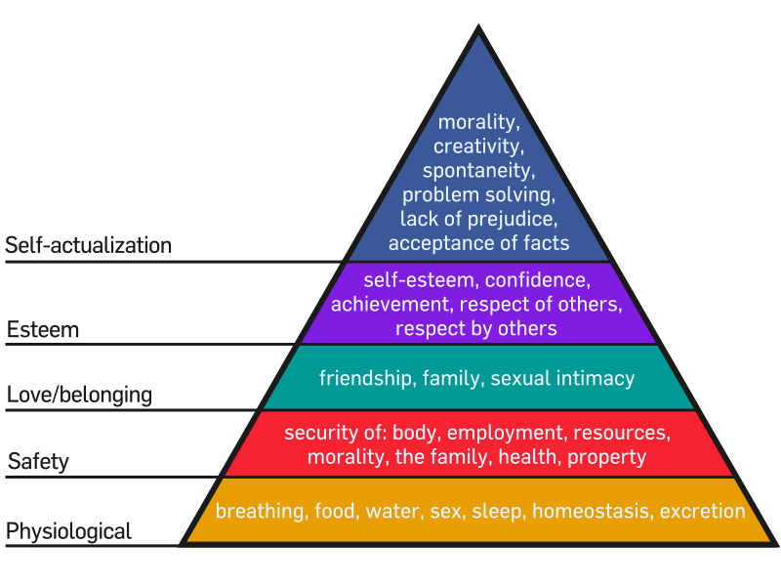
Another Humanist Psychologist
Was Abraham Maslow.
Pyramid of needs

Slide 22
The 3rd major branch of psychology
(Clinical psychology 临床心理学)
Is called behaviorism. 行为主义xíngwéizhǔyì
Behaviorists don’t believe in an unconscious潜意识 (like Freud), or in a need to develop full-potential 十足潜力 (like Rogers and Maslow). Behaviorists only believe in learning. We are what we learn. That’s all. Nothing more.

Slide 23
Behaviorists also don’t believe
In free will 自由意志论 zì yóu yì zhì lùn
Behaviorism is the most scientific 科学的psychology.
There are 3 keys to learning:
Positive Reinforcement 阳性强化[yáng xìng qiáng huà]
Negative reinforcement 负性强化[fù xìng qiáng huà]
Punishment 惩罚chéngfá

Slide 25
Schools use reinforcements 阳性强化 …
For example, if students do well on tests, they get good scores, and go up to higher grades.

Slide 26
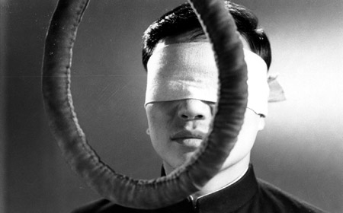
Life uses reinforcement
Be good get rewarded
Be bad get punished.

Slide 27
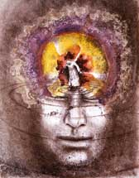
Discussion
(Clinical psychology 临床心理学)
What do you believe?
1. Freudian psychology (精神分析学
→People are motivated by unconscious forces unconscious潜意识 qiányìshí forces. 1.
2. Humanistic psychology
People have a pyramid of needs
to fulfill potential. 2.
3. Behavioral psychology:
Learning, i.e. rewards and 3.
punishments control behavior

Slide 28
Experimental psychology 实验心理学
…is about researching anything 任何事(!) that people do or might do, anything 任何事 they think, or feel!
Why are some people kind 友好的 yǒuhǎo, and others cruel 残酷[?
What are some people highly motivated 士气高涨的 and others not?
What makes people buy 买 one thing and not another?
(marketing 销售 xiāoshòu)
* What makes one person attractive 万人迷 wàn rén mí but not another?

Slide 29
Example: Are you a flirt? 调情[tiáoqíng]
Do you make long eye-contact眼睛接触[yǎn jīng jiē chù]?
Smile微笑 wēixiào at strangers陌生人[mòshēngrén] ?
Get closer近的 than normal to other people?
Talk with strangers 陌生人?
→ If the answer to all four is “Yes” you are a flirt!
DO you flirt when your boyfriend or girlfriend is there with you?
a. All the time!
b. Sometimes, if we’ve been arguing.
c. Never
http://www.betterlovetests.com/quiz-flirting.html

Slide 30
Experimental psychologists
Study ANYTHING, and EVERYTHING!
For more information see
+Psychology Today magazine
http://www.psychologytoday.com/magazine

Slide 31
Psychopathology疯人[fēngrén] = Mental illness
* Depression: 抑郁症 yìyùzhèng
The problem roots in her depression.
问题的根源在于她的抑郁症。
* Bipolar disorder: 躁狂抑郁症，指一种感情上的混乱，特征是时而发狂，时而抑郁

Slide 32
Psychopathology = Mental illness 2
Neurosis: 神经官能症
→ 她的行为表明，她患有严重的神经衰弱症
→ Her behavior points to a severe neurosis.
Psychosis: 精神病，精神错乱，精神失常
→自省力低下会增加非情感性精神病人病情复发和再住院的可能性
→ Poor insight increases relapse and re-admission to hospital in people with non-affective psychosis.

Slide 33
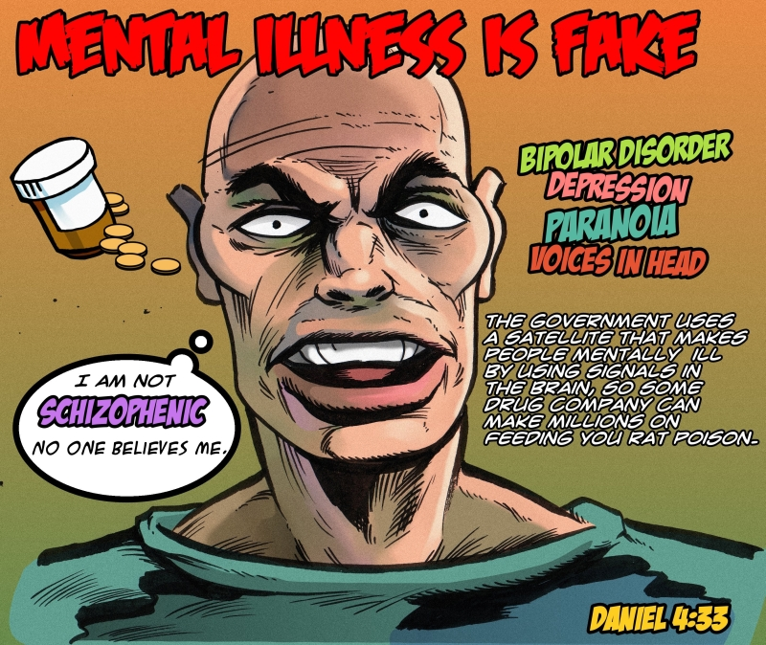

Slide 34
Psychopathology 3
Attention Deficit Disorder 注意力缺乏症，指人，尤指儿童，不能长时间注意力集中，导致学习障碍和许多行为问题的一种病症常用缩写是‘ADD’
Split personality 人格分裂[rén gé fēn liè]
Sociopath: 反社会者[fǎn shè huì zhě]

Slide 35
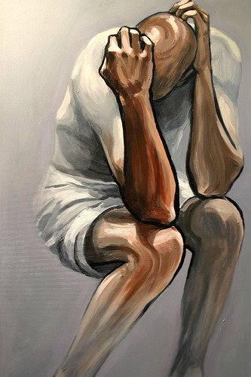
Psychopathology quiz
A client tells you he or she has been very, very sad for a long, long time. Answer: (Depression)

Slide 36
Psychopathology Quiz
Sometimes he’s so extremely happy, then extremely sad. He has wild mood swings. 他的情绪起伏不定
Answer: Bipolar illness

Slide 37
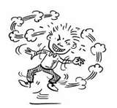
What is this?

Slide 38
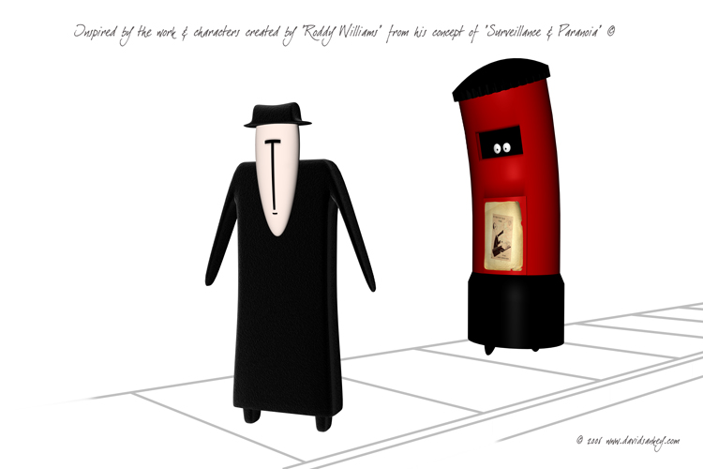
What’s this?
Thinks people are always watching or wants to hurt him or her, but it’s not real.
Paranoid
偏执狂，
妄想症

Slide 39
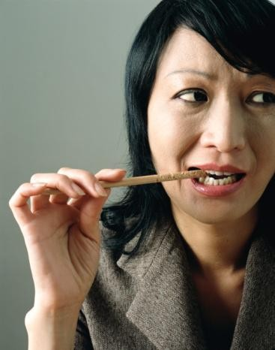
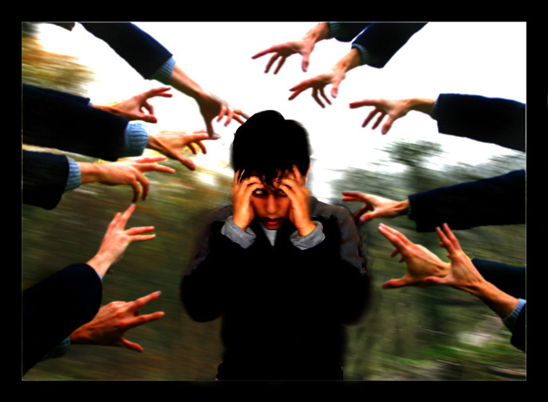
Psychotic
精神病的，患精神病的
Neurotic
神经官能症

Slide 40
Addiction 瘾[yǐn]

Slide 41
PMS (not mental illness!)
→Up to 40 per cent of women have premenstrual syndrome (PMS), including mood swings, bloating, food cravings and pain.
多达四成的妇女深受经前综合症之苦，这些引起体内紊乱的症状包括情绪不稳、肿胀、嗜食和疼痛。

Slide 42
PMS

Slide 43
Some of my favorite books about psychology
“In and out of the garbage pail” by Fredrick S. Perls
“The further reaches of human nature” by A. Maslow
“Beyond freedom and dignity,” by B.F. Skinner
“I’m OK, you’re OK” by Thomas Harris
“The basic writings of Sigmund Freud” by S. Freud
“The interpretation of Dreams” by Sigmund Freud
“Memories, Dreams, Reflections” by Carl Jung

Slide 44
This is just the ABCs of
Psychology
I hope you found it interesting!

