Slide 1
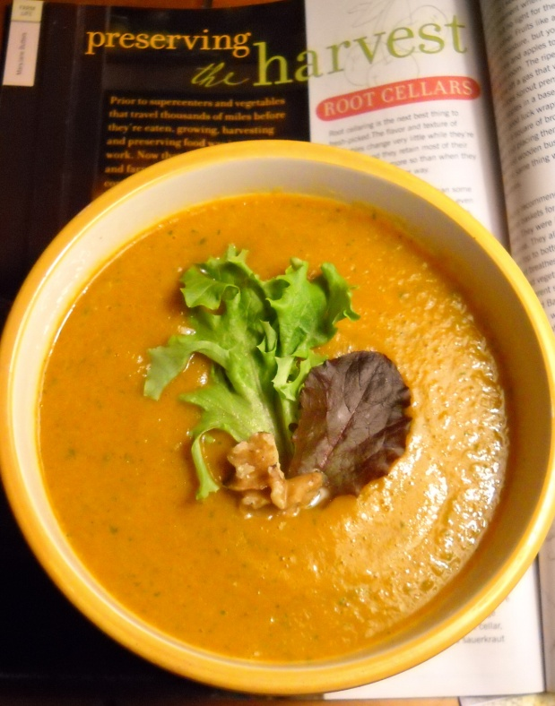
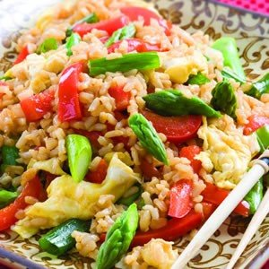
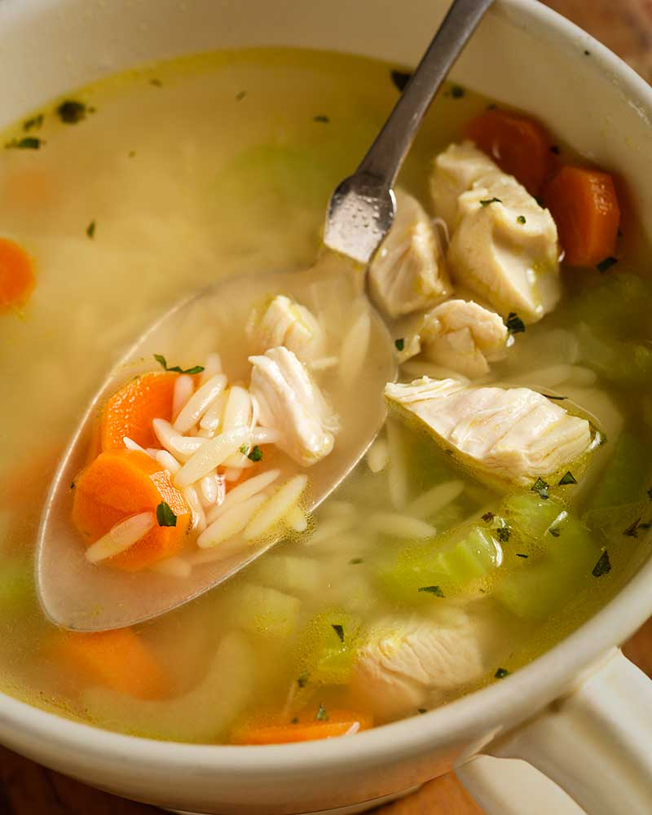
If you want to perform like a champion
You have to eat like a champion!
Recipes 食谱
Super nutritious and delicious!
By Gregory
Perform: 表演 biǎoyǎn
Champion: 冠军 guànjūn
Nutritious: 有营养的 yǒuyíngyǎngde

Slide 2
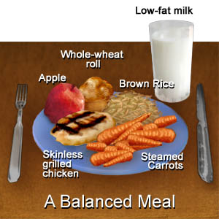
What is American food?
Most fast foods are not typical “American food.” Typical American foods are very basic: fried 炒的, roast 烤肉, or grilled meat 鹅肥油渣 - boiled or steamed vegetables - boiled 煮的 potatoes or corn with a little butter and salt, rice… and other basic foods simply cooked.
What makes American food unique maybe is that we usually provide balanced meals 均衡饮食 jūn héng yǐn shí that are simple and easy to make.

Slide 3
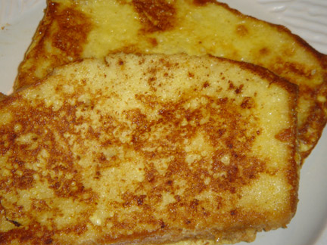
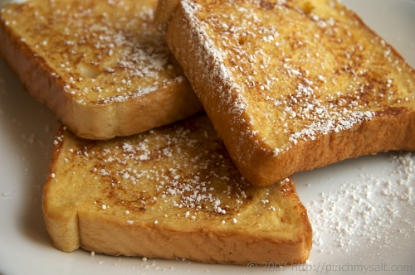
Breakfast of champions
My favorite breakfast is French Toast with scrambled eggs.
French Toast:
Break some eggs into a bowl
Beat with a spoon
Put sliced bread in the beaten egg.
Then, lightly fry the egg
coated bread on both sides using
medium heat.
Put on a plate.
Spread some strawberry jam
or honey on the bread.
Yummy! 美妙的!

Slide 4
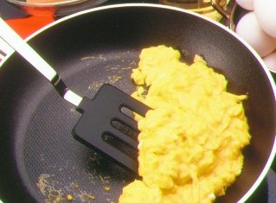
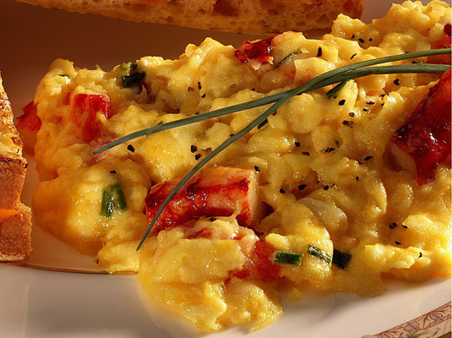
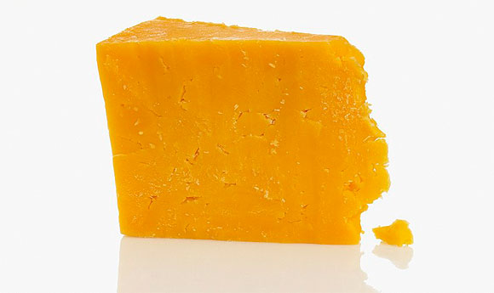
Scrambled eggs, 炒鸡蛋 plus…!
Making scrambled eggs is very easy. Just break some eggs into a heated, lightly oiled fry pan and stir until cooked.
BUT…!
I usually fry some onions, beef, green pepper, red pepper first, then add the eggs and scramble.
After adding the egg I like to add real Cheddar cheese and chopped tomato. Sometimes I put Salsa sauce on top too! Needs a little salt too.

Slide 5
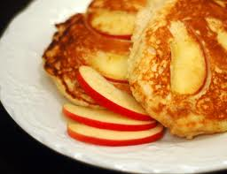
Also for breakfast: Apple Pancakes!
Pancake batter
→ Beat an egg or two in a bowl. Add flour 面粉, baking soda 碳酸氢钠 (1/2 teaspoon) , a little sugar & a little oats 燕麦 and milk. Mix (should be like thick soup).
粘稠度应该像薄饼面糊 Set aside.
Lightly fry some apples in oil with brown sugar and cinnamon 肉桂.
Clean the fry pan. Over low medium heat add a little oil, heat, pour in some batter add a bit of fried apple on top. Turn over when little bubbles appear on top or when bottom is golden brown.
Serve with a small amount of butter, honey, maple syrup, or jam on top. SUUUUPER delicious if done right!

Slide 6
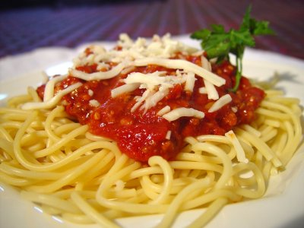
EZ Italian Spaghetti 意大利面
Buy some spaghettis or rainbow noodles &
A jar of spaghetti sauce
Lightly fry (Sauté 嫩煎的) small cut onion, green & red peppers, with small cut lean beef.
Pour sauce into the pan with the Sauté, add spices:
Oregano 皮萨草, thyme 百里香, 1-2 bay leaves 月桂叶, salt, black pepper
And one or two chopped tomatoes
Simmer (cook at very low boil)
Boil noodles until almost soft, then drain water
Put noodles in a bowl, put sauce and shredded cheese on top. Serve while hot!

Slide 7
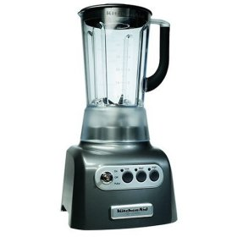
1. Potato Carrot Soup with Chicken
Boil some potatoes and carrots for 15-20 minutes or until soft. Drain the water.
Put in blender 搅拌器 with ¾ cup of milk, and some
Real cheddar cheese add…
Salt → then blend
Fry some cubed chicken breast, with onions green peppers and salt.
Put on top of the thick potato carrot soup! EAT! Yum!!!

Slide 8
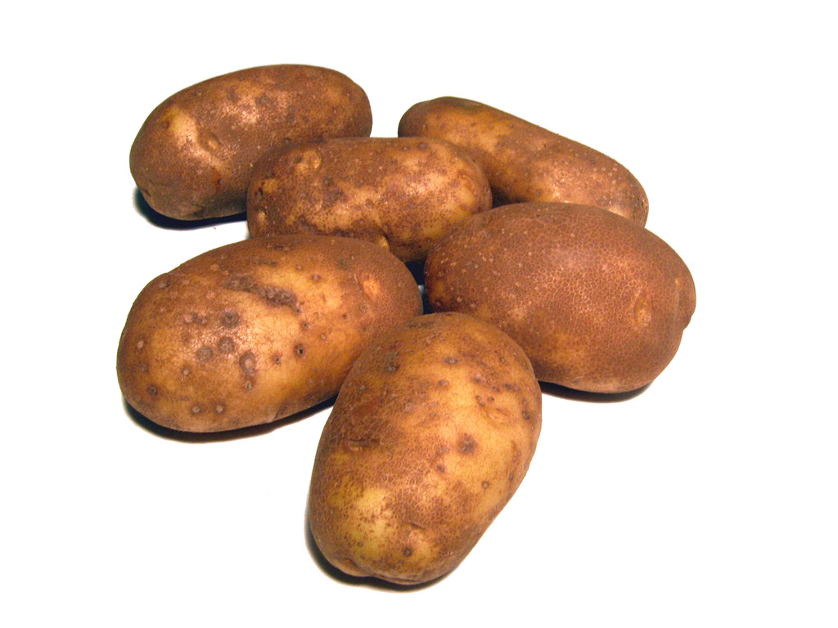
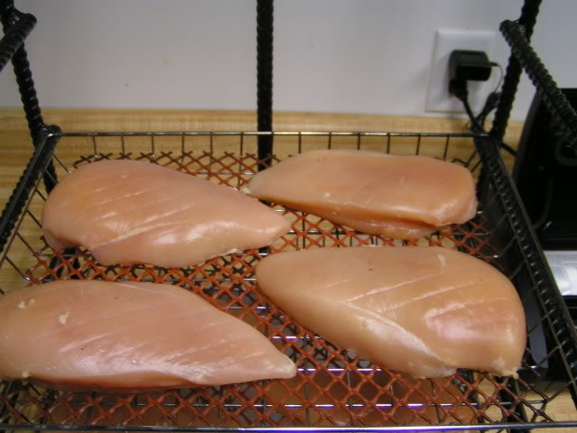
Note: Cut chicken into cubes and light fry the chicken breast with onions and green peppers, then put on top of the soup.

Slide 9
2. Tuna and noodles
Boil some vegetable noodles.
Fry some onion and green pepper, (with maybe a little beef) with a little salt
Add hot spicy tuna [DON”T fry the tuna as it’s a delicate fish. Just heat it up with tomato the other fried vegetables. ]
Mix the boiled vegetable noodles with the fried vegetables and tuna.
Add a tablespoon or two of Mayonnaise.
Mix well and serve hot or cold. Cheese can be added too.

Slide 10
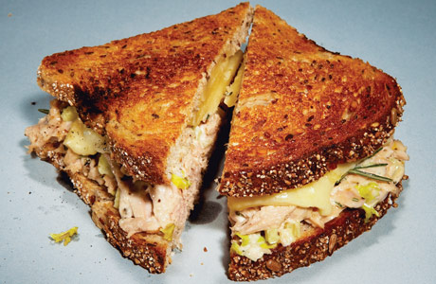
Tuna sandwich 金枪鱼
Buy hot spicy tuna.
Dice (cut into small pieces) some:
Onion 洋葱 yángcōng
Green pepper 甜椒 tiánjiāo
Tomato 西红柿 xīhóngshì
Open and drain the liquid out of the can of tuna.
Put tuna and vegetables into a bowl. Add a tablespoon of mayonnaise. 蛋黄酱 dànhuángjiàng (In the U.S. they have low-fat mayonnaise – but I haven’t seen it at Wall-mart here in Changping yet!)
Mix, put on Whole Wheat bread. 全麦 quánmài
Add some slices of Cheddar cheese on top.
Put another piece of bread on top.
Lightly fry sandwich on both sides

Slide 11
Chicken soup
Fry some onion and green pepper, maybe with crushed fine-cut garlic and ginger root.
Then, add water, cubed potato, carrot and skinless chicken breast.
Boil for 20 minutes or so.
Put some cut broccoli on top, then put a top on the pot and let the broccoli steam.
After five minutes serve. Cheese can also be added to this chicken soup.

Slide 12
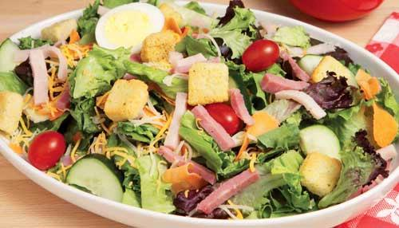
Chef Salad
PUT in a bowl:
Green lettuce (wash, squeeze the water out & rip it up a bit)
Small cut: Green pepper, onion, tomato, carrot, peeled cucumber, etc.
Add a can of drained hot spicy tuna fish
Cubed cheddar cheese
Lightly fried pieces of bread with garlic butter
Serve with a variety of salad dressings on the side. (See next page!)

Slide 13
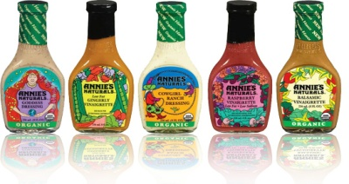
Salad dressings 色拉调味料[sèlātiáowèiliào]
Italian (Vinegar 醋 and oil, usually olive oil 橄榄油)
French
Russian (usually my favorite)
Thousand Island (a little sweet; not for me!)
To try these different salad dressings go to Outback Steak Ranch as they offer these and more – even their own:
http://restaurantrecipesbook.com/outback-steakhouse-ranch-dressing-recipe/

Slide 14
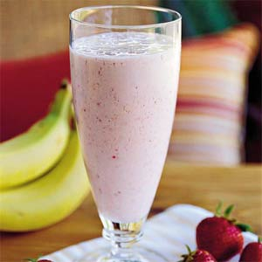
Snacks & quick “pick-me-ups” A “Pick-me-up” is something that gives you energy and makes you feel goooood.)
Blender 搅拌器 fruit drinks:
Blend different fruits with:
Soy bean milk 豆浆 dòujiāng
Fruit Juice (real, please! Not something “flavored!”
Ice water; the above plus ice and or ice cream!
Good fruits: Apple, pineapple, kiwi, strawberry, oranges, banana, etc. But, any fruit is OK I think.
(Blender fruit drinks are also called “smoothies” in the U.S. and are very popular.)

Slide 15
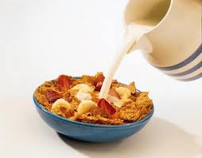
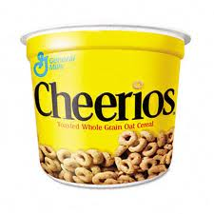
“Breakfast” cereals
NOTE: I eat a bowl of cereal anytime I’m hungry as
a snack. It’s not enough for my breakfast!
1st Buy WHOLE GRAIN cereals, not sugary junk cereals.
Put some in a bowl, add milk and maybe some raisons, and maybe a little brown sugar.
Eat with a spoon (chopsticks don’t work real with cereal! Ha ha)
←GREAT→
GARBAGE!

Slide 16
Discussion
Do you think cooking is difficult?
Of the above recipes, which 哪个 (nǎge) sounds most delicious?
Least 没趣的 interesting/delicious?
Would you like to try 试 [shì] cooking one of the above?
Which one?
What are some advantages of
eating a healthy diet?
What are some problems with not
eating a healthy diet?

Slide 17
Vocabulary 词汇 cíhuì
Recipes 食谱 shípǔ
Perform: 表演 biǎoyǎn
Champion: 冠军 guànjūn
Nutritious: 有营养的 yǒuyíngyǎngde
Balanced meals 均衡饮食 jūn héng yǐn
Fried 炒的 chǎo de
Roast meat 烤肉 kǎoròu
Grilled meat 鹅肥油渣 éféi yóuzhā
Scrambled eggs 炒鸡蛋
Flour 面粉 miàn fěn

Slide 18
Vocabulary
Lightly fry (Sauté 嫩煎的)
Tuna fish 金枪鱼 jīnqiāngyú
Blender 搅拌器 jiǎobànqì
Onion 洋葱 yángcōng
Green Pepper 甜椒 tiánjiāo
Tomato 西红柿 xīhóngshì
Broccoli 布罗科利 Bùluókēlì
Whole Wheat bread 全麦 quánmài
Mayonnaise 蛋黄酱 dànhuángjiàng
Salad dressings 色拉调味料 sèlātiáowèiliào

Slide 19
Vocabulary
Olive oil 橄榄油 gǎnlǎnyóu
Vinegar 醋 cù
Soy bean milk 豆浆 dòujiāng
Eat plenty, especially the whole-grain kind; the extra fiber could help stave off colon cancer
多吃谷物，特别是整粒的谷物，额外的纤维有助于减少结肠癌风险

