Slide 1
Rude People
What do you do?

Slide 2
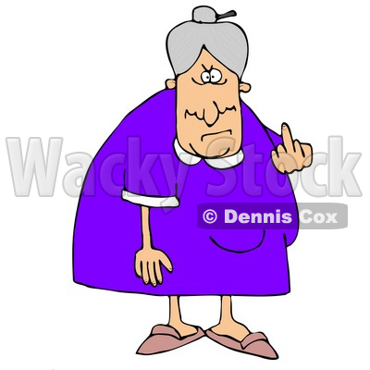
What do you do?
1. Insults
2. Line cutting 插队 Cha Dui
3. Gossiping 流言蜚语 liúyánfēiyǔ
4. Arrogance 傲慢的
5. Swearing 咒骂[zhòumà]
6. Spitting 唾[tuò]
7. Making annoying noises 讨厌的

Slide 3
What do you do about these things?
I _____________ confront面对[miànduì] the rude person.
always, usually, sometimes, rarely, never
If I do confront the rude person, I (am) usually ____________________.
hostile不友好的, friendly 友好[yǒuhǎo]
get revenge 复仇 bàofù; ignore it 不理[bùlǐ] , push, hit, kick the person, patiently explain the issue and hope for a reasonable response.

Slide 4
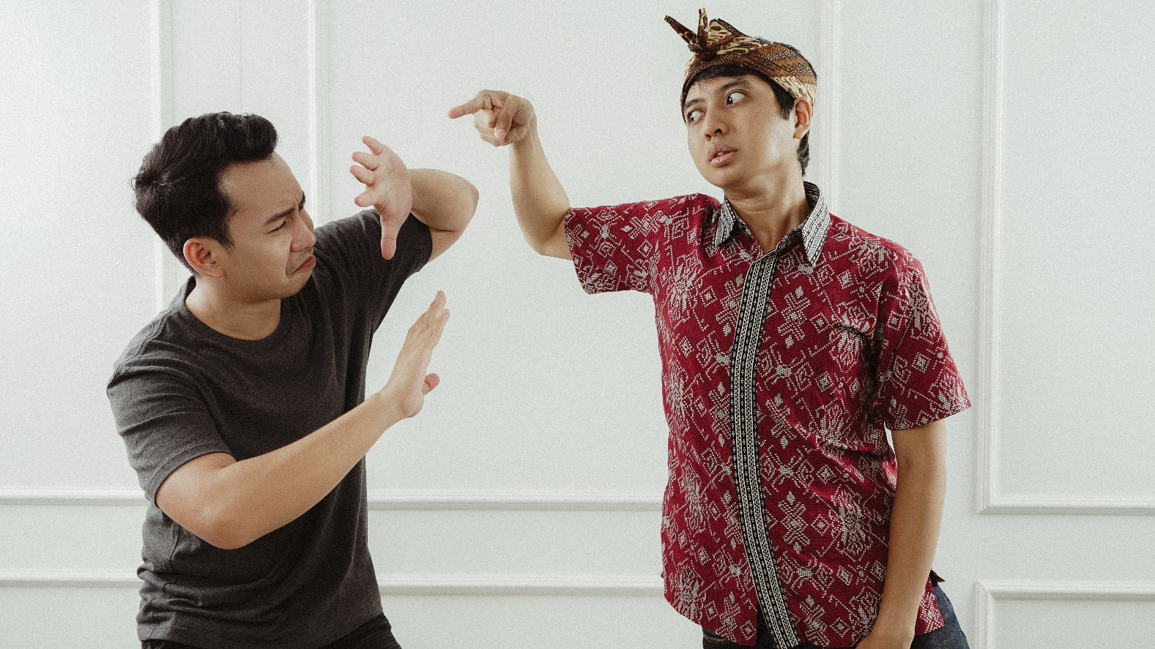
Confrontation is only one way to deal with a possible conflict.
And it’s usually the worst way to deal with a
possible conflict.

Slide 5
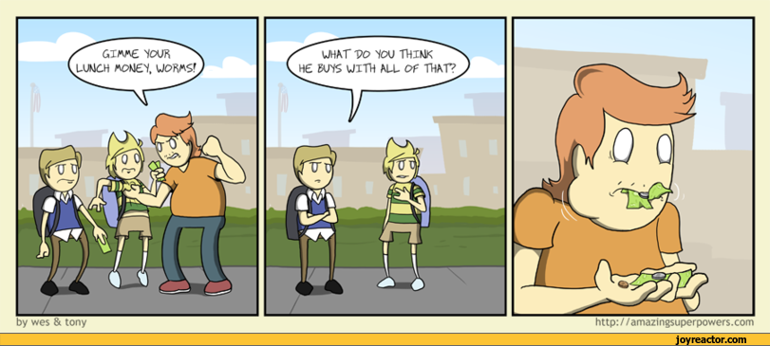
Five strategies for conflict resolution
1. Competing/confronting/conflict
2. Accommodating is cooperative, but it’s also giving the other person exactly what
they want. It has the drawback of reinforcing bullies who often demand more and more until the accommodator/victim is a slave or dead.

Slide 6
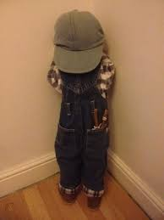
3. Avoidance – ignoring, hiding, postponing
and running from conflicts and problems is
sometimes the best strategy, but not usually.
Usually, people eventually run out of places to
hide and they’ve earned a reputation for being weak and cowardly. This is usually not a good
negotiating position.
Cc

Slide 7
4. Collaborating (problem solving) is an assertive and
cooperative strategy for dealing with conflict and usually creates a win-win scenario. In most cases collaborating is the best strategy. When people work together usually
everyone benefits.

Slide 8
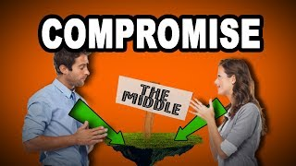
5. Compromising works sometimes. Compromising
usually means each party gets 50% of what they want. In some cases, it’s a good proactive strategy. In other
cases, it can involve giving a bully half of something
they don’t deserve. Thus, compromising can be good
or bad depending on the circumstances.
Compromising can be a “slippery slope.” Once a
person starts compromising, where does he or she
stop?

Slide 9
You can download a file…
That can teach anyone how to prevent and
resolve conflicts from this page:
https://greg
sefl.weebly.com/rude-people.html
The file is called: conflict_resolution_strategy_training_curriculum.pdf

