Slide 1
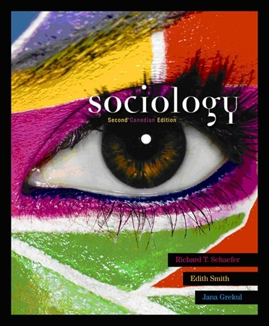
Sociology 社会学[shèhuìxué]

Slide 2
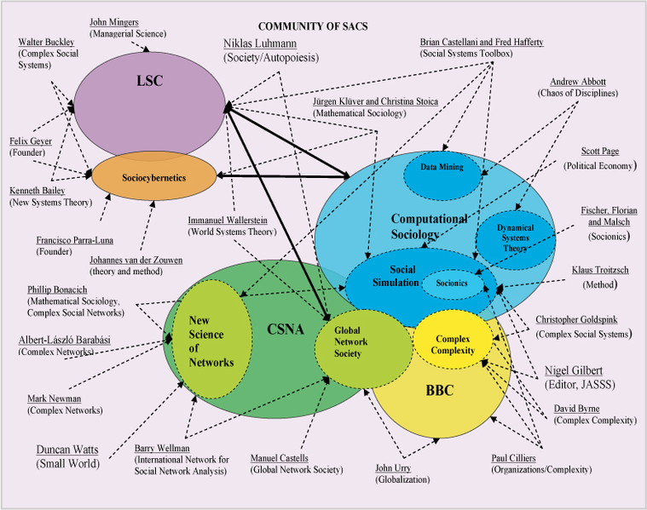
Sociology
Science of the interactions互相联系 and relationships关系 between people.

Slide 3
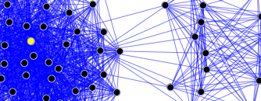
Sociology can be divided into
Macro-sociology – the
evolution进化 of
societies 社会[shèhuì]
Micro-sociology – interaction互动[hùdòng] between individuals and groups
of people

Slide 4
Macro-sociology
What energy do societies use?
Human→ animal→ machines→ computers
A slave奴隶 society is primitive原始[yuánshǐ] .
An interactive交互 society is more advanced先进的xiānjìn de
How free is information?
Can anyone get education?
How does the society help?
→ Poor, elderly, sick, handicapped?
→ Welfare? Religiosity?

Slide 5
Macrosociology questions?
Questions
What kinds of energy are used in Beijing?
How about in very rural areas?
What percentage have access to internet?
What percentage of people finish high school here in China?
What percentage go to university? Is that percentage increasing or decreasing?

Slide 6
Welfare vs. Religion
Macrosociological analysis
Should society help handicapped
残疾人[cánjírén] people more?

Slide 7
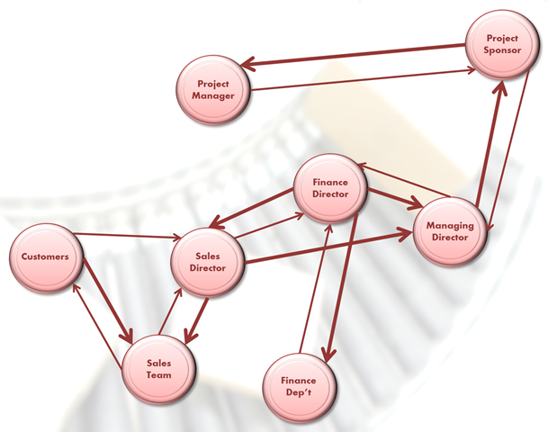
Sociogram 社交图 shè jiāo tú
A map of how individuals 个人 and groups 组 interact. 互相联系

Slide 8
Questions:
Which people in this room do you talk with most? Least?
Do you meet or talk with anyone here outside of school/work?
How many different groups of friends do you have in school/work, and outside?

Slide 9
Do you find
macrosociology (evolution of societies) or microsociology (relationships between individuals and groups) more interesting?

