Slide 1
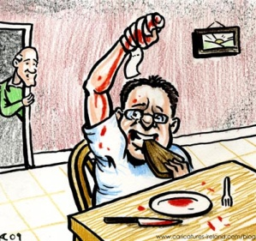
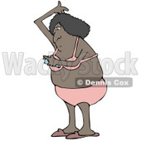
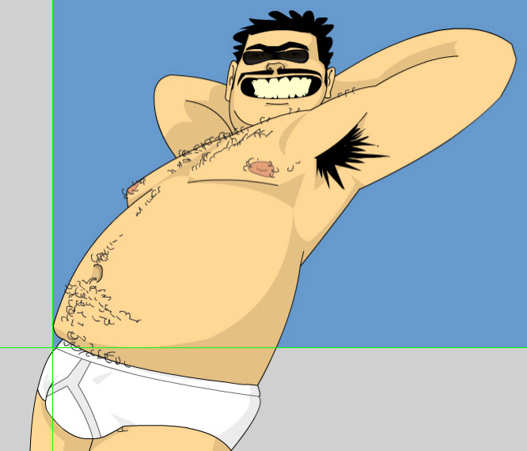
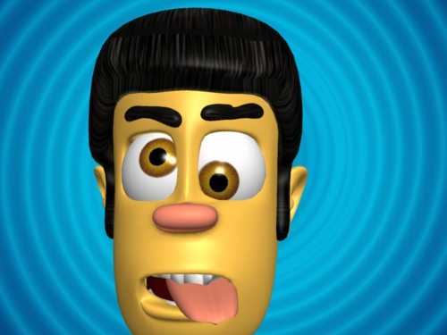
Stupid (笨) people
To be done with listening recording by George Carlin
Comedy listening exercise
喜剧

Slide 2
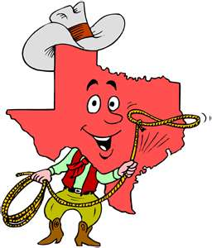
Well I’ll tell you about myself, I’m originally from the State of Texas.
I love being from Texas. We got our own language down there.
We just make stuff up.
We say stuff like: I’ll tell you what!
That’s it.
That’s a complete sentence in Texas.
Complete: 全
Sentence: 一句

Slide 3
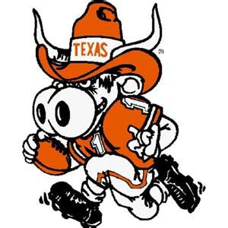
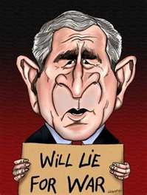
I’ll tell you what!
And everybody from out of state says: What?
I just told you.
And Texans are just completely different from everywhere else in the country.

Slide 4
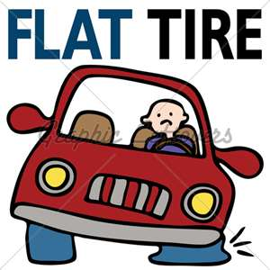
Last time I was home I was driving around and I had a flat tire.
Flat tire: 爆胎 bào​tāi​
I pulled my truck by one of those side of the road gas stations.
Gas station: 加油站 jiā​yóu​zha​
The attendant walks out looks at my truck and looks at me and I swear to god he went:
“Tire go flat爆胎 bào​tāi​?”

Slide 5
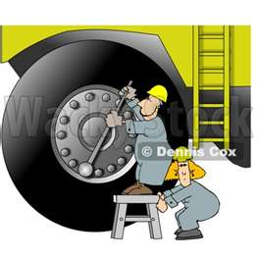
I couldn’t resist. I said “Nope, I was driving around the other three just swelled right up.
Swell: 涨 zhàng​ ; 肿 zhǒng​ ; 隆 lóng​
And without missing a beat he said: “Well the heat will do that.”
Heat: 热 rè

Slide 6
I just hate stupid people.
They should just have to wear signs that say: “I’m stupid.”
That way you wouldn’t rely on them would you?
Rely: 为主 wéi​zhǔ​
You wouldn’t ask them anything.
It would be like: Excuse me, oop! Never mind, I didn’t see your sign.

Slide 7
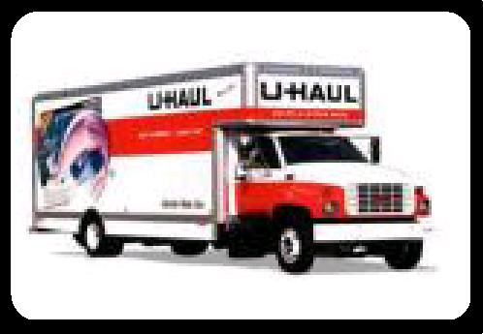
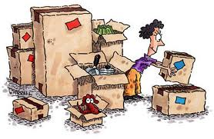
It’s like before my wife and I moved from Texas to California our house was full of boxes.
Box: 箱 xiāng​
There was a U-Haul truck in our driveway.
U-Haul: Rented moving truck
Rent: 租 zu​
Truck: 卡车 kǎ​che​
My friend comes over and says: “Hay, you moving?”
Moving: 搬家 bān​jia​

Slide 8
“Nope, we just pack our stuff up once or twice a week.
Pack: 包装 bāo​zhuāng​
Just to see how many boxes it takes.
Here’s your sign →

Slide 9
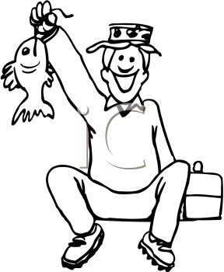
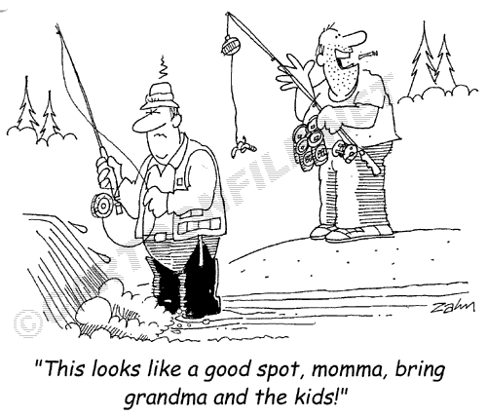
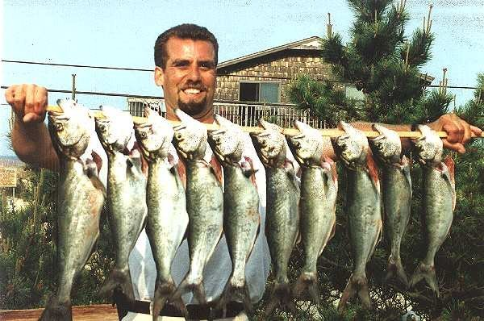
A couple of months ago I went fishing with a buddy of mine.
Fishing: 钓鱼 钓鱼
Buddy: 朋友
And we pulled this boat into the dock, and I lifted up this big string of bass
Bass: 鲈鱼
Boat: 船 chuán​
Dock: 码头 mǎ​tóu​
And this man sitting on the dock asked: Hay, you catch all them fish?

Slide 10
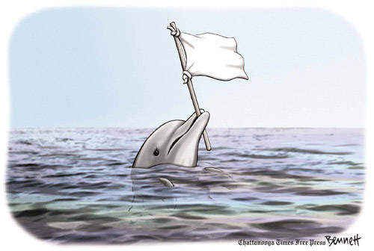
Nope! Talked them into giving up.
Give up = surrender = 降 xiáng​
Here’s your sign. →

Slide 11
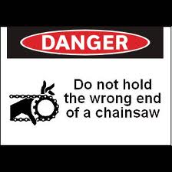
That’s why there are warnings on products, because of stupid people, ladies and gentlemen.
Warning/warning sign: 示警 shì​jǐng​
It’s not for us, it’s for stupid people.
If there weren’t any stupid people you wouldn’t see any warnings.

Slide 12
Or at least if they had to wear those signs you wouldn’t sell them the product would you?
It would just be like: I’m sorry I can’t sell you that.
Why not?
Aw, I forgot.

Slide 13
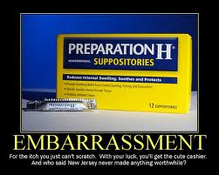
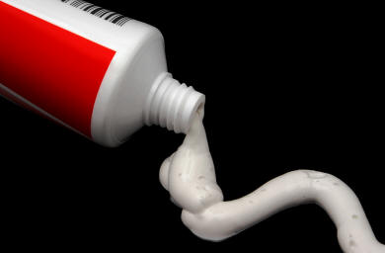
Did you know on a tube of Preparation H it says “do not take this orally?”
Preparation H is medicine for hemorrhoids (痔疮)
A cream medicine 膏 that shrinks 缩水 swelling 肿 on the anus 肛.
“Do not take orally” means: “Don’t eat”

Slide 14
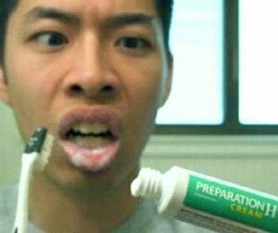
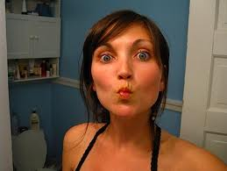
That’s sad isn’t it?
Cause you know somebody wrote them a letter.
Dear Preparation H, I ate this whole dang tube I still got these hemorrhoids.
(He ate the medicine 膏, instead of putting on anus 肛)
Man, my mouth is so small – I can’t eat a jelly bean anymore!
Jelly bean – a small candy 糖 táng​
But I could whistle really good!
Whistle: 口哨 kǒu​shào​

Slide 15
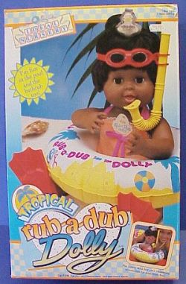
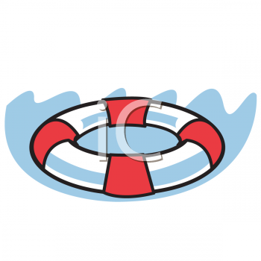
We bought my daughter a bathtub doll
Bathtub: 盆浴 yù​gāng​ ; 浴盆 yù​pén​
Doll: 娃娃 wá​wa​
It’s called rub-a-dub dolly →
Now rub-a-dub dolly floats about the bathtub with a life preserver on it.
Floats: 飘 piāo​
And on the life preserver it says: This is not a life saving device.
Now what kind of idiot would see some guy drowning in the river and go
Drown: 淹死 yān​sǐ​ ; 溺水 nì​shuǐ​
Here! Here’s a rub-a-dub dolly doll!
Oh thank god you saved my life.

Slide 16
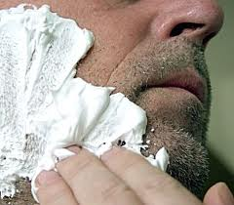
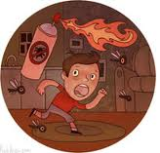
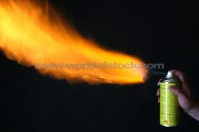
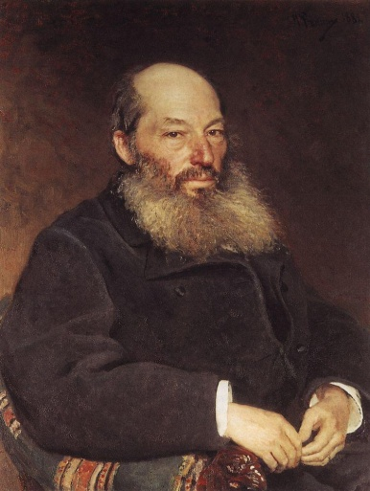
On a can of shaving cream it says avoid spraying this into an open flame 火.
Shaving 刮脸
Where the hell was that guy shaving at?
Was he sitting around the campfire one night and say:
I feel a little bristly
Hairy 毛茸茸
Nice, that’s nice.
A little tender!
Tender: 嫩 →

Slide 17
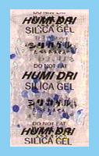
We bought a stereo receiver
Stereo 音响设备
and if you bought a piece of stereo equipment you know inside the box they put that little package of drying agent. And on it is says in big bold letters – what does it say?
DO NOT EAT THIS!
Did you ever buy a piece of stereo equipment and think there might be something to eat in there?

Slide 18
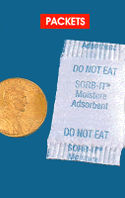
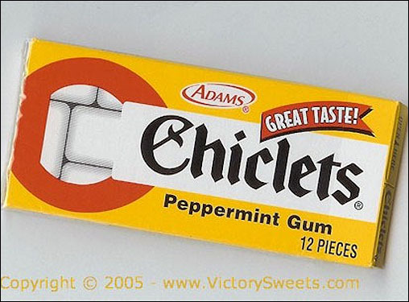
But you know somebody opened that box and said Wooooa!
I got a receiver and a pack of Chiclets!
Chiclets is chewing gum: 口香糖 kǒu​xiāng​táng​
I got music and gum!
is not →

Slide 19
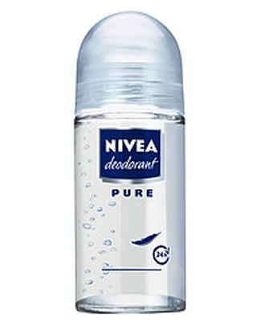
Do you know on the back of a roll-on deodorant it says: Do not apply this to your eyes.
Deodorant: 除臭剂 ; 体香剂
Ladies! When was the last time you were out on a blind date and he was good looking but he just had that stinky eye!
Blind date: 相亲 xiāng​qīn​
Stinky 臭 chòu

Slide 20
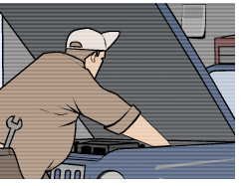
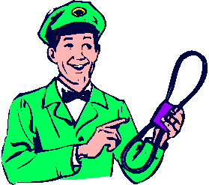
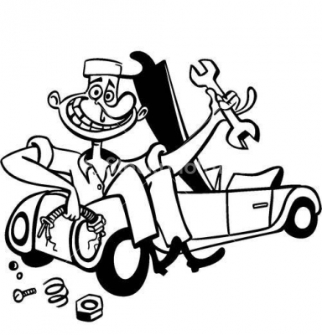
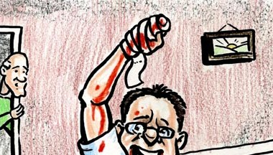
I was working on my wife’s car a couple of weeks ago, I was putting a new fan belt on. Do you know. Do you know on the back of a car fan belt it says: Be sure you stop the motor first.
Motor: 发动机
Wouldn’t you love to have been there the first time that happened?
Some guy walks in the house his hands are all cut up.
Cut up: 创 chuāng​

Slide 21
Hay Walk, what happened?
Uhhh, I’m going to give you boys a little tip!
If you’re going to put a fan belt on a car you better shut that motor off first!
You can’t stop it with your hands, man!
It’s like a machine or something!
Machine: 机械
If I hadn’t seen this one I wouldn’t have believed it.

Slide 22
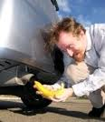
A guy came over to the house drove the car around 45 minutes.
We get back to the house he gets out of the car reaches down and grabs the exhaust pipe and goes: Damn that’s hot!
Exhaust pipe is the end of the muffler: 灭音器
See! If he’s been wearing a sign I could have stopped him.
I could have said, Now I know you’re not going to understand this but…
That’s going to be hot!

Slide 23
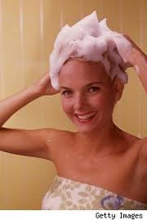
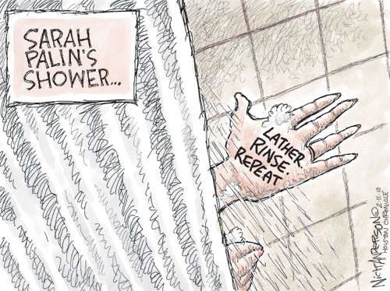
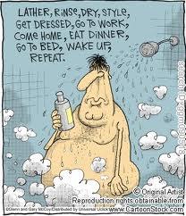
You’ve all seen this it’s on the back of a bottle of shampoo.
Shampoo: 洗发露
It says:
Rinse, lather, repeat, rinse lather repeat. You know there’s still some idiots in the shower cause it doesn’t say: dry your hair and try it again tomorrow!
Rinse: 冲洗 chōng​xǐ​
Lather: 肥皂沫 féi​zào​mò​
Repeat: 重 chóng​
Dry: 干 gān

Slide 24
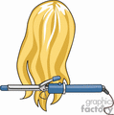
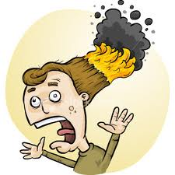
I’m sure some of you ladies here now use curling irons. If you ever get a chance read the warnings on these things. I swear it says the first time you use this curling iron you may notice some slight odor and some smoke.
Odor: 怪味 guài​wèi​
Smoke: 烟气 yān​qì​
That means your hair is on fire!
Fire: 火 huo​
I’m not making these up!

Slide 25
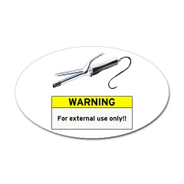
The worst one says: Do not insert this curling iron in any orifice.
Insert: 插入 chā​rù​
My god!
What happened to good old fashioned foreplay?
Foreplay: 前戏 qián​xì​
What did he say? Warm up the curling iron honey!
We’re going to the fair!~
There’s warnings on blow dryers, you know this?
Warnings: 示警
Hair dryer: 电吹风 chuī​fēng​jī​

Slide 26
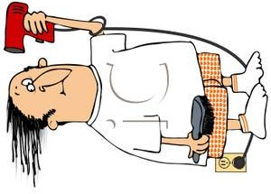
It says: do not use while sleeping.
Well, lord hasn’t that become a problem?
But, I don’t know about the rest of you but I cannot count the number of times I’ve been sound asleep – woke up – I was doing my hair.
Dang it, I was sleep styling again!

Slide 27
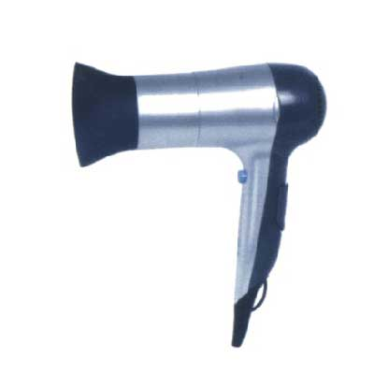
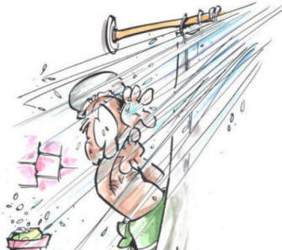
There’s another warning it says: Do not use this blow dryer in the shower.
Who’s writing this pamphlet?
Pamphlet: 小册子
Have you ever been in the shower, Honey I’m done shampooing my hair!
Toss me that blow dryer!

Slide 28
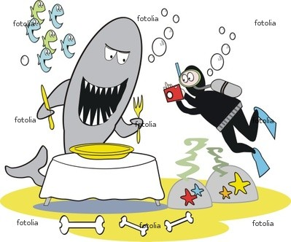
I saw an idiot on TV this week. I was watching one of those animal shows on Discovery channel. There’s a guy inventing a shark bite suit.
There’s only one way to test that.
Shark: 鲨鱼 shā​yú​
Bite: 咬伤
Suit: 套装
You got to get bit by a shark.
But the guy who invented it wasn’t doing the testing. He got his buddy to help him out.
Inventor: 发明人 fā​míng​rén​

Slide 29
That’s the conversation I want to be in on.
Jimmy come here!
Alright Jimmy got that shark suit on. Looks good!
Now, what we’re going to do is we’re going to strap dead fish all over your body.
Stay with me Jimbo, stay with me.
They want you to jump in this pool of sharks and you tell if it hurts when they bite you.
Pool 潭

Slide 30
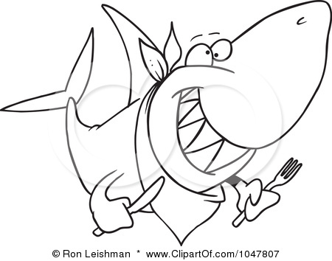
Well, alright… hold my sign, I don’t want to lose it.

